Slide 1
Coastal processes and landforms

Slide 2
Getting started
You’ll need a notepad on which to make notes as you go along, or you could make notes, paste images, etc. on your device.
You can view these slides:
as a slide-show for any animations and to follow links
in ‘normal’ view if you want to add call-outs or extra slides to make notes, paste images, answer questions.

Slide 3
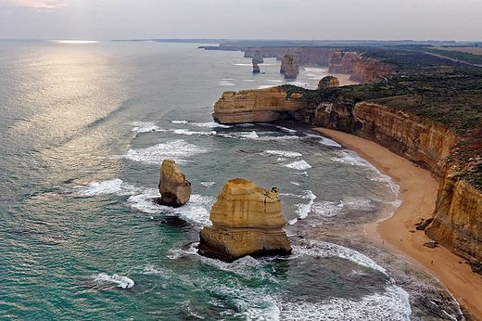
Coastal landscapes
Activity
Watch this video clip. Note down the name of the coastline and where it runs from and to. You will look at this coastline in more detail as work through this PowerPoint.
There are many spectacular coastlines around the world. The photo shows ‘The Twelve Apostles’ off the coast of Victoria, Australia.
The landforms of coastal landscapes are formed by geomorphic processes.
Geomorphic processes are naturally-occurring processes that change the shape of the land. They include erosion, weathering and deposition.
The dominant geomorphic processes in a coastal area often determine the landforms found there.
Notes:
Photo: The Twelve Apostles, Australia, 2011. Source: https://en.wikipedia.org/wiki/The_Twelve_Apostles_(Victoria)#/media/File:The_Twelve_Apostles_2011.jpg

Slide 4
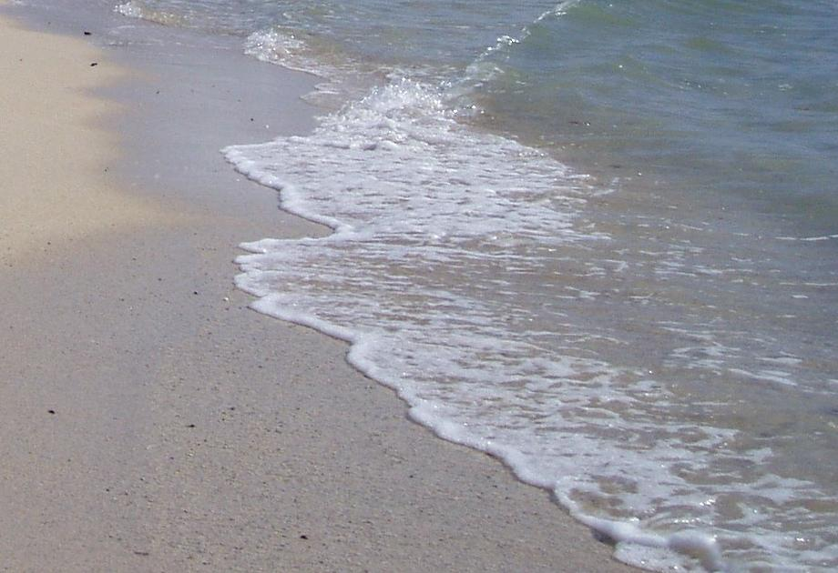
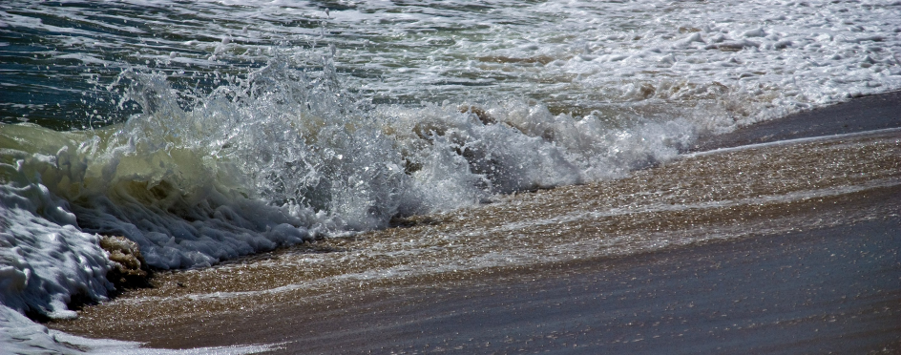
Waves
The wind blowing over the sea causes waves. The distance of ocean over which the wind blows is called the fetch.
When a wave breaks, water is washed up the beach. This is the swash.
The backwash occurs when the water flows back to sea.
When the swash is greater than the backwash, this deposits material – a constructive wave.
When the backwash is greater than the swash, more material is removed – a destructive wave.
Activity
Watch this video clip. Note two more differences between constructive and destructive waves, then sketch both
types of wave.
Backwash
Swash
Notes:
Photos: Swash and Backwash. Sources: https://upload.wikimedia.org/wikipedia/commons/5/55/Swash_Lano_Beach_Samoa.JPG and https://en.wikipedia.org/wiki/Swash#/media/File:Undertow_in_Nantucket.jpg

Slide 5
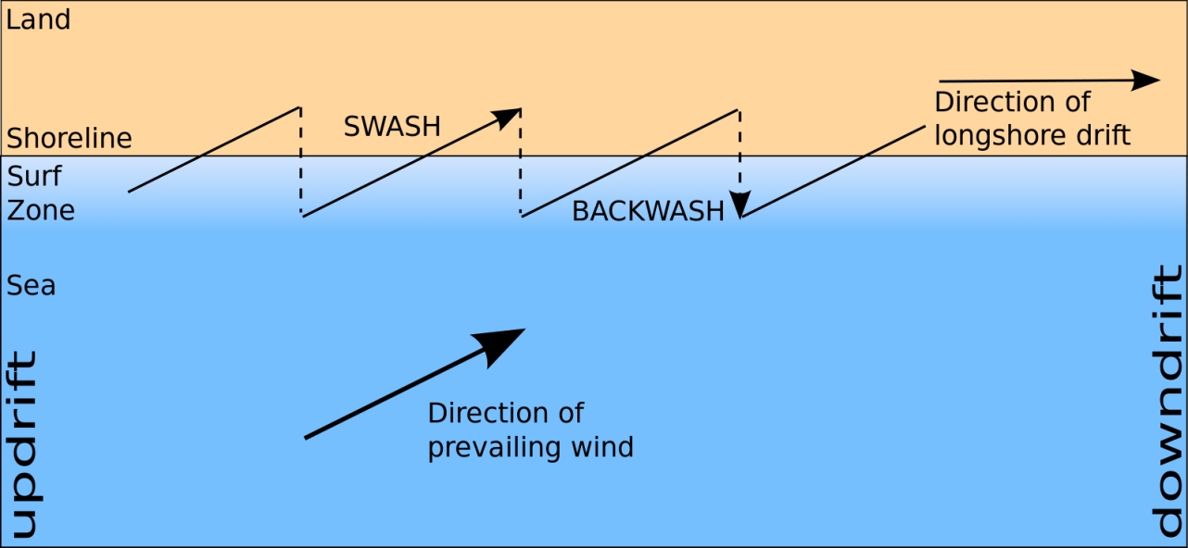
Longshore drift
The swash usually approaches the beach at an angle depending on the wind direction.
Gravity pulls the backwash down the beach at right angles.
As this action is repeated, material is transported along the beach in a process called longshore drift.
Activity
Research the direction in which longshore drift occurs on the Holderness coast – Google Maps or Google Earth is a good place to start.
Notes:
Figure: Longshore drift. Source: https://commons.wikimedia.org/wiki/File:Longshore_drift.svg

Slide 6
Where does the sediment come from?
Coastlines have a continuous new supply of sediment. This comes from the erosion of cliffs and is carried down by rivers and glaciers. There are four main types of coastal erosion process:
Hydraulic action – the force of water crashing against the coastline. Air is forced into cracks in the rock, causing pieces to break away.
Attrition – pieces of rock bash into each other, making them smaller, smoother and more rounded.
Abrasion – pieces of rock and sand wear away cliffs, rather like sandpaper.
Solution – soluble particles are dissolved by seawater.
Activity
Watch this video clip to understand more about these processes. Draw a diagram to represent each of the four types of erosion.

Slide 7
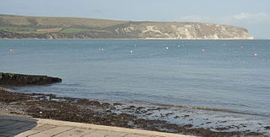
Differing geology along coastlines influences erosion…
Coastlines are often made up of many different types of rock. The structure and composition of different rocks (the geology) at the coast means that some areas are more easily eroded than others.
If a coastline is made up of bands of harder and softer rocks, the softer rock is eroded more easily, creating a bay. The harder rock is left jutting out to sea – a headland.
Activity
For more information watch this video, then visit the British Geological Survey website here. Choose ‘Go to location’ and type ‘Swanage’. Swanage Bay has been eroded much more than the headlands to the north and south. Compare the type of rock the headlands are made of with Swanage Bay itself, by clicking on them.
Notes:
Photo: Swanage Bay, Dorset. Source: https://commons.wikimedia.org/wiki/File:Swanage_Bay_(2685).jpg Photo: © Nilfanion.

Slide 8
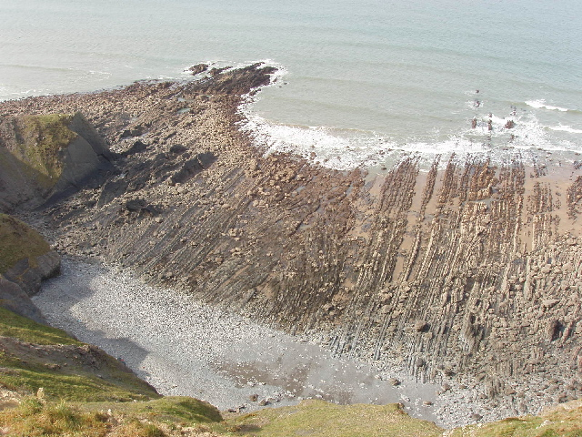
How cliffs are eroded
Activities
Click on the photo below to find out more about Caunter beach. Then watch this clip to for more information.
Create a flow diagram to explain how a wave-cut platform forms.
Cliffs are eroded by the sea, by erosion and by sub-aerial processes. In areas with harder geology, hydraulic action and abrasion create a wave-cut notch at the base of the cliff. Over time the cliff is undercut. When it can no longer hold its own weight, the cliff collapses.
As the cliff retreats, a wave-cut platform is created.
Notes:
Photo: Wave-cut platform, Caunter Beach, Cornwall. Source: https://commons.wikimedia.org/wiki/File:Caunter_Beach,_a_wave-cut_platform_-_geograph.org.uk_-_405023.jpg
Figure: Formation of a wave-cut platform. Source: https://en.wikipedia.org/wiki/Wave-cut_platform#/media/File:Wave_cut_platform.png

Slide 9
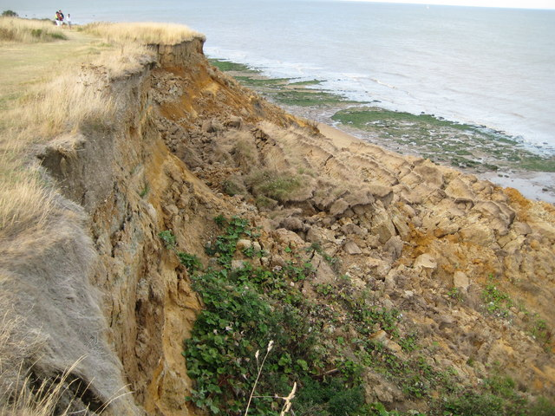
Sub-aerial processes
Cliffs are broken down by sub-aerial processes above the water line. These include weathering (weakening and break-up of rock). The different types are:
freeze-thaw weathering: a type of mechanical weathering when water gets into cracks, freezes and expands, breaking up the rock over time
biological weathering: a type of mechanical weathering where plant/tree roots crack rocks over time
chemical weathering: the breakdown of rocks by acidic sea and rain water.
In areas with a softer geology, if the cliff is weakened by weathering, mass movement can occur in the form of slides (linear) and slumps (rotational). The photo shows a slump in the cliff at The Naze on the Essex coast.
Activity
Watch this video clip for more information. Draw a picture to represent each of the key terms on this slide (shown in bold).
Notes:
Photo: A slump in the cliff at The Naze, Essex. Source: https://commons.wikimedia.org/wiki/File:The_Naze,_Cliff_erosion_(4)_-_geograph.org.uk_-_1479381.jpg

Slide 10
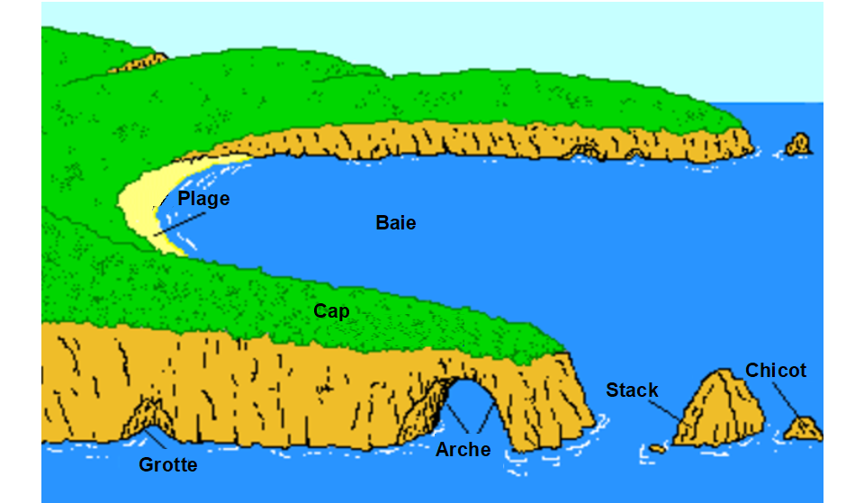
Headland erosion
Headlands can be eroded to form cracks, caves, arches, stacks and stumps, the following three slides describe which processes are involved.
Beach
Bay
Headland
Stump
Stack
Cave
Arch
Notes:
Figure: Headland erosion. Source: https://commons.wikimedia.org/wiki/File:Formation_d%27une_arche.png
Photo: The Twelve Apostles, Australia. Source: https://en.wikipedia.org/wiki/The_Twelve_Apostles_(Victoria)#/media/File:The_Twelve_Apostles_2011.jpg

Slide 11
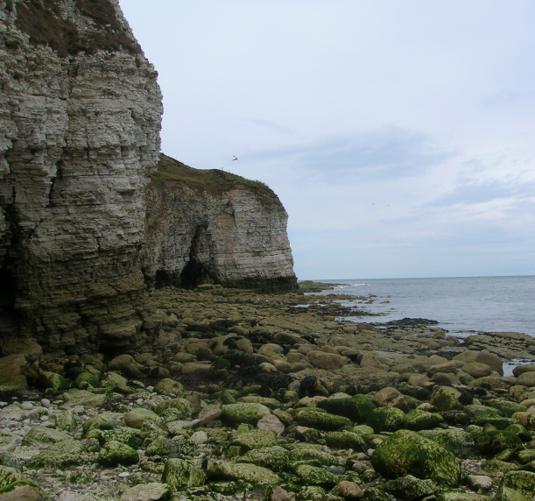
The erosion of a headland – cracks and caves
All headlands are made of rock. Rocks contain joints, faults or bedding planes, resulting from how they were formed.
Erosion by the sea can cause cracks to form in these weaker areas.
Over time, as the cracks are eroded further, caves can form.
Activity
This photo shows Flamborough Head on the Yorkshire coast. Carry out some research on the type of rock found here.
Notes:
Photo: Cliffs at Flamborough Head, Yorkshire coast. Source: https://en.wikipedia.org/wiki/Flamborough_Head#/media/File:Cliffs_at_Flamborough_Head.jpg

Slide 12
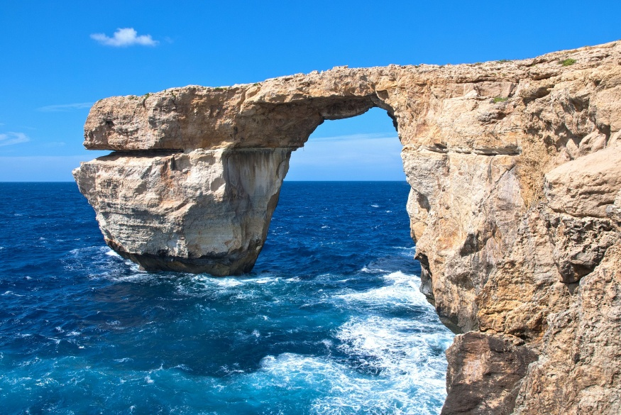
The erosion of a headland – arches
Hydraulic action and other erosion processes deepen and widen caves over time.
Sometimes, they erode all the way through a headland to form a sea arch.
The arch is widened over time by erosion and sub-aerial processes.
Activity
The photo shows The Azure Window in Malta. Research key facts about this arch: What rock is it made from? What did it look like in the past? What has happened since the photo was taken?
Notes:
Photo: The Azure Window, Malta. Source: https://en.wikipedia.org/wiki/Natural_arch#/media/File:Malta_Gozo,_Azure_Window_(10264176345).jpg

Slide 13
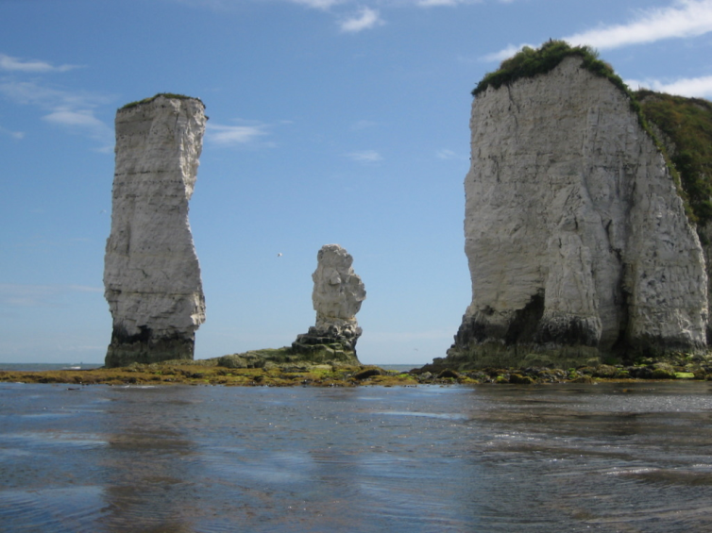
The erosion of a headland – stacks and stumps
When an arch becomes so wide that the roof cannot support its own weight, it collapses leaving behind a stack.
Stacks are made from hard rock that is able to withstand erosion the longest.
As the base of the stack is eroded further, the stack may collapse, forming a stump.
The landforms in the photo – called Old Harry Rocks – are found on the Dorset coast. ‘Old Harry’ is a stack and ‘Old Harry’s Wife’ is a stump.
Activity
Research Old Harry Rocks. What type of rock are they made from? How big are they? What did the area look like in
the past?
Notes:
Photo: Old Harry Rocks, Dorset coast. Source: https://en.wikipedia.org/wiki/Old_Harry_Rocks

Slide 14
Headland erosion – review
Review your knowledge of the coastal landforms that result from headland erosion.
Activity
Watch this video clip for further information about headland erosion. Write down five new facts from the clip.
Beach
Bay
Headland
Stump
Stack
Cave
Arch
Notes:
Figure: Headland erosion. Source: https://commons.wikimedia.org/wiki/File:Formation_d%27une_arche.png

Slide 15
Summary
Coasts are continuously being changed by geomorphic processes.
Sediment is added to the coastline via weathering and erosion.
Waves take material up the beach in the swash and carry it back down the beach in the backwash.
Waves can be constructive (building the beach) or destructive (removing sediment from the beach).
Longshore drift transports sediment along the coastline.
Bays and headlands are formed by differing geology along a coast.
Erosion of cliffs occurs by four processes: hydraulic action, abrasion, attrition and solution.
Sub-aerial processes (e.g. freeze-thaw, biological and chemical weathering) also break down the cliff.
Headlands are eroded to form caves, arches, stacks and stumps.
Notes:
https://ourworldindata.org/energy-mix

Slide 16
Taking it further
Activities
The Holderness coast – a fact file. Based on the video clips you’ve watched and using this link, create a fact file about the Holderness coast. Include details about its location, key landforms and processes, key facts and statistics.
Visit this historical photo website and study the coast photos. What landforms can you name? What geomorphic processes can you see evidence of? How might the area look in 10 or 100 years?

Slide 17
Glossary 1
Abrasion: an erosion process where pieces of rock and sand wear away cliffs like sandpaper.
Attrition: an erosion process where pieces of rock bash into each other, and the cliffs, making them smaller, smoother and more rounded.
Backwash: part of a wave where the water moves back down the beach due to gravity.
Biological weathering: the break down of rocks due to tree or plant roots.
Chemical weathering: the chemical breakdown of rock minerals by acidic rain and sea water.
Constructive wave: where the swash is stronger than the backwash and the beach builds up.
Destructive wave: where the backwash is stronger than the swash and material is removed from the beach.

Slide 18
Glossary 2
Erosion: the wearing away and removal of rock.
Fetch: distance of ocean over which the prevailing wind blows.
Freeze-thaw weathering: a type of mechanical weathering when water gets into cracks, freezes and expands, breaking up the rock over time.
Geology: the structure and composition of rocks.
Geomorphic processes: naturally occurring processes that change the shape of the land.
Hydraulic action: an erosion process where the force of water crashing against the coastline forces air into cracks in the rock, causing pieces to break away.
Longshore drift: the transportation of sediment along a coast parallel to the shoreline, in a direction dependent on the wind direction.
Mass movement: bulk movements of soil and rock, e.g. rockfalls, landslides, slumping.

Slide 19
Glossary 3
Sliding: a linear mass movement of sediment.
Slumping: a rotational mass movement of sediment.
Solution: an erosion process where soluble particles are dissolved by seawater.
Stack: a tall column of rock left when an arch collapses.
Sub-aerial processes: weathering and mass movement processes occurring from above the water.
Swash: part of a wave where material is washed up the beach.
Wave-cut platform: wide, gently sloping rock surface where cliff retreat has occurred on a beach.

Slide 20
Links
From the awarding bodies
Find out more
 | Topic
AQA | 3.1.3.3 Coastal landscape development
Edexcel | Spec A: 1A Coastal landscapes and processes
Edexcel | Spec B: 4.3 Coastal landscapes and physical processes
OCR | Spec A: 1.1 Landscapes of the UK
OCR | Spec B: 3.1 What makes a landscape distinctive?
WJEC | Component 1.2 Landform process and change.
This GEO unit explores erosion, transport and deposition processes in detail.
National Geographic has examples of famous coastal landforms around the world.
For more information about the Holderness Coast, click here.
For exam-style questions and how to answer them, visit the Time for Geography website, scroll down the ‘Coasts’ page and view the ‘Grade booster’ videos.

Slide 21
Acknowledgements
This presentation has been written by Gemma Pollard.
Figures/photos
Slide 3: Photo © Michael J Fromholtz
Slide 4: Photos © versageek © Maki Akiyama
Slide 5: Photo © Yefi
Slide 7: Photo © Nilfanion
Slide 8: Photos © David Hawgoodand © Steinsky
Slide 9: Photo © Nigel Cox
Slide 10: Photos © Salsero35 © Michael J Krumholtz
Slide 11: Photo: © areadeandavid
Slide 12: Photo:© Berit Watkin
Slide 13: Photo © Cmcqueen

