Slide 1
Mass movement on slopes

Slide 2
Getting started
In the UK landscapes topic, most GCSE specifications include learning about mass movement or slopes. In some, weathering and mass movement are together as sub-aerial processes.
You can use this unit if you’re learning about mass movement for the first time, or for revision. You can view these slides:
first as a slide-show for videos, animations and to follow links
second in ‘normal’ view to add labels or extra slides to make notes, paste images, answer questions.
You’ll need a notepad on which to make notes as you go along, or you could make notes, paste images, etc. on your device.

Slide 3
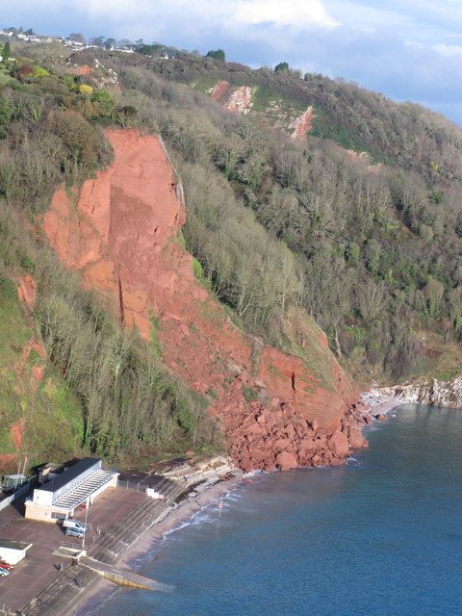
Processes on slopes
Weathering, mass movement and erosion are the main processes operating on hillsides and cliffs. They are linked together:
weathering weakens or breaks up rocks with little movement
mass movement moves material down slopes, e.g. in rock falls and landslides (right)
erosion by the sea, rivers or glaciers can wear away and remove material, usually at the foot of the slope.
Activity: on the image add label to show
the three processes above
how they are linked.
Mass movement on sandstone cliffs, Babbacombe, South Devon.
Notes:
https://www.geograph.org.uk/photo/3238778

Slide 4
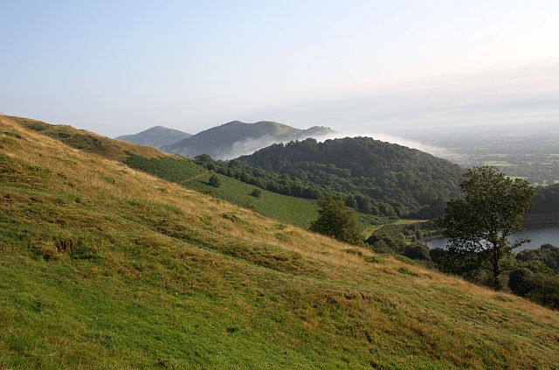
Forces behind mass movements
Energy from gravity drives mass movement.
The force of friction resists gravity, keeping material in place on the slope.
If the forces driving material downhill become greater than those resisting them, the slope becomes unstable. Mass movement begins.
2
3
1
Notes:
https://www.geograph.org.uk/photo/1432550

Slide 5
Different types of mass movement
Mass movements can be very different, depending on:
the type of material: rock, soil, mud or a mixture
the rate of movement: from very slow to very rapid
the amount of water involved, from wet to dry.
Scale:
some mass movements are tiny – a few particles move at a time.
others are massive – a whole hillside may move.
Type | Examples
Fall | Rock fall
Slide | Rock slide, landslide
Slump | Rotating slump
Flow | Mud flow
Creep | Soil creep
Activity:
View this National Geographic video and list the movements you see.
List the reasons why they happen, and which human activities increase the risk. Why are mass movements a hazard?
Notes:
https://www.youtube.com/watch?v=mknStAMia0Q

Slide 6
Falls
Falls happen on vertical or steep slopes when pieces of rock detach and fall away. Falls can occur when:
joints weaken through weathering
water adds weight to the rocks
on coasts, wave action pounds away at a cliff, or erodes and cuts away at its base
earthquakes shocks weaken the material.
The photo shows how mass movement adds sediment to the sea. The same happens with glaciers and rivers.
Rockfall at Bempton Cliffs, Yorkshire, UK.
Notes:
https://commons.m.wikimedia.org/wiki/File:Rock_Fall_at_Bempton_Cliffs.jpg

Slide 7
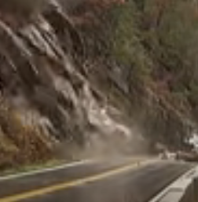
Rock falls and slides
2011 Rock fall, North Cliffs, Cornwall, UK
2009 rock slide in Tennessee, USA
Activity: Watch and compare the two video clips.
What is similar and different about the rock fall and slide? Think about material, speed and water.
Look again at the rock strata in Tennessee. What effect do they have?
Notes:
2011 video: https://www.youtube.com/watch?v=ZVjr4mii3cE&feature=emb_imp_woyt
2009 video: https://www.youtube.com/watch?v=ZVYGJYnJTi0

Slide 8
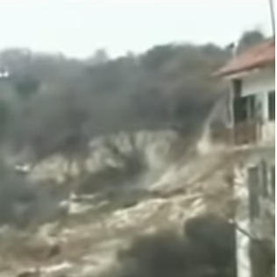
Landslides
Sometimes the term ‘landslide’ is used in general for any mass movement.
But in geography:
landslides are the movement of a large mass of rock, debris, or earth down a slope
landslides move at an angle along a slide plane.
Activity: Watch the video clip.
Describe the landslide: think about material, speed and water.
What scale is the landslide?
2010 landslide at Maierato, Calabria, Italy after heavy rain. Find more details here, with the aftermath here.
Notes:
Video: https://www.youtube.com/watch?v=R__3DYQCVnA

Slide 9
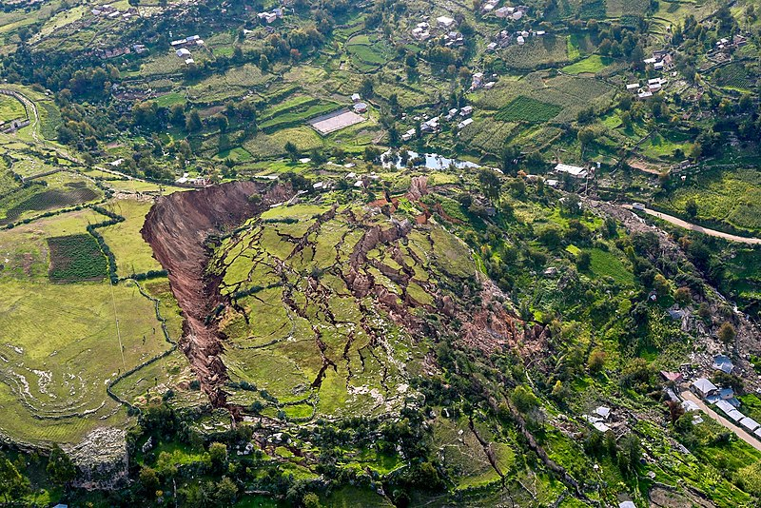
Features of a landslide
Slides take place along an angled slide plane. They are often lubricated by water, for example over an impermeable layer such as clay.
Scar
Head
Fractures
Activity
Think about what happened in the photo.
For some key terms, view in Slide Show and click on the photo.
Toe
Slide plane
This 30-hectare landslide in Cusco, Peru destroyed 100 houses in 2018; find out more here.
Notes:
https://en.wikipedia.org/wiki/File:Landslide_in_Cusco,_Peru_-_2018.jpg

Slide 10
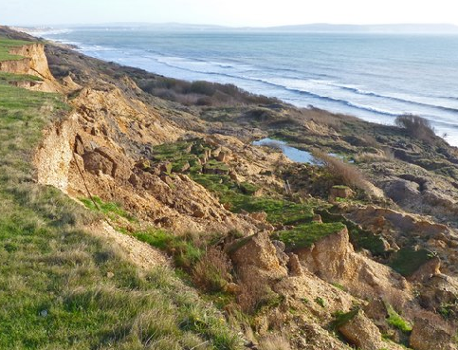
Slumps
Slumps are similar to slides but the slide plane curves.
As a result the material rotates as it moves, and the original land surface (the head) tilts backwards.
Slumps are also called rotational slides: they are common on UK coasts like here at Barton on Sea, Dorset, UK.
Older slumps
Head
Slide plane
Activity
View this BGS clip. How are geology, mass movement and coastal erosion linked?
Notes:
https://www.geograph.org.uk/photo/2709863

Slide 11
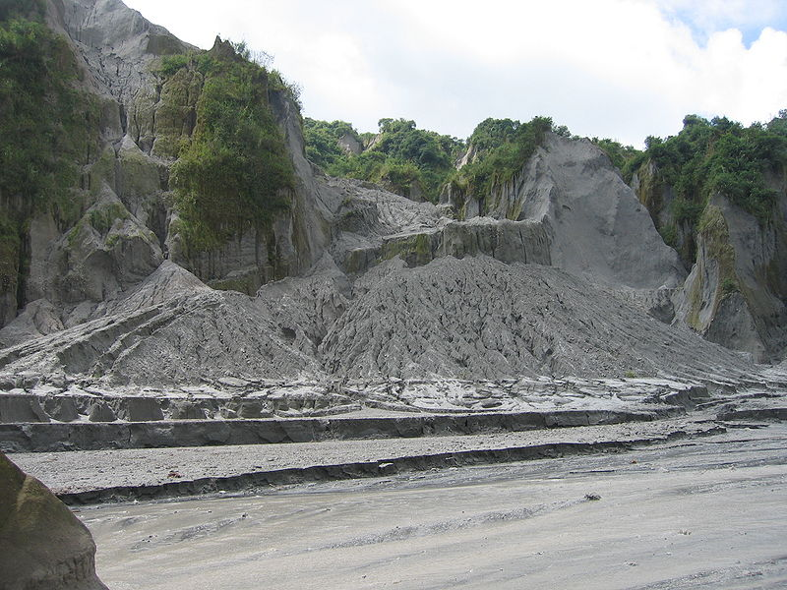
Mudflows
Mudflows often form after sudden heavy rainfall:
soil becomes saturated with water: it liquefies and begins to flow
a flow moves downhill, often following a valley or gulley. It can pick up larger stones and boulders as it flows
mudflows can be slow or very rapid – they can be a deadly hazard.
Mudflow down gulley
Debris fan
Activity: watch this 2021 mudflow in Atami, Japan. Why was it deadly?
Mudflow following the 2006 volcanic eruption of Mount Pinatubo, Philippines: a lahar.
Notes:
https://commons.wikimedia.org/wiki/File:Lahar_Mount_Pinatubo.JPG

Slide 12
Scree creep
Activity: use the text to label the photo.
In upland areas:
Freeze-thaw weathering weakens or breaks up rocks, especially on exposed crags
Rock fragments fall off and build up on the slope below: scree
The scree slowly settles and moves down the slope. This type of mass movement is called ‘creep’.
You find scree slopes:
where glaciers and ice-sheets are active today, like the Alps
or where they were active in the past, like the Lake District.
Scree
Honister Pass, Lake District, UK.
Notes:
https://www.flickr.com/photos/johntasaurus/43214460801

Slide 13
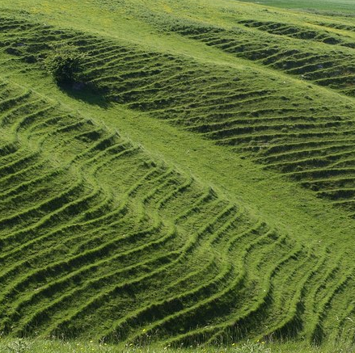
Soil creep
The slowest mass movement is soil creep. It happens when individual soil particles freeze and thaw, get wet and dry.
Particles get wet or freeze. They expand outwards at right angles to the slope.
As the particles dry or thaw, gravity makes them fall vertically downwards.
The result is individual particles are heaved down the slope.
The movement is very slow, even on steeper slopes.
1
2
3
Terracettes
Soil creep is common on UK slopes, like this one in Wiltshire, especially on clay soil.
Notes:
https://www.geograph.org.uk/photo/1345952

Slide 14
Thinking through mass movements: speed and water
Activity: Think about the types of mass movement listed below.
Label them onto the scale for speed. Then decide which are wet, dry, or in between. Scree creep has been added for you.
Rock fall | Rock slide | Soil creep | Landslide | Mud flow
Very slow |  |  |  | Very fast
 |  | Scree creep
Speed
Dry |  | Very wet
Scree creep

Slide 15
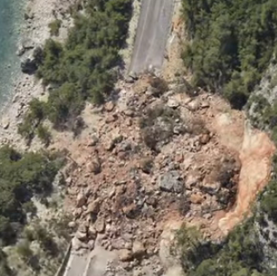
Summary
Weathering, mass movement and erosion are linked processes. They change the landscapes in the mountains, on hillsides and coasts.
Slopes become unstable when the forces driving material downhill are greater than those resisting them. The hill-side material moves downhill: mass movement.
Mass movements include falls, slides, slumps, flows and creeps. They:
include different amounts of water
can move very slowly or rapidly.
Mass movements are affected by different factors. They include the geology, rainfall and human activity such as deforestation and road building.
Activity
Watch this video to check your understanding.
Notes:
Video: https://www.youtube.com/watch?v=RCxvbosa4fU

Slide 16
Factors behind mass movements
Factor | Notes/detail
Geology
Weathering
Climate and weather
Vegetation
Change in steepness | Wave action undermines a cliff
Human activity
Other
Activity:
Look back through the slides – look for ways/factors that explain or set off mass movements, like the example above.

Slide 17
Final check
Can you think of:
Five types of mass movement
Types of mass movement likely on coasts and in upland/glacial environments in the UK
How water can be a factor in mass movements
How slopes might get steeper over time
Comparing a slide and a slump, what is different and what is the same?
What scree and talus are, and where you’d find them
Two human activities that might increase the landslide hazard
The forces keeping slopes stable, and making them unstable.
Some of the answers overlap – a concept map might help you.

Slide 18
Glossary
Freeze-thaw weathering: the process where water gets into spaces in rocks and, as the temperature changes, repeatedly freezes and thaws
Hazard: a natural or human event that can cause death, injury or damage
Impermeable: rocks or soil that do not allow water to pass through
Joint: a crack or fracture in a rock
Lahar: a rapid flow formed from ash and other rocky volcanic debris combined with water from rainfall, or snow/glacier melting.
Mass movement (or mass wasting): the process where gravity moves soil or rock down a slope through falls, slides, slumps, slips, flows and creep
Scree: piles of weathered rock fragments lying loosely on a slope
Strata: layers of rock
Sub-aerial (below the air) processes: weathering and mass movement
Weathering: the process that slowly breaks up rocks. Unlike erosion, it happens with little or no movement in place (or in situ).

Slide 19
Links
From the awarding bodies
Find out more
 | Topic
AQA | 3.1.3.2: Coastal landscapes
Edexcel A | 1: Changing UK landscapes
Edexcel B | 4: The UK’s evolving physical landscape
Eduqas A | 1.2: slope processes
Eduqas B | 2.1: Shaping the landscape
OCR A | 1.1: Landscapes of the UK
OCR B | 3.2: What influences the landscapes of the UK?
WJEC | 1.2: Landform process and change
Bitesize revision site with clear diagrams for:
coastal weathering and mass movement
rivers
All about landslides from BGS
Time for Geography: sub-aerial processes (coasts).

Slide 20
Acknowledgements
This presentation has been written by John Hopkin, author and consultant to the Geographical Association.
Slide 3: Photo © David Hawgood/Geograph
Slide 4: Photo © Bob Embleton/Geograph
Slide 6: Photo © Partonez
Slide 7: Videos © utubecamborne, WDEF News 12
Slide 8: Video © Slavonac1969
Slide 9: Photo © Galeria del Ministerio de Defensa del Perú
Slide 10: Photo © Mike Smith/Geograph
Slide 11: Photo © Neureiter
Slide 12: Photo © Johntasaurus
Slide 13: Photo © Derek Harper/Geograph
Slide 15: Video © The Telegraph

