Slide 1
Mass movement

Slide 2
Getting started
Most A level specifications include mass movement as a topic within the landscape systems and processes section. You can use this unit whether you’re learning about mass movement for the first time or want to use it for revision.
You can view these slides:
first as a slide show for animations and to follow links
again in ‘normal’ view to add labels or extra slides, to make notes, paste images or answer questions.
You’ll need a notepad on which to make notes as you go along, or you could make notes, paste images, etc. on your device.

Slide 3
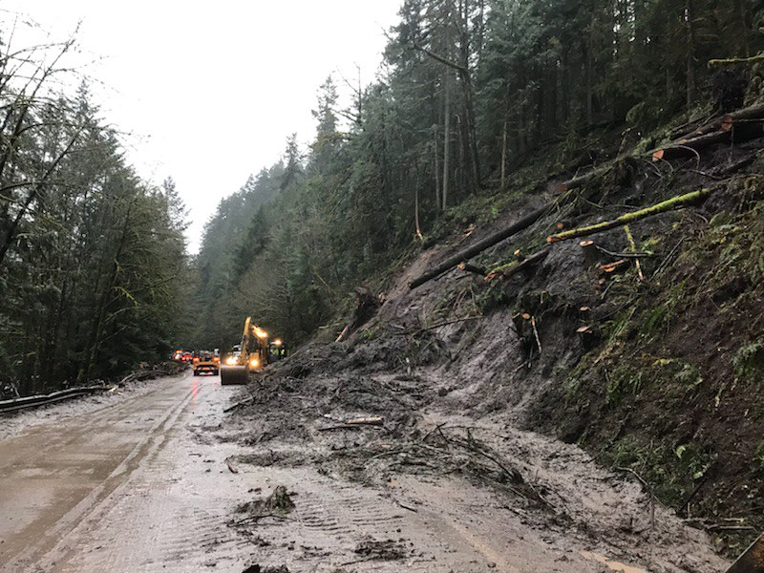
Slopes and mass movements
Slopes cover much of the Earth’s surface: they are one of the basic units of landscapes.
Slopes are open systems, with inputs, throughputs and outputs of material and energy. This unit looks at one throughput, mass movement.
Mass movement moves material from upper to lower slopes. Over time this changes a slope’s profile and reduces its angle, one factor in helping it become more stable and reach equilibrium.
A slope in Oregon, USA. Road-building has undercut, steepened and so destabilised the slope, taking it into a phase of active change: this landslide is the result.
Notes:
https://www.flickr.com/photos/oregondot/46665910465

Slide 4
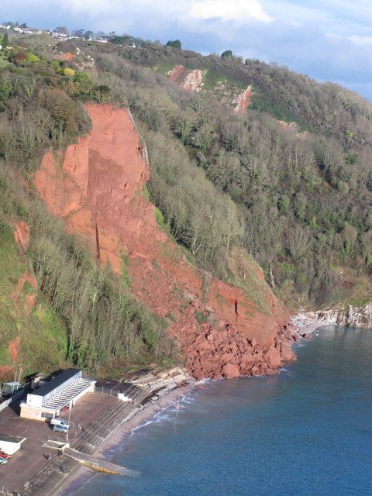
Slope processes
Weathering, mass movement and erosion are three linked ‘big’ processes operating on slopes:
weathering weakens or breaks up rocks in situ
mass movement moves material down-slope using energy from gravity, e.g. in rock falls and landslides (see photo)
erosion by rivers, glaciers, sea or wind wears away and removes sediment, usually at the slope foot: it enters a new system.
Activity
Add labels to the photo showing the processes (right). Label the rock store, throughput and sediment store.
Mass movement on sandstone cliffs, Babbacombe, South Devon, UK
Notes:
https://www.geograph.org.uk/photo/3238778

Slide 5
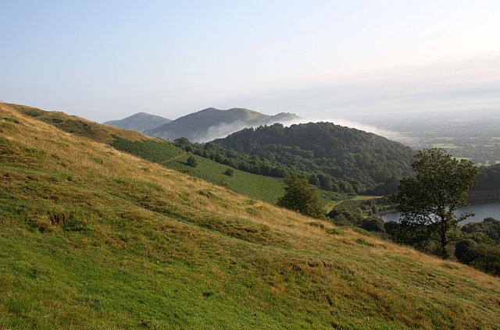
Forces behind mass movements
Gravitational energy drives mass movement.
The force of friction resists gravity, pushing material into the slope (shear strength). On stable slopes this is greater than the forces driving it downhill.
The forces driving material downhill can become greater than those resisting them (sheer stress). Slopes become unstable and can fail: the slope system has crossed a threshold.
2
3
1
Activity
Think about the balance of forces affecting the mass movements on slides 6–8, and the physical/human factors affecting them.
Notes:
https://www.geograph.org.uk/photo/1432550

Slide 6
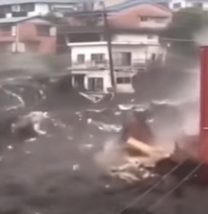
Types of mass movement (1)
There is a range of types of mass movement, varying:
in scale, from individual particles to whole hillsides
in process and form, linked to:
the type of material
the rate of movement
the amount of water involved.
Activity
View the clips/photos of different mass movements on slides 6–8.
Think about how you might classify them: use the criteria above to help.
Mudflow, Atami, Japan, 2021

Slide 7
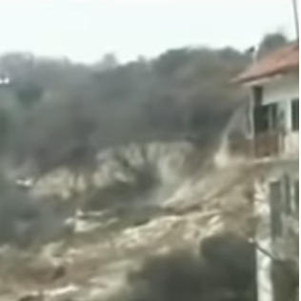
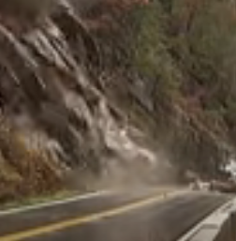
Types of mass movement (2)
Landslide at Maierato, Italy, 2010, after heavy rain. Find more details here, and the aftermath here.
Rock slide in Tennessee, USA, 2009

Slide 8
Types of mass movement (3)
Rock fall, North Cliffs, Cornwall, UK, 2011
Terracettes formed by soil creep (and possibly sheep) Derbyshire, UK

Slide 9
Classifying mass movements: material
The table shows common types of mass movement and the type of materials involved.
In practice, more than one type of movement and material may be involved – for example, a rock fall may set off a debris slide.
Type | Material: rock | Material: soil and unconsolidated material
Fall | Rock fall, topple
Slide | Rock slide | Debris/landslide
Slump |  | Rotational slump
Flow |  | Mud flow
Creep | Talus/scree creep | Soil creep
Activity
Look back at slides 6–8 and locate the examples on this table.
Notes:
AU: in the activity, where it says ‘locate the examples on this table’, does it mean ‘match the examples with the mass movements listed in this table’?

Slide 10
Classifying mass movements: water and speed
Activity
Look again at the examples of mass movement from slides 6–8.
Locate them on copies of the two scales below.
Talus/scree creep has been added for you.
 |  | Scree creep
Slow |  |  |  | Fast
Scree creep
Dry |  |  |  | Wet
Rock fall | Rock slide | Soil creep | Landslide | Mud flow
Notes:
AU: Again, in the activity does ‘locate’ mean ‘add’ or ‘write’, or similar? Personally I don’t find the term ‘locate’ very helpful in these contexts.

Slide 11
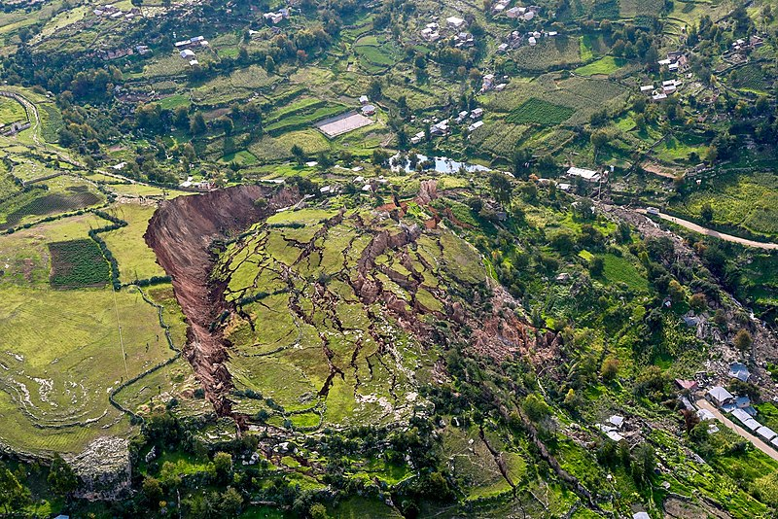
Features of mass movements
This landslide is a good place to start thinking about mass movement features and processes.
Activity
Think about what has happened in the photo and identify some features.
For some key terms, view the next slide using Slide Show.
A 30-hectare landslide in Cusco, Peru destroyed 100 houses in 2018; find out more here.
Notes:
https://en.wikipedia.org/wiki/File:Landslide_in_Cusco,_Peru_-_2018.jpg

Slide 12
Features of mass movements
Flank
Scarp or scar
Head
Fracturing
Slide plane
Toe
Flank
The term ‘landslide’ is commonly used for a range of medium to large-scale mass movements.
Notes:
https://en.wikipedia.org/wiki/File:Landslide_in_Cusco,_Peru_-_2018.jpg

Slide 13
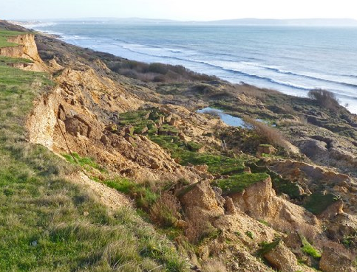
Landslides and slumps
Slides take place along an angled slide plane, often lubricated by water, for example over a bedding plane in rock dipping downhill (slide 7) or over an impermeable layer, such as clay.
Slumps are similar to slides, but the slide plane curves, so the material rotates and the head tilts backwards. They are also called rotational slides. Slumps are common on UK coasts, as shown here at Barton on Sea, Dorset.
Terraced profile
Head
Slide plane
Activity
View this BGS clip and consider the relationship between geology, mass movement and coastal erosion.
Notes:
https://www.geograph.org.uk/photo/2709863

Slide 14
Falls
Falls occur on vertical or steep slopes when fragments or slabs of rock detach and fall to the base as talus. They are often triggered:
when joints weaken through weathering or an increase in pore water pressure
on coasts, through wave action pounding cliffs or undercutting and destabilising the base of the cliff
suddenly, e.g. by earthquakes.
The photo shows how mass movement is an important sediment input into coastal systems – as well as into glacier or river systems.
Talus
Rockfall (or blockfall) at Bempton Cliffs, Yorkshire, UK
Notes:
https://commons.m.wikimedia.org/wiki/File:Rock_Fall_at_Bempton_Cliffs.jpg

Slide 15
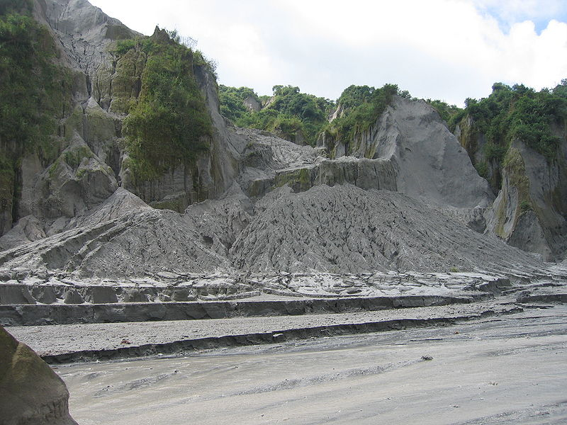
Mudflows
Mudflow down gulley
Mudflows form when soil or weakly consolidated material becomes saturated with water, commonly from sudden heavy rainfall events, including in semi-arid environments:
at the source water gets between the sediment particles: it liquefies and behaves like a fluid
a flow develops and moves downhill, often following a gulley or valley; it can pick up larger stones and boulders as it flows
mudflows can flow slowly, but they are often rapid and can be a deadly hazard (slide 6).
Debris fan
Mudflow following the volcanic eruption of Mount Pinatubo, Luzon, Philippines in 2006: a lahar
Notes:
https://commons.wikimedia.org/wiki/File:Lahar_Mount_Pinatubo.JPG

Slide 16
Solifluction
Solifluction is a type of flow movement occurring in periglacial environments, with:
an active surface layer that thaws in spring and summer
underlying permafrost or rock forming an impermeable layer
limited vegetation cover: tundra.
The active layer of thawed soil becomes saturated with water, reducing friction and allowing slow downhill flows over the frozen permafrost layer beneath.
The photo shows a characteristic landform: solifluction lobes at Eagle Summit, Alaska, USA.
Activity
Check you understand this process by using the text to label the image.
Notes:
https://commons.wikimedia.org/wiki/File:Solifluctionterraceseaglesummit.jpg

Slide 17
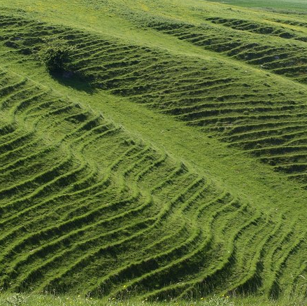
Creep
Soil creep is a process caused by cycles of freezing and thawing, wetting and drying of individual soil particles:
through wetting or freezing, particles expand outwards at right angles to the slope
as the particles dry or thaw, they fall vertically downwards under gravity
individual particles are heaved down-slope.
The rate of movement is very slow, even on steeper slopes.
1
2
3
Terracettes
Soil creep is common on clay soil and is often seen on UK slopes, like this one in Wiltshire
Notes:
https://www.geograph.org.uk/photo/1345952

Slide 18
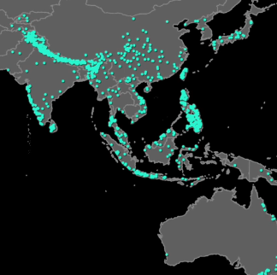
Mass movements as hazards
Activity
Mass movements can be significant hazards. Look back over the examples in this unit: which are (or are not) potential hazards? What factors are involved? Check slide 10.
Explore the NASA clip (right) and consider the world distribution of landslide hazards: what is the relationship with young fold mountains and with population?
Explore the Our World in Data site. Quantify and explain how landslides compare with other hazards.
Compare the distribution of landslides with a relief map: perhaps focus on one continent or region.
Notes:
https://images.nasa.gov/details-GSFC_20150416_Landslide_m11854_Catalog

Slide 19
Mass movements as hazards: Japan
Japan has the highest exposure to natural hazards of high-income countries, and is one of the most exposed to multiple hazards of all countries. These include tectonic, weather (typhoons) and geophysical hazards, which sometimes combine: it is a multi-hazard environment.
Activity
The chart shows the frequency of Japan’s natural hazards. Which might combine to cause landslides?
Based on your knowledge of mass movements, how might climate change amplify the landslide hazard?
Earthquakes: 91% of deaths
Notes:
Data source Prevention web, 2015

Slide 20
Factors behind mass movements
Factor | Notes/details
Tectonic activity e.g. tectonic uplift
Geology
Weathering
Climate and weather
Vegetation
Change in steepness
Human activity
Activity
Summarise your learning by noting the factors that explain or trigger mass movements, using the examples you have studied.
Check/expand your ideas using this BGS page or this online text (section 2).

Slide 21
Summary
Weathering, mass movement and erosion are linked processes operating on slopes in coastal, fluvial, glacial and arid landscapes.
Slopes operate as systems, becoming unstable when the forces driving material downhill exceed those resisting them: the down-slope movement that results is mass movement.
Mass movements include falls, slides, slumps, flows and creeps. They vary in scale and material, and can be classified according to their rate of movement and amount of water involved.
A range of natural and human factors affect slope processes and stability, including internal influences (such as geology) and external (such as undercutting).
Mass movements can be a significant hazard, particularly larger scale and rapid movements. They can be caused or amplified by other hazard events.

Slide 22
Final check
Can you identify:
five types of mass movement
those likely in coastal, periglacial/glacial, arid environments
those likely in the UK (bonus: an example of each)
three different tectonic processes that may be a factor in mass movements
three ways in which water can be a factor in mass movements
three ways in which slopes might get steeper over time
a slide and a slump; their differences and similarities
three human activities that might increase a landslide hazard
the forces that keep slopes stable and make them unstable.
Some of the answers overlap – a concept map might help you.

Slide 23
Links
From the awarding bodies
Find out more
 | Topic
AQA | 3.1 Landscape systems: geomorphological processes (deserts, coasts, glaciers)
Edexcel | Topic 2 Landscape systems, processes and change (glacial, coasts)
Eduqas | Section A Changing landscapes (coastal, glacial/periglacial)
OCR | Topic 1.1 Landscape systems (coastal, glacial, desert)
WJEC | Unit 1A Changing landscapes (coastal, glacial/periglacial).
US National Parks site with detailed diagrams
Comprehensive USGS landslide hazard site
Detailed BGS case study of a UK landslide and its monitoring
Time for Geography: sub-aerial processes (coasts)
More from GEO on systems thinking

Slide 24
Glossary
Equilibrium: a state of balance between the inputs and outputs in a system. A system in dynamic equilibrium is one whose processes are constantly adjusting to change over time.
In situ: in place, happening with little or no movement
Lahar: a rapid flow formed from ash and other rocky volcanic debris combined with water from rainfall, or snow/glacier melting.
Mass movement (or mass wasting): the process by which gravity moves soil or rock down a slope through falls, slides, slumps, slips, flows and creep
Open system: open systems have transfers of both energy and material across their boundaries; they are linked with other systems
Periglacial: places on the fringes of ice sheets or glaciers or those with permafrost, where freeze-thaw cycles dominate
Pore: a small space in a rock or soil

Slide 25
Glossary (2)
Pore water pressure: the pressure on its surroundings of water held in pores
Scree: piles of weathered rock fragments lying loosely on a slope
Sub-aerial processes (below the air): weathering and mass movement
Talus: an accumulation of broken rock debris at the bottom of a slope; scree is an example
Threshold: a boundary between different states, sometimes marked by sudden or rapid change
Trigger/tipping point: something that tips a system into a new state; for example, road construction undercutting and destabilising a slope

Slide 26
Acknowledgements
This presentation has been written by John Hopkin, author and consultant to the Geographical Association.
Slide 3: Photo © Oregon Department of Transport, 2019
Slide 4: Photo © David Hawgood/Geograph, 2012
Slide 5: Photo © Bob Embleton/Geograph, 2009
Slide 6: Video © Hindustan Times, 2021
Slide 7: Videos © Slavonac1969, 2010; WDEF News 12, 2009
Slide 8: Video © utubecamborne, 2011; Photo © Roger Temple/Geograph, 2007
Slide 11: Photo © Galeria del Ministerio de Defensa del Perú, 2018
Slide 12: Photo © Galeria del Ministerio de Defensa del Perú, 2018
Slide 13: Photo © Mike Smith/Geograph, 2011
Slide 14: Photo © Partonez, 2018
Slide 15: Photo © Neureiter, 2006
Slide 16: Photo © D Sikes, 2007
Slide 17: Photo © Derek Harper/Geograph, 2009
Slide 18: Video © NASA, 2015
Slide 19: Data source © Prevention Web, 2015

