Slide 1
Why are coral reefs valuable?
How are they managed?

Slide 2
Getting started
With this GEO resource you will be learning about the location and biodiversity of coral reefs, their value to us, and the environment and threats affecting global reefs today. We will also investigate the response to such threats in term of management.
You’ll need a notepad on which to make notes as you go along, or you could make notes or paste images, etc. on your device.
You can view these slides:
best as a slide-show for any animations, activities and to follow links
in ‘normal’ view if you want to add call-outs or extra slides to make notes, paste images or answer questions.

Slide 3
Activity You have probably covered ecosystems before. Create a mind map of what you know about ecosystems, to include locations, examples and biotic/abiotic factors.
Ecosystems mind map
Ecosystems

Slide 4
These are some things you may have mapped
Named examples of ecosystems: tropical rainforests, deserts, savannah grasslands, tundra, coral reefs.
Definition of ecosystems: a community of plants and animals that interact with non-living matter in balance with each other.
Biotic and abiotic components:
biotic – anything living, flora and fauna, including detritivores.
abiotic – non-living key components, including bedrock, climate, soils.
Think about how these interact.
Ecosystems
Location: large-scale ecosystems tend to be found in particular areas; tropical rainforests in between the tropics, deserts at higher latitudes north or south of the tropics.

Slide 5
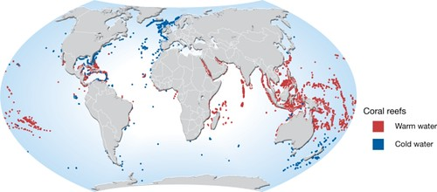
What are coral reefs?
Coral reefs are marine ecosystems found on the edges of land where corals accumulate; they cover around 284,300km² globally.
Most warm-water reefs are found between 30° north and south of the equator, typically where water temperatures do not drop below 16°C, growing faster in temperatures nearer 25°C.
Coral reefs can develop at rates of between 1–100cm/year, depending on the conditions.
Coral reefs can form large structures over time and are some of the largest and oldest ecosystems on Earth, e.g. Australia’s Great Barrier Reef.
Map showing location of coral reefs globally
Notes:
Map source: https://www.flickr.com/photos/gridarendal/31546365923

Slide 6
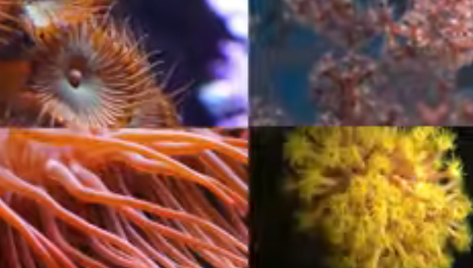
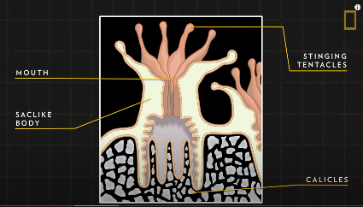
Exploring coral reefs
Activities
Watch this National Geographic video and take notes on the five key points about coral reefs.
Draw a sketch of a polyp and label its functions.
How can you tell the age of coral reefs?
Notes:
YouTube National Geographic video: https://www.youtube.com/watch?v=ZiULxLLP32s

Slide 7
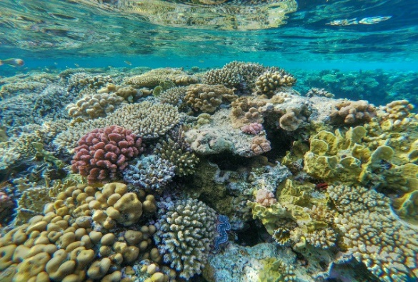
The development of coral reefs
Coral reefs are made up of calcium carbonate (limestone); this is absorbed from the water by each polyp and coralline algae.
Most of the coral structure is dead, made up of skeletons that the living reefs builds onto.
Tropical coral polyps have inside them small, symbiotic algae (called zooxanthellae). The zooxanthellae gain food and safety from the polyp, and the polyp can make food from the algae via photosynthesis.
Corals therefore need sunlight to photosynthesise and are found in shallow waters up to 30m deep.
Coral reefs also develop in waters clear of sediment and away from river mouths.
Coral polyps feeding
Corals in shallow, clear water
Notes:
Source: https://pixabay.com/photos/coral-acropora-reef-ocean-sea-2637018/
Source: https://www.flickr.com/photos/wildlifepictures/46284685272

Slide 8
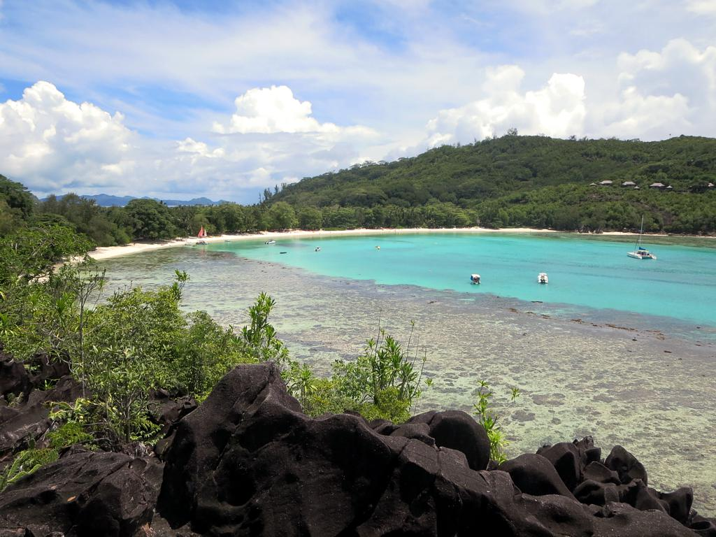
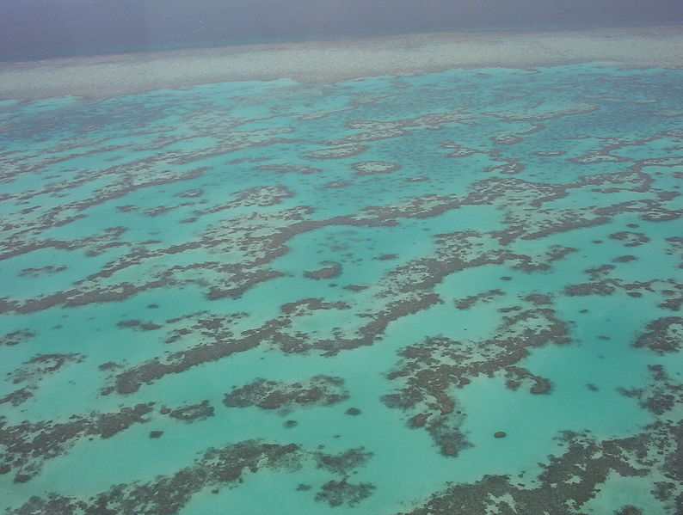
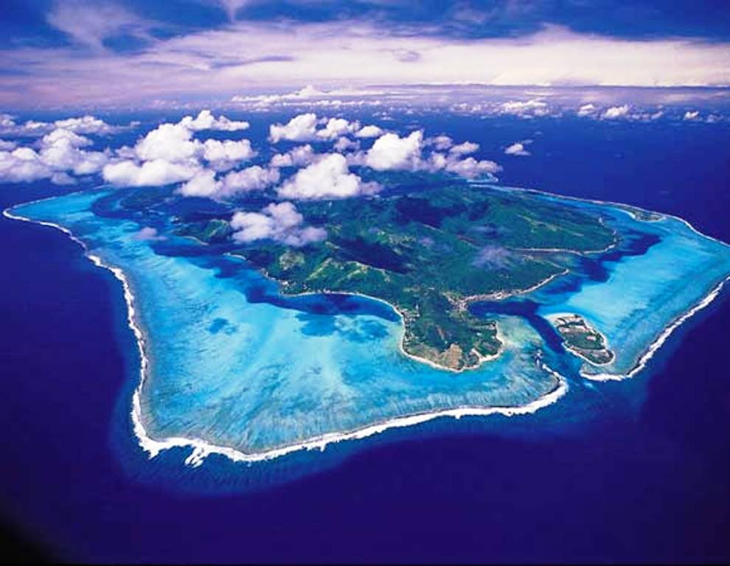
Types of coral reefs
There are three types of coral reefs: click here to find out more.
A fringing reef in Seychelles
The Great Barrier Reef, Australia
An atoll reef in French Polynesia
Notes:
More info on types of corals and what each type of reef is like: https://slideplayer.com/slide/6894037
Source: Fringing reef https://www.flickr.com/photos/davidstanleytravel/11207817916/in/photolist-i5oZMW-f3Mfpr-PrFtXG-o8f3S9-f3McXX-AJ3AT6-Vaj37s-25yUDJW-BjSCY6-9bNFdQ-2i5iZ49-AJ3y6n-8tLL7M-fkqGEt-2i5iZ99-J6gVb7-bwDohR-xgsNrM-2k7mGub-7mbPw2-F4DE9H-bWw3w6-F4DGU2-2i5mV5u-pzMe46-2i5npcT-BhyHwd-pCCXqm-2i5ji9N-2i5mWcV-2i5mmH5-qtJAbU-FRNLqz-qesWEE-qi6TMo-2i5mmWb-fXqn2W-qi5G3m-fXqgVc-qes5kE-qtNMcy-fXqeNL-2i5iZeQ-qwxczp-pzeZZc-Fd3W8M-qf8c1p-qi6qdq-qeW4e5-qewiWu
Source: Atoll reef https://www.flickr.com/photos/dany13/8105116506/in/photolist-KP3szK-KT17Gd-dmdQL3-KLvNQE-KT15eN-KT16uU-KLvR7d-KP3tZi-2jHjMsp-787CQe-3jLx1U-KLvLx3-pr6naT-9pt3mn-9R2vSk
Source: Barrier reefs - https://www.flickr.com/photos/48722974@N07/5093123519/in/photolist-Rvt4JF-bUgrQp-8L4Abt-GPALcA-2izmtVz-in1LVz-23SBXmA-28Eya68-2adCNnS-LhE5JH-kZ1Yup-nyzGQa-mHK8vo-GxLapK-mHKd1f-93psh1-HPacTW-CcbdB3-2k7mGub-bUgrLZ-y6mhk-R69byH-gKRg3A-y6kzP-gKQRvK-gKQsyo-gKQWzx-gKR7ff-gKQPCK-gKQLjS-gKQpmS-gKQDLy-gKREMg-gKRBcv-gKQzd4-yqNqYo-gKQpFs-gKQxwD-gKQKTF-gKJ9Bd-gKKawp-gKK6uM-gKQyWy-gKKdTz

Slide 9
Why are coral reefs valuable?
Coral reefs are very important ecosystems – their value is estimated at $10 trillion a year.
Value of coral reefs to people | Value of coral reefs to the environment
Activity
Can you think of what makes up the value of coral reefs to us and the environment: its ecosystem services? Complete the table above. Assess your answers using slides 10 and 11
To help, read through this information on the NOAA website.
Notes:
https://oceanservice.noaa.gov/education/tutorial_corals/coral07_importance.html

Slide 10
Why are coral reefs valuable to people?
Fishing: 90% of all fish depend upon coral reefs as nurseries – estimated $100million
Tourism: employment
Diet: fish is a fast becoming a more popular source of lean protein
Protection from tropical storms: the waves created by storms break over the reefs reducing damage inland. More than 270 million people live by the coast globally
Leisure activities: diving/snorkeling/free diving
Medicines: corals are used in medicinal research for cancers and viruses.
Notes:
https://oceanservice.noaa.gov/education/tutorial_corals/coral07_importance.html

Slide 11
Why are coral reefs valuable to the environment?
Corals provide the material to create beaches: e.g. parrotfish eat corals, and their excretion creates the white sands seen in tropical beaches.
Carefully balanced food web: one of the most biodiverse ecosystems in the world
Home to a quarter of all global marine life: without coral reefs, the larger species of whales, dolphins and sharks would not survive.
Corals provide shelter for marine life, e.g. anemones for clown fish.
Carefully balanced food web: one of the most biodiverse ecosystems in the world.
Notes:
https://oceanservice.noaa.gov/education/tutorial_corals/coral07_importance.html

Slide 12
How are coral reefs under threat globally?
Coral reefs are under threat globally – click the link to investigate how widespread the threat is.
Skills alert! Practice exam question
You could be asked a judgement question on this topic area. Here’s an example:
‘Climate change poses the most significant threat to coral reefs globally. To what extent do you agree with this statement?’
Activity
Create a mind map of your ideas of what could be threatening coral reefs from your own knowledge as a geographer. Develop each point (top skill).
When you have created it, view this PowerPoint and use Slide 5, ‘Local-global threats’, to check your developed points.
Read more about threats to coral reefs here.

Slide 13
Health of coral reefs: skills alert
Resources
This PowerPoint from Geography Review is a summary of the range of global threats for specific coral reef locations.
The Ocean Tipping Points website explores changes to the reef system at Discovery Bay, Jamaica.
Activities
Open the PowerPoint and go to slide 6: ‘Coral reef health’.
What does this resource show?
Why can you give reasons for the trend it shows?
What conclusions can you draw?
Investigate changes to the reef system at Discovery Bay.
List natural and human factors leading to change, or label a copy of the diagram.
A tipping point was reached between two ecosystem states – what does this mean, and how can it be managed?
Notes:
Link to ppt - https://www.google.com/search?q=geography+review+coral+reefs+ppt&rlz=1C1GCEA_enGB918GB918&oq=geography+review+coral+reefs+ppt&aqs=chrome..69i57.9189j0j4&sourceid=chrome&ie=UTF-8

Slide 14
Geographical concepts: scale
As geographers we think of scale; this concept can be applied here to coral reefs and the threats they face:
Activity
Can you sort the threats you’ve learned about, according to whether they are a local, national or global threat?
Global National Local
Global
National
Local
Notes:
https://sites.google.com/a/markham.edu.pe/mr-carter-s-igcse-geography/oceans/threats-to-coral-reefs – a teacher’s website

Slide 15
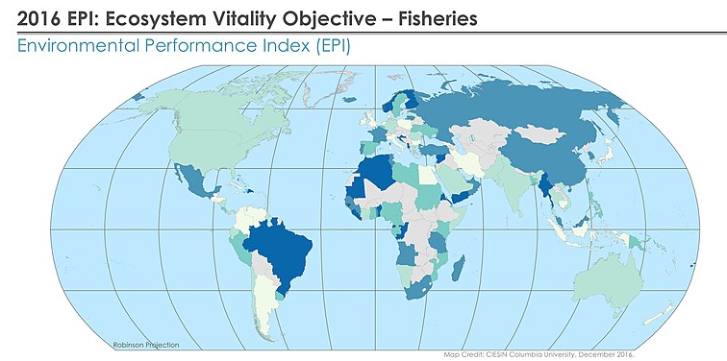
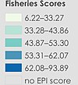
Skills practice: graphical interpretation
Skills alert! Practice exam question
‘Study the map and key, then analyse the global pattern of EPI of fisheries’.
If you are not familiar with EPI, read more here
Notes:
https://commons.wikimedia.org/wiki/File:2016_EPI_Ecosystem_Vitality_Objective_-_Fisheries_(26170608828).jpg

Slide 16
Skills practice: breaking it down
How to analyse the map:
Look for patterns in the map, for example high or low scores, or any anomalies.
You could discuss the map using ‘PADL’: P = Pattern; A = Analyse; D = Data L = Links.
Anomalies
Low scores
High scores
Notes:
https://commons.wikimedia.org/wiki/File:2016_EPI_Ecosystem_Vitality_Objective_-_Fisheries_(26170608828).jpg

Slide 17
Responses to managing threats to coral reefs
Fish sustainably – Maximum Sustainability Yield (MSY)
Buy reef-friendly sunscreen
Education – incorporate coral reefs, values and services into the curriculum
Organic farming – using no synthetic chemicals in farming
Responsible diving – ‘take only pictures, leave only bubbles’
Legislation – e.g. United Nations Convention on the Law of the Sea (UNCLOS)
Coral farming – growing corals in areas where numbers have decreased
Government intervention:
Marine Protected Areas (MPAs) – special controls to protect species and habitats
Building restrictions on the coastal fringe – tackling issues of coastal squeeze
Tackling climate change:
Globally – climate agreements, e.g. COP26
Nationally – switch to renewable energy resources, e.g. UK pledge to complete move from petrol vehicles by 2030
Locally – reduce energy usage
Responsible tourism – ecotourism

Slide 18
A level: breadth and depth
At A level you need to have a range of examples and a few case studies that are more in depth. In this last section you will investigate two examples of coral reefs under threat and how each has been managed:
Cayman Islands (Caribbean)
Menjangan Island (Indonesia).
Investigate on the next two slides:
Which is the most significant threat in each case study?
Evaluate the responses to management of coral reefs in each area:
Local – global issues?
How viable are the programmes?
How applicable to low or high income countries?
Which key players are involved?
Activity
Become familiar with two coral reef ecosystems globally:
Read through this slideshow concerning coral reef restoration in the Caribbean and elsewhere.
Notes:
https://www.slideshare.net/CeciliaEargle/coral-reef-presentation-202209167

Slide 19
Case study: The Cayman Islands
Tourism plays a crucial role in the Cayman Islands economy:
tourism contributes 70% of GDP
2.1 million tourist arrivals in 2016, three-quarters from USA
10% of direct employment.
Tourism has a number of negative social and environmental impacts:
tourists put pressure on water supplies: the islands depend completely on desalination for their water
litter pollution, particularly from cruise liners, affects beaches and marine life
new developments for cruise-ship access have destroyed reefs
reef destruction by divers and souvenir hunters
waves from tourist boats erode the shoreline and disturb mangroves, an important fish nursery.
Resources
Article about the Cayman Islands
Download A: location
Download B: threats
Download C: prevention
Activity
Read the article and downloads about the Cayman Islands and consider the positive and negative impacts of tourism, then complete the activities on slide 20.
Notes:
Table link goes to attached document ‘Caymans Islands Case Study’ please

Slide 20
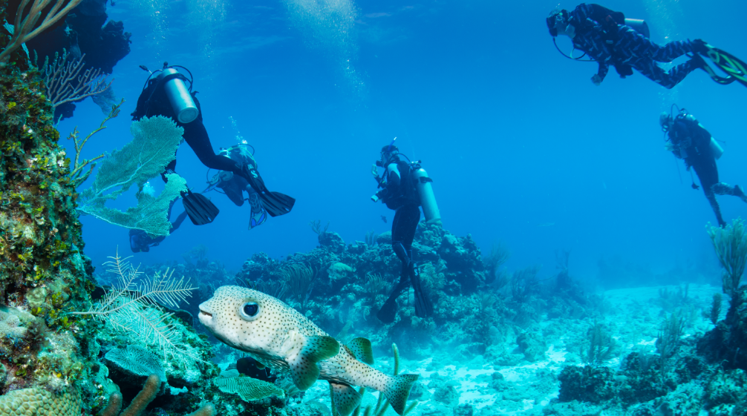
Case study: The Cayman Islands
Activities
Evaluate the threats posed to corals in the Cayman Island’s reefs.
Download and complete the table, using the information in the article.
What could happen in the future to coral reefs in the Cayman Islands? Think about:
increasing global wealth or COVID-19
climate change etc.
the impacts on these reefs.
Notes:
Photo © Shutterstock/Warren Metcalf

Slide 21
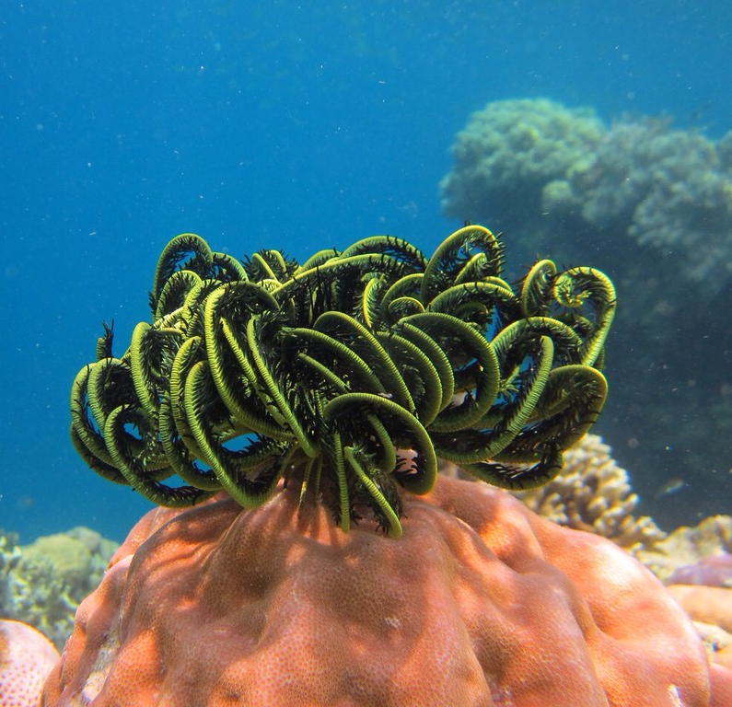
Case study: Menjangan Island
Activity
Having reviewed the case study summary, answer the following questions:
Which factor could be the most significant threat and why?
What issues could there be in managing coral reefs in a developing country?
Assess the management strategies employed. What more is to be achieved?
Notes:
Photo – https://www.flickr.com/photos/amivaa/16305959021/in/photolist-znFecd-8D6EBS-znMGk8-85Et6S-8EnyPb-6vtg3t-pUhqSF-qR4pZM-qyBmvK-qyBmFz-5a9L7b-7U4HXp-8soEm1-qyucsC-qQUiwv-qQZ2Wd-8skAvi-8soDRd-GJpqg5-24ScUF2
PowerPoint - https://www.rgs.org/CMSPages/GetFile.aspx?nodeguid=b0e6e94d-6b45-496c-b9ab-b1de9fc8e94a&lang=en-GB

Slide 22
The great debate: which area is managing coral reefs more successfully, and why?
Arguments for the Cayman Islands | Arguments for Menjangan Island
Overall evaluation…
Activity
Finally, to complete this enquiry, produce an evaluation table to assess management techniques across two geographically different areas globally.
First analyse and list the management successes for each location.
In the ‘overall evaluation’ box you should give your own conclusions based on the evidence you have encountered in this enquiry.

Slide 23
Summary
Coral reefs are among the most biodiverse ecosystems in the world. They are highly valuable biologically, socially and economically.
Coral reefs are found within the tropics.
There are three types of coral reefs; fringing, barrier and atoll reefs.
Corals are living organisms.
Coral reefs are threatened globally, from mostly anthropogenic causes. Tourism, population increase and climate change have irreparably altered marine habitats. Climate change is also caused by human activity, which may have led to a rise in El Niño events.
The impacts of such destruction has long term implications for a sustainable food supply, protection from increasingly stronger tropical storms and industries such as tourism.
Coral reefs are being managed, mostly through local schemes, protecting smaller areas. The interconnectedness of the marine ecosystem is a challenge for global management, owing to the transient nature of species and habitats. There are strengths and weaknesses to both example strategies used across the two case studies; Menjangan Island and the Cayman Islands.

Slide 24
Taking it further
Ted talks:
Could fish social networks save coral reefs? Video 1
Why I still have hope for coral reefs Video 2
Weblinks:
Weblink 1: Fish behaviour modified by increasing boat traffic – the effect of noise pollution
Weblink 2: The Climate Press – the future of global warming.
Reflection
What problems does this new research on noise pollution pose for the tourism industry?
With more frequent bleaching events, are we past the tipping point in protecting coral reefs?
With changing political powers in US/UK, how far will ecopolitics play a role in the near future?
Notes:
Full reference: Young, E.M (2010) ‘Deadly diets: Geographical reflections on the global food system’ Geography, 95:2, pp. 60-69

Slide 25
Glossary (1)
Atoll reef – roughly circular reef systems surrounding a central lagoon
Barrier reef – extensive linear reef complexes that develop parallel to the shore, separated from it by a lagoon.
Coral polyp – the animals primarily responsible for building reefs, can take many forms: large reef building colonies, graceful flowing fans and even small, solitary organisms.
Coral reefs – large underwater ecosystem characterised by reef-building corals.
Ecosystem – system in which organisms interact with each other and the environment.
ENSO – El Niño Southern Oscillation. A recurring climate pattern involving changes in the temperature of waters in the central and eastern tropical Pacific Ocean. On periods ranging from about three to seven years, the surface waters across a large swath of the tropical Pacific Ocean warm or cool by anywhere from 1°C to 3°C, compared to normal.
Fringing reef – grows directly from a shore with no area of open water between the beach and the inshore edge of the reef. This is the most common type of reef.
Notes:
Skinner et al (2016)
https://www.weather.gov/mhx/ensowhat

Slide 26
Glossary (2)
Ocean acidification – about 30% of the CO² that has been released into the atmosphere has diffused into the ocean through direct chemical exchange.
Thermal expansion – when water warms it expands. About half the past century’s rise in sea level is thought to be attributable to warmer oceans.
Symbiotic – having an interdependent relationship that is mutually beneficial.
Notes:
Skinner et al (2016)
https://www.weather.gov/mhx/ensowhat

Slide 27
Links
From the awarding bodies
Further research
 | Topic
AQA | 3.1.3.3 Coastal landform development
Eduqas | 2.1.9. Carbon cycles 2.2.6 -2.1.10 Global governance of oceans 3.2 Ecosystems
Edexcel | 2B.9 Coastal flooding 6.2 Biological processes on carbon
OCR | 4. b. Coastal management 1.c. Carbon and water cycles 3. 3 Exploring Oceans
WJEC | 1.1.7 Coastal environments 3.2.6-19 Global governance of oceans
Try this 360⁰ virtual reef tour or Cayman reef webcam
BBC: Blue Planet II (Episode 3)
Deaths of Earth’s coral reefs documentary (2018)
ICUN: Plastic in oceans
Reef Creature Identification (P. Humann and N Deloach)
Coral reefs: A very short introduction (C. Sheppard)
The Greenpeace book of coral reefs (N Hannah and S. Wells).

Slide 28
Acknowledgements
This presentation has been written by Helena Maxfield, Teacher of Geography, Merchant Taylors’ School.
Figures
Slide 5: GRID-Arendal
Slide 6: National Geographic
Slide 7: Pixabay; Gregoire Dubois
Slide 8: David Stanley; dany13; eutrophication&hypoxia
Slide 15: Wikimedia
Slide 16: Wikimedia
Slide 20: Shutterstock/Warren Metcalf
Slide 21: Amelia Isa

