Slide 1
Everyday stories of climate change

Slide 2
Getting started
The questions to consider in this PowerPoint presentation relate to a graphic novella, Everyday Stories of Climate Change.
As you read the novella, you’ll need a notepad on which to make notes as you go along, or you could make notes, paste images, etc. on your device.

Slide 3
Everyday impacts of climate change
When we talk about climate change, we often use abstract ideas such as, ‘the planet is warming’ or ‘rainfall is becoming more unpredictable’. How do these changes impact the daily lives of ordinary families across the world? In Everyday Stories of Climate Change you will travel to Bangladesh, South Africa, Bolivia, Puerto Rico, and Barbuda to discover how families experience the impacts of climate change, and their strategies to adapt and recover.
Notes:
FSC own the graphic

Slide 4
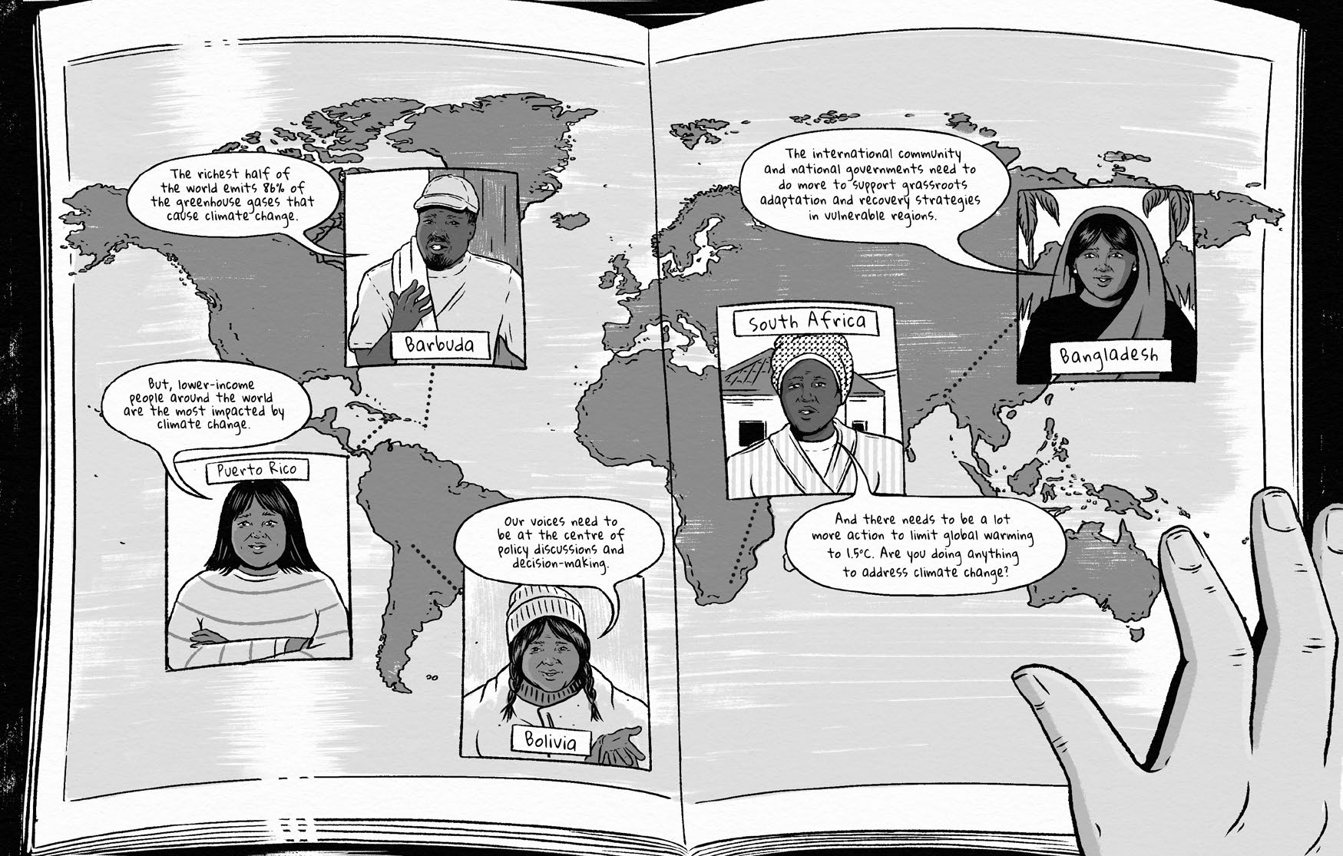
Reading the stories
Read the novella and make notes as you read.

Slide 5
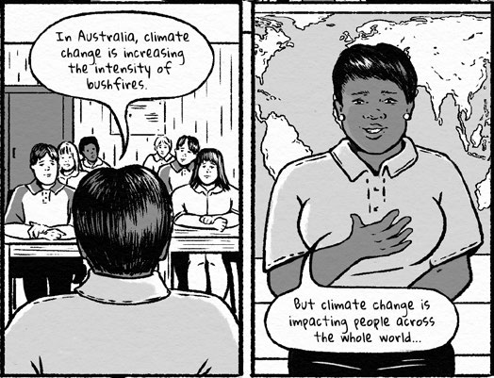
Discussion points: Climate change and the world
What is climate change?
Does climate change affect all regions on Earth equally?
What kind of map is displayed on the teacher’s wall? What is its significance?

Slide 6
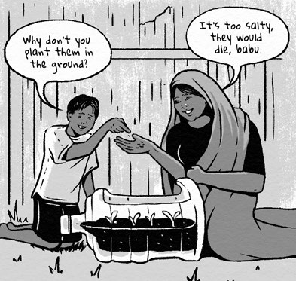
Discussion points: Impacts
How does climate change impact the everyday lives of families?
Extension: Categorise the impacts into social, economic, political, cultural, environmental and psychological short- and long-term.
How and why do different characters experience climate change impacts differently? You might like to create a table with different rows to represent gender, age, disability, race and ethnicity.

Slide 7
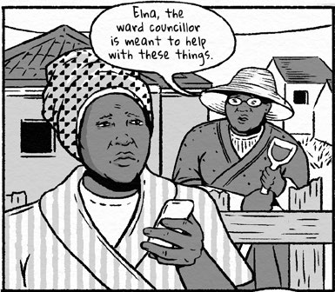
Discussion points: Adaptation and recovery
Define the difference between climate change adaptation and recovery from climate change impacts.
Describe how people adapt to and recover from climate change in Bangladesh, South Africa, Bolivia, Puerto Rico and Barbuda.
Outline the resources families used to adapt to and recover from climate change impacts.
Explain some of the challenges that the families faced when trying to put in place sustainable climate change adaptation measures.

Slide 8
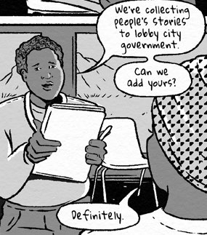
Discussion points: Improving adaptation and recovery
Identify who is responsible for climate change adaptation and recovery across the five neighbourhoods.
Suggest how the families can collaborate with other families in the neighbourhood to better adapt and recover.
Discuss how local, national and foreign governments might better support low-income families to adapt to climate change and recover from its impacts.

Slide 9
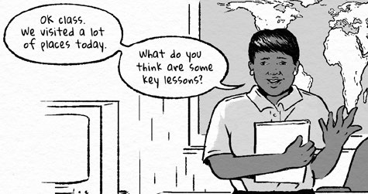
Discussion points: Representing climate change experiences
How does the comic’s portrayal of people impacted by climate change compare to that in mainstream media representations?
If you created a comic about climate change, who would be your main characters and why?
If you created a comic about climate change, what would you like the reader to take away from it and why?

Slide 10
Links
From the awarding bodies
Find out more
 | Topic
AQA | 3.1.1.4 Climate change
Edexcel A | 2.3 Climate change and human activity
Edexcel B | 1.3 Climate change and human activity
Eduqas A | 5.1.2 Causes of climate change
Eduqas B | 2.4: Climate change - cause and effect
OCR A | 2.3.1/2 Climate change
OCR B | 2.1 Climate change – human activity
WJEC | 5.1.1/2 Evidence/causes of climate change
CCEA | D: Causes of climate change.
Time for geography has a great summary of the human causes of climate change. It uses the term climate forcings.
David Attenborough talks about the impact of climate change for all of us.
Evidence, causes and impacts of climate change from the Met Office.
To finish with, check Bitesize and watch climate change in 60 seconds.

Slide 11
Glossary
Adaptation: adjusting natural or human systems in response to the impacts of a hazard (such as climate change)
Climate forcings: factors that upset the global energy budget and cause climate change.

Slide 12
Acknowledgements
This presentation and the stories in Everyday Stories of Climate Change are based on research by Adeeba Nuraina Risha (BRAC University), Dr Gemma Sou (RMIT University) and Associate Professor Gina Ziervogel (University of Cape Town).
All illustrations © Gemma Sou.

