Slide 1
Numerical and statistical skills in GCSE geography
Richard Peasland

Slide 2
Numerical and statistical skills
Measures of central tendency.
Measures of dispersion.
Relationships in bivariate data.

Slide 3
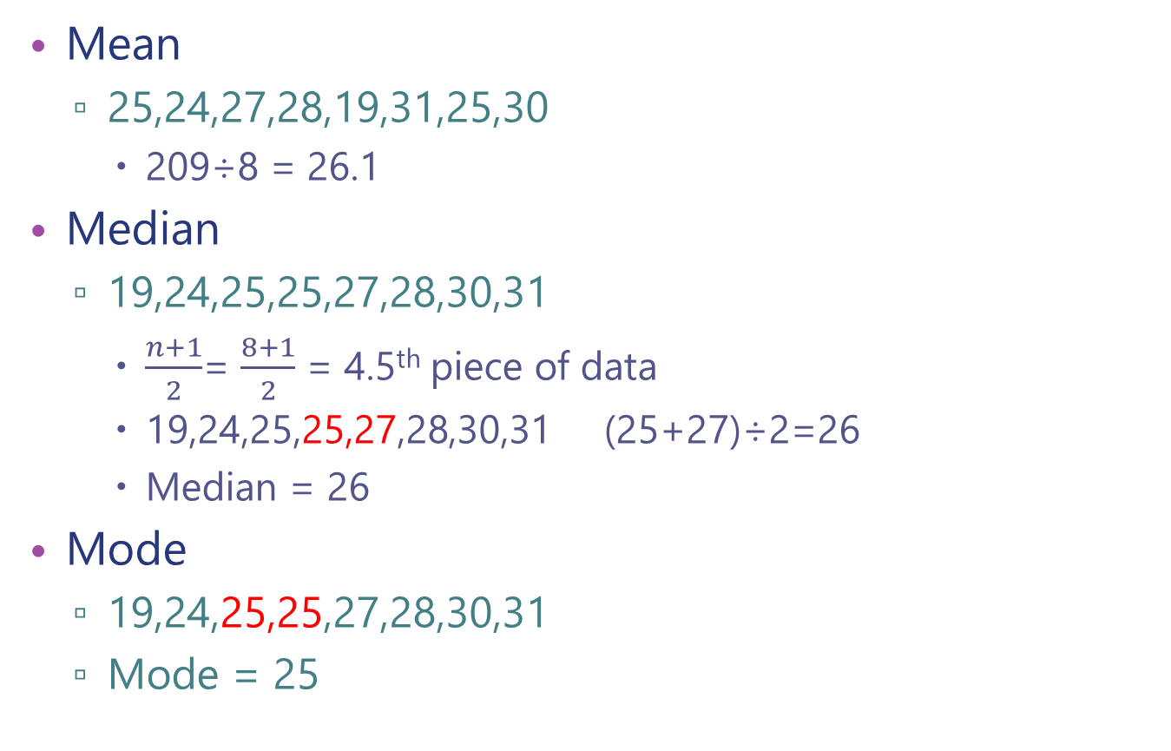
Measures of central tendency
Mean
25,24,27,28,19,31,25,30
209÷8 = 26.1
Median
19,24,25,25,27,28,30,31
$\frac{n+1}{2}$= $\frac{8+1}{2}$ = 4.5th piece of data
19,24,25,25,27,28,30,31 (25+27)÷2=26
Median = 26
Mode
19,24,25,25,27,28,30,31
Mode = 25

Slide 4
Measures of central tendency
Which to use?
Generally the mean is the most useful as it uses all the data but if there are outliers the median might be more representative.
Mean
25,24,27,28,19,31,25,30,100
309÷9 = 38.6
Median
19,24,25,25,27,28,30,31,100

Slide 5
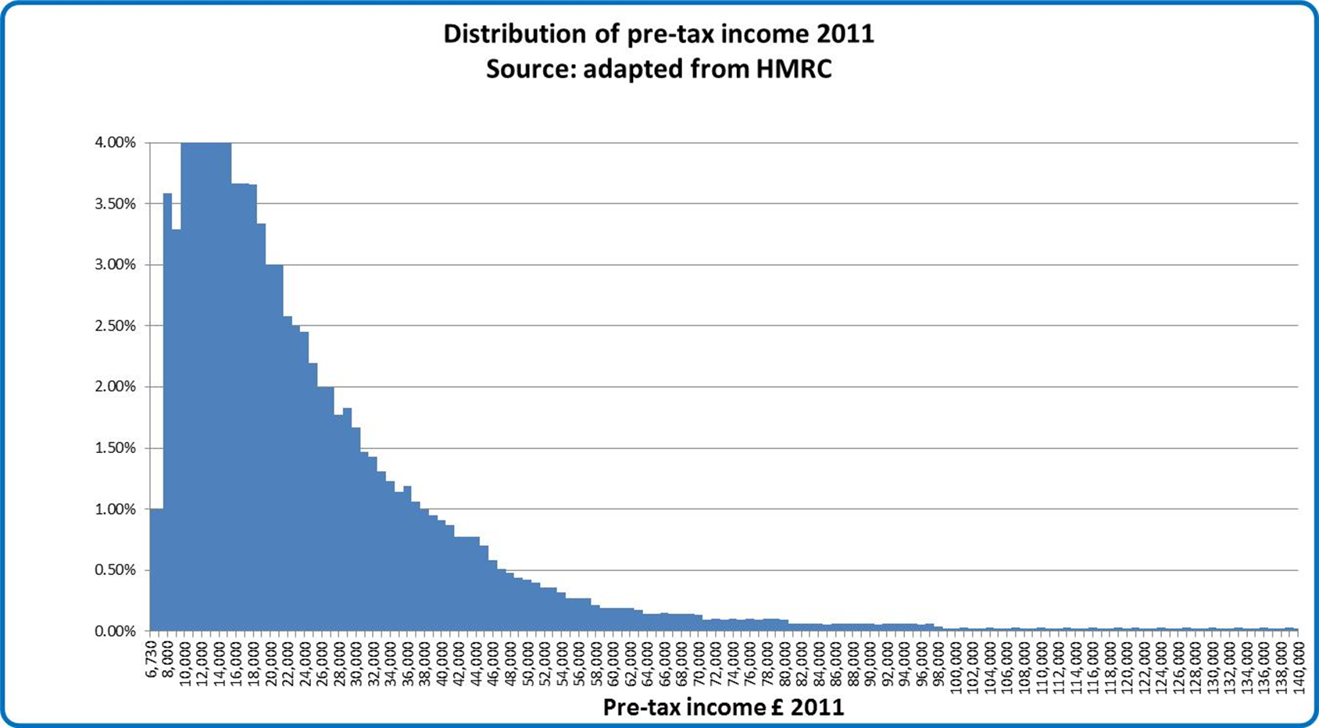
Median income: £20,300
Which is most representative?
Mean income: £26,500
Notes:
Graph source: https://theuxbridgegraduate.wordpress.com/2013/09/29/definitively-rich/

Slide 6
Measures of dispersion
Measures of dispersion describe the spread of data around a central value (mean, median or mode). They tell us how much variability there is in the data.
They include:
Max and min
Upper and Lower Quartiles
Range
Interquartile range

Slide 7
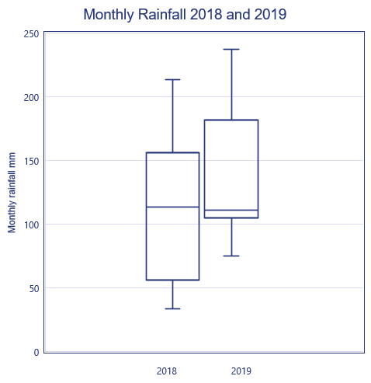
Measures of dispersion
To describe data we can calculate the interquartile range. (The middle 50% of the data).
The interquartile range tells you the about spread of the data.
It will give you information about the variation of different data sets which you can’t see by just comparing the means.
25%
UQ
M
50%
LQ
25%
Notes:
Data source Slides 7-10: Richard Peasland

Slide 8
Measures of dispersion?
First we need to calculate the: Median, Upper quartile & Lower quartile.

Slide 9
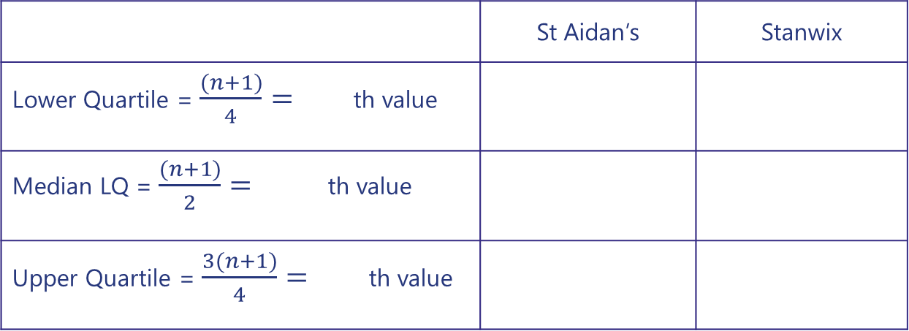
Working out quartiles
 | 1 | 2 | 3 | 4 | 5 | 6 | 7 | 8 | 9 | 10 | 11 | 12 | 13 | 14 | 15 | 16 | 17 | 18 | 19 | 20 | 21 | 22 | 23
St A. | 41 | 42 | 42 | 44 | 45 | 45 | 45 | 46 | 46 | 46 | 48 | 49 | 51 | 53 | 53 | 54 | 54 | 58 | 59 | 62 | 65 | 65 | 68
Stan. | 55 | 46 | 49 | 51 | 51 | 52 | 52 | 52 | 53 | 53 | 54 | 56 | 56 | 56 | 60 | 60 | 60 | 61 | 62 | 62 | 63 | 64 | 65
 | St Aidan’s | Stanwix
Lower Quartile = $\frac{(n+1)}{4}=$ th value
Median LQ = $\frac{(n+1)}{2}=$ th value
Upper Quartile = $\frac{3(n+1)}{4}=$ th value
6
45
58
12
49
56
18
58
61

Slide 10
Interquartile Range
The difference between the upper and lower quartiles.
St Aidan’s:
58-45= 13
Stanwix
61-52= 9
UQ
UQ
M
LQ
M
The IQR tells us that the scores are much more spread out in St Aidan’s than in Stanwix. The mean doesn’t give us that information. Using the IQR we will be able to draw more robust conclusions about the geography of these two places.
LQ
Notes:
Conclusion:
The data shows that on average environmental quality is higher in Stanwix than St Aidan’s however, that doesn’t clearly describe the situation. The interquartile range for Stanwix and St Aidan’s is 9 and 13 respectively. Quality in Stanwix is much less variable and most areas score within a small range- This may be because all the housing is of a similar age, size and style. In St Aidan’s the quality is much more variable, the upper quartile of 58 is only 3 points behind the UQ of Stanwix. The LQ of St Aidan’s is only 45, this is much lower than Stanwix’s LQ of 52. This large range is possibly because of the mix of small dense terraced housing without gardens and larger tree lined terrace avenues with gardens.

Slide 11
Relationships in bivariate data
Notes:
OCR Mathematical skills booklet- https://ocr.org.uk/qualifications/as-and-a-level/biology-a-h020-h420-from-2015/planning-and-teaching/

Slide 12
Relationships in bivariate data
Notes:
Data source slides 12-15: Richard Peasland

Slide 13
Interpolating data

Slide 14
Extrapolating data

Slide 15
Trend line

Slide 16
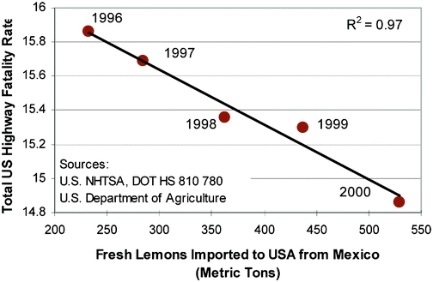
Correlation vs Causation
Beware of what your graph is telling you! It does not tell you anything about causation. You need to refer back to your geographical theory to help you explain causation.
Notes:
https://blogs.ch.cam.ac.uk/pmr/2010/06/17/open-data-climate-change-research-and-chemoinformatics/

Slide 17
Links to further support
The Field Studies Council are offering a range of packages of support for GCSE geography students. With outreach and digital packages sitting alongside their more traditional day and residential course offer there is a solution to suit everyone. Find out more: https://www.field-studies-council.org/secondary-and-further-education-courses/

Slide 18
Links
From the awarding bodies:
From the GA and the FSC:
GA specs summary
AQA specification
CCEA specification
Eduqas specification
Edexcel specification
OCR specification
WJEC specification
Methods of statistical analysis of fieldwork data, GA
Methods of presenting fieldwork data, GA
© Geographical Association, 2020

