Slide 1
The A level independent investigation literature review

Slide 2
Getting started
You’ll need a notepad on which to make notes as you go along, or you could make notes, paste images, etc. on your device.
You can view these slides:
as a slide-show for any animations and to follow links
in ‘normal’ view if you want to add call-outs or extra slides to make notes, paste images, answer questions.

Slide 3
The A level independent investigation literature review
Why is it important to conduct a literature review when planning an independent investigation on Changing Places?

Slide 4
What is a literature review?
You start a literature review by doing some background reading as you start planning your independent investigation.
You prove that you have done the reading by including a ‘literature review’ in your final report.
It is essential to keep an accurate reference for any source (whether it is a book or a web page) that you may want to refer to in your report.

Slide 5
Why have a literature review?
It is really important to have an understanding of the theoretical geography that is behind your research.
For example, if you are going to investigate the impact of globalisation on Mile End (which is a neighbourhood of Tower Hamlets in East London) you need to have an understanding of how globalisation can affect any UK town or city.
When you write your literature review – which needs to be short and concise – you show how understanding the general theory of globalisation will help you understand the specific example you investigate in Mile End.

Slide 6
What kind of literature?
Students use three main types of literature when researching their independent investigation. All of these are useful, but only one is likely to provide a review of the relevant geographical theory:
Text books, journals and academic papers
Often provide useful theoretical understanding of concepts and processes
The best place to find theoretical understanding for the literature review
Information websites such as Wikipedia
May provide useful geographical and historical context of the place under investigation
Reports from think tanks and government bodies
Provide useful secondary data that may help to answer the research questions

Slide 7
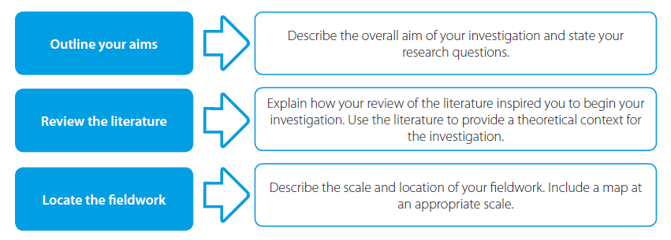
How does the literature review fit in?
The literature review usually forms part of the introduction of the NEA report.
Reproduced with permission: Andy Owen (2019) A Level Geography Independent Investigation.

Slide 8
Time to do a literature review
One academic geographer who famously wrote about Changing Places and the concepts of globalisation and identity was Doreen Massey.
Read ‘A Global Sense of Place’ written by Doreen Massey in 1991.

Slide 9
Activity 1
Doreen Massey’s article was written in 1991. On page 1 she mentions email, which was a relatively new technology in 1991. She goes on to write about ‘time-space compression’.
Think about the technological changes since 1991 and about the concept of ‘time-space compression’. These technologies change the way we work and communicate – so how might they be changing urban places? Think, in particular, about how we work today.

Slide 10
Activity 2
On pages 5 and 6, the author describes a walk down Kilburn High Road, in London. She concludes by writing:
If it is now recognized that people have multiple identities then the same point can be made in relation to places.
Think about this idea of places having multiple identities.
a) What factors may contribute to places having multiple identities?
b) Are these identities due to internal causes (endogenous) or external links to other places (exogenous)?

Slide 11
Activity 3
On page 8, Doreen Massey writes:
Places do not have single, unique 'identities'; they are full of internal conflicts.
Why it is important to recognise that change creates conflict? How could we investigate this through an independent investigation?
a) Identify groups of people (stakeholders or players) who may have differing views on change in your local place.
b) What might you ask them?
c) How could you make sure that you get a balance of views from across these groups?
During the Covid–19 lockdown it may not be possible to talk to people face-to-face. Research how you could collect a digital survey using Survey Monkey or similar.

Slide 12
Activity 4
On page 7, the author asks us to imagine we are a satellite, looking down on the Earth – and to visualise the things that connect us:
If one moves in from the satellite towards the globe, holding all those networks of social relations and movements and communications in one's head, then each 'place' can be seen as a particular, unique, point of their intersection. It is, indeed, a meeting place.
What is connecting your neighbourhood to other places? Think about the movement of people, and think about how goods, ideas and information are spread around the globe.
a) How is your place connected to other places?
b) Where is it connected to?
c) How could you investigate the importance of these connections?

Slide 13
Links
Awarding bodies and the Geographical Association (GA)
 | Topic
GA | Specification summary
AQA | Specification, support and example NEA
Eduqas | Specification, investigating and research and data analysis skills
Edexcel | Specification, exemplars and maths support
OCR | Specification and NEA support
WJEC | Specification, investigating and research skills and data analysis skills

Slide 14
Acknowledgements
This presentation has been written by Andy Owen, formerly Geography Subject Officer for one of the awarding bodies and a former Head of Geography.
Figures
Slide 7 – diagram from A Level Geography Independent Investigation (2019) by Andy Owen. Reproduced with permission.

