Slide 1
Urban case study: London

Slide 2
Getting started
You’ll need a notepad on which to make notes as you go along, or you could make notes, paste images, etc. on your device.
You can view these slides:
as a slide-show for any animations and to follow links; look out for a voice-over on some slides too.
in ‘normal’ view if you want to add call-outs or extra slides to make notes, paste images, answer questions.
These slides cover a broad overview from all the different GCSE exam boards, and not everything is covered. Do use these along with your school textbook or revision guide.
There are activities embedded here, with answers, to help you practice applying some of the knowledge.

Slide 3
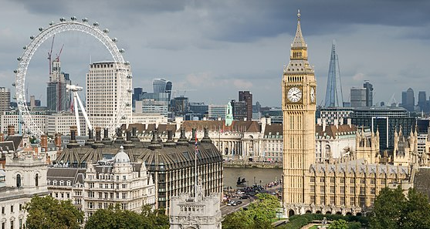
Why study London?
London is a world city, globally connected through business and finance to cities around the world. It is the capital city of the United Kingdom and has been an important settlement since Roman times. Here, we look at the growth and development of London, the challenges it faces and some of the ways it is adapting to the modern world.
Notes:
Photo:© User:Colin / Wikimedia Commons / CC BY-SA-4.
https://commons.wikimedia.org/wiki/File:Palace_of_Westminster_from_the_dome_on_Methodist_Central_Hall_(cropped).jpg

Slide 4
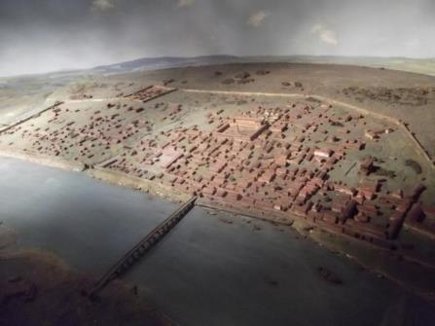
Why is London in an important location?
Site
Roman London was originally built as a bridging point on the River Thames, which also meant it developed a port function.
Situation
The flat land gave the city room for expansion, with farm land beyond the walls. All travel across the river came through the city so the Romans could control South-East England.
What is interesting for geographers is how the past has helped shape what we see today.
A reconstruction of Londinium – the Romans were at this site around the years 47–50 CE.
Activity
Watch this history of London.
Create a timeline of key events in the development of the modern city.
Notes:
Image: Matt Brown. From: https://www.flickr.com/photos/londonmatt/6766182715

Slide 5
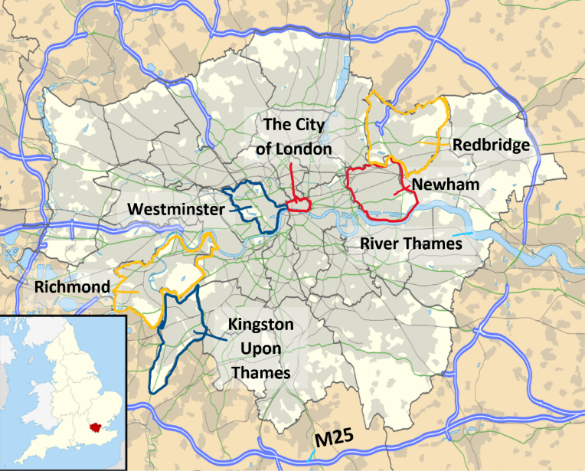
Notes:
Map source: https://upload.wikimedia.org/wikipedia/commons/thumb/7/7d/Greater_London_UK_location_map_2.svg/960px-Greater_London_UK_location_map_2.svg.png
Voice over: This map shows the extent of what we currently call ‘Greater London’. The light shaded area has been divided into the various ‘boroughs’ of London- for example the ‘City’ of London is one of these boroughs in the centre of the city on the north bank of the Thames but other boroughs include Kingston upon Thames in the south west and Redbridge in the north east. You don’t need to learn this map for GCSE – but knowing the names of a few of the boroughs, particularly those ones that we look at in more detail such as the ones in East London that have seen some redevelopment, will give you some ‘place-specific detail’ needed in longer mark answers.

Slide 6
Why is London an important city?
‘London’s role as a port declined in the twentieth century but it remained the main hub for the UK transport network. Motorways converge on London, such as the M1. The UK’s two busiest airports – Heathrow and Gatwick – are both close to London. The Palace of Westminster is the home of the UK Government.
London is the UK’s capital and is by far its wealthiest city. The gap between London and the rest of the UK has widened as both earnings and house prices have risen faster in London than elsewhere. In London the average salary is £34,473 compared to the UK average of £22,044. The average house price in London is £514,000 compared to the UK average of £272,000. London is a ‘world city’ – along with New York, it is one of the most important financial centres in the world. The headquarters of many large international and British companies are based there, such as KPMG. The city also attracts investment and migrants from all around the world’.
Activity
Read and highlight the text to show the importance of London:
local reasons – use green
national reasons– use yellow
global reasons use red.

Slide 7
Why is London an important city?
‘London’s role as a port declined in the twentieth century but it remained the main hub for the UK transport network. Motorways converge on London, such as the M1. The UK’s two busiest airports – Heathrow and Gatwick – are both close to London. The Palace of Westminster is the home of the UK Government.
London is the UK’s capital and by far the wealthiest city. The gap between London and the rest of the UK has widened, as both earnings and house prices have risen faster in London than elsewhere. In London, the average salary is £34,473 compared to the UK average of £22,044. The average house price in London is £514,000 compared to the UK average of £272,000. London is a ‘world city’ – along with New York, it is one of the most important financial centres in the world. The headquarters of many large international and British companies are based there, such as KPMG. The city also attracts investment and migrants from all around the world.’
Notes:
Voice over: Your highlighting should look something like this. It is often difficult to decide if a reason is local, national or global. For example, London’s role as a port provides local jobs but brings goods from all over the world. The migrants who come to London could be international migrants, but also from other parts of the UK.
Think – which of these reasons is the most significant reason that makes London an important city?
It is worth noting some of the specific detail here, such as average salary data as this is a case study so as such you do need to be able to use some of these data to back up any points you might want to make in an answer.

Slide 8
How has London changed over time?
London has grown and declined over time. Here is some data.
Year | Population: millions
1801 | 1.0
1811 | 1.3
1821 | 1.5
1831 | 1.8
1841 | 2.2
1851 | 2.6
1861 | 3.2
1881 | 4.7
1891 | 5.6
1911 | 7.2
1921 | 7.4
1931 | 8.1
1951 | 8.2
1961 | 8.0
1971 | 7.4
1981 | 6.5
1991 | 6.7
2001 | 7.2
2011 | 8.2
Activity
Make sure you know the meaning of urbanisation, counter-urbanisation and re-urbanisation.
Draw a line graph to show how London’s population has changed over time. Annotate the graph with the key terms.
Answers on the next slide…
Notes:
Voice over: The data here are from the UK census held every 10 years. The boundary of London used here is the edge of ‘Greater London’ with its various boroughs. When drawing your graph think about the units and scale.
It is worth differentiating between urbanisation, as defined here, and urban growth. Growth refers to the physical expansion of a town or city as well as increasing numbers of people. Urbanisation is about the proportion of people living in towns and cities.

Slide 9
What processes have led to population change in London?
COUNTER-URBANISATION
RE-URBANISATION
URBAN GROWTH and URBANISATION
Notes:
Voice over: Your graph should hopefully look something like this. It may differ slightly depending on your scale. Don’t forget all graphs need a title, ‘A line graph to show…’ and the axes need to have units and labels.
In an exam you are unlikely to have to draw a whole graph completely from scratch. Usually you would be required to add some data to a pre-drawn graph.
You could also be asked to describe the pattern on a graph, or to ‘use’ the graph in an answer. To answer this sort of question you need to be able to quote actual data – state the overall trend (it goes up/ down/ fluctuates) quote real numbers of population and dates. Avoid trying to give reasons why the graph looks like it does. That would be ‘explain’ not describe.

Slide 10
What processes have led to population change in London?
As areas of London became redeveloped, and new jobs available, more people are attracted in.
London grows due to migration and ‘natural increase’. London physically grows at the edges through the process of ‘suburbanisation’.
COUNTER-URBANISATION
RE-URBANISATION
URBAN GROWTH and URBANISATION
As traffic, crime and pollution increase, the wealthy move out of the city, and make use of the transport links to commute to the city.
Notes:
Voice over: These are some of the reasons behind the patterns. Some of these key terms and processes are explained in more detail in the urban processes presentation. As London grew at the edge, it swallowed up existing villages that then become part of the city, yet they have managed to retain some of their original feel – places such as Camden Town, and Surbiton are now parts of London. More recent redevelopments, such as those in East London mentioned later in this presentation, attract people in for jobs in business and finance, part of the re-urbanisation of London.

Slide 11
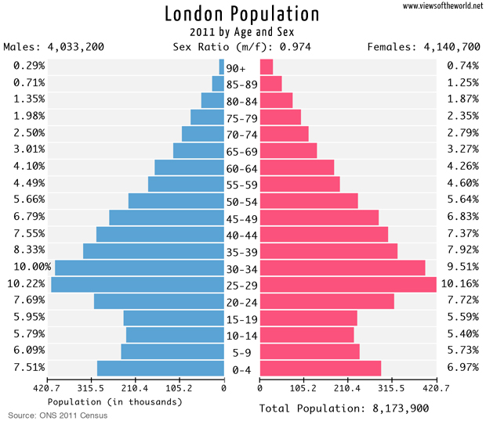
What is London’s age structure?
Fewer older people possibly indicates counter-urbanisation to retirement (rural or coastal) locations.
Large numbers of young adults in their 20s living and working in the vibrant city. They are the ones having the young children.
Notes:
Voice over: This type of data representation is called a population pyramid (despite it not really looking like a pyramid) a type of sideways double bar chart. You may have come across these in studies of development. It splits the population into 5-year age categories which you can see running up the centre, and into males and females on each side. The x axis shows the population in thousands of people, but sometimes it can be percentage data. Like much of the data we have on London, this is based on the UK Census of 2011, a large questionnaire sent out to households. The next census is due in 2021 (but the results won’t be out for a few years after it).
In an exam you could be asked to add some data to a pre drawn pyramid or to start picking out various patterns- a few key features of London’s population has been shown here. It would be useful to contrast this pyramid with that of other towns and cities as well as for the whole of the UK to really see how London’s population structure is different to other places.
Data from the ONS: available at http://www.viewsoftheworld.net/?p=3229 Hope we can use it!

Slide 12
What is London’s cultural mix?
International migration has created multicultural communities living in London. Different cultural groups are concentrated in specific areas of the city, such as the Caribbean community in Brixton, or the South Korean community in New Malden.
Over time, these communities will start businesses of their own which often cater for the specific needs of that community, such as shops selling certain types of food. Building functions can also change (setting up religious buildings, for example). This means the area can take on a specific ‘identity’ linked to different cultural groups.
Activity
Watch this video about multiculturalism in London.
List the reasons for the presence of the Caribbean community in Brixton and how the area reflects the needs of the community.

Slide 13
How do different parts of London compare?
Activity – GIS enquiry
The Datashine website loads up an interactive map, showing layers of data from the 2011 Census.
Choose two places, one in Richmond (West London) and one in Newham (East London). Change the ‘data chooser’ to collect specific data about the two places.
Contrast these two areas of London.
 | Richmond (TW9) | Newham (E15)
Employment (professional occupations)
Education (qualification gained, degree)
Health (general health)
Housing (5 or more bedrooms)
Notes:
Voice over: This website is an example of a geographical information system which allows you to explore a range of spatial data- here mapping a load of data collected in the 2011 census. We going to look at two contrasting areas of London: Richmond to the west, and Newham to the east. It is not easy to explain how a website like this works if you have not had much experience of GIS in the past. If you have used a GIS in the past then this will be more straightforward! However, have a go.
The box in the top right enables you to load up different data, which will make the map change colour. The key to the map is on the left, and as you move your mouse around to different areas the data for that area will be displayed. Use the box at the bottom of the website to find the two places- you can type the postcode straight in (e.g. TW9 will take you to Richmond). Once here, find one specific area to focus on and collect all the data for this place by changing the data chooser in the top right. Do the same then for somewhere around Newham (E15 postcode). Fill in the table to record the data.
The question that follows- ‘contrast the two areas’ requires you to use the data in the table to find differences between them. You will probably see that Newham is considered a lot poorer and more deprived than Richmond, and you’ll have some actual data that you can use to back that up.
Oliver O'Brien & James Cheshire (2016) Interactive mapping for large, open demographic data sets using familiar geographical features, Journal of Maps, 12:4, 676-683 DOI: 10.1080/17445647.2015.1060183

Slide 14
What challenges does London face?
As a growing city, London has a number of challenges to solve.
1. Inequality: London is the wealthiest city in the UK, but social deprivation affects 2 million people (lack of decent services, housing, income or employment). Projects such as redevelopment (see later slides) can help to address these problems.
2. Housing: The Mayor of London’s office has calculated 66,000 new homes are needed each year; recent new building has averaged 20,000 per year. New homes can be built on ‘brownfield’ sites (old industrial wasteland) or ‘greenfield’ sites (open space on the edge of urban areas).
Notes:
Voice over: This is a case study, so spending some time learning the detail is important – the highlighted text can be learnt if you want some specific facts.
The new housing needed is a real problem – new ‘affordable’ homes are needed for many of the poorest residents of London, yet much new housing is built for the private sale or rental market, with prices way above what lower-income Londoners can afford. Brownfield sites can be used but are often restricted in space, need work to decontaminate the site but on the plus side might already have water and electricity supply. It also helps redevelop areas that have experienced decline. Greenfield sites are often cheaper to build on, and new developments are not restricted in size but it does mean building on open space with the negative impact on wildlife and the environment.

Slide 15
What challenges does London face?
3. Transport: Around 3 million people use the London underground train network every day, and millions more use the buses. With population increase this will put the transport network under considerable strain.
4. Pollution and Waste: Air pollution from cars means 2 million Londoners (including 400,000 children and 450 schools) live in areas of pollution above international pollution limits. A quarter of London’s waste still goes to landfill rather than recycling.
Solutions to these include encouraging cycling through the public bike hire scheme (currently called Santander cycles), and building the Crossrail trainline and the cycle superhighway. The congestion charge discourages cars from the city centre.
Notes:
Voice over: These are just a snapshot of some of the various challenges London faces. The schemes to solve them, such as Crossrail, are often expensive and controversial. If you are using these slides to build some case study notes, it is worth having a look at the London Mayor’s website, in which the current plans and targets to solve many of the city’s problems are outlined.

Slide 16
Why did East London experience industrial decline?
Mass unemployment, particularly low-skilled workers.
Manufacturing Industries closed in 1960–90s: some moved abroad, where costs are lower.
Area gained negative reputation. Region became the location for newly arrived, often poor migrants.
By 2000 area contained brownfield sites. Newham was one of the poorest boroughs in the UK on many social measures.
Small existing industries pollute the land and air; the Thames still polluted from former industrial age; not cleaned up.
Area experiences graffiti and rise in litter. Possible crime (and fear of crime) increases.
Notes:
Voice over:
This is a rather crude attempt at explaining some of the many factors that led East London to experience decline. The industries that used to thrive in East London were traditionally found in the Lea Valley, such as shipbuilders – these moved out to the Far East to places such as China leaving many in the area unemployed. There was an old railway terminal in Stratford that was abandoned. Data from the 2001 census showed Newham was one of the poorest boroughs in Europe and was part of the reason why the area won the bid to host the 2012 Olympic games.

Slide 17
How is East London being redeveloped?
These are some of the factors that have led to change. East London (on the borders of Newham, Waltham Forest, Hackney and Tower Hamlets) hosted the summer Olympic Games in 2012. A reason for winning the bid to host the Games was that they would act as a stimulus for positive change.
Social – the Athletes’ Village is now a new housing development (East Village), with 2,800 homes, a new school (Chobham Academy) and five new communities planned by 2030. BUT house prices are rising across the whole area, so it is still unaffordable for many locals.
Economic – the International Quarter is a business hub for 25,000 people which attracts TNCs. BUT it was still being built in 2020.
Environmental – whole park landscaped, with over 100 hectares of open space for wildlife.
Activity
Watch this video from 2017. Write a set of notes, with data to support them, under these headings:
Olympic Park
Copperbox Arena
Aquatics Centre
Velodrome
Here East
Housing.

Slide 18
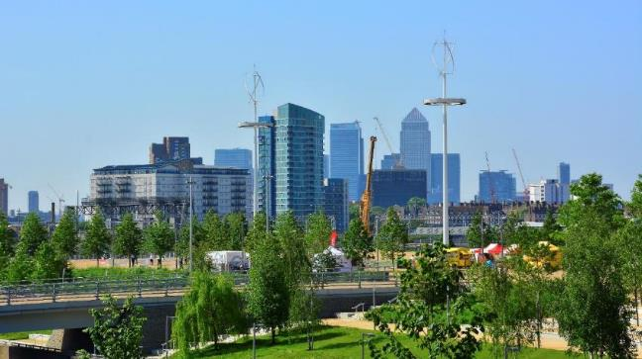
How is East London being redeveloped?
Activity
Draw an annotated field sketch of this view of the Olympic Park.
Notes:
Voice over: Drawing a field sketch is a key fieldwork skill. It is usually done in the field, of course, but the basic skills can be practised at home with an image like this. Take a blank sheet of paper and have a go. It is not about art – draw some of the basic shapes, the bridge and trees in the foreground, for example, and the tall skyscrapers in the background. What is more important is the annotation – pick out certain features to talk about that help to tell the story of the London Olympics-led regeneration.
Photo: https://www.flickr.com/photos/mdpettitt/14520874788/in/photolist-o8ahb9-opsPMG-opFidF-o8dMZc-o8ax46-opDhVC-opD14b-orq9St-o8aXme-opNCZF-o8iDYd-opN3TV-opMGLa-fnvsYu-o16ER3-SgR29W-ouRgRn-oygSvz-oebB7Y-otCcNf-odmMwa-owYSEJ-outxnN-ouQdzp-owvALV-of37YJ-oxrATP-ovtQMu-oxatYs-odmi27-of2hSK-odkKts-oec2dH-otD8uJ-oeaMdH-of2xN7-ovagLY-ovCsjJ-of1eiw-ovsxSE-odm9UA-of1nRy-oebHZM-ouC3xo-odn6sF-oyhHMF-ovoHpF-ovsjuC-of3Wk6-of1f4G

Slide 19
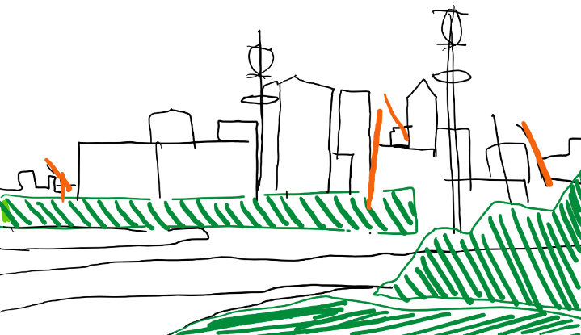
Wind turbines generate renewable energy across site.
Canary Wharf and the high rise businesses of London Docklands in background – already investment in East London
Trees and grass shows landscaped parklands – makes the area attractive to tourists and locals.
Large cranes all over region showing new developments
Landscaping of River Lea valley prevents flood damage and trees help prevent flooding.
Field sketch of the Olympic Park and surrounding area, looking South.
Notes:
Voice over: Your sketch will hopefully look better than this one! But this shows the basic block shapes that can be used to tell your geographical story. The key is in the annotations, and there are a few suggestions here but there are of course many more – you could highlight the locals playing in the public open spaces, and more could be made of the river management for flood protection, for example.

Slide 20
Practice question
Evaluate the success of attempts to redevelop an urban area in a high income country you have studied.
Your answer might include:
Evaluate: this means look at things that went well and things that did not go so well. You could also look at social, economic and environmental aspects.
Place-specific detail: it needs to sound like the Olympics-led regeneration of East London. You need names of places, key dates and numbers.
Answer the question! Make sure you are writing about redevelopment in London, and the successes of it. Be critical too, to evaluate successfully.
Notes:
Voice over: This could be a GCSE style question, although of course the wording of the question would depend on the specific exam board. The key with something like this is to make sure you have learnt the detail from the case study. Some specific points are highlighted in this presentation but you should look up more in the textbooks or online to ensure you have a good level of detail.
Common errors students make is that they don’t evaluate, they just describe – they say what changed rather than looking at a range of perspectives or saying any problems with the changes (the obvious criticism here is the house price rise for the locals). Another common error is to miss that this question is about a city in a higher income country, so London. You could get an identical question about the management of cities in the developing world, so ensure you read the question carefully.

Slide 21
Links
Awarding organisations
Find out more
 | Topic
AQA | 3.2.1 Urban issues and challenges
Edexcel A | 4.3 – 4.5. Changing cities.
Edexcel B | 5.3 – 5.7 Dynamic UK cities
Eduqas A | Key Idea 2.3.2 Urban issues
Eduqas B | Key Idea 1.1.2 – 3: Urbanisation
OCR A | 1.2.6 People of the UK
OCR B | 5.1 b, 5.2a, 5.2b Urban futures.
WJEC | Key Idea 2.3.2 Urban issues
CCEA | B: Changing urban areas
Mind the Gap: ‘London vs the rest’ presented by Evan Davis. Available online elsewhere if not on iPlayer. Very useful to explore the national dominance of London.
See the website of the London Assembly to explore how they manage London.

Slide 22
Glossary
Counter urbanisation: The movement of people out of built-up areas and into the countryside.
Migration: The movement of people from one area to another.
Natural increase: A situation where more babies are being born than the number of people dying which increases population.
Re-urbanisation: The movement of people back into an urban area, after a period of population decrease.
Site: The physical characteristics of the location of a city.
Situation: The location of the place in relation to its physical and human surroundings.
Suburbanisation: The growth of residential areas at the edge of a town or city.
TNCs: Transnational companies- businesses that work in more than one country.
Urbanisation: The process by which an increasing proportion of people live in towns and cities.

Slide 23
Acknowledgements
This presentation has been written by Richard Bustin, Head of Geography at Lancing College and an experienced author.
Figures
Slide 3: Photo (cc by-sa-4) ©User: Colin Palace of Westminster
Slide 4: Image Matt Brown
Slide 5: Image Wikimedia commons
Slide 8 and 11: ONS Census data 2011

