Slide 1
The where and why of weathering

Slide 2
Getting started
Most GCSE specifications include weathering as a topic in the physical geography section. Whether you’re learning about weathering for the first time or using it for revision, this unit takes you through what you need to know.
You’ll need a notepad on which to make notes as you go along, or you could make notes, paste images, etc. on your device.
You can view these slides:
as a slide show to watch animations and to follow links
in ‘normal’ view if you want to add call-outs or extra slides to make notes, paste images or answer questions.

Slide 3
In this GEO unit you’ll find out about:
what weathering is
different weathering processes and where they occur
how weathering links with mass movement and erosion.
Over 160 years weathering has broken up the surface of this gravestone in Nottinghamshire – especially towards the bottom, where the stone gets wetter
Notes:
Image © https://www.geograph.org.uk/photo/6871138

Slide 4
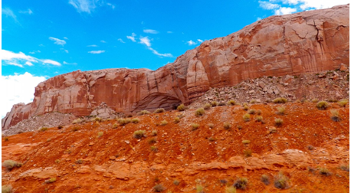
What is weathering?
Weathering is a natural process that slowly breaks up rocks. Unlike erosion, it happens with little or no movement. Without weathering, much of Earth’s land surface would be solid rock.
Activity
In the photo find and label:
an outcrop of solid rock
piles of rock fragments fallen from the outcrop
layers of crumbling rock broken up by weathering.
Weathering in an arid environment: South West USA
Notes:
Image © https://pxhere.com/en/photo/1014733

Slide 5
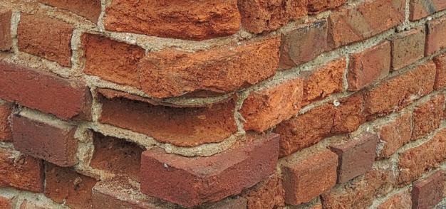
Weathering happens all around us
Weathering can happen by:
water, heat and cold
the actions of plants and animals.
We can divide weathering into three types:
Mechanical weathering (also called physical weathering)
Chemical weathering
Biological weathering.
Some rocks are more resistant to weathering than others. In general. softer and younger rocks weather more quickly than harder and older rocks.
Activity
Using this National Geographic site:
write a definition for weathering, and list the agents of weathering
explain how weathering helps form soils.
Water got into these bricks, then the frost broke them up: this is mechanical weathering
Notes:
Image © https://pxhere.com/en/photo/787642
National Geographic site: https://www.nationalgeographic.org/encyclopedia/weathering/

Slide 6
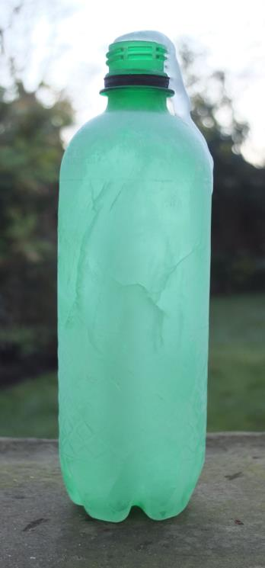
Mechanical weathering: ice
When water freezes, it forms ice crystals and expands: you can see this happen if you leave a water bottle in the freezer.
The same thing happens when water gets into joints and pores in rocks. When it freezes the pressure is strong enough to shatter the rock, especially if it happens repeatedly – this is called freeze-thaw action.
In the UK, freeze-thaw action can happen anywhere cold enough to freeze in winter, especially in upland areas. Freeze-thaw action is strongest on rocky outcrops near glaciers and ice sheets.
9%
Notes:
Image © John Hopkin

Slide 7
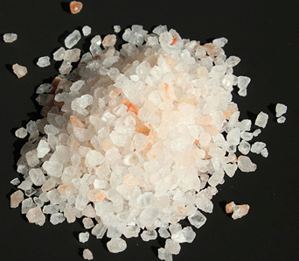
Mechanical weathering: salt cracking
Something similar happens when water containing dissolved mineral salts soaks into spaces in rocks.
When the water evaporates, salt crystals form in the rock. They act like ice crystals and expand, making the rock crumble apart.
This type of weathering happens:
on sea cliffs in the UK, which are battered by salty waves and sea spray
in regions like the Middle East where low rainfall and high temperatures concentrate mineral salts in the ground.
Notes:
Image © https://commons.wikimedia.org/wiki/File:Himalayan_salt_large_grain_V1.jpg

Slide 8
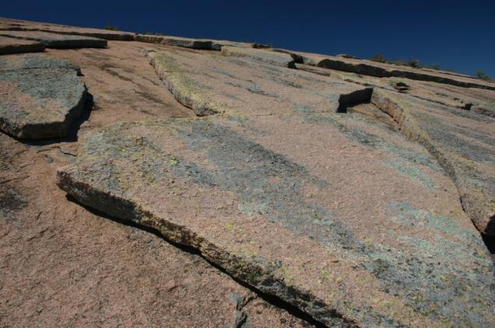
Mechanical weathering: heating and cooling
During the day, the sun warms rock surfaces. Rock particles expand, then cool and contract at night, stressing and weakening the rock.
This type of weathering is also called thermal expansion. It is strongest in hot deserts where the temperature difference can be up to 40⁰–50⁰C.
Eventually the outer layer of rock can flake off (see right) – this is sometimes called onion-skin weathering.
A granite dome in Texas, USA – the outer layers are flaking off or exfoliating
Notes:
Image © https://commons.wikimedia.org/wiki/File:GeologicalExfoliationOfGraniteRock.jpg

Slide 9
Mechanical weathering: activities
Watch this clip about freeze-thaw action.
Make a copy of the diagram below: add labels or textboxes to explain the process.
Watch this BBC clip about mechanical/physical weathering up to 2:15 minutes.
What do freeze-thaw and onion-skin weathering have in common? What is different?
Notes:
Image © https://commons.wikimedia.org/wiki/File:Mechanical_weathering.png
Freeze-thaw action clip: https://www.youtube.com/watch?v=_XnCTcjNpuc
Mechanical weathering clip: https://www.youtube.com/watch?v=1tRan4DVbnQ

Slide 10
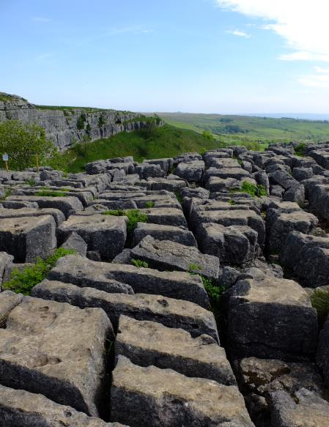
Chemical weathering
Activity: watch this clip about chemical weathering from 2:14 minutes and create a summary.
Chemical weathering happens when minerals dissolve in water, react with rocks and break them down. For example, rainwater absorbs CO₂ from the atmosphere and becomes slightly acidic: when it falls on rocks they can slowly dissolve and decay.
In the UK chemical weathering especially affects limestone rocks in places like Yorkshire. It widens and deepens joints in the rock (see right).
Chemical weathering is strongest in the tropics where there is plentiful rainfall and high temperatures, which speeds up chemical reactions.
Limestone pavement at Malham Cove, Yorkshire
Notes:
Image © John Hopkin
Chemical weathering clip: https://www.youtube.com/watch?v=1tRan4DVbnQ

Slide 11
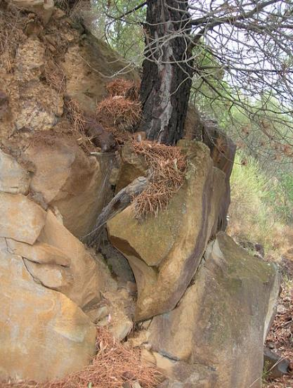
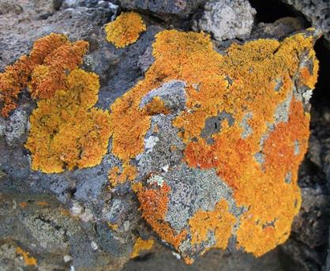
Biological weathering
Biological weathering is caused by animals or plants, as in the following examples:
Animals that burrow underground can loosen and break up the surface rocks.
Plant roots get into joints and split rocks apart (photo, top right) as they grow and enlarge, like this tree in Italy (see top right).
On a small scale, mosses and lichens grow on rock surfaces. They hold water on the surface and encourage chemical weathering – even on hard rocks like this lava flow in La Palma (photo, bottom right).
Activity: Compare this video clip and this video clip. Which clip gives the clearest explanation of biological weathering?
Notes:
Images © https://commons.wikimedia.org/wiki/File:Bioweathering-salina.JPG; https://commons.wikimedia.org/wiki/File:Lava_z14.jpg
Video clip 1: https://www.youtube.com/watch?v=fDyXSLUOfxU
Video clip 2: https://www.youtube.com/watch?v=4F4VjxQFyn4

Slide 12
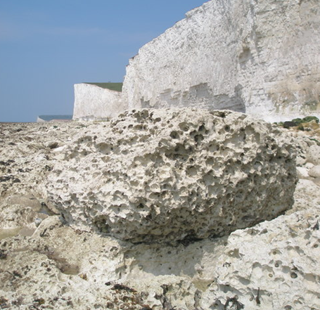
All together…
Activity
Often different types of weathering work together, like on this chalk boulder on a beach in East Sussex.
Think about mechanical, chemical and biological processes: which types of weathering may be breaking up the rock here?
Mechanical: salt crystals from sea water expand inside pores in the rock.
Chemical: chemicals in sea and rain water have pitted the rock surface.
This boulder is in the south of the UK at sea level, where freeze-thaw action is less common.
Biological: shellfish live in the hollows, protecting them from wave action. The shellfish can slowly enlarge the hollows.
A chalk boulder at the top of the beach at Seven Sisters, East Sussex, southern England
Notes:
Image © https://www.geograph.org.uk/photo/4979954
Map link to Seven Sisters: https://www.geograph.org.uk/gridref/TV5496

Slide 13
Weathering, mass movement and erosion
Weathering, mass movement and erosion are different processes, but they can be linked. Weathering weakens or breaks up rocks in situ. It can feed into:
mass movement on slopes, where gravity moves material downhill, including landslides and rock falls (see right)
erosion by rivers, glaciers, the sea and wind, which wear away and remove material.
Activity Watch this video, which was filmed in Switzerland. Then explain:
which weathering process likely weakened the cliff face
what is going on as the rocks move down the slope
which type/s of erosion might work on the material when it reaches the bottom of the valley below.
Notes:
Image © https://www.youtube.com/watch?v=5uOiQ__iOmE
Video clip: https://www.youtube.com/watch?v=5uOiQ__iOmE

Slide 14
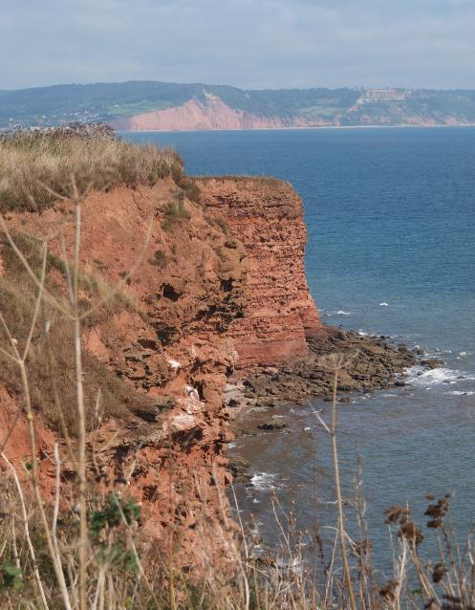
Apply your learning
Activities
Make a copy of the photo on the right, then add labels to show:
where weathering is likely to be happening and why
where the cliff is likely to be eroded by wave action
evidence of mass movement, and what type it is.
Look back at slides 6–11 and explain which types of weathering are likely to affect this sandstone cliff.
A sandstone cliff in South Devon
Notes:
Image © John Hopkin
Link to another image of a South Devon cliff: https://www.geograph.org.uk/photo/2373956

Slide 15
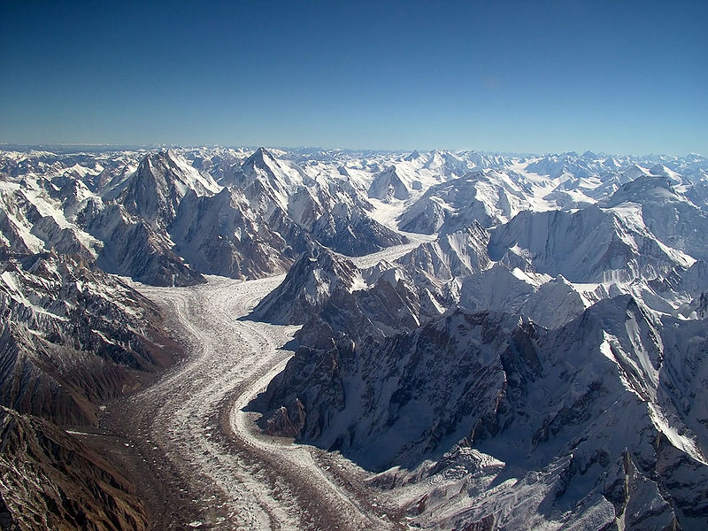
Apply your learning
Activity
Make a copy of the photo above, then add detailed labels to show:
where weathering is likely to be happening, which type and why
evidence of mass movement, and what type it is
what agent of erosion is happening here.
The 63 km-long Baltoro Glacier and Karakoram Mountains, Pakistan
Notes:
Image ©Guilhem Vellut, CC by SA 2.0 https://en.wikipedia.org/wiki/Baltoro_Glacier#/media/File:Baltoro_glacier_from_air.jpg

Slide 16
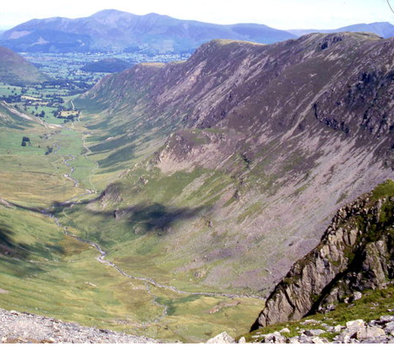
Weathering in a glaciated upland valley in the UK
Activities
Make a copy of the photo (right). Use call-outs to add the following labels:
U-shaped valley with a flat floor
A small stream, Newlands Beck
Rocky crags (cliffs)
Steep sides covered with shattered rocks: scree
Check to see what the landscape looks like on an OS map.
Add your own labels to show where weathering and mass movement are active.
Newlands Valley in the Lake District
Notes:
Image © https://www.geograph.org.uk/photo/1424463
OS map link: https://www.geograph.org.uk/showmap.php?gridref=NY225159

Slide 17
Check your learning
Freeze-thaw; thermal expansion; salt cracking | A simple definition of weathering
Movement down a slope due to gravity | The three main types of weathering
A natural process that breaks down rocks into smaller pieces | The main way in which weathering is different from erosion
Happens in situ (in place), with little or no movement | Three mechanical weathering processes
Mechanical, chemical, biological | A definition of mass movement
Activities
Match up the phrases in the left- and right-hand columns above.
List the weathering processes that may be active in these environments: upland UK, coastal UK, hot deserts. Look back through the slides to check, then add locations and/or examples.

Slide 18
Links
From the awarding bodies
Find out more
 | Topic
AQA | 3.1: UK landscapes, and coastal or glacial weathering
Edexcel A | Topic 1 UK landscapes, and river, coastal or glacial
Edexcel B | Topic 4 UK landscapes, and coastal weathering
WJEC Eduqas A | 1.2: Landform process and change: coastal weathering
Eduqas B | 2.1: Shaping the landscape: coastal and river landscapes
OCR A | 1.1 Landscapes of the UK
OCR B | 3.2. What influences the landscapes of the UK?
Try one or two of these summaries from:
The Geological Society here, with UK examples here
Time for Geography clips: UK weathering and slope processes in upland and coastal environments
This clip links weathering to geology and the rock cycle: watch to around 7:00 minutes.
Notes:
AQA link: https://filestore.aqa.org.uk/resources/geography/specifications/AQA-8035-SP-2016.PDF
Edexcel A link: https://qualifications.pearson.com/content/dam/pdf/GCSE/Geography-A/2016/specification-and-sample-assessments/Geography_A_Issue3%20GCSE%20(9-1)%20Specification.pdf
Edexcel B link: https://qualifications.pearson.com/content/dam/pdf/GCSE/Geography-B/2016/specification-and-sample-assessments/Specification_GCSE_L1-L2_Geography_B.pdf
WJEC Edugas A link: https://www.wjec.co.uk/media/mlyil2jr/wjec-gcse-geography-spec-from-2016-e.pdf
Edugas B link: https://www.eduqas.co.uk/qualifications/geography-gcse-b/
OCR A link: https://www.ocr.org.uk/Images/207306-specification-accredited-gcse-geography-a-j383.pdf
OCR B link: https://www.ocr.org.uk/Images/207307-specification-accredited-gcse-geography-b-j384.pdf
Geological society links: https://www.geolsoc.org.uk/ks3/gsl/education/resources/rockcycle/page3461.html and https://www.geolsoc.org.uk/ks3/gsl/education/resources/rockcycle/page3569.html
Time for Geography clips: (upland) https://timeforgeography.co.uk/videos_list/rivers/weathering-on-hillslopes/ (coastal) https://timeforgeography.co.uk/videos_list/coasts/subaerial-erosion-processes
Weathering to geology clip: https://www.youtube.com/watch?v=pmF41T52nJs

Slide 19
Glossary
Chalk: a type of soft limestone.
Exfoliation: the process in which cracks develop parallel to the surface of rocks, then layers split off.
Freeze-thaw action: the process in which water gets into spaces in rocks and, as the temperature changes, repeatedly freezes and thaws.
In situ: in place, happening with little or no movement.
Joint: a crack or fracture in a rock.
Limestone pavement: an area of flat slabs of limestone (called clints) broken up by vertical joints (grykes).
Mass movement (also called mass wasting): the process in which gravity moves soil or rock down a slope through falls, slides, slumps, slips, flows and creep.
Pore: a small space in a rock or in the soil.
Process: a set of natural or human actions that change environments.
Scree: piles of weathered rock fragments lying loosely on a slope.

Slide 20
Acknowledgements
This presentation has been written by John Hopkin.
Figures
Slide 3: image © Geograph
Slide 4: image © Ph
Slide 5: image © Ph
Slide 6: image © John Hopkin
Slide 7: image © Wikimedia
Slide 8: image © Wikimedia
Slide 9: image © Wikimedia
Slide 10: image © John Hopkin
Slide 11: top image © Wikimedia; bottom image © Wikimedia
Slide 12: image © Geograph
Slide 14: image © John Hopkin
Slide 15: image © Wikipedia
Slide 16: image © Geograph

