Slide 1
Urban processes

Slide 2
Getting started
You’ll need a notepad on which to make notes as you go along, or you could make notes, paste images, etc. on your device. You can view these slides:
as a slide-show for any animations and to follow links; some slides also have a voice-over
in ‘normal’ view if you want to add call-outs or extra slides to make notes, paste images, answer questions.
These slides cover a broad overview from all the different GCSE exam boards, so not everything is covered. Do use these alongside your school textbook or revision guide.
There are activities throughout, with answers, to help you practise applying some of the knowledge.

Slide 3
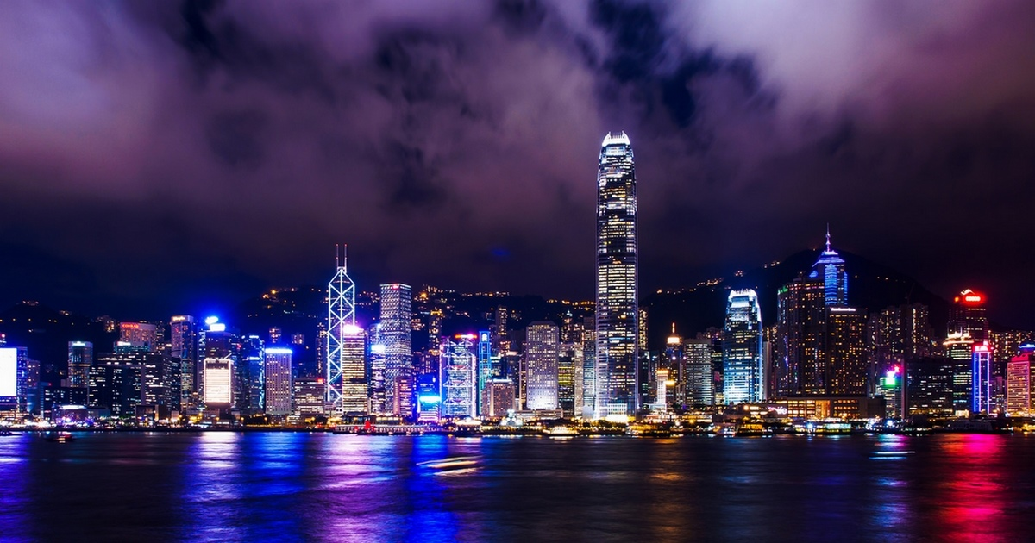

Why do geographers study towns and cities?
Urban | An area with a high concentration of buildings, people and infrastructure: towns and cities.
Notes:
Voice over: Towns and cities have long been of interest to geographers. They are places of immense wealth and abject poverty, and these are often situated right next door to each other. In 2014, the United Nations declared that over 50% of the whole world’s population now live in urban areas, and this number is set to increase to nearly 70% by 2050. What processes control this growth? What are the impacts of such rapid urban development? These questions underpin this presentation, and are also key to all the GCSE urban geography courses.
Photo source: https://www.geography.org.uk/teaching-resources/videos/urbanisation.

Slide 4
How do urban areas change over time?
  Urban areas grow and decline over time.
Key word | Definition
Urbanisation | The process by which an increasing proportion of people live in towns and cities.
Counter-urbanisation | The movement of people out of built-up areas and into the countryside.
Re-urbanisation | The movement of people back in to an urban area after a period of population decrease.
Activity
Watch Dr Lemanski explain some key terminology for this topic. Think: What is the difference between ‘urban growth’ and ‘urbanisation’?

Slide 5
What causes urbanisation?
Urbanisation is the result of two key processes:
rural to urban migration
natural increase.
A person (or group) may decide to leave the countryside. The reasons to leave are known as push factors and can include lack of jobs, schools, roads, medical care and poor sanitation.
An urban area may have a range of attractions, known as pull factors. These include the possibilities of jobs and education plus better healthcare, roads, water and food.
Key word | Definition
Rural-urban migration | The movement of people from the countryside to towns and cities.

Slide 6
What causes urbanisation?
‘Chad’s capital, N’Djamena, is growing fast. In 1950 its population was 37,000 – by 2020 it was just under 1 million. After years of worsening drought in his village of Tchoffal, Omar, a 45-year-old vegetable grower, moved to the city with his wife and 10 young children. In a small valley behind his house, Omar grows lettuce, aubergines, peppers and cucumbers. He can earn up to 150,000 CFA ($290) with each harvest, much more than in his village, and he harvests every 45 days.
“It's much easier to grow my vegetables here in the city, as there are no water shortages,” he says. “The drought in Tchoffal was terrible, it was a disaster for us. There was so little rain, all our cattle were dying. The lack of water meant people could not irrigate their fields – there was no way for people to earn a living. I don't blame them for wanting to leave.” Tchoffal only has one well to serve almost
400 people.
Now he lives in the city, Omar can go up the road to buy essentials and sell his produce. In his village there was no market, meaning a journey of several kilometres to buy basic goods like soap. This means the villagers had to be self-sufficient, living on what they could grow and their cattle raised.
Omar is pleased he moved to N'Djamena but life is not without problems. His mud-brick home has no running water or electricity. Omar's children sometimes help him to tend to the family's goats, or pitch in at harvest time. Omar is illiterate, and cannot speak French, the official language of Chad.’
Activity
Read this story and:
highlight rural push factors in red
highlight urban pull factors in blue.

Slide 7
What causes urbanisation?
‘Chad’s capital, N’Djamena, is growing fast. In 1950 its population was 37,000 – by 2020 it was just under 1 million. After years of worsening drought in his village of Tchoffal, Omar, a 45-year-old vegetable grower, moved to the city with his wife and 10 young children. In a small valley behind his house, Omar grows lettuce, aubergines, peppers and cucumbers. He can earn up to 150,000 CFA ($290) with each harvest, much more than in his village, and he harvests every 45 days.
"It's much easier to grow my vegetables here in the city, as there are no water shortages," he says. "The drought in Tchoffal was terrible, it was a disaster for us. There was so little rain, all our cattle were dying. The lack of water meant people could not irrigate their fields - there was no way for people to earn a living. I don't blame them for wanting to leave." Tchoffal only has one well to serve almost 400 people.
Now he lives in the city, Omar can go up the road to buy essentials and sell his produce. In his village there was no market, meaning a journey of several kilometres to buy basic goods like soap. This means the villagers had to be self-sufficient, living on what they could grow and their cattle raised.
Omar is pleased he moved to N'Djamena but life is not without problems. His mud-brick home has no running water or electricity. Omar's children sometimes help him to tend to the family's goats, or pitch in at harvest time. Omar is illiterate, and cannot speak French, the official language of Chad.’
(push factors out of the urban area in yellow).
Activity
Read this story:
highlight rural push factors in red
highlight urban pull factors in blue.
Notes:
Voice over: This is a true story slightly shortened from one which originally appeared on the BBC news website, although sadly it is no longer there. Do ensure you have used an atlas or online mapping site to find out where Chad is located, and it’s capital, N’Djamena. The idea of ‘rural push’ and ‘urban pull’ is not so straightforward- in the answers I have also highlighted in yellow some push factors out of the urban area back to the village. The rest of his extended family still live in the village and this too becomes a pull factor back to the village.

Slide 8
What causes urbanisation?
Natural increase | An increase in population caused by more babies being born (the ‘birth rate’) than people are dying (the ‘death rate’).
Many cities contain populations with large numbers of young adults who move to the area for work. Once settled, many start families; this in turn increases the population. Natural increase is calculated by subtracting the death rate from the birth rate.
 | Birth rate (per 1000/year) | Death rate (per 1000/year) | Natural increase (per 1000/year)
London, UK | 12.7 | 4.9 | 7.8
Mumbai, India | 20.1 | 6.0 | 14.1
Activity
Watch a short video from TED-ED which explains the global urbanisation story.
Notes:
Data here are from the UK Census, Office for National Statistics and the Mega Cities Project.
Voice over: You can see from the natural increase data here that even without any migration, both London and Mumbia’s populations will rise just because more people are being born in the city than dying.

Slide 9
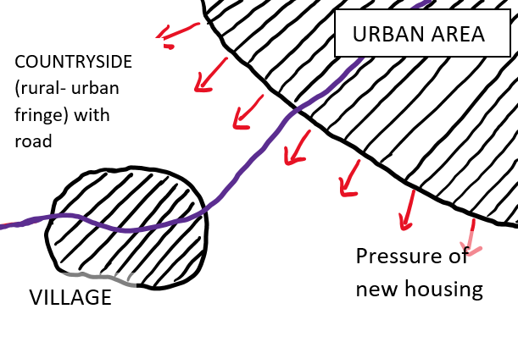
What is suburbanisation?
Explanation | Aerial view diagram
Rural-urban migration, or natural increase leads to increases in urban populations and a demand for new housing in the suburbs. Often the best location for this is on the edge of urban areas: the rural-urban fringe. Existing villages are still separate from the nearby urban area, but are connected via road and rail.
New housing is built on the rural urban fringe, often following transport routes: a process known as urban sprawl. These new residential areas are close enough to the city for daily commuting to work, but far enough out to avoid many urban problems, e.g. traffic, crime and pollution. Often existing villages are swallowed up by the sprawling urban area. Suburban growth is a key process of city growth in richer countries.
Activity
Complete this set of explanations by adding a labelled diagram into the blank space.

Slide 10

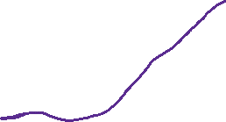

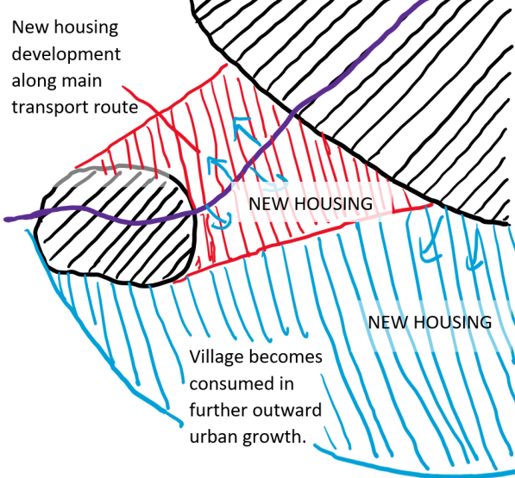
What is suburbanisation?
Explanation | Aerial view diagram
Rural-urban migration, or natural increase leads to increases in urban populations and a demand for new housing in the suburbs. Often the best location for this is on the edge of urban areas: the rural-urban fringe. Existing villages are still separate from the nearby urban area, but are connected via road and rail.
New housing is built on the rural urban fringe, often following transport routes: a process known as urban sprawl. These new residential areas are close enough to the city for daily commuting to work, but far enough out to avoid many urban problems, e.g. traffic, crime and pollution. Often existing villages are swallowed up by the sprawling urban area. Suburban growth is a key process of city growth in richer countries.
Activity
Complete this set of explanations by adding a labelled diagram into the blank space.

Slide 11
What is counter urbanisation?
Counter urbanisation is the movement of people out of urban areas. It is happening in cities in the developed world and results in their population going down. It can be understood by looking again at push and pull factors. This time, the push factors are the reasons to leave the urban area, and the pull factors are reasons to live in rural areas.
Crime levels (or the perception of crime) are higher in urban areas. | Desire for a ‘slower pace of life’.
Modern internet connections mean rural areas are globally connected. | Working from home is now easier, which cuts commuting time and transport costs.
Traffic brings noise and air pollution. | Modern and efficient transport links connect rural and urban areas.
House prices and rental costs are generally lower in rural areas - families can live in larger houses, with gardens. | The ‘24 hour city’ vibe means urban areas generate light and noise all night.
Activity
Colour code each of the reasons listed in the table:
urban push – red
rural pull – green.

Slide 12
What is counter urbanisation?
Counter urbanisation is the movement of people out of urban areas. It is happening in cities in the developed world and results in their population going down. It can be understood by looking again at push and pull factors. This time, the push factors are the reasons to leave the urban area, and the pull factors are reasons to live in rural areas.
Crime levels (or the perception of crime) are higher in urban areas. | Desire for a ‘slower pace of life’.
Modern internet connections means rural areas are globally connected. | Working from home is now easier, which cuts commuting time and transport costs.
Traffic brings noise and air pollution. | Modern and efficient transport links connect rural and urban areas.
House prices and rental costs are generally lower in rural areas – families can live in larger houses, with gardens. | The ‘24 hour city’ vibe means urban areas generate light and noise all night.
Activity
Colour code each of the reasons listed in the table:
urban push – red
rural pull – green.

Slide 13
What is re-urbanisation?
Re-urbanisation is a process whereby a town or city begins to see a rise in population after a previous drop in population.
It is often as a result of regeneration of areas of the town or city. This is where old buildings and polluted land and soils are renovated or destroyed and replaced with new. New transport routes can be created and open spaces landscaped.
Often new areas are marketed as new (a process called rebranding) to attract new business investment, sometimes from TNCs. They bring new employment to the area which in turn can attract more people to live there.
Notes:
Voice over: For more information on re-urbanisation as a result of urban regeneration see the example of East London Olympic led regeneration in the London Case study presentation.

Slide 14
How do rates of urbanisation differ around the world?
Activity
Write five correct statements from the data in this graph. Now write one deliberately false statement. Share these with another student and try to work out which are the true/false statements.
Notes:
Voice over: This activity really gets you to look closely at the graph. Many exam questions at GCSE require you to identify true and false statements from graphs. If you do not have another student to compare your sentences with then just write them for yourself- it is a useful exercise!
For example: The percentage of urban population in Africa increased by 30% between 1950 and 2020, whereas in Europe it was only by 24%. TRUE
Africa is predicted to have a higher percentage of urban population than Europe in 2030. FALSE
It is worth pointing out here that although these data are correct, using data from a whole continent such as Africa is not always very useful in terms of identifying global patterns. There is huge diversity of urban populations within the African continent, and within Europe. However, these crude patterns can provide a starting point to think about rates of urbanisation around the world, over time.
Data from United Nations Population Fund.

Slide 15
Why do rates of urbanisation differ around the world?
The graph on the last slide illustrates a common pattern.
Rates of urbanisation are highest in the poorer, lower income countries of the world. Many of the people in these countries still live in rural areas; rates of rural- urban migration are highest here.
In high income countries, such as the UK and USA, the highest rates of urbanisation happened last century, so current rates are much lower. Many people are leaving the towns and cities.

Slide 16
Which are the biggest cities in the world?
Key word | Definition
Major city | An urban area with a total population of 200,000 people or more.
Mega city | An urban area with a total population of 10 million people or more, e.g. Tokyo, Lagos.
World city | An urban area that is economically and politically significant on a global scale, that has links to other world cities through trade, e.g. New York, London.
Rank | 1950 | 2020
1 | New York | Tokyo
2 | Tokyo | New Delhi
3 | London | Shanghai
4 | Osaka | Sao Paulo
5 | Paris | Mexico City
6 | Moscow | Cairo
7 | Buenos Aires | Dhaka
8 | Chicago | Mumbai
9 | Kolkata | Beijing
10 | Shanghai | Osaka
Activity
Map these cities! What has changed?
Download a blank world map here.
Notes:
Voice over: When an urban area sees an increase in population it will become first a major city, then a Megacity. If it is of global financial and cultural importance it can also be described as a World City. Not all world cities are megacities (e.g. London), and not all megacities are world cities (e.g. Lagos, Nigeria).
This table shows the world’s biggest cities by population in 1950 and 2020. The activity asks you to map these- on a blank world map put a blue dot in each location of the top 10 cities in 1950, and write the number of its world ranking. Next repeat the exercise for the cities in 2020. This time use a red cross for each city. Some places might have a blue dot and a red cross!
Data from World Economic Forum (1950 data) and United Nations (2020 data). The ranking is based on population size rather than physical size.

Slide 17
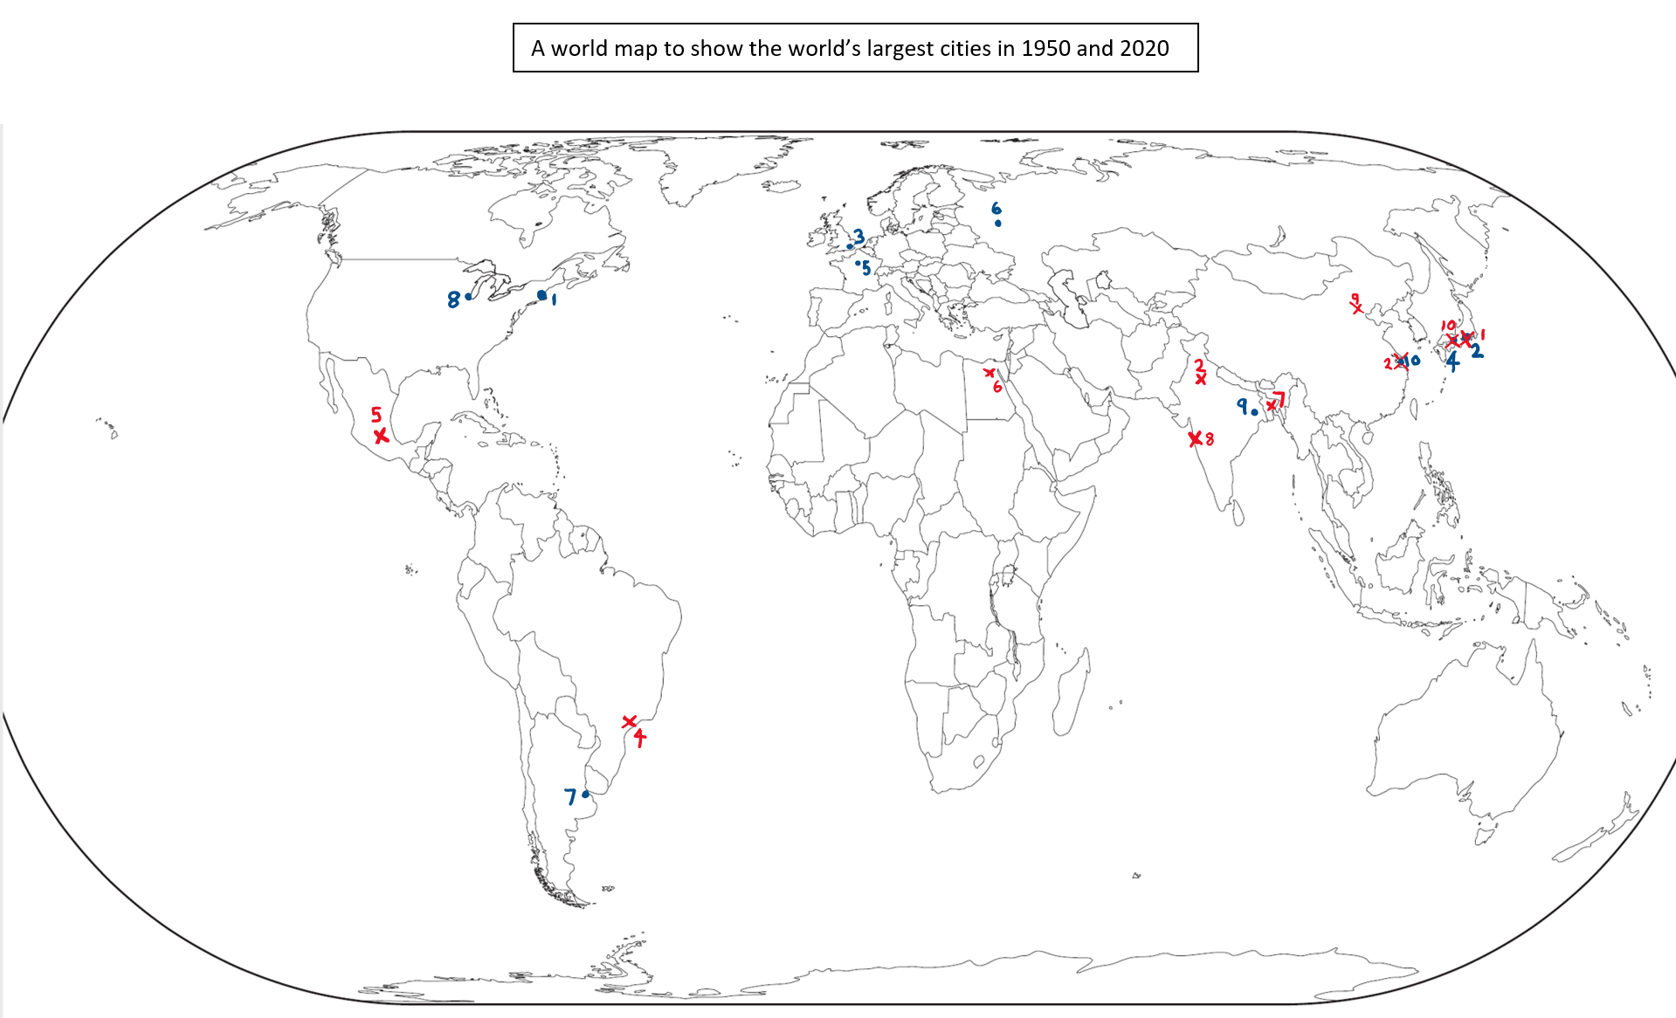
Where are the largest cities in the world?
Notes:
Voice over: Your map should look like this – do add the names of the cities on. This map shows how the distribution of the world’s largest cities has changed over time. In 1950 many of these cities were in higher income countries – notice London was ranked third in the world. Through the processes of counter- urbanisation in the richer cities and the rapid urbanisation in the developing and industrialising world, this pattern has shifted by 2020. Some countries, such as Japan. China and India contain many of the world’s biggest cities. The continent of Africa has one entry in the top 10 with Cairo in Egypt.

Slide 18
What are megacities?
In 1975 there were only four megacities in the world (New York, Tokyo, Mexico City and Sao Paulo). By 2015 there were over 20.
London, through the current process of
re-urbanisation, is predicted to become a megacity by 2030.
Future megacities of the world are likely to be in Asia. As urban areas grow they often merge with other urban areas to form one larger city: In China, cities in the Pearl River delta are merging to create a new megacity of the future.
Activity
Look up and list the current ‘megacities’ in the world: try World Data.
Notes:
Voice over: The prediction that London will become a Megacity by 2030 is based on a number of assumptions which may no longer be true. The Covid-19 pandemic which caused global lockdowns in 2020 forced many people to work from home – the realisation that this was possible may well spur another period of counter urbansiation, with people commuting to work in the towns and cities for a few days a week and working from home for the rest. Given the strong road and rail connections between places, as well as good internet access, and not to mention generally cheaper house prices in the countryside, we could potentially see a global slowdown in the rates of urbanisation. It is too early to see if this is true, but ‘thinking geographically’ about these issues can enable you to challenge predictions like this critically.

Slide 19
What are the impacts of rapid urbanisation?
Rapid population growth in a city can lead to a variety of challenges, particularly in cities in lower income regions of the world.
Housing
  In low income countries many people are forced to live in slums
  or ‘squatter settlements’, often building their own homes on marginal land.
Resources
Cities can have problems providing food, sanitation, waste disposal, efficient transport systems, education and medical care for a growing population.
Urban primacy
  This situation occurs when one city becomes so large and important that it is at least double the size of the next largest city in the country. For example, Bangkok is around 35 times larger than the next biggest city in Thailand.

Slide 20
What are the impacts of rapid urbanisation?
Environmental issues
Squatter settlements often have no plumbed-in water supply or sanitation, which pollutes the groundwater and river systems. Air pollution can occur through use of cars and increasing traffic, as well as polluting industries.
Employment
  Many people take jobs in the informal sector of the economy, where they work without a formal contract, often for themselves, doing semi-legal work. This is covered in more detail in the urban life presentation.
Any exam answer should include an example: You could use Lagos, Nigeria and the Makoko ‘megaslum’ – see the case study presentation.
Notes:
Voice over: These are very generic points, and best explained through the use of a case study, so do look at the presentation of Lagos.

Slide 21
Exam practice
Activity
State one reason why the population of megacities is predicted to grow. (1 mark)
Explain why the rapid growth of megacities may cause environmental and social problems. (5 marks)
Notes:
Voice over: Here a couple of exam style questions which you may encounter. Have a go at answering these. Think about how much to write and how long to spend on each question- clearly the first one will be a short sentence or a few words. The second question has ‘explain’ as its command word which means give reasons. There are also two parts to it (social and environmental) so make sure you include both. An example is key here.

Slide 22
Exam practice answers…
Reasons: Megacities’ populations will grow due to rural-to-urban migration or to natural increase. (Don’t just write ‘jobs’).
Your answer could include:
Environmental: lack of sanitation pollutes waterways, lack of efficient waste disposal means waste piles up, polluting the ground and air. The need for jobs may force people to work in polluting industries.
Social: lack of housing, and the creation of squatter settlements on marginal land, lack of jobs forces people to take low paid work, or to work for themselves.
  For example: In the Ajegunle squatter settlement in Lagos, 1.5 million people live in 8km ² of low-lying flood prone land. Lack of sanitation means sewage pollutes the watercourses: this has an impact on disease.
Notes:
Voice over: Your answer must include both environmental and social problems. The best answers should refer to a named example- here this has been added from the Lagos case study.

Slide 23
Links
Awarding organisations
Find out more
 | Topic
AQA | 3.2.1 Urban issues and challenges
Edexcel A | Topic 4.1, 4.2: Changing Cities
Edexcel B | Topic 3.1, 3.2: Challenges of an urbanising world.
Eduqas A | 2.3.1 Urban Issues
Eduqas B | Key ideas 1.1, 1.2 urbanisation and processes and change.
OCR A | 1.2.5 , 1.2.6 People of the UK. 2.2.4-6 People of the Planet.
OCR B | 5.1 a and b Urban Futures.
WJEC | 2.3 Urban Issues
CCEA | Unit 2B Changing urban areas.
BBC bitesize has sections on urban geography, with examples and practice questions.
Time for Geography website has a series of useful videos.
This National Geographic/ESRI site has satellite has great satellite imagery

Slide 24
Glossary
TNCs: Trans-National Corporations are large multi-national companies with operations in several countries

Slide 25
Acknowledgements
This presentation has been written by Richard Bustin, Head of Geography at Lancing College and an experienced author.
Figures
Slide 3: Photo source: https://www.geography.org.uk/teaching-resources/videos/urbanisation.

