Slide 1
Urban life

Slide 2
Getting started
You’ll need a notepad on which to make notes as you go along, or you could make notes, paste images, etc. on your device.
You can view these slides:
as a slide-show for any animations and to follow links; look out for a voice-over on some slides too.
in ‘normal’ view if you want to add call-outs or extra slides to make notes, paste images, answer questions.
These slides cover a broad overview from all the different GCSE exam boards, and not everything is covered. Do use these in conjunction with your school textbook or revision guide.
There are activities embedded here, with answers, to help you practice applying some of the knowledge.

Slide 3
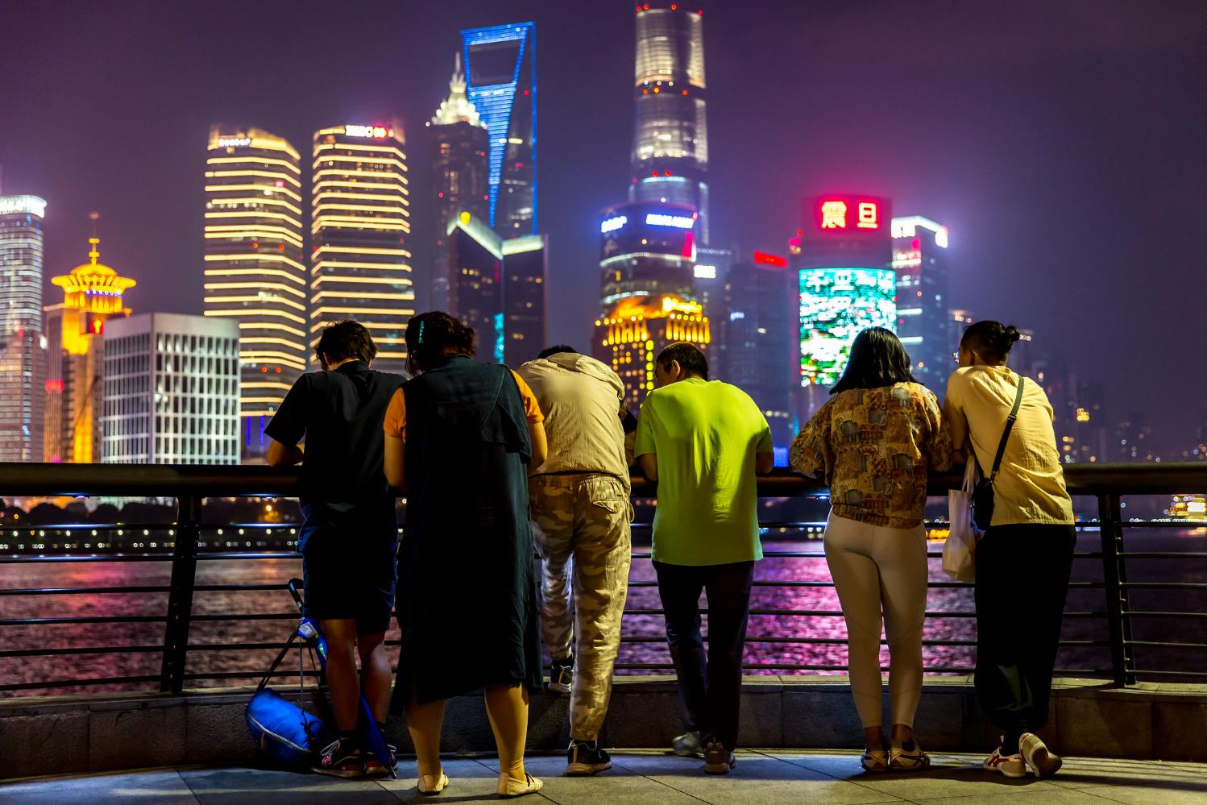
Why do geographers study urban life?
Over 50% of the world’s population now live in towns and cities, rather than in the countryside.
Notes:
Image: https://www.flickr.com/photos/franckmichel/46148032774
Voice over: We now live in an urban world, with the majority of the world’s population living in towns and cities. This presentation covers a range of aspects about life in urban areas: the types of work people do, the land uses we create and the ways people are attempting to make urban life more sustainable. This presentation should be used alongside the presentation on urban processes, as well as the two case study examples of London and Lagos.

Slide 4
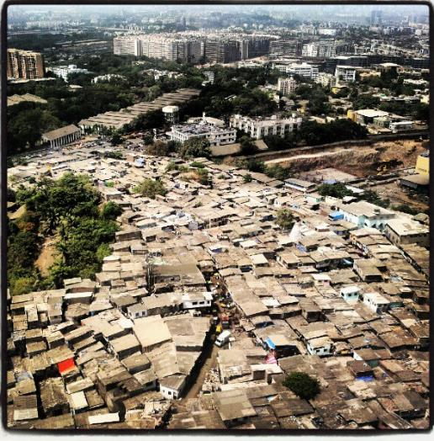
How wealthy are people in urban areas?
Towns and cities are sites of inequality between rich and poor people. These contrasts tend to be much more obvious in urban areas in the developing world
e.g. Mumbai, India (left).
Estimated population: 20 million.
Includes: 28 billionaires, and 9 million people living in squatter settlements.
Notes:
Image: https://www.flickr.com/photos/nupurbarua/23159128863

Slide 5
What work do people do in urban areas?
Rich or poor, people find work in urban areas. Urban economies are different in cities around the world:
Primary: Jobs that involve obtaining raw materials from the ground or sea, such as fishing or mining.
Secondary: Jobs that involve the manufacturing of raw materials into something else – making cars and vehicles for example.
Tertiary: Jobs that provide a service of some kind, such as selling, teaching, finance and legal work.
Quaternary: Jobs that involve the use of high tech computer technology.
Notes:
Voice over: These classifications of types of job are not just restricted to urban areas and you may have come across these in topics on development. Around pre-industrial cities, such as those found in the developing world at the moment, primary sector employment dominates with people making a living through small scale farming or fishing where the urban area acts as a market for goods. In industrial towns and cities, the sorts of ones we find in the rapidly developing world, it is secondary that dominates, and this usually coincides with urban growth as people flock to the towns and cities looking for work in manufacturing industries. A post industrial society sees tertiary and quaternary dominating- these sorts of cities are the ones we see in the developed world.

Slide 6
What work do people do in urban areas?
Cities change through time, so their economies change too.
 | Pre-industrial city | Industrial city | Post-industrial city
Primary | 70% | 27.5% | 10%
Secondary | 20% | 45.0% | 30%
Tertiary | 10% | 27.5% | 55%
Quaternary | 0% | 0% | 5%
Activity
Use the data table here to draw three pie charts to show the changing urban employment structures.
Notes:
Voice over: A stacked bar chart like this is a great way to present data, in this case different types of employment. The bars are stacked on top of each other, and is percentage data so each bar should add up to 100. To calculate the percentage of a particular employment sector you need to work out the bar area. For example, in the pre industrial city at the bottom, there are not many people employed in the tertiary sector (shown in purple)- to calculate the exact percentage you see that the purple part of the bar starts at 90 and goes on to 100 percent, therefore it is only 10% of the population.
The activity asks you to turn these three bar charts into pie charts. One percent is then 3.6 degrees, so this should help calculate the angles for each of the categories. In an exam you often get skills questions that ask you to add bits of data, or calculate from a graph so having a good basic knowledge of different ways to present data is key.

Slide 7
What work do people do in urban areas?
Pie charts to show changing urban employment structures
Activity
What do these graphs reveal about the nature of urban employment as towns and cities grow and change?
Notes:
Voice over: Your pie charts should look something like these. The most important part of all this of course is what urban geography the data reveal. A pre industrial urban area would be a town or city untouched by industrial development- you can see here most people would be employed in activities like farming. Good examples would be many towns and cities in the developing world, perhaps N’Djamena, the capital of Chad. As an urban area begins to manufacture goods and open factories often it will experience an influx of workers, and the secondary sector will increase, as can be seen here. Examples of cities like this are the rapidly industrialising cities in the world such as Lagos in Nigeria, or perhaps Sao Paulo in Brazil. A post industrial city is one that, often, has experienced deindustrialisation and most people are employed in the service economy, perhaps with high tech quaternary industries too. Most cities in the developed world such as London seem to fit this pattern.
There is an assumption here that all cities will be pre, then industrial then post industrial but there is of course, no reason to suggest that is what will happen- particularly if the industrial process is known to create pollution and contribute to climate change. Those cities may well be on a different path to development.

Slide 8
What work do people do in urban areas?
Activity Employment classification: For each job type, put a tick in at least one of the purple and orange boxes. | FORMAL | INFORMAL | PRIMARY | SECONDARY | TERTIARY | QUATERNARY
Rag pickers find loose metal, and use it to make tools.
A teacher of geography in a city school.
An office worker in a TNC in the City of London.
A man fishes in Lagos Lagoon to feed his family and sell the rest.
A street hawker sells packets of fresh water.
A child works in a backstreet leather tanning workshop.
A street gang in Lagos charge protection money for visitors.
A scientist in a London hospital is computer modelling the spread of disease.
Notes:
Voice over: The activity here is about classification of activities- some might fit into more than one category, so be careful!

Slide 9
What work do people do in urban areas?
Activity Employment classification: for each job type, put a tick in at least one of the purple and orange boxes. | FORMAL | INFORMAL | PRIMARY | SECONDARY | TERTIARY | QUATERNARY
Rag pickers find loose metal, and use it to make tools.
A teacher of geography in a city school.
An office worker in a TNC in the City of London.
A man fishes in Lagos Lagoon to feed his family. Excess is sold.
A street hawker sells packets of fresh water.
A child works in a backstreet leather tanning workshop.
A street gang in Lagos charge protection money for visitors.
A scientist in a London hospital is computer modelling the spread of disease.
Notes:
Voice over: Your table might look something like this. Now think about which of these activities are more likely to occur in urban areas in richer countries, and which in urban areas in poorer countries- ignore the city names and imagine these jobs could occur in any urban area. It is not so straightforward- in urban areas in rich countries, such as London, we are unlikely to see much informal economy work like rag picking or street hawking but we do see people working zero hours contracts, or working for themselves. Many urban areas in the developing world, such as Lagos, are attracting trans national companies and therefore highly skilled workers. If you have studied Lagos in Nigeria as a case study you will be familiar with the Eco Atlantic development.

Slide 10
How does land use vary in urban areas?
Commercial: Land that is used for business to generate an income (earn money). Can include retail (shops), businesses in offices and residential areas that are designed to generate profits.
Industrial: A form of commercial land use that uses machinery to produce products or a service.
Residential: Land that is used for housing, including high rise flats, terraced housing (joined together), semi-detached housing (two houses joined together) and detached housing.
Open space: Land that has not been developed, or is used for parks and recreation.

Slide 11
Why does land use vary in urban areas?
Land use can be partly explained by the bid rent theory:
Activity
Watch Urban Earth: London, Mumbai.
Can you identify the different types of land use and their proximity to the edges and centre of the cities? What else stands out?
Retail land use
Industrial land use
Residential land use
This theoretical model suggests that in city centres (on the left of the graph) rent values are highest. Retail pays landlords the highest amounts of rent to locate there – so shops and restaurants are often in city centres. Moving out of the centre (in theory) the next dominant land use is industrial (manufacturing and business parks) with residential areas dominating in the suburbs.
Notes:
Voice over: There have been many attempts to try to describe and explain how, and why, land uses vary over an urban area. Yet this model, like all the models created in the 1930s to 60s bears little resemblance to modern urban areas. These models were based on industrial areas, not the post industrial areas that now dominate the developed world. They were developed before roads controlled the expansion of urban areas- it says nothing of out of town retail areas or the rise of internet shopping which has completely changed the nature of town centres.
The activity asks you to reflect on land use by looking at some real cities. It is based on a project called urban earth: a photo was taken every 8 steps from the outside through the middle and back out the other side of three major cities. The photos were put together to make a journey. Watch them- and of course pause them if it goes too quick! Compare and contrast- do we go from residential, through industrial to retail, then back again, or is there more going on? Have a look at building heights too, how do these differ over the urban area.

Slide 12
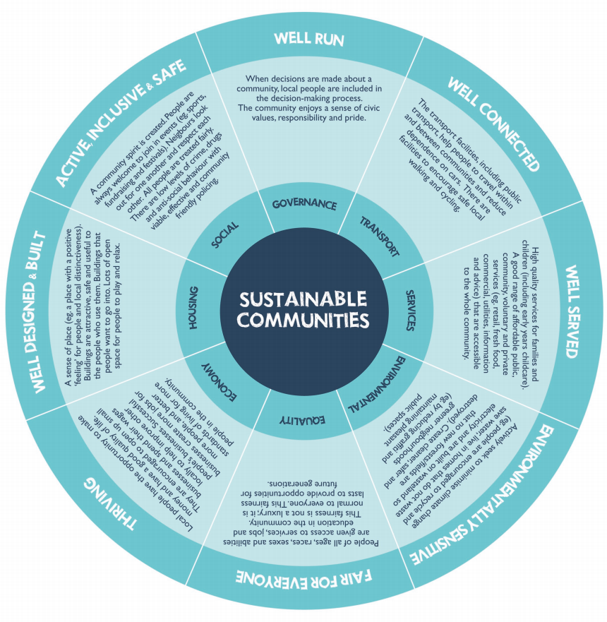
How can urban life be more sustainable?
The Egan Wheel shows eight aspects about what makes an urban area sustainable.
Activity
How sustainable are London and Lagos? Have a look at the presentations on these cities and compare them to this model.
Notes:
Source of image: GCSE Toolkit: Is the Future Sussed? A study of urban living (2010) J. Widdowson. Geographical Association.
Voice over: This wheel contains a lot of information, but a useful idea is to compare it to your case study urban areas - one in the developing world and one in the developed world. Think what elements of the urban areas might fit into each of the categories. You might think it, but it is not true to say that urban areas in the developing world are less sustainable than those in the developed world. If you have studied Lagos in Nigeria there are 5,000 rag pickers who sift through the rubbish dumped in a large landfill site. This could be described as the most efficient recycling system in the world!

Slide 13
How can urban life be more sustainable?
Example: East Village, Olympic Park, London. This sustainable housing community was created after the 2012 Olympic Games in London.
RAIN
Green roof absorbs rainwater and attracts wildlife.
Rainwater flows into small ponds in the village. These create a natural environment, increase green space and filter the water in the reed beds.
Flats: affordable housing
Clean water is pumped back into the village and used in the flats for flushing toilets.
Cross section through East Village to show elements of environmental sustainability.
Notes:
Voice over: This is just one of many examples of sustainable development as a result of the London Olympics. See the London case study presentation for more on London.

Slide 14
Practice question
‘Urban areas in the developing world are less sustainable than those in the developed world’. To what extent do you agree with this statement?
Things to consider:
‘To what extent do you agree’ means give an opinion- ideally, include points for and against the statement.
Include actual place names and data, such as ‘East Village’ in London.
A structure could be: ‘I agree with the statement because… (give detail), however, I disagree because… (give more detail). So, I partially agree with the statement’.
Notes:
Voice over: This could be a GCSE style question- quite a challenging one! There is a possible structure shown here, but the key is to use some actual facts and figures to back up your thoughts and ideas.

Slide 15
Links
Awarding organisations
Find out more
 | Topic
AQA | 3.2.1: Urban issues and challenges
Edexcel A | Topic 4.1 – 4.8: Changing cities
Edexcel B | Topic 3.1 – 3.3: Challenges of an urbanising world.
Eduqas A | 2.3 Urban Issues
Eduqas B | 1.1 and 1.2: Urbanisation, processes and change.
OCR A | 1.2.6: People of the UK. 2.2.3 – 6: People of the planet.
OCR B | 5.1 a and b: Urban futures.
WJEC | 2.3: Urban issues
CCEA | B: Changing urban areas
BBC bitesize has sections on urban geography, with examples and practice questions. Here’s a video about the Egan Wheel.
Time for geography website has a series of useful videos on cities.

Slide 16
Glossary
Industrial: An urban area that is experiencing the development of secondary manufacturing industries and high levels of migration for work. Many cities in newly industrialising countries are industrial.
Pre-industrial: An urban area that has yet to experience any industrial development. Often dominated by primary industries such as farming and found in the developing world.
Post-industrial: An urban area that has experienced industrial decline and the dominance of tertiary (service) industries. Most cities in the developing world are post industrial.
Proximity: Closeness of one place to another.

Slide 17
Acknowledgements
This presentation has been written by Richard Bustin, Head of Geography at Lancing College and an experienced author.
Figures
Slide 3: Image © Franck Michel on Flickr
Slide 4: Image © Nupur Baraba on Flickr
Slide 12: Egan Wheel in Widdowson (2010) ‘Is the Future Sussed? A study of urban living’ The Geographical Association.

