Slide 1
The UK’s diverse human landscapes

Slide 2
Getting started
You’ll need a notepad on which to make notes as you go along, or you could make notes, paste images, etc. on your device.
You can view these slides:
as a slide-show for any animations and to follow links
in ‘normal’ view if you want to add call-outs or extra slides to make notes, paste images, answer questions.

Slide 3
What does investigating the human landscape involve?
Landscapes are what you can see of an area of land, including its natural and human features. Human landscapes are those mainly built or changed by people’s economic and social activities.
In this unit you will investigate some of the opportunities, challenges and solutions of urban and rural living in the UK.
Activity
Watch the video The UK in 100 seconds.
Make a list of the examples of human landscapes that you see.
Notes:
Link: https://www.youtube.com/watch?v=0drvdLYGNuc

Slide 4
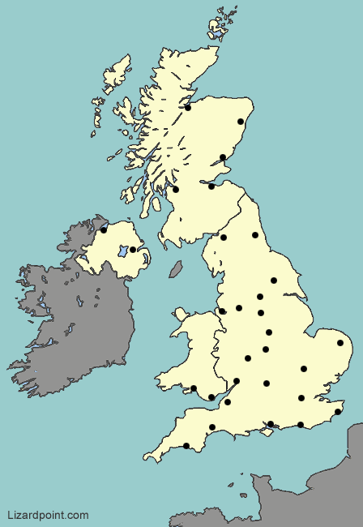
Where are the UK’s big cities?
Activity
Download this UK map.
Use the downloaded map and an atlas to name the major UK towns and cities shown with dots.
Notes:
Map: https://lizardpoint.com/geography/

Slide 5
Urbanisation and city change in the UK
Urban areas have high population densities, rich land use mixes, complex transport systems and large spheres of influence.
Urbanisation is continuing in the UK: in 2019 83% of the UK’s population was urban, up from 79% in 2000.
Growing cities must adapt to accommodate population growth and economic change.
Activity
Follow the link to the ‘Best Places to Live 2020’ to find the nearest urban area to you.
What do you think makes this a good urban place to live?
Notes:
Link: https://www.thetimes.co.uk/article/best-places-to-live-sunday-times-3qkwjnvrm
Data: https://data.worldbank.org/indicator/SP.URB.TOTL.IN.ZS?locations=GB

Slide 6
City change processes
City change processes provide opportunities and challenges:
Urbanisation: especially due to industrialisation in the 18th and 19th centuries.
Migration: 20th century migrants arrive from former colonies in places like India and Caribbean, and other European countries.
Suburbanisation: growth of housing areas further from the centre
Deindustrialisation: economic decline and dereliction.
Decentralisation: people and employment move out of inner cities.
Counter-urbanisation: people move from urban to rural areas.
Re-urbanisation: people return to live in city centres.
Each process means opportunities: immigration brings vibrant new cultures; regeneration and investment improve the city.
Change also brings challenges, such as inequality, overcrowded
poor housing, congestion, environmental decline.

Slide 7
Birmingham: the UK’s second largest city
Birmingham:
has a population of 1.2 million (West Midlands conurbation: 2.4 million)
attracts 41 million visitors per year
is a key motorway and rail transport hub
has an international airport
attracts internal and international migrants
has a multicultural population from 180 countries.
Activity
Watch the video ‘Booming Birmingham’.
Use bullet points to list what Birmingham has to offer.

Slide 8
Central Birmingham land use
Cities have different land uses compared with rural areas, and within cities different land uses group together to form different zones. This is called morphology: the structure of a city.
Central areas are usually well-connected with the rest of the city, attracting people to do business, work, shop and spend leisure time there. Competition for space makes land expensive, so there are often many tall buildings.
Activity
Watch this video of Birmingham city centre, then write a paragraph to describe central Birmingham. Refer to:
different land uses such as retail, commerce, recreation and residential areas
accessibility and communications.
Notes:
Link: https://www.youtube.com/watch?v=hBky0VeBThI

Slide 9
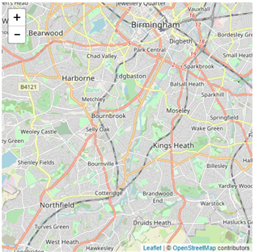
Regeneration projects in Birmingham
Examples of urban change in Birmingham
New city centre Bull Ring and Grand Central: retail and entertainment redevelopments.
Brindley place: derelict 19th century canal warehouse and factory area converted to prestigious offices and apartments.
New Monaco housing project
Citywide Transport Plan and Southside Green Vision offers sustainability.
Longbridge: derelict car plant site regenerated into a technology park, retail area and housing.
Notes:
Open street map: https://wiki.openstreetmap.org/wiki/Birmingham

Slide 10
Regeneration: Longbridge, Birmingham
History: 1906–2005 car plant in south-west Birmingham:
supported up to 25,000 other jobs in city
closed in 2005 due to global competition
demolition/dereliction resulted in a brownfield site with an opportunity for regeneration.
Currently an ongoing £1billion redevelopment:
£100 million technology park.
£70 million shopping centre.
2000 homes (4,000 planned).
3,700 jobs created (9,000 planned).
Activity
What positive or negative impacts could this regeneration have on the Longbridge area?

Slide 11
Transport and green space opportunities
The Birmingham Connected Transport Plan provides:
a 20 year strategy for a fully integrated citywide transport system
better rail links in the city and beyond
increased cycle and walking routes
increased connectivity between road and rail links.
The Birmingham Green Vision trialling ‘Southside A 38’ envisions:
greening the grey centre
large scale green walls and roofs
expanding parks and green spaces
increasing tree numbers.
Activity
Watch the video Birmingham transport plan
Read the article Birmingham’s Green Vision.
Then list examples of Birmingham’s urban sustainability.
Notes:
Links: https://www.telegraph.co.uk/education/stem-awards/design/designing-green-cities
https://www.birmingham.gov.uk/info/20013/roads_travel_and_parking/2032/draft_birmingham_transport_plan

Slide 12
The challenge of the rural-urban fringe
The rural-urban fringe is where the outer edge of the city meets rural areas and their land uses mix.
The fringe of the West Midlands Conurbation is under pressure from urban sprawl.
Since 2000, 40,000+ people have moved from central Birmingham to the suburbs and rural villages.
Commuter villages e.g. Dorridge and Knowle develop: expanding housing estates with urban characteristics.
House prices increase, green space declines.
New transport links, e.g. HS2 and road links; leisure developments; retail parks and industrial estates use up greenfield sites.
Activity
Read the article from the local paper and suggest how New Monaco might reduce urban sprawl.
Notes:
Link: https://www.expressandstar.com/news/local-hubs/birmingham/2018/08/18/275-million-birmingham-urban-village-given-green-light/

Slide 13
Birmingham HS2: opportunity or challenge?
The Birmingham HS2 project is a controversial rail project.
Phase 1 link: Birmingham to London
Opportunities:
26,000 jobs created in Birmingham and Solihull.
£4million increase in economic output.
More trains for people and freight, and greater connectivity for Birmingham to SE England and mainland Europe.
Challenges:
Very expensive, with cost increases from £56 billion to £106 billion (so far).
Loss of green space and habitats.
Delays move Phase 1 completion to 2031.
Resources:
HS2: Engine for growth
BBC business: jobs pledge.
Activity
Read the articles. How will HS2 affect Birmingham? Create a balance sheet of the opportunities and challenges.
Notes:
Links: https://assets.publishing.service.gov.uk/government/uploads/system/uploads/attachment_data/file/577956/RFS13_West_Midlands_V3.pdf
https://www.bbc.co.uk/news/business-54010727

Slide 14
Urban challenge
As cities grow they become less sustainable. They:
expand and use up more space
create more pollution and generate more waste
use more energy and water.
Most UK cities are trying to become cleaner, greener and more sustainable with greening, recycling and eco-friendly transport.
For example, Bristol’s Ashley Vale Project has built 41 eco-friendly homes, a city farm, allotments, local workshops and a community centre on a small brownfield site. Residents here show high levels of community spirit and individual well being.
Activity
Read about Ashley Vale Community Build, then make notes on this initiative. What makes it sustainable?
Notes:
Link: http://www.lowenergyapartments.eu/the-yard-ashley-vale-community-build-bristol/

Slide 15
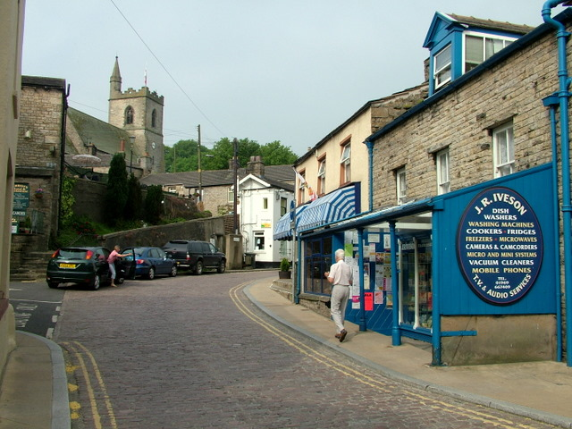
Rural settlements face challenges and opportunities
This is Hawes in North Yorkshire.
Activity
Look closely at the photo of Hawes on the Welcome to Yorkshire site.
Describe the settlement and its situation, or take a screengrab and add annotations.
Investigate the website and use Streetview or this amateur video to explore the village. Suggest opportunities and challenges for residents of Hawes, such as employment and transport.
Location of Hawes on Google Maps
Notes:
Image: © Copyright George Tod and licensed for reuse under this Creative Commons Licence. https://www.geograph.org.uk/photo/622803

Slide 16
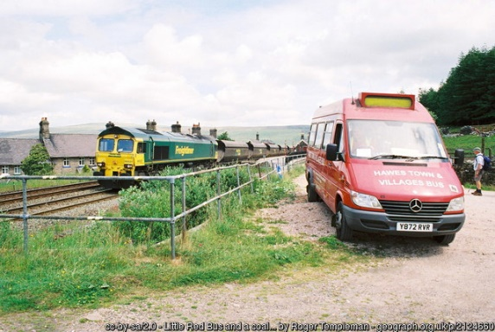
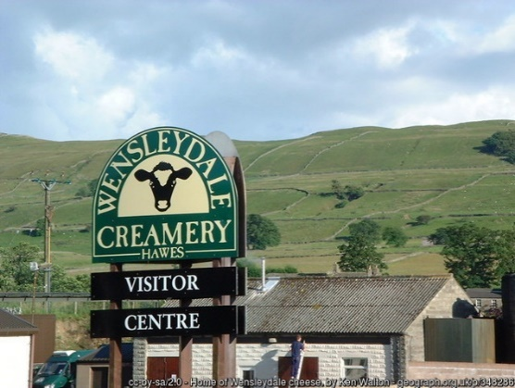
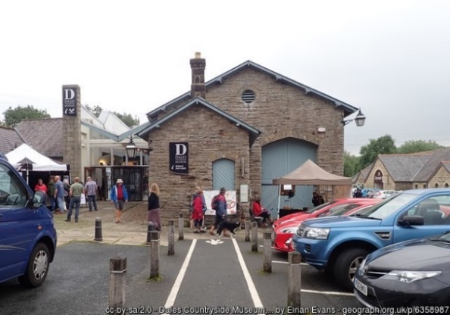
Challenges and opportunities in Hawes
The post office, bank, library and petrol station saved by ‘Upper Dales Community Partnership’
Poor internet connections
Community-run bespoke transport
Few job opportunities
Struggling businesses
Worker buyout of Wensleydale creamery
Growing tourism
Train station closed
Declining bus services
Shop/service closures
School closures
Wensleydale cheese achieves protected status
Activity
Classify these as challenges or opportunities for Hawes’ residents.
Community bus at Garsdale Station
Wensleydale Creamery
Hawes former railway station
Notes:
Images:
Wensleydale Creamery Photo - © Ken Walton (cc-by-sa/2.0)
Station - © Copyright Eirian Evans and licensed for reuse under this Creative Commons Licence
Community bus - © Copyright Roger Templeman and licensed for reuse under this Creative Commons Licence

Slide 17
Rural settlement decline: the Outer Hebrides
The Outer Hebrides is a remote archipelago with harsh weather and difficult terrain.
The population has declined to 26,000, a fall of 50% since 1901: its population density is less than in the Sahara Desert!
Traditional fishing and faming have declined.
Outmigration has occurred as young people leave to find work.
An ageing population is left with care issues.
The economy struggles despite government grants and increasing tourism.
Activity
Read this newspaper article, then make notes on the challenges of and solutions to rural decline.
Notes:
Links: https://www.visitouterhebrides.co.uk/
https://www.scotsman.com/news/environment/outer-hebrides-battle-reverse-steep-population-decline-1463230

Slide 18
Rural settlement growth: South Cambridgeshire
Counter-urbanisation means people are migrating from London and Cambridge into traditional villages to live and work. South Cambridgeshire’s population of 150,000 is estimated to rise to 182,000 by 2031. The problems created are:
house prices rise; local people leave and community spirit lost.
farming land lost for development of housing and businesses
fewer farming jobs
wildlife habitats destroyed
villages merge
increased traffic and congestion on country roads.
Activity
List the challenges created by this growth:
underline in red if social
underline in blue if economic
underline in green if environmental.
You may find some challenges need underlining in more than one colour.

Slide 19
Glossary
Archipelago: a group of islands.
Brownfield site: a former industrial or commercial site, often abandoned, used for development.
Conurbation: a large urban area where two or more cities have grown together.
Greenfield site: a site in a rural area which has never been developed, often farmland or used for nature.
Situation: the location of a settlement, where it is in relation to its surrounding features.
Sphere of influence: the area surrounding a settlement where the people and economy interact.
Urbanisation: the process by which an increasing proportion of people in a country live in towns and cities.

Slide 20
Links
Awarding organisations
Find out more
 | Topic
AQA | 3.2.1 Urban issues and challenges
Edexcel A | Topic 4.1, 4.2: Changing Cities
Edexcel B | Topics 3, 8.Challenges of an urbanising world, UK challenges
Eduqas A | 2.1: The urban-rural continuum in the UK
Eduqas B | 1.2 Urban and rural processes and change in the UK
OCR A | 1.2.5, 1.2.6: People of the UK.
OCR B | 7.1. UK change
WJEC | Theme 2: Rural – urban links
CCEA | Unit 2B: Changing urban areas
Videos:
Rural Challenges: Cornwall
Opportunities for rural rebranding/regeneration
Time for Geography knowledge boosters: cities.

Slide 21
Acknowledgements
This presentation has been written by Susan and Stephen Schwab, authors and resource writers. Stephen chairs the GA Secondary Phase Committee and is a consultant to the GA.
Figures
Slide 4: Map https://lizardpoint.com/geography/uk-cities-quiz.php
Slide 9: Map https://wiki.openstreetmap.org/wiki/Birmingham
Slide 15: Image © George Tod
https://www.geograph.org.uk/photo/622803
Slide 16: Images (cc-by-sa/2.0)
© Ken Walton https://www.geograph.org.uk/photo/348286
© Eirian Evans https://www.geograph.org.uk/photo/6358987
© Roger Templeman https://www.geograph.org.uk/photo/2124660

