Slide 1
River management: a case study of the River Severn

Slide 2
Getting started
You’ll need a notepad on which to make notes as you go along, or you could make notes, paste images, etc. on your device.
You can view these slides:
as a slide-show for the animations and to follow links
in ‘normal’ view if you want to add call-outs or extra slides to make notes, paste images, answer questions.
The geo-location of each photo is given using the What3Words website. Use this website to see an aerial view of each location. In many locations you can also take a virtual fieldtrip by dragging Pegman onto the map to open Street View.
Notes:
https://what3words.com/daring.lion.race

Slide 3
Types of river management
There are a number of ways that people can manage rivers to try to reduce the effects of erosion or flooding. These strategies can be divided into two broad types:
Hard engineering is when artificial structures are constructed to change the shape of the river channel or manage the way that a river flows.
Soft engineering is when engineers work with nature to try to reduce the likelihood of river flooding. The Environment Agency calls this Natural Flood Management (NFM) and they estimate that Natural Flood Management can reduce flood risk by between 5% and 25%.

Slide 4
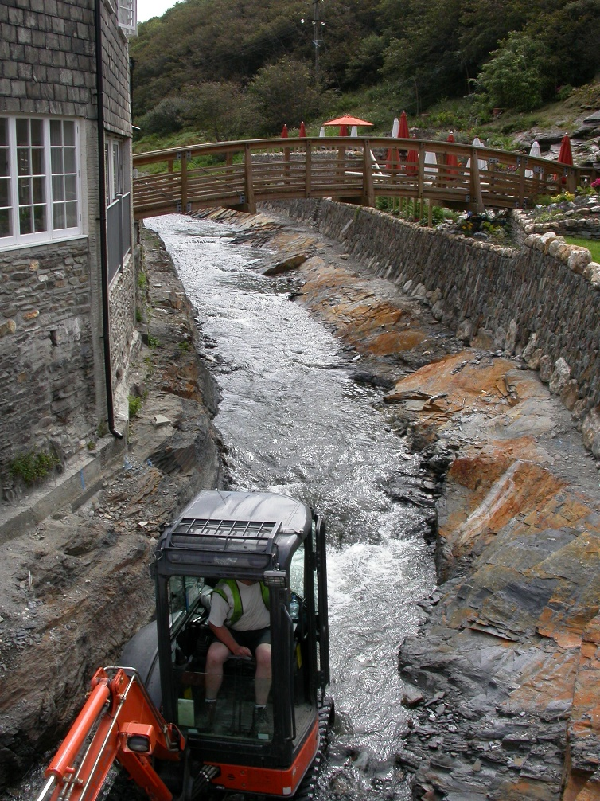
Hard engineering
The River Valency, Boscastle, Cornwall
Geo-location: spun.cherub.mistaking
Hard engineering strategies are used to artificially manage rivers to reduce the risk of erosion or flooding. Strategies include:
dredging the river to make it deeper. This increases the capacity of the river.
widening or straightening the river so that it flows more quickly
building embankments or walls to prevent water spilling over the top of the bank.
Activity
Make a flow chart to explain why dredging the river will reduce the risk of flooding
Notes:
https://what3words.com/spun.cherub.mistaking

Slide 5
Soft engineering
Soft engineering strategies allow a river to flow more naturally. The river is managed so that:
it slows down
is able to store water and release it slowly.
Strategies include:
planting trees in the upper catchment to soak up water
blocking up old field drains so that rainwater takes longer to get into the river
felling trees across small tributaries so that the flow of water down these streams is slowed down
replacing artificial straight sections of river with more natural meandering sections.
Activity
Watch this short video about river restoration in Cumbria.
Identify two main benefits of this river restoration project.
Explain why restoring a river’s meanders can help prevent flooding further downstream.
Notes:
https://www.youtube.com/watch?v=TwchwblcMmc

Slide 6
Newtown flood defences
Newtown is a small town on the River Severn in mid Wales. The town was badly affected by flooding in 1960 and again in 1964. This website has archived pictures of the flood damage, and this one has a short video of the flood in 1960.
A hard engineering scheme was designed to protect Newtown from future floods and this was completed in 1967. The next four slides describe the scheme.
Activity
Suggest how the Newtown flood would have affected the following groups of people:
businesses in the town centre
home owners
elderly people living in the town
school children.
Notes:
Pictures https://www.peoplescollection.wales/discover/query/Newtown%20flood%201960
Video https://player.bfi.org.uk/free/film/watch-newtown-disastrous-floods-of-1960-1960-online

Slide 7
Newtown flood wall
The main part of the Newtown defence scheme was the construction of an embankment and wall on the southern bank of the river to prevent it spilling into the town centre during a flood.
The embankment is faced in stone so that it cannot be eroded during a flood.
The River Severn, Newtown, Powys
Geo-location: ticked.foster.streaking
Notes:
https://what3words.com/ticked.foster.streaking

Slide 8
Newtown – flood wall
In this photo you can see a detail of the flood wall. A lot of the ground surfaces in any town centre are impermeable – water runs off materials such as tarmac and concrete so storm drains must be installed to remove surface water quickly during a rain storm. The metal structure, which you can see about 2.5 metres up the wall, is a valve. It is below ground level on the other side of the wall. If rainwater or floodwater gets trapped behind the wall it will push the metal valve open so that it can escape back into the river.

Slide 9
Newtown – flood embankment
The River Severn, Newtown, Powys
Geo-location: pollution.cakewalk.proven
This photo was taken about 100 metres downstream of the footbridge. The embankment separates the river from the eastern part of the town centre.
Notes:
https://what3words.com/pollution.cakewalk.proven

Slide 10
Newtown – footbridge
This section of the river was dredged and realigned to make the water flow away from Newtown more rapidly. Tree debris was caught under King Bridge causing it to block the flow of water. The old bridge was replaced with this one that has a single span.
You can see an old map of Newtown here with a modern satellite image beside it.
The River Severn, Newtown, Powys
Geo-location: hinted.dressings.strict
Activities
Compare the shape of the river on the old map and satellite image carefully in the area to the west of Cambrian Mill. Sketch the shape of the river then and now and label it to show the main changes.
Suggest why the new footbridge has a single span.
Notes:
https://maps.nls.uk/geo/explore/side-by-side/#zoom=16&lat=52.51636&lon=-3.31333&layers=6&right=BingHyb
If the weblink does not take you directly to the correct location you may need to zoom in to find Newton which is in mid-Wales, due west of Birmingham.

Slide 11
Shrewsbury – demountable flood defence
Shrewsbury is another town on the River Severn that has a history of flooding. Watch this video of flooding in Shrewsbury in February 2020.
This photo was taken from a footbridge over the river. On the left is a flood wall that protects the large office building. The car park is not protected by any hard engineering. However, if a flood is forecast the car park is closed so that cars will not be damaged.
Shrewsbury, Shropshire
Geo-location: usual.chains.mirror
Notes:
Video https://youtu.be/lS0Cjz_d0VA
Image https://what3words.com/usual.chains.mirror

Slide 12
Shrewsbury – demountable flood defence
This photo shows a detail of Shrewsbury’s hard engineering scheme. The metal plates in the road conceal places where metal posts can be fixed if a flood has been forecast. Metal shuttering is then slotted in between the posts. This is a demountable flood defence scheme – in other words, the defences are taken down and stored when they are not needed.
You can see slots in this wall where the metal flood defences can be slotted
Shrewsbury, Shropshire
Geo-location: usual.chains.mirror
Notes:
https://what3words.com/usual.chains.mirror

Slide 13
Shrewsbury – land use zoning
Shrewsbury is also protected from the worst effects of flooding by a soft engineering strategy known as land use zoning.
Land uses that will not be damaged by flood water, such as the public park in this photo or the car park on slide 11, are not protected by hard engineering schemes. These areas are allowed to flood. They provide a valuable floodwater storage area until the level of water in the river starts to go down. Then the water that has been stored here can slowly be released back into the river.
River Severn, Shrewsbury, Shropshire
Geo-location: could.basic.raves
Notes:
https://what3words.com/could.basic.raves

Slide 14
Land use zoning
It would be very expensive to protect every bit of land from flood water. It may be better to accept that some flooding will happen – as long as the flooding happens in locations where there will be very little risk of damage to people or property.
Activity
Look at these land uses. Arrange them along the continuum.
Playing fields
Car parks
Housing
Primary school
Hospital
Historic building
Very vulnerable to flood damage
Not vulnerable to flood damage

Slide 15
Flood risk in Shrewsbury
Activities
Use What3Words to explore each of the locations in Shrewsbury in the table below. Record the main land use(s) you can see at each location.
Use this flood GIS. Type Shrewsbury into the search engine and find the same locations. Record whether the flood risk at each location is low, medium or high.
Location | Land use | Flood risk | Vulnerability
could.basic.raves
mops.tops.tiles
grin.focal.talked
gear.forced.forced
cult.holly.pulse
parent.large.merit
miss.eagles.tens
name.stages.abode
Activity
3. Are the land uses at these locations vulnerable to flood damage? Record yes or no in the final column. Justify your decisions.
Notes:
Flood GIS:
https://floodassist.co.uk/resources/flood-risk
Locations:
Https://what3words.com/could.basic.raves
Https://what3words.com/mops.tops.tiles
Https://what3words.com/grin.focal.talked
Https://what3words.com/gear.forced.forced
Https://what3words.com/cult.holly.pulse
Https://what3words.com/parent.large.merit
Https://what3words.com/miss.eagles.tens
Https://what3words.com/name.stages.abode

Slide 16
Managing the whole catchment
Many UK rivers have hard engineering schemes to make them straighter and/or deeper. Some, like Newtown, have flood walls and embankments that restrict the ability of a river to flood onto its floodplain naturally. Hard engineering allows flood water to move downstream more rapidly.
An unintended consequence of hard engineering is that flood water arrives at places further downstream sooner after the rain event and in larger quantities. If these places have no flood protection, or the flood protection is inadequate, this could lead to flooding there. This is why the Environment Agency uses a combination of hard and soft engineering strategies.
Activity
Watch this short video animation. It describes how we need to manage the whole catchment area of a river – not just where the river flows through a town.
Use evidence from the video to answer this question:
‘Hard engineering is the best way to protect towns and cities from flooding’. To what extent do you agree?
Notes:
https://www.youtube.com/watch?v=21YAP8RF_sw

Slide 17
Links
From the awarding bodies
Find out more
 | Topic
AQA | 3.1.3.2, 3.1.3.3, 3.1.3.4 Coastal, river, glacial landscapes
Edexcel A | 1: The changing landscape of the UK
Edexcel B | 4: The UK’s evolving physical landscape
Eduqas A | 1: Landscapes and physical processes
Eduqas B | 2.1: Shaping the landscape
OCR A | 1.1 Landscapes of the UK
OCR B | 3 Distinctive landscapes
WJEC | 1: Landscapes and physical processes
CCEA | 3.4, 1A: River environments.
A video describing hard engineering approaches to river management
A video describing problems of hard engineering and ‘softer’ alternatives
Watch this video about the River Severn. Think about why the risk of flooding on the River Severn is so high. You should be able to identify at least one physical factor and one human factor.
Have a look at the GEO units on landforms on the River Severn and river processes.
Notes:
https://timeforgeography.co.uk/videos_list/rivers/river-management-hard-engineering/
https://timeforgeography.co.uk/videos_list/rivers/problems-hard-enginee
https://www.youtube.com/watch?v=_M48ANM3hAQring-and-softer-alternatives/

Slide 18
Acknowledgements
This presentation has been written by Andy Owen, author and Consultant to the GA.
Figures
Slides 6, 8, 9, 10, 11, 12, 13 and 14: photos © Andy Owen

