Slide 1
Population change

Slide 2
Getting started
You’ll need a notepad on which to make notes as you go along, or you could make notes, paste images, etc. on your device.
You can view these slides:
as a slide-show for any animations and to follow links
in ‘normal’ view if you want to add call-outs or extra slides to make notes, paste images or answer questions.

Slide 3
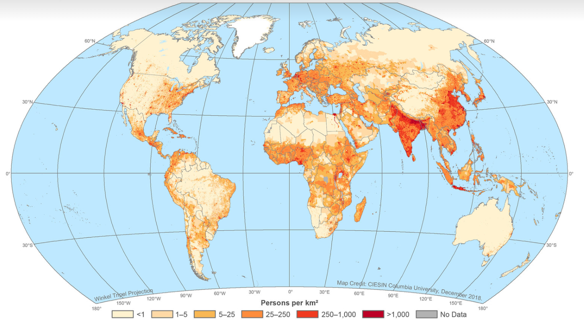
World population pattern
The map below is a dot density map, showing the population density per pixel. Dot density maps are useful for showing detailed spatial patterns like this. Use the T-E-N technique when describing patterns: Trend: state the overall pattern; Evidence: extract data from the map; Notable: Quote anything interesting or unusual about the pattern.
Activity
Click on this map to explore it in greater detail.
Describe the spatial pattern of population it shows.
Use the T-E-N approach, and the next three slides, to help add detail.

Slide 4
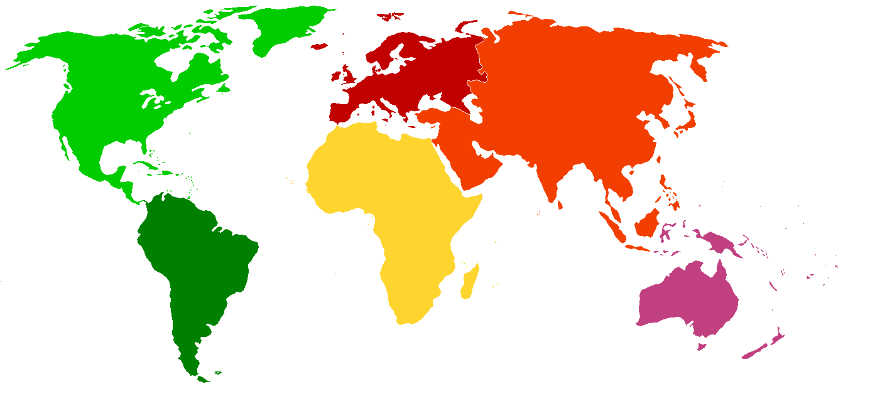
Continent names
When describing spatial patterns you can refer to continent names. The world’s land masses are divided into seven continents, six of which are shown on the map.
Example describing the overall Trend in the spatial pattern:
‘Europe is the most densely populated continent’.
Trend
Evidence
Notable
Europe
North America
Asia
Africa
South America
Oceania
Antarctica

Slide 5
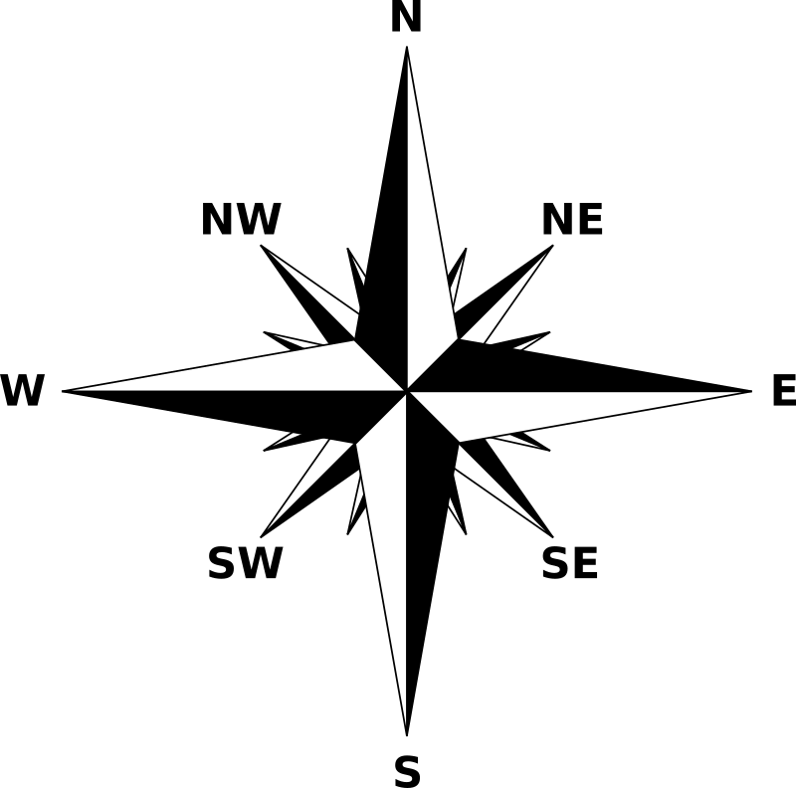
Evidence: Direction and data
Quoting evidence helps us to substantiate (add weight to) our statements. Direction is used to specify a particular part of a continent, country or region. A key shows the data value for a particular colour used on a map.
Example of providing Evidence of the spatial pattern:
‘Northwest Europe has large areas with 250–1,000 people per km².
Trend
Evidence
Notable
Use a compass rose for directions
Use the key to extract data values

Slide 6
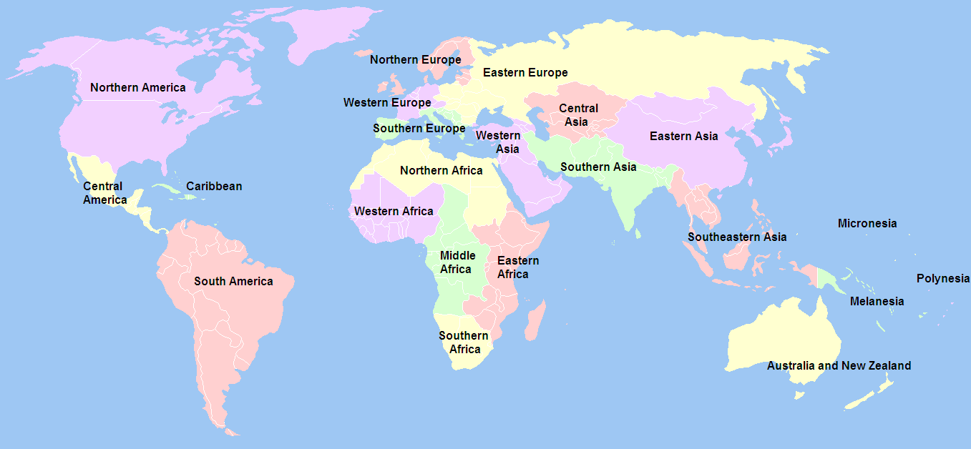
Evidence: World region names
Quoting world region names demonstrate thorough geographical knowledge. A world region is a large part of the world with similar characteristics.
Example of describing something Notable in the spatial pattern:
‘Southern Asia has the densest population of any world region.
Trend
Evidence
Notable

Slide 7
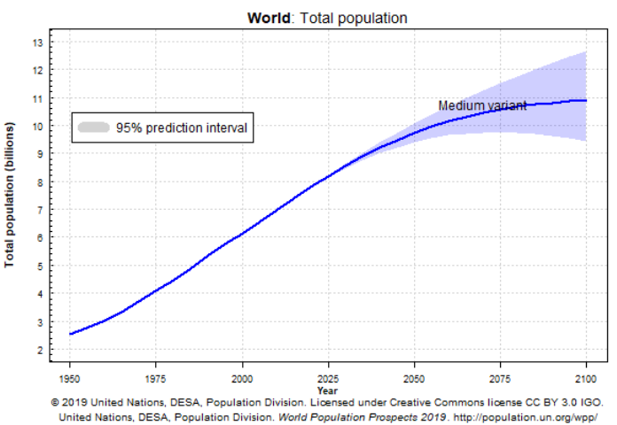
World population growth
The world’s total population has been increasing steadily.
In 1950 it was 2.5 billion.
By 2100 it will projected to stabilise at 10.8 billion people.
Activities
Use the line graph to:
state the population in 1975 and 2000
give the date when the population growth starts to slow down.

Slide 8
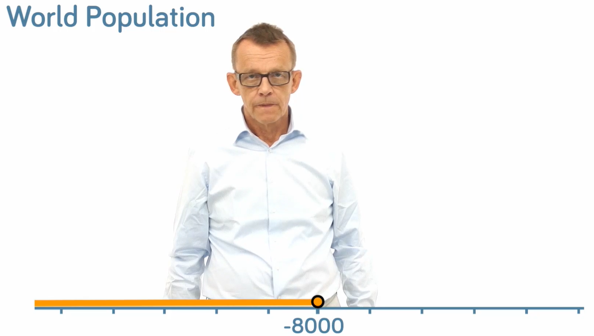
World population growth
Activity
Watch this Gapminder video
Describe how and why the world’s population has changed.
You might start by thinking about which countries have fast- or slow-growing populations.

Slide 9
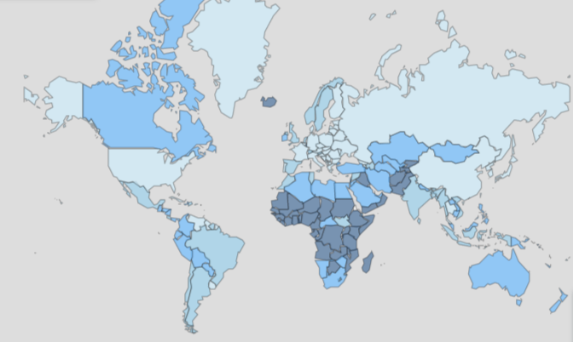
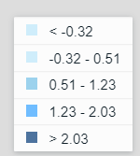
Pattern of annual population growth
The map below is a choropleth map that shows the annual (yearly) population growth rate (in %) for each country. This type of choropleth maps uses shading to show an average value for an entire country, but doesn’t show variation within the areas.
Activities
Click on this link to explore this interactive map.
Describe the world pattern of annual population growth rates. Refer to continent, compass rose directions and/ or world regions.

Slide 10
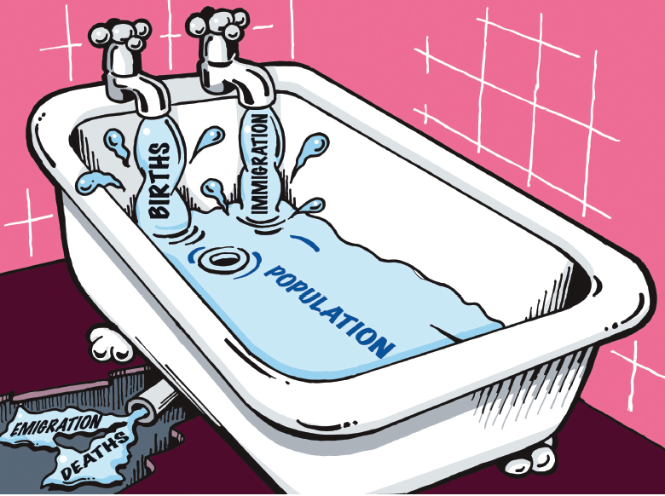
How does population grow?
Births add people to a country’s population.
Population increases when births are higher than deaths.
The population is shown by the bathwater level.
The bath represents a country or planet.
Population growth initially speeds up when deaths decrease.
Population growth eventually slows when births decrease.
Level of bathwater = Population
The bath = a country
Deaths remove people from a country’s population.

Slide 11
Calculating population change
Natural change refers to the population change resulting from differences between births and deaths.
Natural change = birth rate − death rate.
Natural increase is when the population grows and occurs when births are higher than deaths. It is shown as a positive figure.
Natural decrease is when the population shrinks and occurs when deaths are higher than births. It is shown as a negative figure.
 | Birth rate | Death rate | Natural increase
United Kingdom | 11 | 9 | +2
Bangladesh | 18 | 6
Japan | 7 | 11
Activity
Calculate the natural change figure for Bangladesh and Japan.
Interpret what this data means in terms of natural increase or decrease.

Slide 12
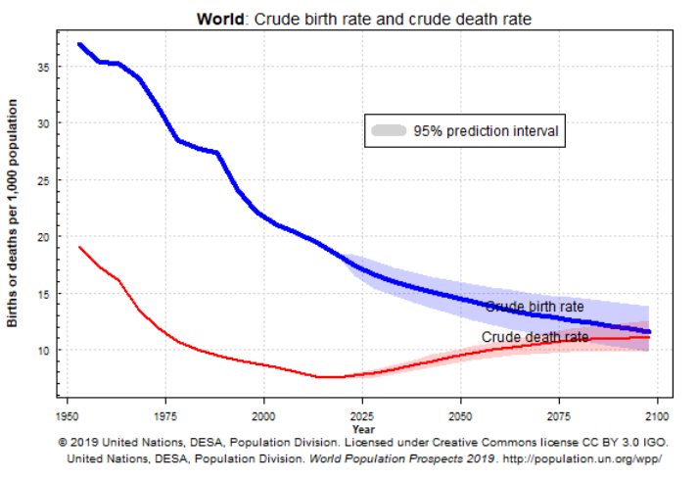
Trends in world birth and death rates
Birth and death rates are projected to dramatically change from 1960 to 2100.
Activity
Work out the rate of natural increase (NI) in 1960 and 2050. (NI = BR − DR)
Explain how you can tell that natural increase is projected to be almost zero by 2100.
You might want to refer to the bath diagram and the previous slides.
Natural
increase
N.I.

Slide 13
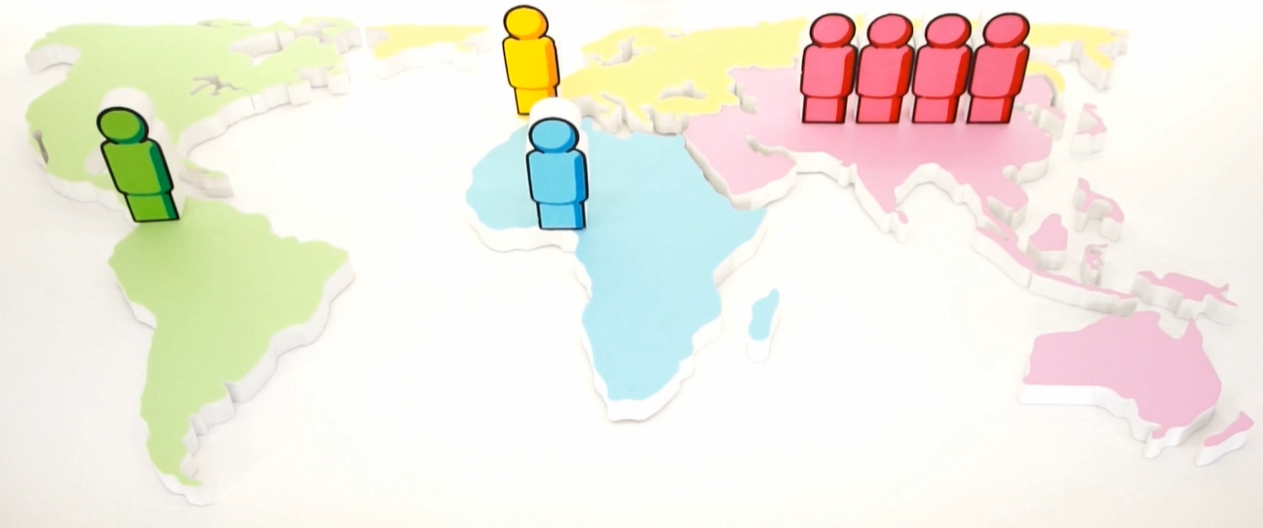
Where do 7 billion people live?
This map shows the distribution (spread) of the world’s population.
One person symbol represents 1 billion people.
Gapminder’s Hans Rosling said the ‘population pin code’ of the world was 1114 but this will change to 1145 by 2100.
Activity
Watch this Gapminder video.
Describe the spatial pattern of the world’s population.
Describe where the additional 4 billion people will be added by 2100.
Europe
Asia and Oceania
The Americas
Africa

Slide 14
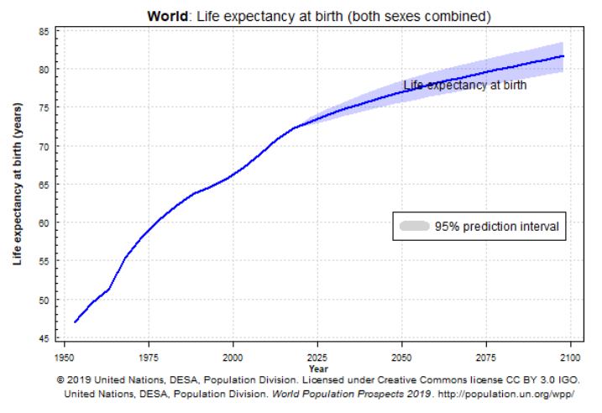
Increasing world life expectancy
World life expectancy is projected to increase from 57 years in 1970 to 83 years by 2100.
Increased life expectancy is caused by better incomes, leading to better diet, sanitation and healthcare, which results in lower death rates.
Activities
Use data from the line graph to describe:
how life expectancy has changed
how life expectancy is predicted to change in the future.

Slide 15
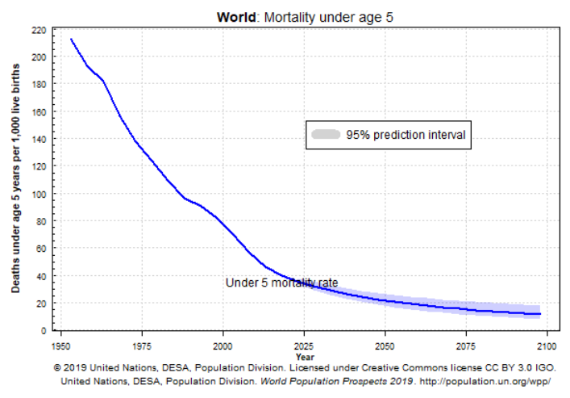
Decreasing world child mortality
World child (under 5) mortality is projected to decrease from 156 per 1000 in 1970 to 12 per 1000 by 2100.
Women have fewer children when they have access to contraception and feel confident that their children are less likely to die from diseases.
Improved female education (more girls go to school) means they have higher aspirations, and as women will choose to have fewer babies.
Decreased child mortality therefore leads to lower birth rates.

Slide 16
Population change in Bangladesh
Bangladesh is a middle-income country in South Asia. It has the 8th largest population of any country with 164 million people, and has one of the highest population densities of any country.
In 1962, 25% of Bangladeshi children sadly died before the age of five. Women had an average of 6.7 babies each.
By 2020 child mortality has decreased to less than 3% and women had only 2.0 babies each.
Activity
Watch Gapminder video 1 04:29 - 07:16 mins and 14:59 - 23:15 mins.
Explain how Bangladesh reduced its birth and death rates.
Challenge: Watch Gapminder video 2. What does this video show you about how the size of the development gap between rich and poor countries has changed over time?

Slide 17
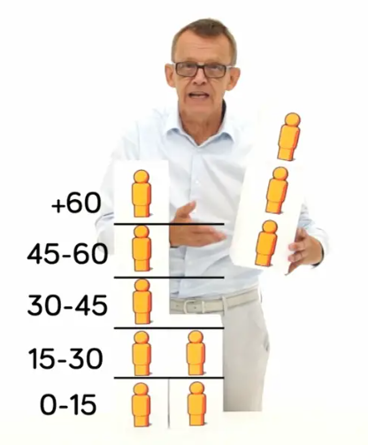
If births are so low why will the world’s population still grow?
Bangladesh’s decreasing birth rate is typical of many middle- and some low-income countries.
World births have never been as low as they are today. In 2021 the fertility rate is 2.5 babies per woman, but we are still expected to add another 4 billion to world’s human population.
Activity
Watch this Gapminder video
Explain why 4 billion people will still be added to world’s population, despite global births being so low.

Slide 18
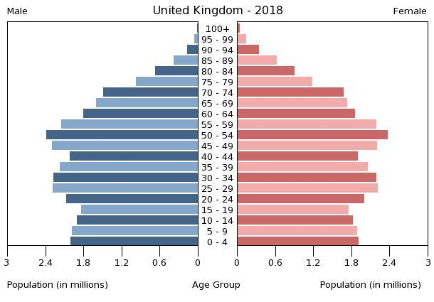
The UK’s population pyramid
Population pyramids are graphs that show the population structure of a country, as seen in the video on the previous slide. Each row shows the amount or proportion of the population in 5-year age categories. The graph below shows the United Kingdom’s population pyramid. Its shape shows that the UK’s population is growing slowly.
A wide top shows a long life expectancy and a low death rate
Straight sides show a low death rate - people don’t start dying until the age of 60-64 years
A narrow base shows a low birth rate

Slide 19
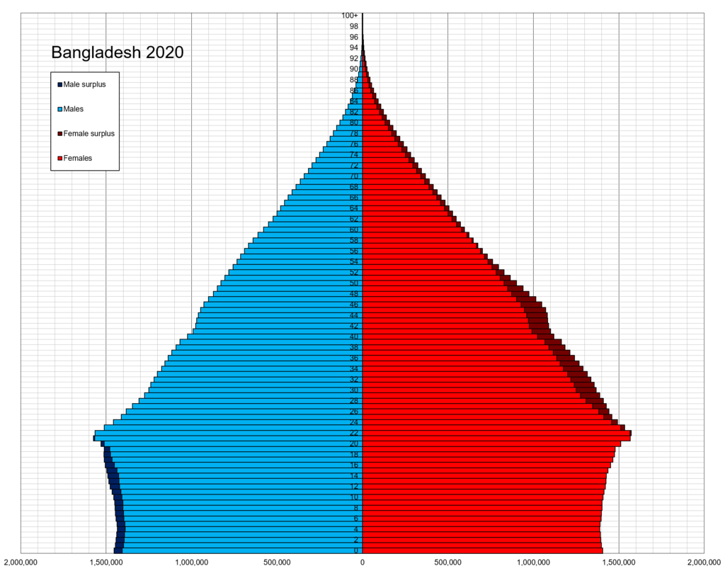
Bangladesh’s population pyramid
The shape of Bangladesh’s population pyramid is very different to the UK’s and this indicates that life is very different. Bangladesh’s population is growing rapidly.
A narrow top shows a short life expectancy and high death rate, so a low number of elderly people in the population
A pyramid shape shows a historically high death rate from 25 years upwards
A narrow base shows a low birth rate
Activity
Describe how Bangladesh’s population pyramid will change in the future.
Challenge: Suggest what these changes indicates about future changes to birth rates, death rates and life expectancy.

Slide 20
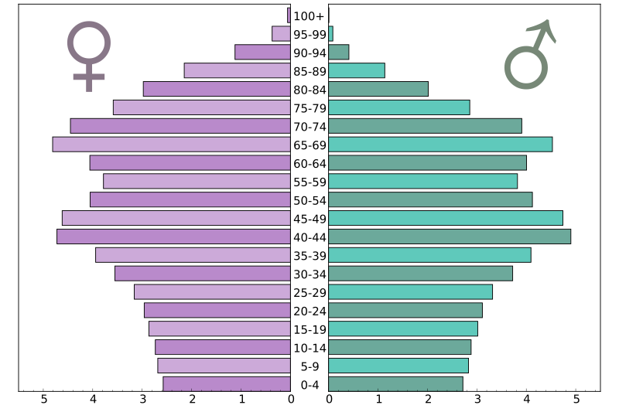
Japan’s population pyramid
The shape of Japan’s population pyramid is very different to the UK’s and Bangladesh. Japan’s population is shrinking and ageing.
A very wide top shows a long life expectancy and low death rate
A top-heavy shape shows a low death rate and an ageing population
A narrow base shows a very low birth rate and few young people in the population
Activity
Click on this link to investigate Japan’s population pyramid.
Challenge: Suggest why Japan’s population will experience natural decrease in the future. You may want to look back at the bath diagram.

Slide 21
The rise of single women in Japan
Many women in East Asia are choosing not to get married and instead pursue a single life, remaining childless (without having children).
Activity
Click on this link to read more about changing gender norms in Japan.
Watch this YouTube video explaining what life is like for Japanese women.
Explain how women’s lives are changing in Japan.
Challenge: How will these changes lead to an ageing population?

Slide 22
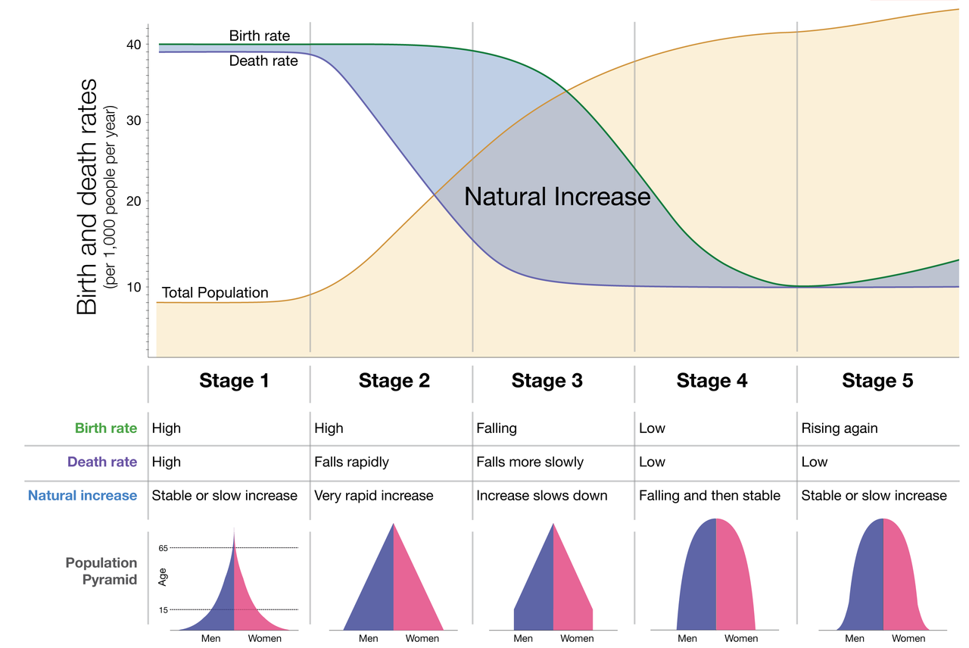
Demographic Transition Model
The demographic transition model is a theory of how the population of a country changes - it was created by Warren Thompson in 1929. Over time Thompson predicted that countries would move through stages. Today Bangladesh is in stage 3, the UK is in stage 4 and Japan is in stage 5.
Activity
Describe how the total population of a country (the bathwater level in the bath diagram) changes over time.
Suggest reasons for these changes.
Falling
Low
Natural decrease

Slide 23
Links
From the awarding bodies
Find out more
 | Topic
AQA | 3.4.1 Skills (and 3.2.3 Population and resources)
Edexcel A | 4: Changing cities; 5: Global development; 6: Resources; Skills.
Edexcel B | 2: Development; 3: Urbanising world; 5: UK; Skills
Eduqas A WJEC | 2.2/2.3: Urban change; 7: social development, Skills
Eduqas B | 1.1: Urbanisation; skills
OCR A | 1.2: People of the UK; 2.2: People of the planet, 3: Skills
OCR B | 6: Dynamic development; 9: Skills
CCEA | 2A: Living in our world; 7.1: Skills
BBC Bitesize has a summary of population for GCSE
Interactive population pyramids worldwide
Interactive DTMs from Harvard and geographer online – which has the best explanation?
In more detail:
Hans Rosling talks about population growth
This UN webpage and video focuses on population growth.

Slide 24
Glossary
Child mortality: how many children under 5 die per 1000 live births.
Choropleth map: a map where areas are shaded according to their numerical value.
Demographic transition model: a theory of how population changes over time.
Dot density map: a map where the density of the dots indicates population density.
Fertility rate: the average number of babies per woman.
Life expectancy: how many years a person is predicted to live from birth.
Natural increase: when the birth rates is higher than the death rate.
Natural decrease: when the death rate is higher than the birth rate.
Population density: the number of people living in an area – usually people per square kilometre (km²).
Population pyramid: a graph showing the population structure of a country.
Spatial pattern: how data values vary from place to place on a map.

Slide 25
Acknowledgements
This presentation has been written by Garry Simmons, Head of Geography at Wilmington Grammar School for Girls, Dartford, Kent.
Figures
Slide 3: Diagram source: https://www.flickr.com/photos/54545503@N04/48009145056
Slide 4: Diagram source: https://upload.wikimedia.org/wikipedia/en/9/99/BlankMap-World-Continents-Coloured.png
Slide 5: Diagram source: https://openclipart.org/detail/233063/compass-rose-2
Slide 6: Diagram source: https://commons.wikimedia.org/wiki/File:United_Nations_geographical_subregions.png
Slides 7, 12, 14 and 15: Diagram source: https://population.un.org/wpp/Graphs/DemographicProfiles/Line/900
Slides 8, 13 and 17: Source of image: Free video from www.gapminder.org
Slide 9: Diagram source: https://data.worldbank.org/indicator/SP.POP.GROW?view=map

Slide 26
Slide 10: Diagram source: Geography Teachers toolkit: Moving Stories: Why is the population of the UK changing? (2008) J Widdowson, Geographical Association.
Slide 16: Diagram source: https://commons.wikimedia.org/wiki/File:Bangladesh_Map_Flag.svg
Slide 18: Diagram source: https://commons.wikimedia.org/wiki/File:UK_population_pyramid_(2018).jpg
Slide 19: Diagram source: https://en.wikipedia.org/wiki/Demographics_of_Bangladesh#/media/File:Bangladesh_ single_age_population_pyramid_2020.png
Slide 20: Diagram source: https://commons.wikimedia.org/wiki/File:Japan-population-pyramid-2017.svg
Slide 21: Photo source: https://www.flickr.com/photos/busyprinting/4673278409
Slide 22: Diagram source: https://en.wikipedia.org/wiki/Demographic_transition#/media/File:Demographic-TransitionOWID.png

