Slide 1
Managing the UK’s resources

Slide 2
Getting started
You’ll need a notepad on which to make notes as you go along, or you could make notes, paste images, etc. on your device.
You can view these slides:
as a slide-show for any animations and to follow links
in ‘normal’ view if you want to add call-outs or extra slides to make notes, paste images, answer questions.

Slide 3
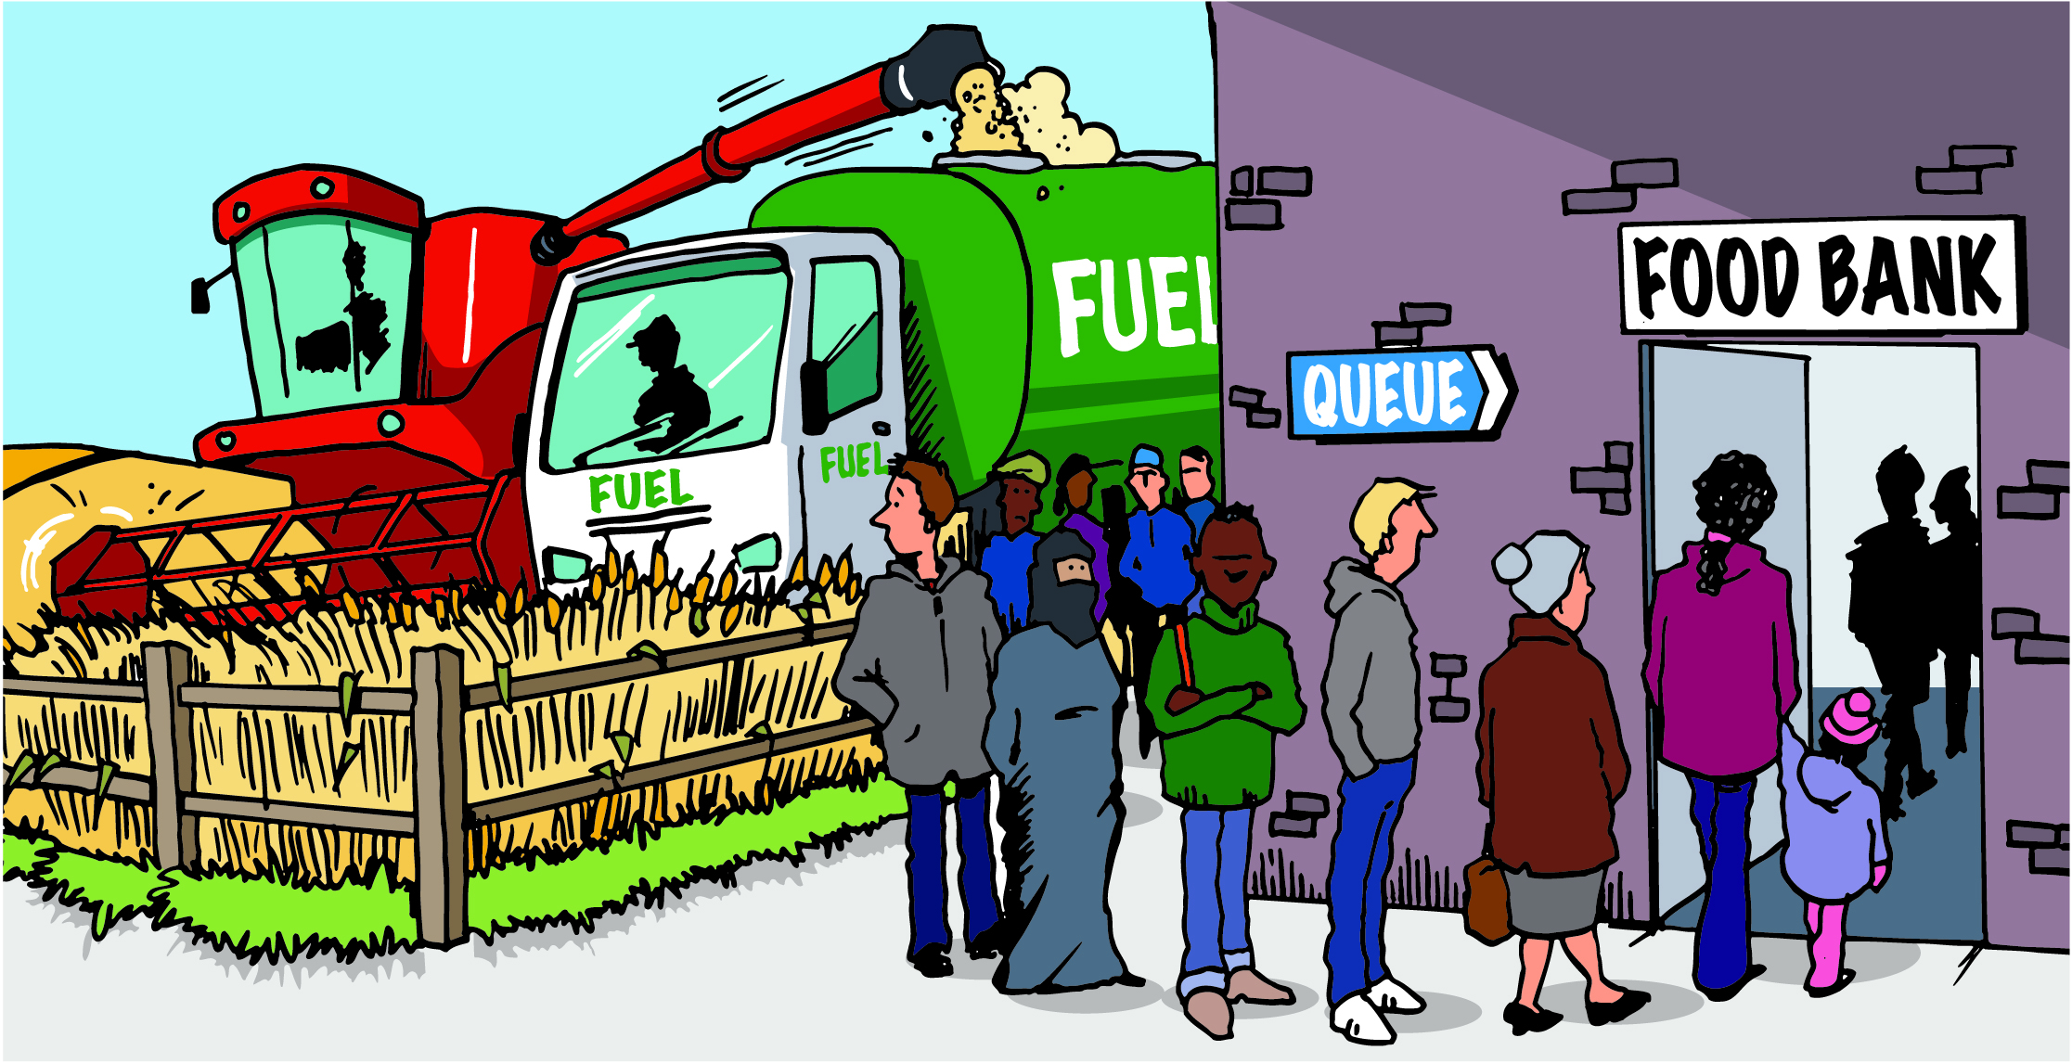
Managing the UK’s resources
Resources are things that people use. Some are vital for our survival, others help maintain our standard of living.
Activity
Study the cartoon. What do you think it shows about resource management?
Notes:
Source of image: GCSE Toolkit: Resource Management: Food, water, energy (2018) G. Pollard. Geographical Association.

Slide 4
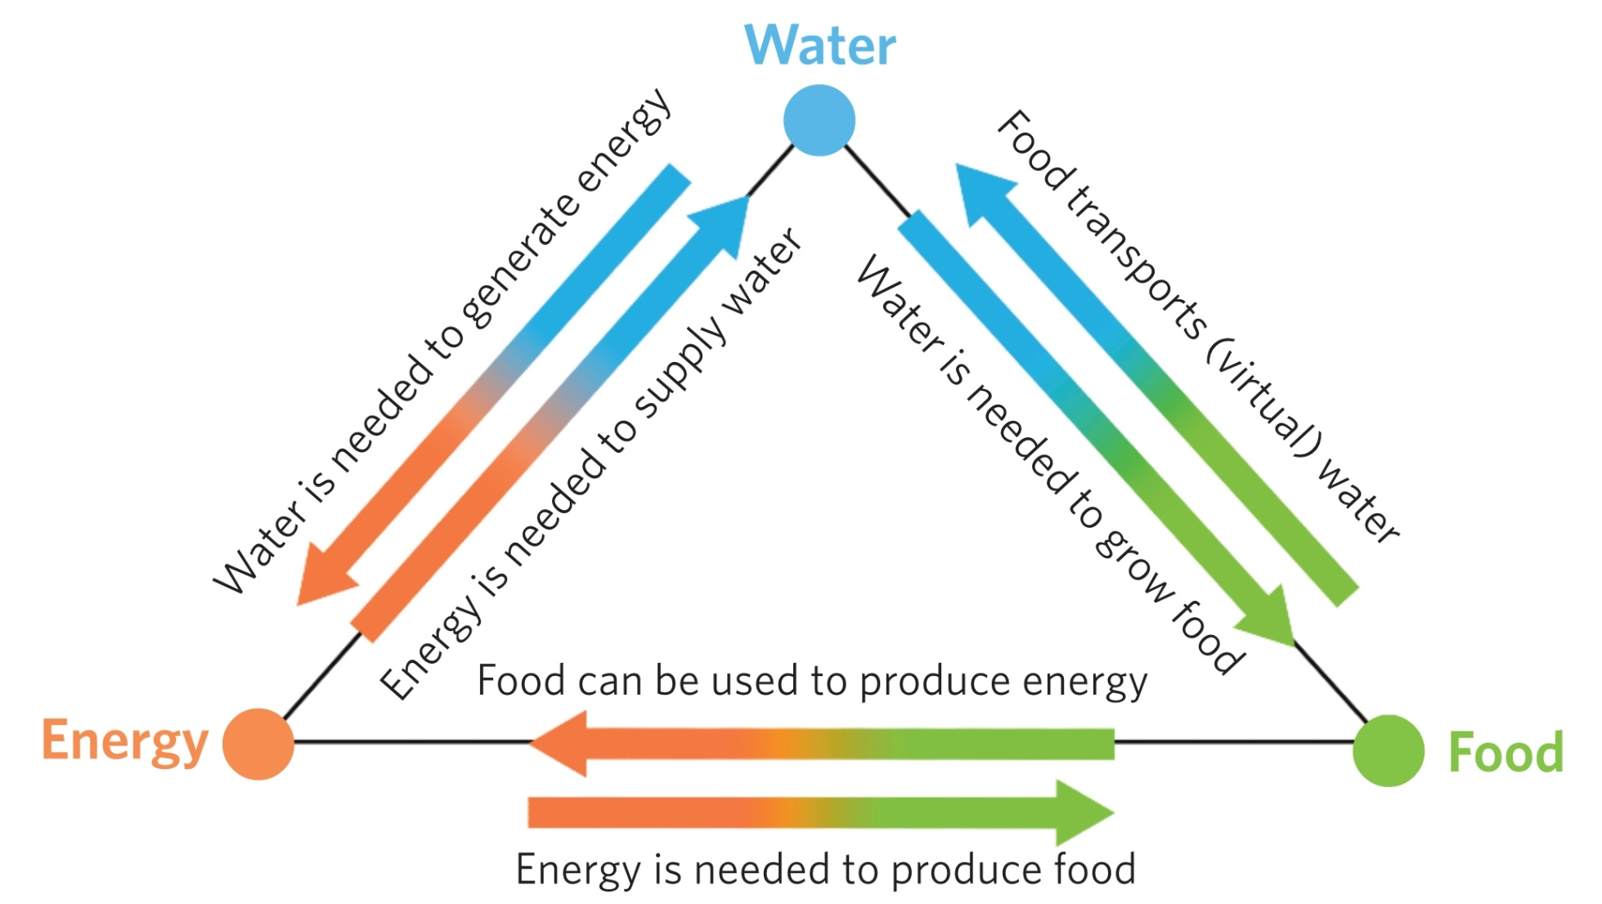
The UK’s resources are interdependent
In some places crops like corn or soybeans are grown for biofuel. This uses up farmland and water resources that could have been used to feed people.
The diagram shows that food, water and energy resources are interdependent. They are precious and central to sustainable development. This is known as a nexus.
Notes:
Source of image: GCSE Toolkit: Resource Management: Food, water, energy (2018) G. Pollard. Geographical Association.

Slide 5
Managing the UK’s resources
Food, water and energy are all resources essential for human development.
Each contributes hugely to people’s social and economic wellbeing.
Food is needed for human health; people need calories and nutrients to stay well.
Water is needed for drinking, washing, sanitation and cooking. It is vital for farming and industry too.
Energy is needed for domestic use, transport and industry.
Managing these resources means using them sustainably to prevent resource insecurity.

Slide 6
The UK’s food security
The UK is not self-sufficient in food. The population is predicted to grow to 73 million by 2037, so UK food resources will become more insecure.
The UK imports 48% of the food consumed. This increases consumer choice, provides food all year round and helps to keep prices down.
UK fruit imports (value) 2019
Spain | South Africa | Nether-lands | Costa Rica | Colombia | Others
20% | 12% | 6% | 5% | 5% | 52%
UK vegetable imports (value) 2019
Spain | Nether-lands | Ireland | France | Poland | Others
32% | 27% | 6% | 4% | 4% | 26%
Activity
Explain what is meant by food insecurity.
Study the data; what does it tell you about the UK’s sources of food, and food security?

Slide 7
The impacts of importing food to the UK
The distance travelled by imported food to the UK is measured in Food Miles:
Transporting food by road, ship and air adds to our carbon footprint as consumers, and the UK as a whole.
Flying in high value, perishable foods accounts for 11% of the UK’s food transport emissions.
Flying in food creates 10 times more carbon than road transport and 50 times more carbon than shipping.
Resources
Next Generation Food:
Where does UK food come from?
Video: UK food miles
Activity
Study the map and watch the video.
List the factors that have to be taken into account when considering food miles.
Do you think we can apply the US example to the UK?

Slide 8
Organic farming in the UK
Organic food is becoming more popular with some UK consumers, as no harmful chemicals are involved in its production.
485,000 hectares of UK land are farmed organically.
The food is usually sold locally – reducing food miles, thus increasing food security.
Organic food production provides jobs and supports the local economy.
It builds links between consumers and producers.
It is sustainable.
Resources
Videos:
Why Convert To Organic Farming?
Shillingford Organics
Activity
Watch the videos and suggest the farming successes and challenges for Shillingford Organics.
Notes:
www.youtube.com/watch?time_continue=274&v=F6i40og_9GA&feature=emb_logo
Soil association article :
https://www.soilassociation.org/organic-living/organic-heroes/meet-the-producers/martyn-bragg-shillingford-organics/

Slide 9
UK agribusiness
Agribusiness is farming as intensively as possible to maximize yields and reduce costs.
The more food that is produced, the fewer imports are needed, so food security is increased.
Huge financial investment buys machinery and chemicals (fertilizer and pesticides).
Farms are large but need few workers.
The farms are unsustainable, impacting negatively on habitats, species, soil and water quality.
Resources
BBC class clips: The development of agribusiness in the UK
Activity
Watch the video, then write down your own definition of agribusiness.
Suggest the advantages and disadvantages of agribusinesses for the UK’s food security.
Notes:
www.bbc.co.uk/teach/classclipsvideo/the-development-of-agribusiness-in-the-uk-z68qp3

Slide 10
Managing the UK’s water resources: increasing demand
As the UK population increases so does the demand on domestic water which is up 70% since 1970.
Farming uses water for irrigation. The effects of climate change and the demand for early crops have increased this demand.
Industry and energy production uses water in large amounts.
Water demand increases as the UK’s wealth and high standard of living increases, e.g. for domestic appliances such as dishwashers.
Resource
Video: England could run short of water within 25 years
Activity
Read the article and construct a mind map of UK water demand problems and solutions.

Slide 11
Managing the UK’s water resources: demand and supply
The UK currently has a water surplus – supply is greater than demand.
BUT the areas of highest population and highest demand are not the areas of greatest water supply.
The north and west of the UK have a water surplus (high rainfall and sparse population).
The south and east of the UK have a water deficit (a combination of low rainfall and high population).
Study the map on the following slide which explains this imbalance.

Slide 12
Managing the UK’s water resources: demand and supply imbalance
Notes:
Map source: https://www2.slideshare.net/tudorgeog/uk-water-supply-and-demand?qid=36f081bf-a39b-493a-9eb3-840a8b5032ee&v=&b=&from_search=12

Slide 13
Managing the UK’s water resources: increasing supply
Water transfer – water moves from an area of surplus to an area of deficit e.g. Water from Kielder Water reservoir travels to the cities of the north-east. Water travels by rivers, canals or pipes.
Plans for other water transfer projects were halted due to costs and environmental disruption.
Water can be abstracted from groundwater stored in underground aquifers.
‘Grey water’ from bathrooms and washing machines (but not toilet outflows) can be used for irrigation.

Slide 14
UK water quality
70% of the UK’s surface water is rated poor quality.
Pollution from agrichemicals, industry, litter, energy production, and untreated sewage is washed into rivers.
Ground water is polluted too.
Legislation is used to help control pollution.
The Environment Agency samples water daily to monitor quality.
Water is filtered and chlorinated before re-use.
Resources
BBC: ‘Rivers used as open sewers’
The Guardian: Shocking state of English rivers.
Activity
Read the articles:
what is your opinion of UK river water quality problems?
what solutions are suggested?
Notes:
www.bbc.co.uk/news/uk-england-49131405

Slide 15
UK energy resources: supply
The UK’s sources of energy have changed.
In 1990 75% of UK energy came from non-renewable fossil fuels.
By 2019:
coal use had declined to 1% due to concerns over pollution and greenhouse gas emissions
40% of UK energy came from renewable sources and this will increase further
the UK imported more of its energy resources, increasing energy insecurity due to the dependence on foreign providers.

Slide 16
UK energy use and security
Match the energy type to the correct description.
Nuclear | A black/brown fossil fuel that is mined and then burnt to provide energy. Non-renewable.
Hydro-electric | A fossil fuel trapped underground, for example methane. It gets trapped in rock formations and pipes are used to release it. Sometimes, it is released by hydraulic fracturing (‘fracking’). It can be burnt for heat or used to generate electricity. Non-renewable.
Natural gas | This includes energy generated from the sun, wind, waves, tides and from biomass. Renewable.
Oil | Energy harnessed from water. Dams are built across a river and a controlled amount of water is forced through tunnels to turn turbines and generate electricity. Renewable.
Coal | A carbon-based liquid made from fossilised remains and trapped in underground rock formations. Pumped out of the ground via drill rigs and pipes. Non-renewable.
Renewables | Radioactive minerals such as uranium are mined and electricity is generated from the energy released when the atoms of these minerals are split by nuclear fission in nuclear reactors. Usually considered non-renewable.
Click here for answers.

Slide 17
UK energy resources: fossil fuels
Coal-fired power stations are closing ahead of a 2025 ban. By early 2021 only four will remain providing less than 1% of the UK’s electricity.
Gas-fired power makes up the bulk of the declining share of fossil fuels in the energy system at 38%.
Nuclear power provides slightly less than a fifth of the UK’s electricity.
Resources
BBC Bitesize:
What are fossil fuels?
Activity
Use the links to make notes on fossil fuels.
What are the advantages and disadvantages of using each in the UK?

Slide 18
UK energy resources: renewable energy
The more UK energy is produced from renewable sources, the more sustainable and secure the energy budget becomes.
The UK generates electricity from solar power, wave and tidal power, onshore and offshore wind power, hydroelectric power and biomass.
Resource
BBC Bitesize: What are fossil fuels?
Activity
Create a mind map describing how each renewable source produces energy.
Add at least one advantage and one disadvantage of using each source in the UK.

Slide 19
UK energy resources: fracking
The UK has large reserves of shale gas, a fossil fuel.
Fracking is a process to extract oil and natural gas trapped in shale rocks underground.
Shale use would reduce the need to import energy, increasing UK energy security.
Fracking was favoured by the government until 2019. However, many people opposed it due to environmental concerns, safety issues and costs, and arguing it is unsustainable.
Resources
BBC: What is fracking?
Fracking halted in England
Friends of the Earth: fracking map
Activity
Describe the advantages and disadvantages of fracking.
Explain why the UK Government halted fracking in 2019.
Notes:
https://friendsoftheearth.uk/climate-change/uk-fracking-map-where-could-fracking-happen add map link.

Slide 20
Links
Awarding organisations
Find out more
 | Topic
AQA | 3.2.3.The Challenge of resource management
Edexcel A | Topic 6. Resource management.
Edexcel B | Topic 7, 9: People and the biosphere; Consuming energy resources
Eduqas A | 6.3: Water resources and their management
Eduqas B | 3.2: Ecosystems under threat
OCR A | 1.3 Environmental challenges
OCR B | Topic 8. Resource reliance.
WJEC | 6.3: Water resources and their management
CCEA | Theme D: Managing our environment
BBC Bitesize: What are resources?
Resource management videos, BBC Geography:
Food
Energy
Water.
Time for Geography videos:
Water security
Food security.

Slide 21
Glossary
Abstraction: To take water from a natural source to be used.
Aquifer: Water held in a layer of rock underground.
Biofuel: Fuels made from biomass: plant or animal materials.
Fossil fuels: Coal, natural gas and oil, formed a long time in the past from the remains of living organisms.
Nexus: A connection or link between things.
Resource insecurity: When there is not enough of a resource for the population’s needs.
Resource security: When there is enough of a resource for the population’s needs.
Sustainable use: To use a resource at a rate that does not impact negatively on the environment.

Slide 22
Acknowledgements
This presentation has been written by Susan and Stephen Schwab, authors and resources writers. Stephen chairs the GA Secondary Phase Committee and is a consultant to the GA.
Figures
Slides 3, 4, 16, 23: GCSE Toolkit: Resource Management: Food, water, energy (2018), G. Pollard. Geographical Association.
Slide 12: Map source: https://www2.slideshare.net/tudorgeog/uk-water-supply-and-demand?qid=36f081bf-a39b-493a-9eb3-840a8b5032ee&v=&b=&from_search=12

Slide 23
Answers for slide 16
Renewables | This includes energy generated from the sun, wind, waves, tides and from biomass. Renewable.
Coal | A black/brown fossil fuel that is mined and then burnt to provide energy. Non-renewable.
Nuclear | Radioactive minerals such as uranium are mined and electricity is generated from the energy released when the atoms of these minerals are split by nuclear fission in nuclear reactors. Usually considered non-renewable.
Natural gas | A fossil fuel trapped underground, for example methane. It gets trapped in rock formations and pipes are used to release it. Sometimes, it is released by hydraulic fracturing (‘fracking’). The gas can be burnt for heat or used to generate electricity. Non-renewable.
Oil | A carbon-based liquid made from fossilised remains and trapped in underground rock formations. Pumped out of the ground via drill rigs and pipes. Non-renewable.
Hydro-electric | Energy harnessed from water. Dams are built across a river and a controlled amount of water is forced through tunnels to turn turbines and generate electricity. Renewable.

