Slide 1
Can Haiti throw off its historical chains?

Slide 2
Getting started
You’ll need a notepad on which to make notes as you go along, or you could make notes, paste images, etc. on your device.
You can view these slides:
as a slide-show for any animations and to follow links
in ‘normal’ view if you want to add call-outs or extra slides to make notes, paste images, answer questions.

Slide 3
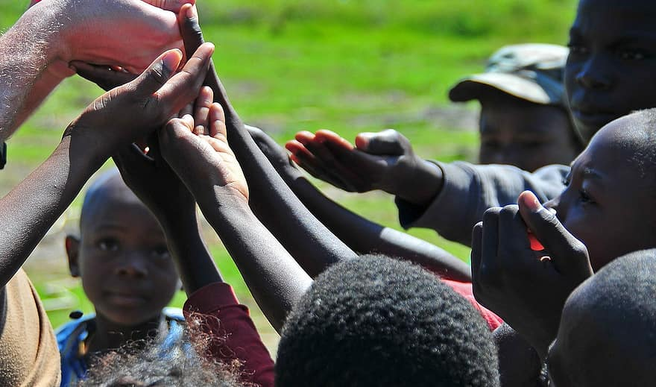
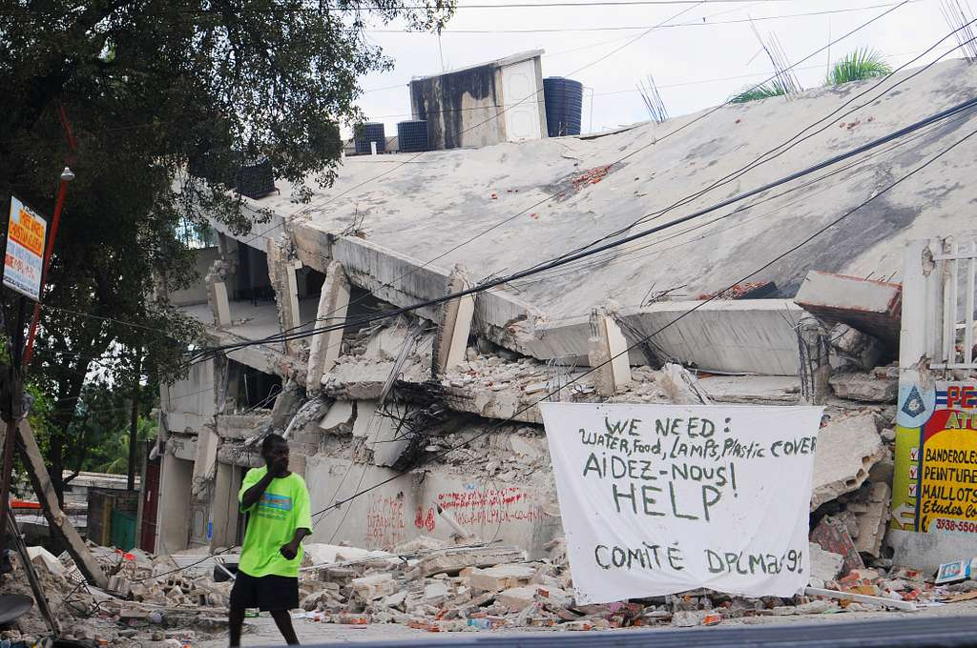
What is the single story of Haiti?
Look at these images. What do they tell us about the single story of Haiti?
Notes:
https://www.pikist.com/free-photo-vllcq
https://picryl.com/media/a-haitian-man-walks-past-a-sign-requesting-help-and-supplies-in-port-au-prince-4f9f95

Slide 4
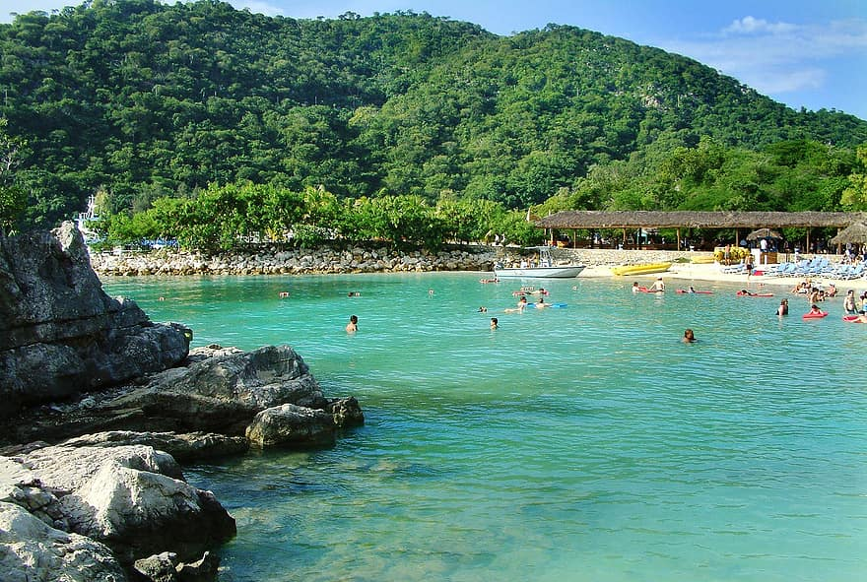
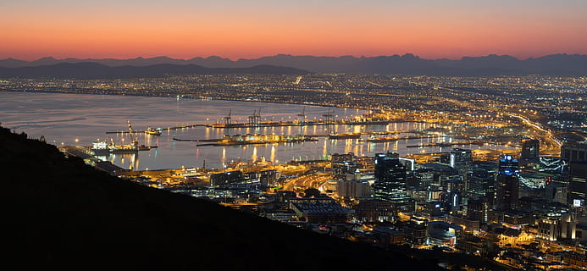
What is beyond Haiti’s single story?
Haiti is often portrayed as a helplessly impoverished country which is a victim of natural hazards and needs help from others.
This simplifies the story of a country with heroic history, diverse landscapes and rich culture.
Activity
What do these images tell you about Haiti’s more complex story?
Notes:
https://www.pikist.com/free-photo-vehdy
https://www.wallpaperflare.com/haiti-port-au-prince-caribbean-sunset-sunrise-rainstorm-wallpaper-eoxjo

Slide 5
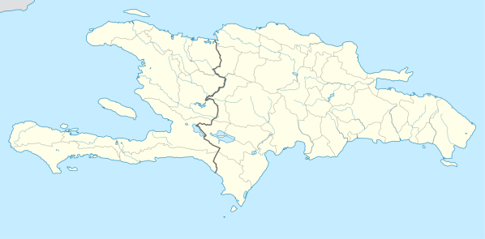
Haiti’s painful history
Arawak and Carib people were living on the island of Hispaniola when it was ‘discovered’ by the Spanish.
Spain gave the western third of the island to France, who started producing coffee and sugar in their new colony.
The indigenous people were almost wiped out by disease and being made to work so hard, so slaves were brought from Africa to do the work.
Some slaves started to rebel, with some running away and setting up ‘maroon’ communities, then helping others escape.
Haiti
Hispaniola

Slide 6
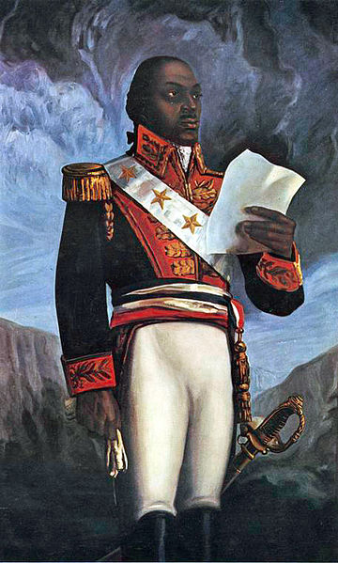
Haiti’s heroic history
In 1790 France agreed to give the vote to free black people, but the white people in charge of the colony refused to do this. Violence resulted.
In 1791 Toussaint Louverture commanded an army of rebelling black slaves and eventually took over the whole island of Hispaniola.
France tried to regain control, but Haiti was declared an independent republic in 1803.
The county lay in ruins after so much fighting, but after 300 years as a colony it was free.
Notes:
https://en.wikipedia.org/wiki/File:G%C3%A9n%C3%A9ral_Toussaint_Louverture.jpg

Slide 7
Haiti’s heroic history
However, France didn’t recognize Haiti’s independence and organized blockades of the coastline which made it hard for Haiti to trade.
In 1825 the King of France said he would recognize Haiti’s independence if Haiti paid 150 million francs to compensate French colonists.
This was more than 10 times Haiti’s whole annual budget, but the government agreed to pay in five installments to avoid war.
Haiti had to borrow money from French banks to make the first two payments and the government taxed Haitians heavily to pay back the loans.
The loans were finally paid off in 1947.

Slide 8
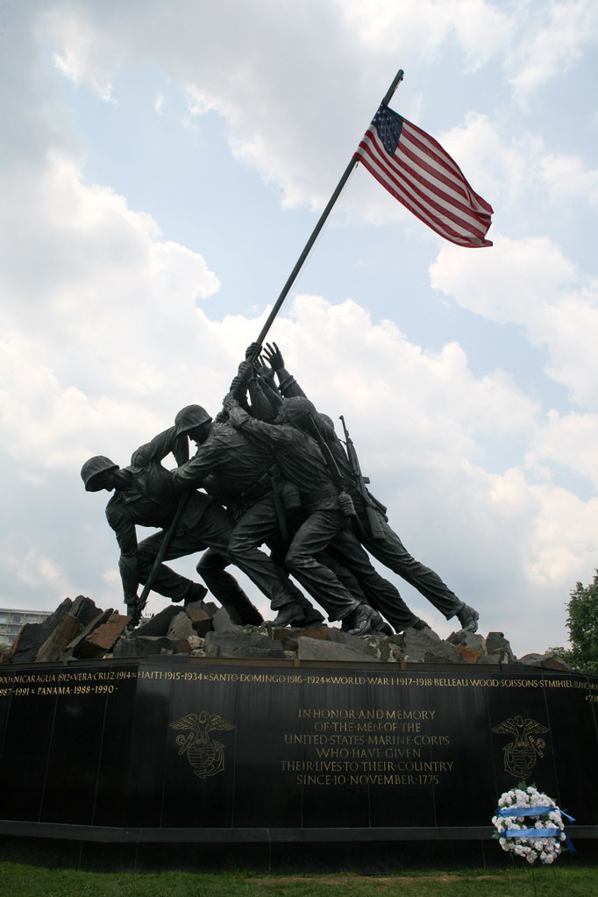
USA involvement
Haiti struggled with political problems, lack of money to spend on education and health, and the threat of European powers taking control.
The USA took control of Haiti in 1915 and invested in the country, improving the infrastructure and training a Haitian National Guard, but the country was once more not free.
Haiti became independent again in 1934.
Notes:
https://www.flickr.com/photos/nostri-imago/2858024523

Slide 9
Dictators and despots
Following its new independence Haiti was ruled by a series of dictators.
There was also a big divide between Haitians who were mixed race and those who were black.
The Duvalier family ruled Haiti from 1957–1986, controlling Haitians through intimidation and using the country’s wealth for their own benefit whilst Haiti became even poorer.
Following riots in 1986 the Duvalier family fled and democratic elections were held in 1990.

Slide 10
What happened next?
Haiti’s path has not been smooth since 1990 – find out more by watching this video clip.
Reflect on what you have learnt so far:
has Haiti always been poor?
why did Haiti end up in so much debt to France?
what impact did this debt have on Haiti?
how has the USA intervened in Haiti?
do you think USA intervention has helped Haiti?

Slide 11
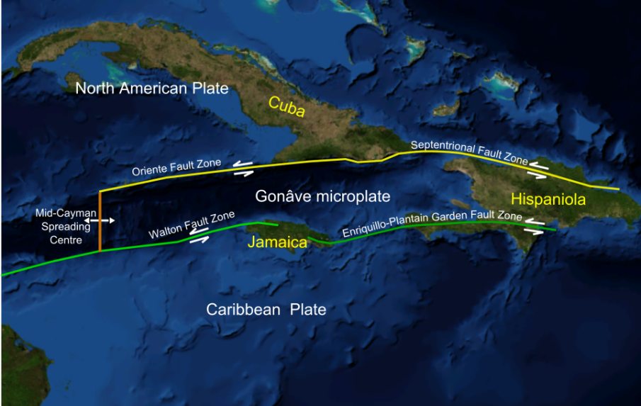
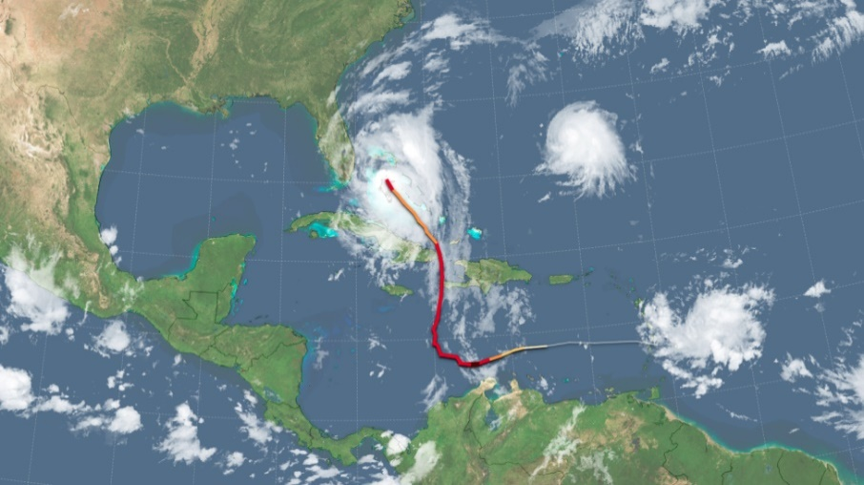
What makes Haiti a multi-hazardous environment?
A
Two main fault lines run through the island of Hispaniola, increasing the risk of earthquakes (A).
The island also lies in the path of many tropical storms which form in the Atlantic and move west into the Caribbean, such as Hurricane Matthew (B).
B
Notes:
https://upload.wikimedia.org/wikipedia/commons/thumb/3/32/Gon%C3%A2ve_microplate.png/1200px-Gon%C3%A2ve_microplate.png
https://commons.wikimedia.org/wiki/File:Path_of_Hurricane_Matthew.png

Slide 12
How does poverty affect Haiti’s vulnerability to natural hazards?
‘Disasters are not natural. We – humanity and society – create them and we can choose to prevent them… even when we cannot keep our infrastructure standing, we can stop people dying, we can protect our most valuable possessions, and we can learn to deal with devastation.’
From Disaster by Choice by Ilan Kelman (2020)
Notes:
Source of quote: Disaster by Choice: How Our Actions Turn Natural Hazards Into Catastrophes (2020), Ilan Kelman

Slide 13
Why was Haiti’s 2010 earthquake such a major disaster?
An earthquake of magnitude 7.0 struck Haiti in January 2010.
Thousands of buildings crumbled and there were no rescue and emergency services to help.
The Haitian government announced that 230,000 people had died.
UN troops came to help with reconstruction, but brought cholera to the island, leading to another 10,000 deaths
Activity
Do you think this was a natural disaster?
What role do you think poverty played?

Slide 14
What about tropical storms?
In 2004 Tropical Storm Jeanne led to 3,000 deaths in Haiti. It triggered mud flows, floods and landslides on slopes which had been deforested.
In 2008 four tropical storms in a row killed hundreds in Haiti – Fay, Gustav, Hanna and Ike.
In 2016 Hurricane Matthew crossed Haiti, killing at least 500 people.
Cholera, introduced to Haiti in 2010, became more of a problem because of floods caused by Hurricane Matthew.
Activity
Do you think this was a natural disaster? Why?

Slide 15
Who makes choices about Haiti’s future?
In 2016 researchers advised that spending US$66 million could stop the spread of cholera.
Haiti didn’t have enough money to do this and no one has given them help.
Remember that UN troops brought cholera to Haiti in 2010.
Activity
Whose fault is it that there is still cholera in Haiti?
Whose choices determine Haiti’s future?
Notes:
https://thebluediamondgallery.com/tablet-dictionary/c/cholera.html

Slide 16
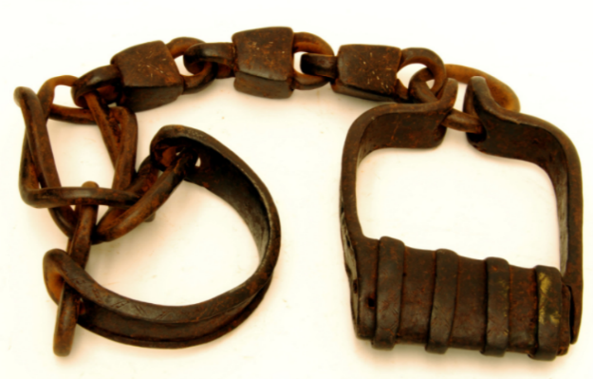
Can Haiti throw off its historical chains?
Reflect on what you have learnt about
Haiti’s history
why Haiti is a multi-hazardous environment
how poverty affects Haiti’s vulnerability to natural hazards.
Do you think Haiti can throw off its historical chains and become a country where people have a good quality of life? Justify your answer.
Notes:
https://commons.wikimedia.org/wiki/File:Trans-Atlantic_Slave_Trade_Artifacts.png

Slide 17
Challenge activities (optional)
Should France pay reparations to Haiti? Read this article – what is your view?
Find out more about the book Disaster by choice – watch this summary.
How has colonisation affected other countries around the world? Carry out research to find out.

Slide 18
Links
From the awarding bodies
Find out more
 | Topic
AQA | 3.2.2 Section B: The Changing Economic World
Edexcel A | 5 Global Development
Edexcel B | 2 Development Dynamics
Eduqas A | 6 Development and Resource Issues
Eduqas B | 1.3 A Global Perspective on Development Issues
OCR A | 2.2 People of the Planet
OCR B | 6 Dynamic Development
WJEC | 6 Development and resource issues
CCEA | Unit 2C: Contrasts in world development.
What were the negative impacts of colonization for India? Article
Are problems in the Democratic Republic of Congo today the result of colonization? Article
Images of Haiti by Haitians – photo story

Slide 19
Glossary
Single story: Only looking at a place from one viewpoint, leading to stereotypes and misconceptions
Colony: When a country is controlled by another country
Indigenous: The original people who belong to a place.

Slide 20
Acknowledgements
This presentation has been written by Catherine Owen, Head of Geography at The King Alfred School and Chair of the GA’s International Special Interest Group.
Figures
Slide 3: Source of images: https://www.pikist.com/free-photo-vllcq and
https://picryl.com/media/a-haitian-man-walks-past-a-sign-requesting-help-and-supplies-in-port-au-prince-4f9f95
Slide 4: Source of images: https://www.pikist.com/free-photo-vehdy and
https://www.wallpaperflare.com/haiti-port-au-prince-caribbean-sunset-sunrise-rainstorm-wallpaper-eoxjo
Slide 6: Source of image: https://en.wikipedia.org/wiki/File:G%C3%A9n%C3%A9ral_Toussaint_Louverture.jpg
Slide 8: Source of image: https://www.flickr.com/photos/nostri-imago/2858024523
Slide 11: Source of image: https://upload.wikimedia.org/wikipedia/commons/thumb/3/32/Gon%C3%A2ve_microplate.png/1200px-Gon%C3%A2ve_microplate.png and https://commons.wikimedia.org/wiki/File:Path_of_Hurricane_Matthew.png
Slide 15: Source of image: https://thebluediamondgallery.com/tablet-dictionary/c/cholera.html

