Slide 1
Plate tectonics – an update on the theory, new evidence and new conclusions

Slide 2
Getting started
You’ll need a notepad on which to make notes as you go along, or you could make notes, paste images, etc. on your device.
You can view these slides:
as a slide-show for any animations and to follow links
in ‘normal’ view if you want to add call-outs or extra slides to make notes, paste images, answer questions.

Slide 3
Plate tectonics: new theories
Plate tectonics is a relatively young and developing theory. Scientists are still gathering new information and, as scientific knowledge advances, we make new conclusions in the light of better evidence.
Researchers now are benefiting from new tools to ‘see’ inside Earth’s interior, and massive leaps in computing power allow scientists to visualise 3-D models which provide critical insights into long-standing gaps in geology’s unifying theory of plate tectonics.
In order to advance knowledge it is often necessary to discard previously held conclusions. This is the case with recent work on plate tectonics. Until very recently it was thought that convection in the mantle was the driving force which moved the plates, a theory still found in many textbooks and videos. We now know this is incorrect: the theory is in the midst of a dramatic upgrade.
Notes:
Topic master Glaciers p. 11

Slide 4
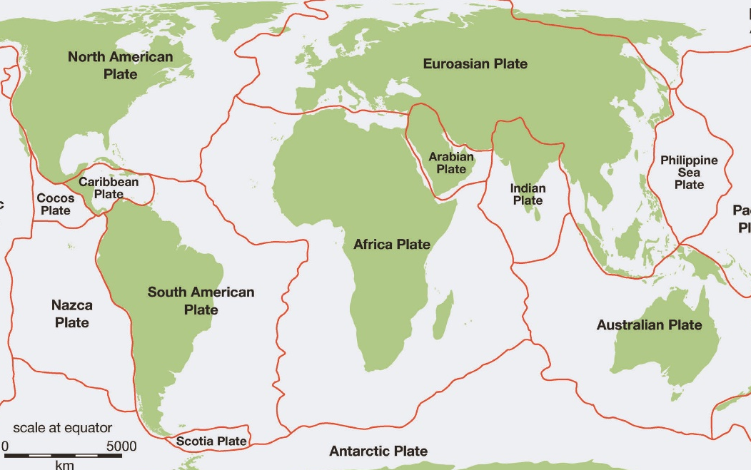
The theory of plate tectonics
The surface of Earth is broken up into large plates called tectonic or lithospheric plates.
They are formed from the rigid outer shell of Earth, called the lithosphere, which is made up of crust and the uppermost part of the mantle.
These two parts of the lithosphere are chemically different, but both are brittle and rigid.
Activities
Click on the linked diagram above, then:
Make a copy or take a screen grab of the map showing the plates.
Explore the GeolSoc website to discover more about the plates and their composition.
Complete the multiple choice quiz here.

Slide 5
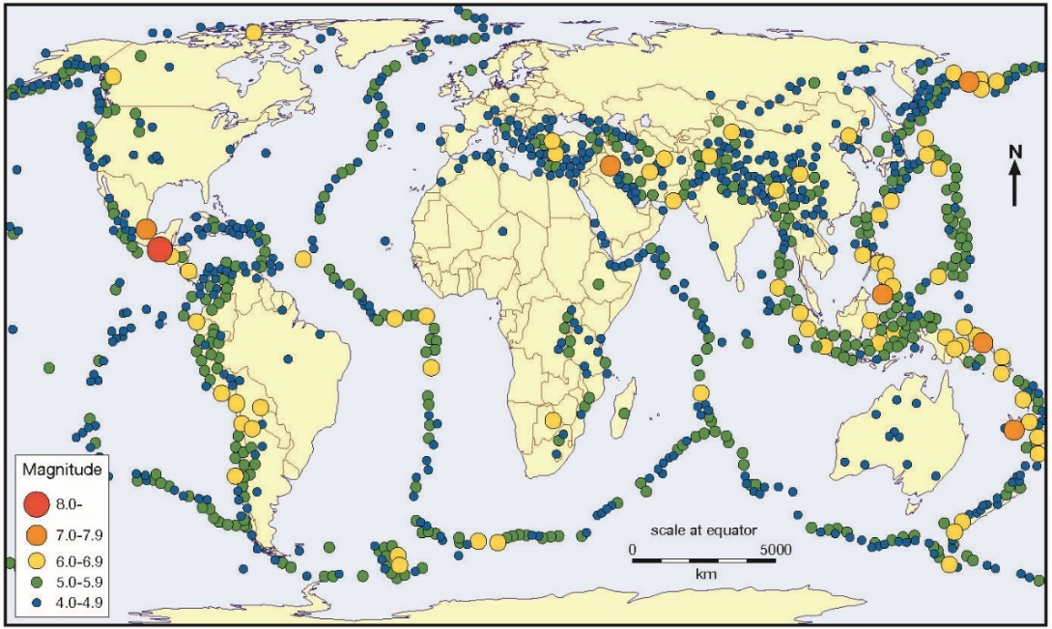
What is happening at the plate margins?
Each plate is in motion relative to its neighbours, causing the geological activity we have noticed at the plate boundaries.
You will notice that it is also possible, though less common, for geological activity to take place in the middle of plates.
Activity
Click on this link and explore the relationship between earthquakes, volcanoes and plate boundaries.
Study each layer independently, then combine them.
Describe the relationships across the different layers. What anomalies do you notice?
Notes:
Source: https://www.geography.org.uk/eBooks-detail/012e39f1-fac8-4bb0-996e-59b295c1f670

Slide 6
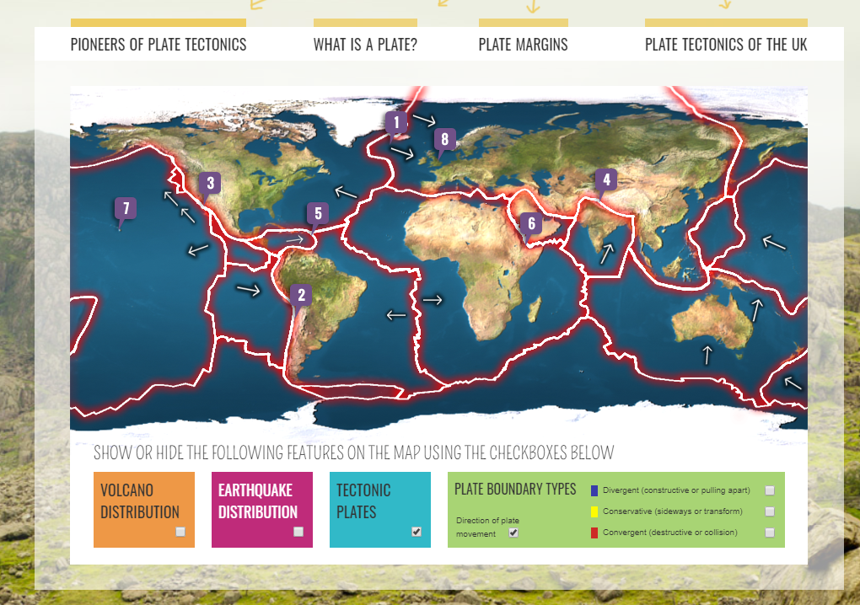
Are all the plate boundaries the same?
There are three different types of plate boundary and a fourth zone where the boundaries are not well defined. At these zones the effects of plate interaction are unclear:
divergent boundaries
convergent boundaries
transform boundaries
plate boundary zones.
Activities
Click on the linked image (left) to explore the nature of the different boundaries. Screen grab and make notes on all three boundaries.
Be sure to watch the animations.
Use this USGS link to investigate further and identify a zone where plate interaction at the boundary is unclear.
Notes:
Image source: https://www.geolsoc.org.uk/Plate-Tectonics/Chap2-What-is-a-Plate

Slide 7
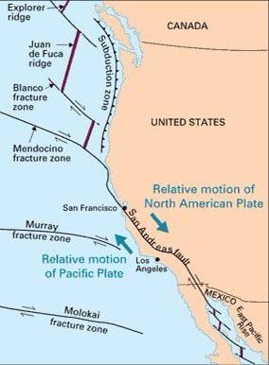
Alternative terms
The zone between two plates sliding horizontally past one another is generally called a transform-fault boundary, a transform boundary, or sometimes, a conservative boundary.
A convergent boundary is sometimes termed a destructive boundary. We now know that slabs of lithosphere may exist in the mantle for many millions of years, so this term is misleading.
a divergent boundary or divergent plate boundary is also known as a constructive boundary or an extensional boundary.
The San Andreas Fault is a transform fault connecting the spreading ridge in the Gulf of California with that off the north-west USA.
Notes:
Map source: https://commons.wikimedia.org/wiki/File:San_andreas_fault_system_los_angeles_basin.png

Slide 8
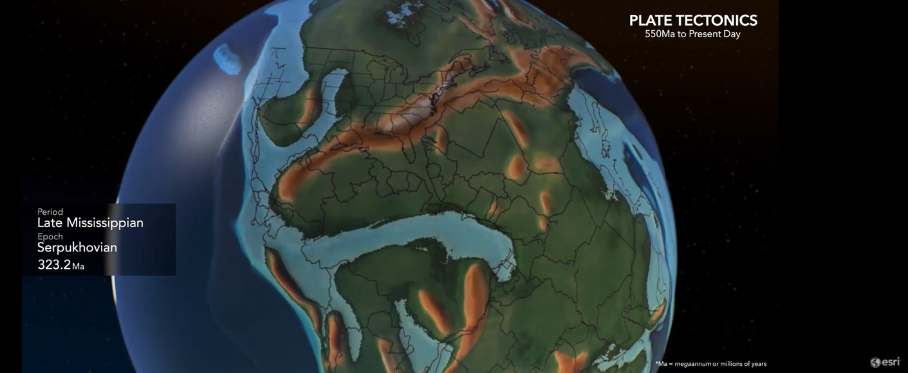
Are the continents fixed in place?
Click on the image above to view this ESRI animation showing tectonic plate movement and the changing paleogeography of the oceans and continents back to 540 million years ago (Cambrian-Precambrian Period).
Notes:
Source: ESRI

Slide 9
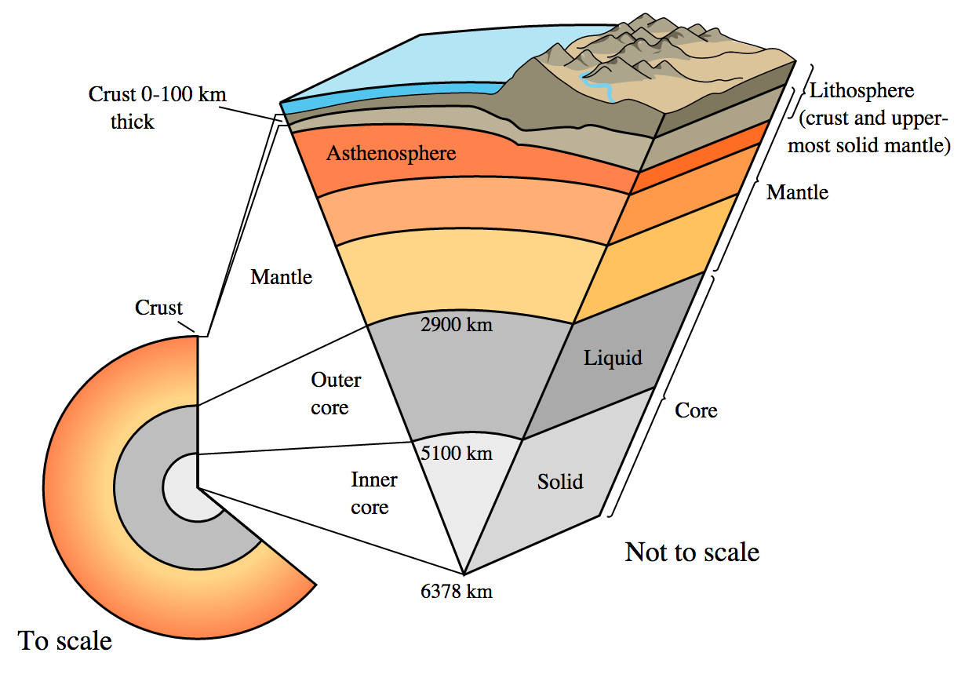
What lies underneath the lithosphere? Earth structure and internal energy sources
Activity
Click on this link and watch the video exploring the layered structure of Earth.
Take a copy of the diagram, then describe the characteristics of these layers:
solid inner core
liquid outer core
mantle (mesosphere, asthenosphere and lithosphere)
crust.
Notes:
Image: https://timeforgeography.co.uk/videos_list/plate-tectonics/structure-planet-earth/

Slide 10
Big ideas – many puzzles
Plate movements explain earthquakes, volcanoes, mountains, the formation of mineral resources, a habitable climate, and much else. They’re part of the engine that drags carbon from the atmosphere down into Earth’s mantle, preventing a runaway greenhouse climate like Venus’s. Their recycling through the mantle helps to release heat from Earth’s liquid metal core, making it churn and generate a magnetic field to protect Earth’s atmosphere from erosion by the solar wind. Read more here.
The mantle is continuously churning due to convection within Earth. Convection cells form where hot mantle rock rises from near the core, due to its lower density. As the hot rock rises away from the heat source, it cools down, causing an increase in density. Eventually the rock becomes cool enough to begin sinking back to the core, where the process starts again. It was once thought that this convection was the driving force that moved the plates. However, the theory is in the midst of a dramatic upgrade.
Activity
Read the first paragraph from this paper then explain why mantle convection is not now thought to drive plate movement.

Slide 11
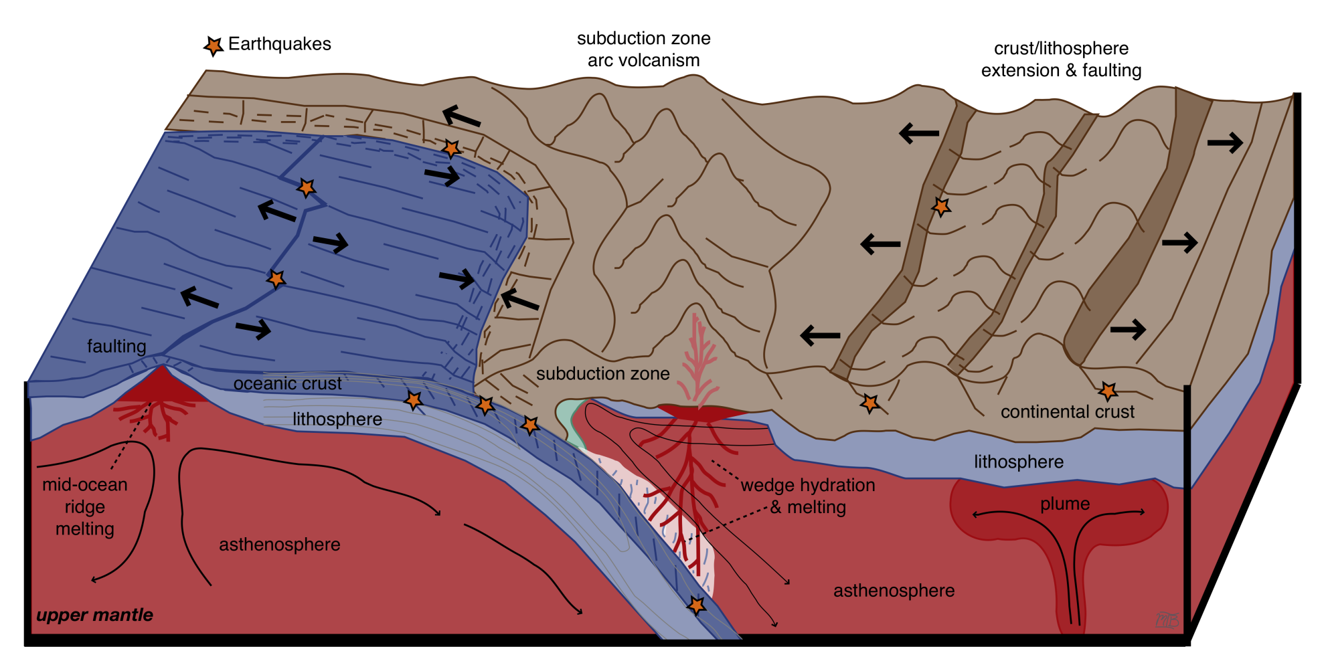
If not convection, then what…?
Convection does exist, but it seems to occur as patchy thermal plumes rather than a pattern of strong, regular cells. These help to explain previously anomalous hot spots such as Hawaii.
A plume is also thought to be responsible for Iceland’s volcanism. Plumes are considered to originate at the mantle–core boundary; there are thought to be about nine major plumes.
Several forces have been proposed as the drivers of plate movement. Three main forces determining movement are:
ridge push (gravitational sliding)
slab pull
viscous drag.
Activity
Click on the diagram below to find an article about the forces driving plate motion. (You can ignore all the formulae.)
Copy or screen grab the diagram and make notes explaining the three main forces determining plate movement.
Notes:
Figure courtesy of Magali Billen, Dept. of Earth and Planetary Sciences, UC Davis, CC BY-NC-SA 3.0 US.
https://geo.libretexts.org/Courses/University_of_California_Davis/UCD_GEL_56_-_Introduction_to_Geophysics/Geophysics_is_everywhere_in_geology.../04:_Plate_Tectonics/4.01:_The_Forces_Driving_Plate_Motions

Slide 12
Apply your learning
Activity
Make a copy of the diagram above. Add call-outs to the locations for the following, with short notes explaining their characteristics:
oceanic and continental plates
ridge push, slab pull, viscous drag
thermal plumes.
Notes:
Image © Geographical Association https://www.geography.org.uk/Journal-Issue/52138cb7-9c33-431d-89b1-70f39e5f46f0

Slide 13
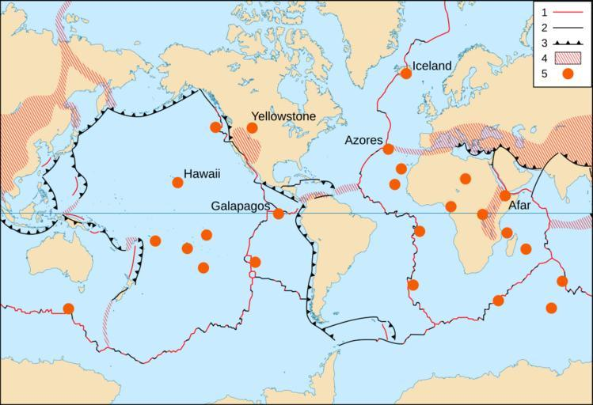
Thermal plumes and hotspots
There is continued debate about the nature of thermal plumes and hot spots. It is still unclear whether hot spots are caused by plumes located as deep as the core–mantle boundary or by localised upper-mantle volcanism, or by either of those processes operating at different places. The work to discover the cause is continuing.
Activity
Click on the linked map (left) to view at a larger size, then open this link and scroll down to find an explanation of the Hawaiian–Emperor Chain.
Screen grab the Hawaiian hot spot cutaway and describe and explain its formation – include references to recent studies.
Identify two further hot spot areas and research the explanation for their formation here.
Notes:
Map source: https://snappygoat.com/s/?q=bestof%3ATectonic+plate+boundaries2.png+en+Tectonics+plates+map+internationalized+%3Cbr%3E+1-Asthenosphere%3B+2-Lithosphere%3B+3-Hot+spot%3B+4-Oceanic+crust%3B+5-Subducting+plate%3B#41037fc37a3e4e9fb4e7ec1b17b52cbdad6ed2d3,0,86.

Slide 14
Taking it further 1: how do we know what is happening in the mantle?
A tomographic transect across the East Asian mantle under the Eurasian–South China Sea margin, the Philippine Sea and the western Pacific from researchers Wu and Suppe (2018) shows the slabs subducting into the mantle.
Activities
Click on this link and watch the animation which explains how tomography can reveal what is happening in the mantle.
Download the pdf from the section ‘Optional Files Seismic Tomography: Background’ and make brief notes on how tomography provides three-dimensional images of Earth’s interior.

Slide 15
Taking it further 2: Hades Underworld Explorer
The Atlas of the Underworld is the first complete mapping of subducted plates in Earth’s mantle and their geological interpretation.
Activities
Click on the link and start exploring the underworld!
Select a section preset or drag the markers to view a geodesic section of any supported global tomographic model for the areas you are studying – e.g. across the Sea of Japan (left)
Click settings (top right on the web page) for more information.
Notes:
http://www.atlas-of-the-underworld.org/hades-underworld-explorer/
Elaine: should be OK with this one - the map is Google, and the site says open source

Slide 16
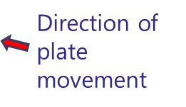
Hades Underworld Explorer in the Pacific
Descending Pacific Slab (blue) dragging down the Pacific Plate
Activity
In this cross-section the cold subducting slab of the Pacific Plate (an oceanic plate), subducts the Eurasian Plate and descends into the mantle (shown in blue, top right). Identify three other areas you are studying, then:
create a geodesic section for each
see if you can interpret the tomography section.
Notes:
http://www.atlas-of-the-underworld.org/hades-underworld-explorer/

Slide 17
Taking it further 3: complex ideas about modelling plate movement
In this paper the authors predict global patterns of plate motions using numerical models. The paper deals with complex issues of flow. Look at the diagram that shows lithospheric thickness models and slab pull plate-driving forces:
blue arrows show slab pull edge forces for individual subduction segments
background colours show lithospheric thicknesses
black contour lines surround regions where lithosphere is thickest reaching the base of the asthenosphere.
Activity
Read the abstract at the beginning of the paper. What are the authors trying to show?

Slide 18
Taking it further 4: How do subduction zones and arcs form? A lecture by Robert Stern
Activity
Click on the image (top left) to watch a 14-minute lecture by Robert Stern and Taras Gerya about how subduction zones form.
Screen grab the diagram (bottom left) from the lecture. As you watch the video make brief notes on each mechanism that may start a new subduction zone.
Notes:
Source: https://www.youtube.com/watch?v=SF8HMDV3JgU

Slide 19
Glossary 1
Convergent boundary: where lithosphere descends into the asthenosphere as one plate dives under another
Divergent boundary: when two tectonic plates move away from each other
Plate tectonics: Earth's outermost layer is broken into a dozen or more large and small plates that are moving relative to one another
Ridge push: (also known as gravitational sliding) occurs when gravity acts on material that has built up due to volcanic eruptions. As this material sinks, the plates move away from the ridge and more material is added
Slab pull: at a subduction boundary, one plate is denser and heavier than the other; the denser begins to subduct beneath the less dense plate. The edge of the subducting plate is much colder and heavier than the mantle, so it continues to sink, pulling the rest of the plate along with it. The force that the sinking edge of the plate exerts on the rest of the plate is called slab pull
Subduction: as an oceanic plate moves towards a continental plate, it sinks beneath it because it is heavier. It is then destroyed, forming deep sea trenches and island arcs with volcanoes

Slide 20
Glossary 2
Tectonic or lithospheric plates: large-scale features on Earth’s surface. They are huge, rigid blocks of the lithosphere, generally composed of both continental and oceanic lithosphere
Thermal plume: an upwelling of abnormally hot rock within Earth’s mantle
Tomography: imaging through a cross-section of a solid object using penetrating waves such as X-rays or ultrasound
Transform boundary: a boundary where two plates slide past each other
Viscous drag: a force opposing the motion of the plate (or slab) and acting to slow it down
Volcanic ‘hot spot’: an area in the mantle located away from plate boundaries where heat rises as a thermal plume from deep in Earth
Volcanism: a wide range of processes associated with molten rock, gas, ash etc. expelled at Earth’s surface

Slide 21
Links
From the awarding bodies:
Further reading:
 | Topic
AQA | 3.1.5.2 Plate tectonics
Eduqas | 3.1.1 Tectonic processes and hazards, 3.1.2 Volcanoes, processes, hazards and their impacts
Edexcel | Dynamic Landscapes Topic 1: Tectonic Processes and Hazards
OCR | Topic 3.5 – Hazardous Earth
WJEC | Contemporary Themes in Geography, Section A: Tectonic Hazards
CCEA | Unit A2 1: Physical Processes, Landforms and Management
GEO: Reading around tectonic processes and landforms
‘Plate update: refreshing ideas for teaching plate tectonics’ Teaching Geography Spring 2017, Duncan Hawley and John Lyon
USGS: Understanding plate motions and Dynamic Planet map
The Geology Society: Plate Tectonics
© Geographical Association, 2020

Slide 22
Acknowledgements
This presentation has been written by John Lyon.
Figures
Slide 4: Map © Geographical Association
Slide 5: Map © Geographical Association
Slide 6: Image © Geology Society
Slide 7: Map source Wikimedia
Slide 8: Image © ESRI
Slide 9: Diagram © Time for Geography
Slide 11: Diagram © Dept of Earth and Planetary Sciences, UC Davis
Slide 12: Diagram © Geographical Association
Slide 13: Map © Snappy Goat
Slides 15/17: Images © Atlas of the Underworld
Slide 18: Images © R Stern Robert Stern Lecture YouTube video

