Slide 1
Paleoclimates – climate change in
the Quaternary Ice Age

Slide 2
Getting started
In this unit you will explore the climate of the current Ice Age, looking at how and why it has changed.
You’ll need a notepad on which to make notes as you go along, or you could make notes, paste images, etc. on your device.
You can view these slides:
as a slide-show for any animations and to follow links
in ‘normal’ view if you want to add call-outs or extra slides to make notes, paste images, answer questions.

Slide 3
Ice Ages, glacials and interglacials
There have been five known Ice Ages in Earth's history. Currently, we are in the Quaternary Ice Age, which started 2.6 million years ago.
During Ice Ages, the environment fluctuates between phases of colder conditions, known as glacials, and warmer phases known as interglacials.
The Earth is currently in an interglacial phase of the Quaternary Ice Age termed the Holocene.
The last glacial phase of the Quaternary, when large ice sheets spread across much of Europe and North America, ended approximately 11,700 years ago with the start of the Holocene.
There have been around 30–50 glacial-interglacial cycles in the Quaternary.
All Quaternary glacial and interglacial phases except the Holocene are grouped together and known as the Pleistocene.

Slide 4
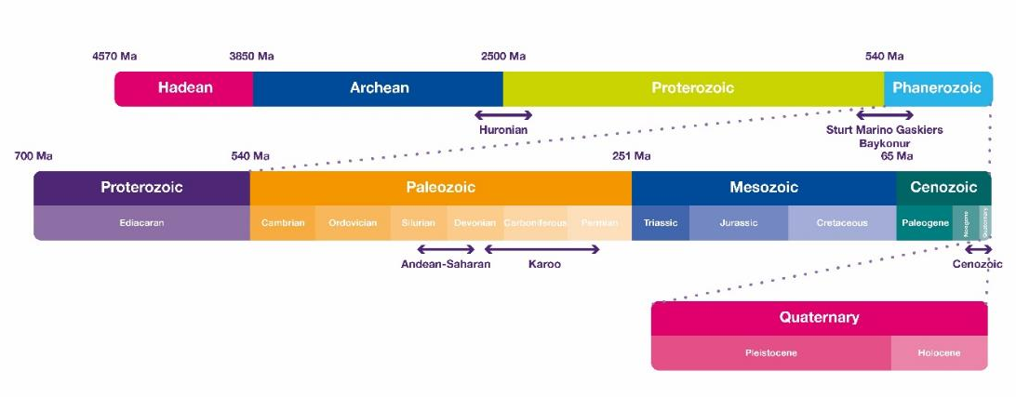
The Quaternary in perspective
Activity
Locate the following events on this timeline:
the age of the dinosaurs – the Mesozoic
the age of the trilobites – the Palaeozoic
earliest life appears around 3500 million years ago.
Notes:
Image source https://www.metlink.org/resource/6-past-climate-change/

Slide 5
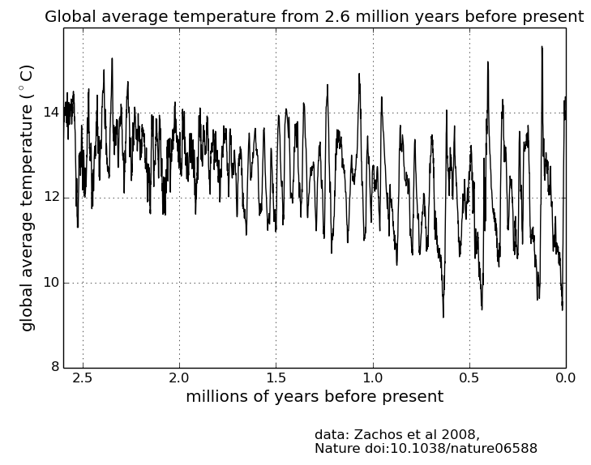
Pleistocene glacials and interglacials in the UK
Activity
Watch the animation (look for the GIF) and download the Google Earth animation showing the extent of the ice sheet covering the British Isles through part of the Pleistocene.
When was the ice most extensive?
Does it correspond to the coldest temperatures on the graph to the left?
Notes:
Image source: https://www.metlink.org/resource/past-climate-changes-module-1/

Slide 6
Gathering data about past climates
In order to understand how the climate has changed in the past, we need weather measurements from the time before instruments existed.
For these purposes, we have to use climate proxies, such as the information stored in ice cores (below) or bogs, tree rings and shells.
Activities
Explore this map and text and make notes about the different sources of proxy climate data.
Watch this video and check your understanding using the questions below the film.
Notes:
Image National Science Foundation Ice Core Facility used with permission

Slide 7
Forcing climate change: the Milankovitch Cycles
The Earth’s orbit around the Sun changes in three ways through time because of the combined gravitational pull of the Sun, Saturn, Jupiter and other planets – these are known as the Milankovitch Cycles. They affect which regions of the Earth’s surface are closest to or facing the Sun at different times of year.
The three cycles affect:
how circular or elliptical the Earth’s orbit around the Sun is
the angle of tilt of the Earth’s axis of rotation
where in space the Earth’s axis of rotation points (the precession of the axis).

Slide 8
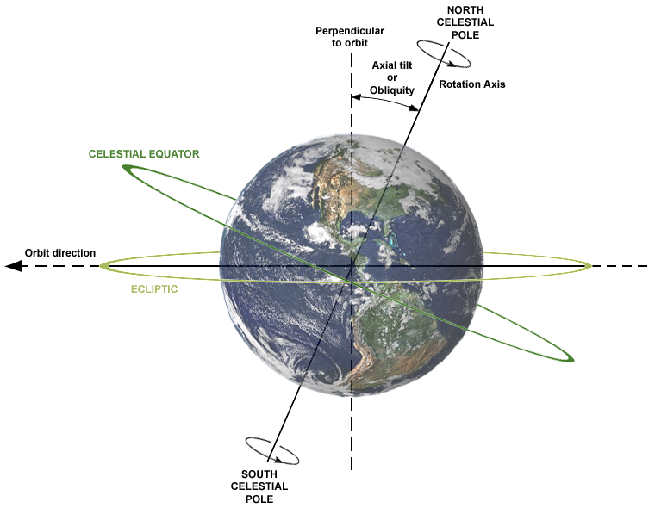
Earth and Sun
Axial tilt: 23.5º
The Earth orbits around the Sun once a year on an elliptical orbit.
The Earth also rotates around an (imaginary) axis through the North and South Poles. The Earth’s axis is tilted by 23.5°: the axial tilt.
The Earth rotates round its axis every 24 hours. This explains day and night: it is daytime on the side of the Earth facing the Sun, night on the side facing away.
Activity
Watch this animation of Earth’s orbit and axis. Try and explain day and night and seasons to a member of your household using the animation or a globe/ ball and light/ torch.

Slide 9
Changes to the Earth’s orbit
Orbit: the Earth’s orbit is elliptical. The shape of this orbit changes slightly over 110,000 years.
The Earth is currently closer to the Sun in January than in July, meaning that the seasons are more extreme in the Southern Hemisphere than in the Northern Hemisphere. The Northern Hemisphere receives about 7% less radiation in its summer, and 7% more in its winter than the Southern Hemisphere in its equivalent seasons.
With a more elliptical orbit, the Earth passes closer to the Sun than it ever does on a more circular orbit.
This can allow the melting of polar ice in the summer. With a more circular orbit, winter ice can survive the summer and grow in the following winter, triggering a glacial period.
Activity
Watch the first animation on this NASA page to check you can visualise changes in the Earth’s orbit.
Notes:
https://commons.wikimedia.org/wiki/File:Seasons1.svg

Slide 10
Changes to the Earth’s tilt
Axis tilt: Earth’s axis tilts; the angle of tilt changes over 41,000 years.
The tilt changes between 21.1° and 24.5°. It is currently 23.5° and decreasing.
If the Earth’s axis were vertical, we wouldn’t have any seasons.
When the axis tilts more, summers are warmer and winters colder. When the axis tilts less, summers are cooler and winters are warmer.
Activities
Watch the second animation on this NASA page to check you can visualise changes in the Earth’s tilt.
Stretch your thinking: why might a smaller angle of tilt cause ice caps to grow?

Slide 11
Changes to the Earth’s rotation (precession)
Axis rotation: Earth spins on its axis; this changes over 26,000 years because of the pull of the Sun and moon on the Earth.
Over time the axis ‘wobbles’ and points to a different direction in space.
One way to visualise this is like a child’s spinning top wobbling as it slows down
It changes which star we see as the North Star – currently it is Polaris, but 13,000 years ago, it would have been Vega.
When the North Pole points more towards the Sun, the Northern Hemisphere is warmer.
Activity
Watch the third animation on this NASA page to check you can visualise changes in the Earth’s rotation.
Read this article and look for examples of Saharan rock art that record the changing climate.

Slide 12
Milankovitch Cycles: feedbacks and combinations
Feedback mechanisms
If a polar region receives less sunlight, ice grows which in turn reflects more sunlight, cooling the Earth more
As oceans cool, they absorb greenhouse gases, cooling the climate more.
Combinations
Water and land heat up and cool down differently: continental drift interacts with the Milankovitch Cycles
The three Milankovitch Cycles interact: at the Mid-Pleistocene Transition around 1.2 million to 700,000 years ago, the Milankovitch cycles started interacting differently, with a shift to a dominant 100,000 year climate signal.
Notes:
© By Dragons flight (Robert A. Rohde) CC-BY-SA-3.0, via Wikimedia Commons: https://commons.wikimedia.org/wiki/File:Five_Myr_Climate_Change.png

Slide 13
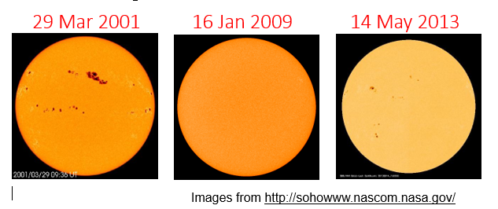
Forcing climate change: the Sun
We get energy (light, ultraviolet light and heat) and charged particles from the Sun.
Charged particles give us the Northern and Southern lights and can have an impact on communications.
However, changes in the energy we get from the Sun have a greater impact on weather and climate.
The more sunspots there are on the surface of the Sun, the more energy arrives at the top of the atmosphere and heats the Earth’s surface.
The Sun may have introduced an overall global warming of approximately 0.07°C before 1960.
Activities
Select Sun from the menu on this site.
Scroll down to the graph which shows ‘solar irradiance and sunspot number’. Solar irradiance is the amount of the Sun’s energy arriving at the top of the atmosphere. Describe how the two lines relate to each other.
Now scroll up to the graph which shows sunspot activity since 1700. When would you expect there to have been a warmer/ colder climate?
Notes:
https://soho.nascom.nasa.gov/home.html

Slide 14
Forcing climate change: volcanoes
Huge explosive volcanic eruptions in the Tropics, energetic enough to push sulphur gases up into the relatively stable stratosphere where they condense into aerosols (small particles), can have a cooling effect on climate by increasing the albedo of the atmosphere. More of the Sun’s light is reflected by the aerosols before it reaches the ground. The climate cools.
The impact of a volcano is greatest in the summer (when there is more sunlight to be reflected) and over land (which heats up and cools down more quickly than ocean water).
Volcanoes can also emit greenhouse gases.
Activities
Have a look at this PowerPoint then research the very different ways the following volcanoes affected the climate:
Eyjafjallajökull, 2010
Tambora, 1815
Yellowstone, 640,000 years before present.

Slide 15
1816: the ‘year with no summer’
The combined eruptions of La Soufrière (1812), Mayon (1814) and Tambora (1815) had catastrophic global effects, leading to a ‘year with no summer’ in 1816. As a result:
in 1817, 11.5% of Parisians were described as destitute
65,000 people starved to death in Ireland
in Switzerland, the death rate was 56% higher in 1817 than in 1815
formula baby milk was invented
Turner painted vivid sunsets
Dracula and Frankenstein’s monster were created.
Activities
Read this article and recreate figure 5, either with a screenshot, in Excel or on graph paper, leaving space for two more bars per month
Now use the Met Office website to look at the current climate at Tynemouth. Add current frost days and rainfall days to your figure. Where are the significant differences to 1816?
Does your graph support the conclusions in the article?

Slide 16
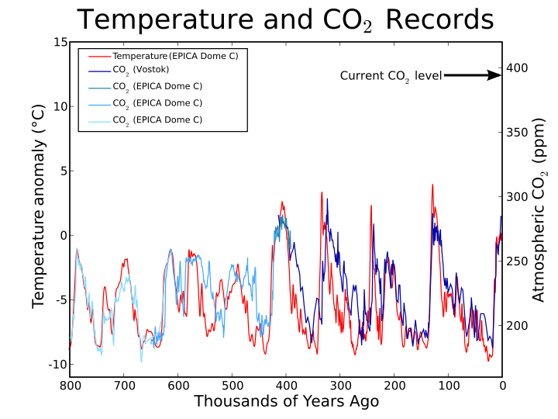
Carbon dioxide and temperature
Data from Antarctic ice, such as the Vostok ice core, show that CO₂ levels in the atmosphere and atmospheric temperatures fluctuate roughly together.
The initial changes in temperature during interglacial periods are explained by the Milankovitch Cycles. As ocean temperatures start to rise, the solubility of CO₂ in water decreases and so the oceans release CO₂ into the atmosphere. In turn, this release amplifies the warming trend, leading to yet more CO₂ being released.
Naturally, the increase in CO₂ lags behind the increase in temperatures.
Activity
Try this experiment or, if you have the equipment, this one.
Notes:
Source https://commons.wikimedia.org/wiki/File:Co2-temperature-records.svg Leland McInnes under the Creative Commons Attribution-Share Alike 3.0 Unported

Slide 17
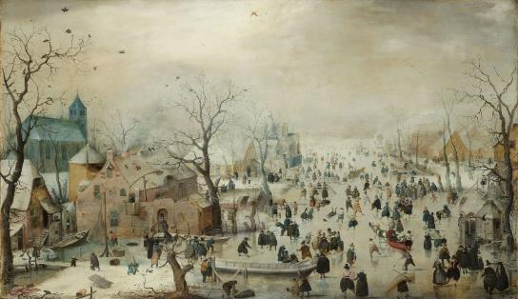
The Little Ice Age
The Little Ice Age (LIA) was a generally colder period between 1450 and 1850. Within the period, there were some isolated colder events, which occurred at different places at different times. In the Northern Hemisphere, temperatures were generally less than 1°C colder during the Little Ice Age than during the late 20th century.
Notes:
Image: Henrik Avercamp / Wikimedia Commons https://en.wikipedia.org/wiki/File:Hendrick_Avercamp_-_Winterlandschap_met_ijsvermaak.jpg
Full reference: Knight, S. (2019) ‘Did the European conquest of the Americas contribute to the Little Ice Age?’
Teaching Geography 44 (2) pp.68-71.

Slide 18
Did the European conquest of the Americas contribute to the Little Ice Age?
Read this article then reflect:
Some people have argued that the drop in atmospheric CO₂ in 1610, only 18 years after Columbus landed, marks the start of the Anthropocene – the period during which human activity has been the dominant influence on the Earth’s geology, ecosystems and climate system. Other suggestions for when the Anthropocene started include:
Megafauna extinctions from 50,000 to 10,000 BC. Overhunting by humans made a significant contribution.
The beginning of farming around 11,000 BC, or when it became widespread in 8,000 BC.
The beginning of rice farming in 6,500 BC. Rice farming releases methane, a greenhouse gas, into the atmosphere.
The beginning of evidence for human activity recorded in soils, 3000 to 500 BC.
The Industrial Revolution, 1760 AD.
Nuclear explosions: 1945 saw the first nuclear explosions; long-lived radioactive elements leave a dateable layer in soils. At much the same time the widespread use of mass-produced fertilisers, which impact on the nitrogen cycle, and of new plastics occurred.
What do you think – is there such a thing as the Anthropocene? If so, when did it start?
Notes:
Image: Henrik Avercamp / Wikimedia Commons
Full reference: Knight, S. (2019) ‘Did the European conquest of the Americas contribute to the Little Ice Age?’
Teaching Geography 44 (2) pp.68-71.

Slide 19
Climate change in the UK
The Central England Temperature dataset (CET) is the longest instrumental record of temperature in the world.
The data represents the temperature in a roughly triangular area enclosed by Lancashire, London and Bristol.
The sources of the data include records kept by individuals around the country. The precision of the data published for each year reflects the number, accuracy, reliability and geographical spread of the temperature records that were available for that year.
The mean monthly temperature record starts in 1659 with daily data being available from 1772.
Reflection
The instrumental data used in creating the CET has been carefully combined and corrected.
Have a look at the TEMPEST database. What are the uses and limitations of written accounts such as these?

Slide 20
Glossary 1
Aerosol: A suspension of airborne solid or liquid particles, with a typical size between a few nanometres and 10μm that reside in the atmosphere for at least several hours.
Albedo: The fraction of solar radiation reflected by a surface or object. Snow-covered surfaces have a high albedo, the albedo of soils ranges from high to low, and vegetation-covered surfaces and oceans have a low albedo.
Anthropocene: The period during which human activity has been the dominant influence on the Earth’s geology, ecosystems and climate system.
Climate feedbacks: An interaction in which a perturbation (change) in one climate quantity causes a change in a second, and the change in the second quantity ultimately leads to an additional change in the first. A negative feedback is one in which the initial perturbation is weakened by the changes it causes; a positive feedback is one in which the initial perturbation is increased.
Climate forcings: Forcing represents any external factor that influences global climate by heating or cooling the planet. They may be either natural or anthropogenic (caused by humans).
Climate proxies: Climate proxies are preserved physical characteristics of the past that stand in for direct meteorological measurements and enable scientists to reconstruct past climatic conditions.

Slide 21
Glossary 2
Glacial: A colder period within an Ice Age, when glaciers and ice sheets grow.
Ice Age: A period of time when there is widespread glaciation and permanent ice at the poles.
Interglacials: Periods with a warmer climate in between glacials.
Precession: Precession is a change in the orientation of the rotational axis of a rotating body.
Sunspots: Sunspots are temporary phenomena on the Sun's photosphere that appear as spots darker than the surrounding areas on the surface of the Sun.
Stratosphere: The highly stratified (layered) region of the atmosphere above the troposphere extending from about 10 km (ranging from 9 km at high latitudes to 16 km in the Tropics on average) to about 50 km altitude.

Slide 22
Links
From the awarding bodies
Further reading
 | Topic
AQA | 3.1.4 Glacial systems and landscapes
Eduqas | 1.2.2 Glaciated landscapes: causes of climate change
Edexcel | 2a Climate change and glaciated landscapes
OCR | 3.1 Climate change
WJEC | 1.2.2 Glaciated landscapes: causes of climate change
CCEA | D1: Natural climate change processes
Metlink notes: past climate change
Skeptical Science: Climate change myths
From the GA:
The Anthropocene: a primer for geographers
GEO: Reading around climate change
Knight, S. (2019) ‘Did the European conquest of the Americas contribute to the Little Ice Age?’ Teaching Geography, 44, 2, pp.68-71.
The Little Ice Age, How Climate made History, 1300-1850, B. Fagan, Basic Books, (2000)
The Two-Mile Time Machine: Ice Cores, Abrupt Climate Change, and Our Future Richard B. Alley, Princeton University Press, (2002)

Slide 23
Acknowledgements
This presentation has been written by Dr Sylvia Knight, Head of Education at the Royal Meteorological Society
Figures
Slide 4: https://www.metlink.org/resource/6-past-climate-change/
Slide 5 https://www.metlink.org/resource/past-climate-changes-module-1/
Slide 6 National Science Foundation Ice Core Facility used with permission
Slide 12: Image: © By Dragons flight (Robert A. Rohde) CC-BY-SA-3.0, via Wikimedia Commons: https://commons.wikimedia.org/wiki/File:Five_Myr_Climate_Change.png
Slide 13 https://soho.nascom.nasa.gov/home.html
Slide 16: Graph source https://commons.wikimedia.org/wiki/File:Co2-temperature-records.svg Leland McInnes under the Creative Commons Attribution-Share Alike 3.0 Unported
Slide 17: source of image: Henrik Avercamp / Wikimedia Commons https://en.wikipedia.org/wiki/File:Hendrick_Avercamp_-_Winterlandschap_met_ijsvermaak.jpg

