Slide 1
Evidence of glacial retreat

Slide 2
Getting started
You’ll need a notepad on which to make notes as you go along, or you could make notes, paste images, etc. on your device.
You can view these slides:
as a slide-show for any animations and to follow links
in ‘normal’ view if you want to add call-outs or extra slides to make notes, paste images, answer questions.

Slide 3
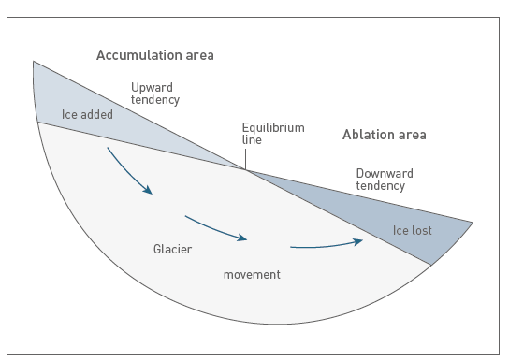
Glacial retreat
Glacier formation depends on the balance between the input of ice from sources such as snowfall (accumulation); and the loss of ice by processes such as melting (ablation).
The balance between accumulation and ablation
is the ‘mass balance’ of a glacier. When there is more ablation than accumulation the balance is negative and the glacier shrinks – or retreats.
Notes:
Source of diagram: Top Spec Geography: Glaciated Landscapes (2017) R Waller and P Knight, p. 11

Slide 4
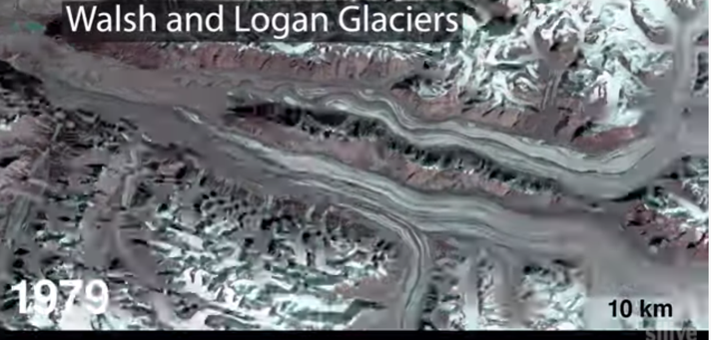
Glacial retreat: remote sensing
It generally takes time for glaciers to respond to change. Some glaciers and ice sheets expand and retreat over periods of hundreds of thousands, or even millions, of years. In some situations, however, glacier ice can move quickly, or disappear quickly.
At present, around the world many mountain glaciers are retreating by tens or hundreds of metres per year. Remote sensing is one way in which these changes can be recorded and measured.
Activity
Click on the image above to launch a video using Landsat satellite images to show the flow of ice over nearly fifty years of records.
What are the advantages of seeing glaciers moving this rapidly?
Is viewing glaciers this way misleading in your view, or not? Explain your answer.

Slide 5
Glacial retreat: landscape evidence 1
Many glacier margins feature sequences of recessional moraines that are associated with a general pattern of glacial retreat, punctuated by minor winter readvances. We can readily identify these small-scale ridges in both modern-day and relict glacial environments and use them to reconstruct recent and long-term glacier fluctuation.
Activity
Find out more about the different types of moraines here. Use this information to identify different types of moraine on this photo of a valley glacier in north-west Mongolia (there is a larger version of it on the next slide).
Notes:
Source of image: Top Spec Geography: Glaciated Landscapes (2017) R Waller and P Knight, p. 13 © Richard Waller

Slide 6
Notes:
Source of image: Top Spec Geography: Glaciated Landscapes (2017) R Waller and P Knight, p. 13 © Richard Waller

Slide 7
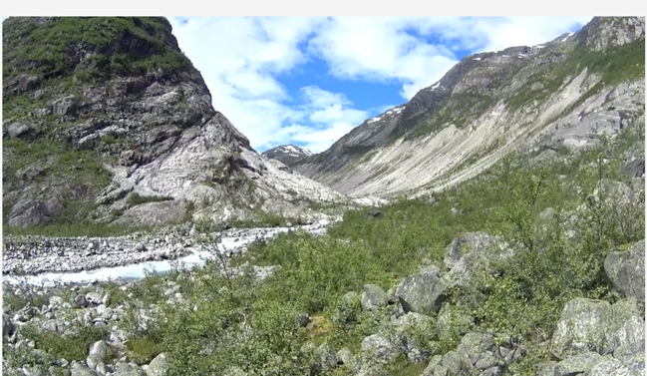
Glacial retreat: landscape evidence 2
This video clip was filmed in Norway, and shows how landscape evidence can provide information about both the features of glacial retreat, but also the rate of retreat.
The clip refers to ‘downwasting’: this is when glaciers get thinner because of melting. Many mountain glaciers are currently both retreating and downwasting.
Activities
Click on the image to launch the video.
Explain how landscape evidence is used here to gauge the rate of retreat.
Is this method going to be replicable in every glaciated landscape? What other evidence for rate of retreat could be used instead?
What effect would downwasting have on transportation and deposition?

Slide 8
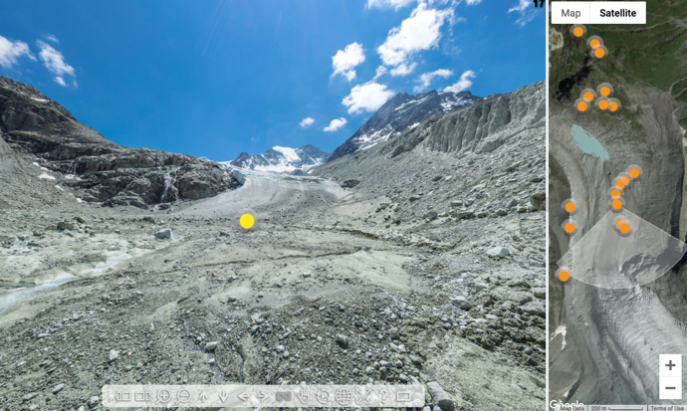
A virtual fieldtrip
VR Glaciers and Glaciated Landscapes lets you explore glaciated landscapes using a Street View-style approach.
Activities
Click on the top image to watch a video about the VR resource for info about what it does.
Select a field trip to go on from this page (scroll down), or click on the bottom image to visit the Moiry Valley, Switzerland.
Record landscape evidence of glacial retreat from your fieldtrip – you could use screengrabs for this.

Slide 9
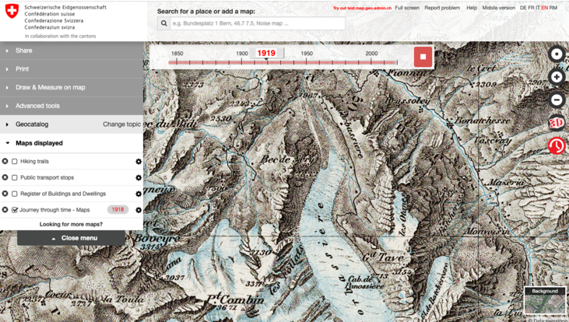
Glacial retreat: evidence from maps 1
The SwissTopo website provides maps from the Swiss national mapping service from the mid-nineteenth century to the present. These maps provide evidence of longer-term glacial recession and the rate of retreat.
Activities
Visit the website and select a glacier, e.g. the Glacier de Corbassière.
Select the ‘Journey through time’ icon on the left to see the changes over time.
What is the oldest map you can find that shows a glacier?
Can you find any glaciers that have completely disappeared?

Slide 10
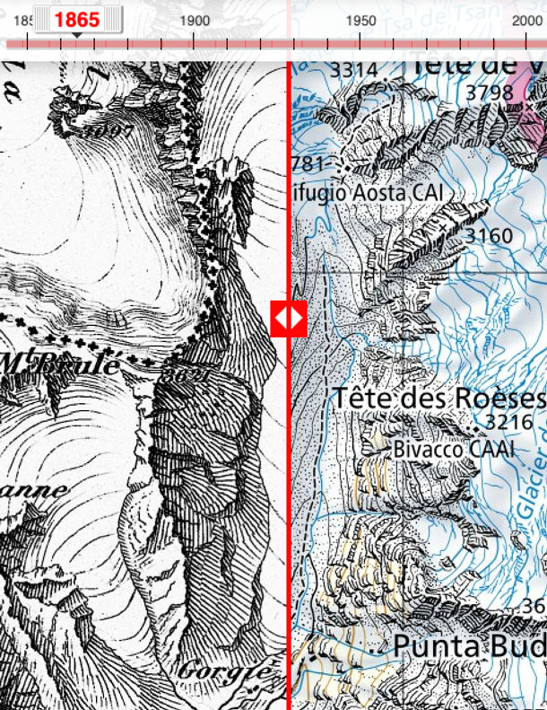
Glacial retreat: evidence from maps 2
Activities
You can use the SwissTopo maps to measure glacial retreat. There is a Compare tool in the Advanced tools menu. Select this while the map is in ‘Journey through time’ and drag to compare maps.
Compare a modern glacier limit to its limit on the oldest map. Measure the difference between the points and convert it to metres/km using the scale.
Repeat this for each year a new map was produced.
Plot your results on a graph of glacial extent versus time. Describe the rate of change.
Use your graph to make a prediction for when your glacier will disappear.

Slide 11
Summary
Mass balance explains whether a glacier advances or retreats (or does neither).
Glaciers take time to respond to changes, but in recent years some glaciers have retreated rapidly.
Remote sensing provides one way of recording and measuring glacial retreat.
There is also landscape evidence for glacial retreat, especially recessional moraines.
Historical maps are another source of evidence for glacial retreat.
All these ways of evidencing glacial retreat can be accessed remotely.

Slide 12
Taking it further
An ice age lasting 115,000 years in two minutes
Reflection
List the assumptions the team used in their modelling, and its uncertainties and limitations.
Run the main animation, then take screenshots to summarise what you find, e.g. using dates, places, ice maxima/minima.
Taking it even further:
Here’s an animation of the effects of the ice mass/volume on the region. Run the animation through to today, then again, noting the effects on uplift. Look out for changes in the spot height in the central Alps, and the coastline near Venice.
Read this article, summarising how a team from Zurich University simulated the glacial history of the alps. You could then:
use a relief map of the Alps in your atlas to find the places identified
run the main animation
run another animation of the Alpes Maritimes here
read the abstract of the full paper here.
Notes:
Full reference: ‘An ice age lasting 115,000 years in two minutes’, Simone Ulmer, ETH Zurich
‘Modelling last glacial cycle ice dynamics in the Alps’, Julien Seguinot, Susan Ivy-Ochs, Guillaume Jouvet, Matthias Huss, Martin Funk, and Frank Preusser, https://tc.copernicus.org/articles/12/3265/2018/

Slide 13
Glossary
Ablation: the loss of ice from a glacier or ice sheet by processes such as melting, sublimation and calving.
Downwasting: when a glacier gets thinner due to ablation.
Mass balance: the balance between accumulation and ablation in a glacier system.
Recessional moraines: a (temporary) terminal moraine deposited while a glacier is at a temporary standstill.
Relict: something left behind from an earlier time, when everything else from that time has gone.
Remote sensing: getting information about something at a distance, e.g. satellite images of the Earth’s surface.

Slide 14
Links
From the awarding bodies
Further reading
 | Topic
AQA | 3.1.4 Glacial systems and landscapes
Eduqas | A 1.2 Glaciated landscapes
Edexcel | 2A: Glaciated Landscapes and Change
OCR | 1.1.2 Glaciated Landscapes
WJEC | A 1.2 Glaciated landscapes
CCEA | D 2: Lowland glacial landscapes.
Top Spec Geography: Glaciated Landscapes by Richard Waller and Peter Knight, published by the GA, 2017
Time for Geography: Glaciation – especially Types of Moraine and Glacier Mass Balance
National Snow & Ice Data Center
NASA Earth Observatory
NOAA Climate.gov

Slide 15
Acknowledgements
This presentation has been written by Rob Bircher, an experienced author, publisher and secretary of the Worcester Branch of the GA.
Figures
Slides 3, 5, 6 : Sources of the tables, photos and diagrams: Top Spec Geography: Glaciated Landscapes, (2017) R. Waller and P. Knight

