Slide 1
Changing place identities

Slide 2
Getting started
In this unit you’ll learn more about the concept of place identity and how we might investigate it through the independent investigation, including a virtual field visit to Limehouse, East London.
You’ll need a notepad on which to make notes as you go along, or you could make notes, paste images, etc. on your device.
You can view these slides:
as a slide-show for any animations and to follow links
in ‘normal’ view if you want to add call-outs or extra slides to make notes, paste images or answer questions.

Slide 3
What is place identity?
Place identity is an important concept in Changing Places. People develop a sense of place identity for any place with which they are familiar – where they live, where they grew up or where they work.
Place identity depends on our experience of a physical place – the sights, sounds and even smells of the place.

Slide 4
What creates place identity?
People identify with a wide variety of features including:
the physical environment – the White Cliffs of Dover
the human environment – flagship (or landmark) buildings such as The Shard, London
historic landmarks – the Tower of London
the economy/work – Stoke-on-Trent is known as The Potteries because of historic patterns of employment
history - the dreaming spires of Oxford are named after the long history of the university
food or drink – Balti in Birmingham, Yorkshire pudding.

Slide 5
What factors influence place identity?
The features already listed can be grouped into factors:
Environmental – such as landscape or climate
Physical – including buildings and streetscapes
Historical – events that happened at the place
Economic – jobs, both contemporary and in the past
Social and cultural – such as ethnic diversity and links between the place and other places.
This last factor is very important. Globalisation means that every place is linked to many other places, and these links to elsewhere define place identity.

Slide 6
Multiple place identities
Place identity is personal – each of us develops an attachment to place that is informed by our own memories and our own experiences.
We all experience places slightly differently so places have multiple identities.
Each place has its own features, landmarks and environments, so for a place to have multiple place identities it needs a diverse population who experience the place in different ways – perhaps because of inequalities or unconscious bias within society.

Slide 7
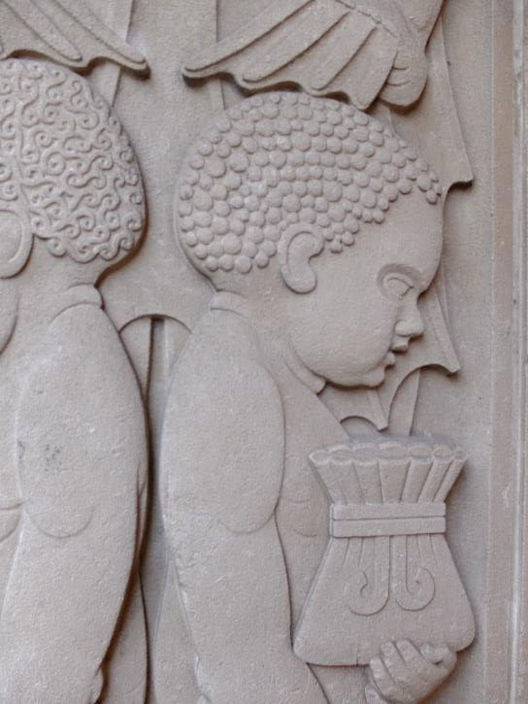
Identity and BLM
The Black Lives Matter (BLM) movement made the concept of place identity headline news in 2020.
Many UK cities have slave trading histories which are now part of the place identity of that city.
Wealth from the slave trade paid for grand buildings that are still standing today and traders gave their names to street names.
Slave child, Liverpool
Notes:
Photo © Andy Owen

Slide 8
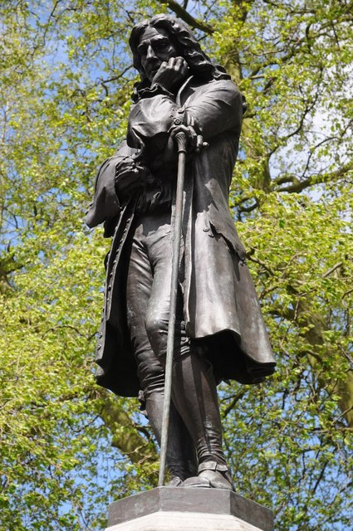
Memorial statues
BLM protesters have objected to statues that memorialise slave traders. In June 2020, the memorial statue of Edward Colston was torn down. Click here to hear the news report and think about how history has created multiple identities.
This statue in Liverpool commemorates the slaves who were trafficked. There is a similar one in Benin.
Notes:
(l) https://www.geograph.org.uk/photo/3972742
(c) Caitlin Hobbs CC 3.0 https://commons.wikimedia.org/wiki/File:Edward_Colston_-_empty_pedestal.jpg
(r) Photo © Andy Owen

Slide 9
Identity and NEA
Identity gives geographers an opportunity to investigate changing places through an NEA. For example, you could investigate these questions:
What are the historical, social, cultural or physical features of your neighbourhood/town/city that create its sense of place?
How is your neighbourhood/town/city perceived by different groups of people?
Is there a perceived threat to this sense of identity?
How is your town/city represented by different people or in different media?

Slide 10
Representation and NEA
The flip side of identity, in a way, is the concept of representation.
Places are represented in the news, adverts, film and in works of art. Places can also be misrepresented in ‘fake news’.
Authors, artists, filmmakers and musicians all represent place in their paintings, films, novels and music.
The way they represent place will depend on their personal attachment to the place and their personal experiences, which will depend on factors such as their gender and ethnicity.

Slide 11
A virtual field trip
In this investigation you are going to use Google Street View to conduct a virtual field trip to locations in Limehouse (in London) that are represented in the work of contemporary artist, Doreen Fletcher.
Hopefully this experience will help you to:
identify possible research questions that you might investigate in your own locality
think about how an NEA can be used to investigate:
a concept such as place identity or representation
or a process such as gentrification.

Slide 12
Re-photography
This virtual fieldwork uses a technique called re-photography to carry out data collection.
Re-photography relies on having access to older images from secondary sources – you visit the location and take a new photograph of the same place.

Slide 13
Aim of the investigation
Here is a working title for our virtual investigation: How is the neighbourhood of Limehouse changing?
As titles go, this one is too vague for a good NEA title. What do we mean by change? Where is the link to a geographical concept? However, while you are doing the virtual investigation, think about how you could improve on it. How might you do something similar in your own area but with a greater focus on:
a geographical process such as gentrification or rebranding
or a concept such as identity or representation?
Think about research questions
As you work through the images, think about potential research questions that you could investigate in this place.
Jot down at least three different research questions.

Slide 14
Doreen Fletcher
You are going to use a collection of images created by local artist, Doreen Fletcher, to investigate changing places.
Doreen has been painting images of this part of London since the 1980s.
She is interested in capturing images of features that help create a sense of identity in this place but which are also vulnerable to change – places which, as she says, are ‘almost gone’.
You can see Doreen Fletcher’s paintings, and read her blog, here.

Slide 15
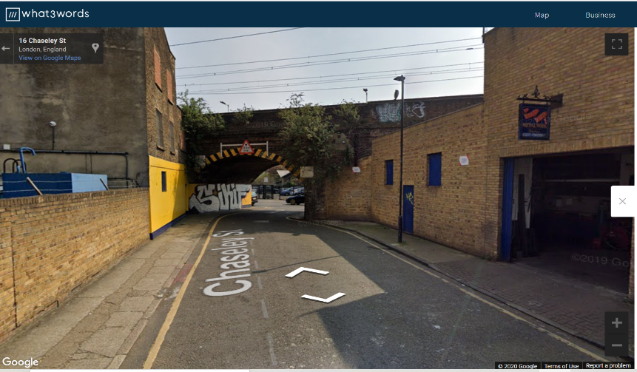
What3words
Log on to https://what3words.com/
This site uses combinations of three words to identify very specific locations. So, for example, this location can be found by searching the What3Words website with: rigid.buzz.sheep
Notes:
Photo © Google.

Slide 16
What you need to do
When you are on the What3Words website:
Find the location of each of the images of Doreen Fletcher’s paintings shown here using the unique combination of three words.
At each location, drop the symbol of the yellow person onto the map so you can see what the street looks like ‘now’.
Take a screen shot so you can compare the image in the painting with a recent photo of the same location.

Slide 17
Things to think about during the visit
Think about the following questions while you conduct your virtual field trip. Think about how you might take one or more of these ideas and use it to focus an investigation in your own locality.
What has changed? What hasn’t changed? Is there any pattern?
Why does this change occur? How could you find out?
What has been lost? What has been gained?
Who has benefitted? Which groups of people might have lost out?
Continues on next slide…

Slide 18
Things to think about during the visit
What might local people think about these changes? How could you find out?
What has the artist painted? Why might she have chosen them?
Does this collection of images create a clear sense of identity?
Would other local people choose similar features to represent this place? How could you find out?
How well do these paintings represent Limehouse? How is this place represented in other media?

Slide 19
Analysis of images
Re-photography allows you to identify change since the original image was made. Images are an example of qualitative data and a suitable way to analyse this evidence is through careful annotation of the differences that can be observed between the old and new images. What has changed and what remains the same?
It is important to realise that labels are very different from annotations. A label is a simple description. For example, in Image 7, a simple label would point at the public house in Doreen Fletcher’s painting and read:
This public house has been demolished.

Slide 20
Effective analysis
Effective analysis involves carefully making sense of the evidence and offering an interpretation of it. In this example, an annotation of Image 7 could involve a consideration of:
the factors that may have caused change in this community
how this type of change may affect communities, their sense of identity, and the local economy.

Slide 21
Chains of reasoning
Annotation, therefore, needs to go further than description. You need to make inferences – linking this change to your understanding of the wider theoretical context – in this case, making links to concepts such as change, identity or attachment.
It’s also a good idea to use connectives, such as ‘so’ or ‘this means that’, to develop chains of reasoning within your annotation.

Slide 22
An example
The photo on slide 23 shows Salmon Lane in 2019. Look at the annotations carefully. They do three things that make them analysis rather than description:
Use connectives to create a chain of reasoning.
Refer directly to a review of geographical literature (referenced in a footnote).
Refer to the 'voice' of the artist.

Slide 23
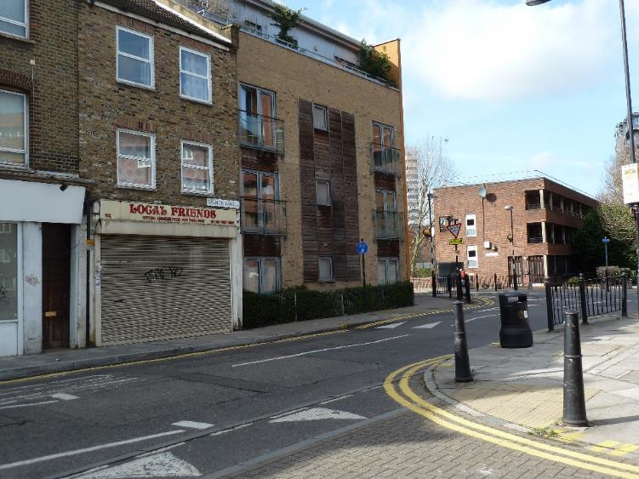
The public house in the painting has been replaced by flats so the community has lost a meeting place. A quarter of the UK’s pubs closed in the period 1982-2017¹. This means that this community has lost part of its historic and social identity.
The artist appears to have enlarged the tower block slightly. This may be because the artist wants to emphasise that the 60’s tower blocks play an important part in the identity of this place.
Footnote 1. Why London’s pubs are disappearing. (2017) The Economist. https://www.economist.com/britain/2017/08/24/why-londons-pubs-are-disappearing
Notes:
Photo © Andy Owen

Slide 24
Links
Find out more from GEO:
Changing Places is a generic term geographers use to describe change in urban and rural places. It is a core A level unit, although the awarding bodies use different titles.
COVID-19 and Changing Places independent investigation
Planning the independent investigation on Changing Places
Investigating regeneration at London's Olympic Park
From the awarding bodies
 | Topic
AQA | 3.2.2 Changing Places
Eduqas | 2.1 Changing Places
Edexcel | 4 Shaping Places/ Regenerating Places
OCR | 2.1 Changing Spaces; Making Places
WJEC | 2.1 Changing Places

Slide 25
Acknowledgements
This presentation has been written by Andy Owen, author and Consultant to the GA. It is adapted from his book: Owen, A. (2019) A Level Geography Independent Investigation. Tewkesbury: Insight & Perspective.
Figures
Slide 7: Photo © Andy Owen
Slide 8: photos (l-r) © Philip Halling/Geograph; Caitlin Hobbs CC 3.0; Andy Owen
Slide 15: photo © Google
Slide 23: photo © Andy Owen
Doreen Fletcher artwork with kind permission: https://www.doreenfletcherartist.com/

