Slide 1
Peatlands and the carbon cycle

Slide 2
Getting started
You’ll need a notepad on which to make notes as you go along, or you could make notes, paste images, etc. on your device.
You can view these slides:
as a slide-show for any animations and to follow links
in ‘normal’ view if you want to add call-outs or extra slides to make notes, paste images, answer questions.

Slide 3
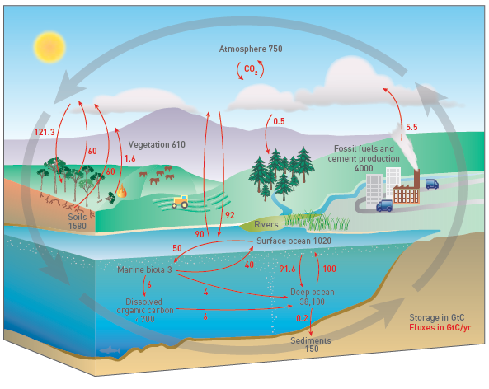
The carbon cycle
Resource
You can find a GEO unit here that explores the carbon cycle and the different stores.
Activities
Make a blank copy of the diagram.
Identify which are stores and which transfers (flows between stores).
Which of the stores shown is the pedosphere?
Notes:
Diagram source: Top Spec Geography: Water and carbon cycles (2019), Russell Chapman and Sara Thornton, Figure 5.2, page 32

Slide 4
Peatlands
Peatland is an important global store of carbon – the world’s peat deposits contain about 650 GtC of carbon.
Although they take up only around 3% of the Earth’s land surface, peatlands contain twice as much carbon as all the world’s forests.
In fact, there may be more peatland to be discovered – large peat areas were only recently identified in Congo and in South America.
Activity
Click on the image to launch a map of the global distribution of peatlands.
Describe the distribution of peatlands.
What classification of peatland types does this distribution suggest to you?
Notes:
Map featured on https://theconversation.com/peatlands-keep-a-lot-of-carbon-out-of-earths-atmosphere-but-that-could-end-with-warming-and-development-151364

Slide 5
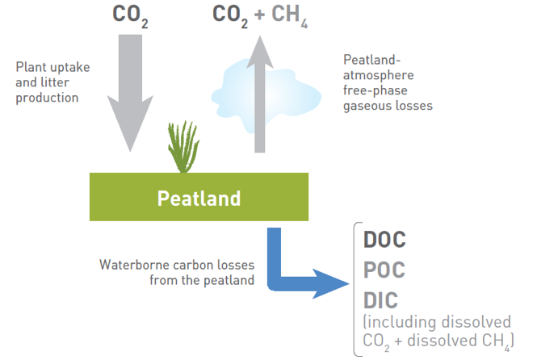
Peatlands as a carbon sink
Peatland vegetation absorbs carbon dioxide from the atmosphere through photosynthesis. When the vegetation dies and is incorporated into the peat, some of this carbon avoids aerobic decomposition (due to the anaerobic waterlogged conditions) and is stored for millennia. Most peat carbon has accumulated over the last 8–10,000 years.
There is a small amount of anaerobic decomposition of the dead plant material, peatland vegetation releases CO₂ from respiration, and some carbon is lost through leaching, but compared with the amount of carbon stored, intact peatlands have been a major carbon sink.
Activity
Explain the process of carbon sequestration in peatlands.
Explain why peatlands act as a carbon sink.
Notes:
Figure 5.3 Source TSG Water & Carbon Cycles page 33

Slide 6
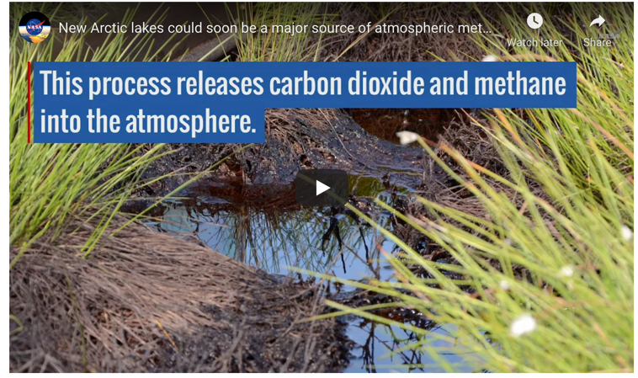
Peatland and permafrost
Permafrost (permanently frozen ground) covers 24% of the land surface in the northern hemisphere: most of it peatland,
It is estimated that the northern hemisphere’s permafrost and peatlands hold four times more carbon than humans have emitted since the industrial revolution.
Climate warming in the Arctic is melting the permafrost: 70 years earlier than scientists predicted. As the peatland thaws, there is the potential for huge amounts of carbon to be released into the atmosphere.
Activities
Watch this video. Use it and the text here to explain how thermokarst lakes and the release of methane (a potent greenhouse gas) could upset predictions about the rate of climate change.
Draw a diagram of a thermokarst lake as part of your explanation.

Slide 7
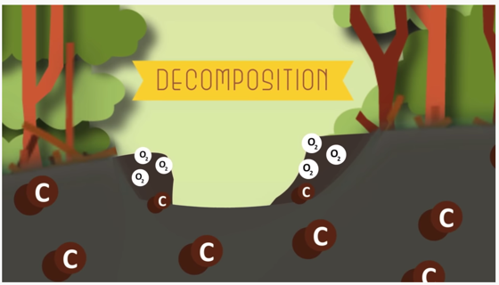
Peatland degradation
When peatlands are drained, oxygen can get to the dead vegetation, allowing microbes to decompose it. There is a rapid loss of stored carbon to the atmosphere, mainly in the form of CO₂. When this happens, the degraded (damaged) peatland ecosystem changes from a net carbon sink to a net carbon source.
Degraded peatlands are also drier and become vulnerable to fires. Often, fires burn underground which can make them impossible to put out. Peatland fires release massive amounts of carbon dioxide into the atmosphere: for example, peatland fires in Indonesia in 2015 added 16 million tonnes of CO₂ to the atmosphere a day.
Activity
Watch this video and use it and the text opposite to explain in your own words how peatland can change from a carbon sink to a carbon source.

Slide 8
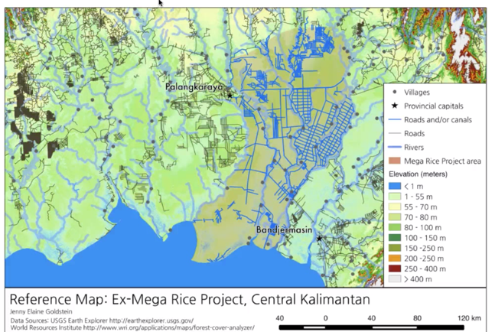
The Mega Rice Project, Indonesia
The Mega Rice Project (MRP) aimed to convert 15,000km² of deep peatland in
Central Kalimantan, Indonesia, into rice paddy fields. 6000km of canals were dug to drain the peatland, but the project was abandoned because the soils were too acidic for rice.
However, during the dry season, the drained peatland became very dry and now fires happen almost every year – burning the peat and remaining forest areas.
Attempts have been made to restore the peatlands by damming the drainage channels – canal blocking. But local people have breached the dams so they can keep using the canals for transport.
Activity
Watch this video in which a researcher presents her findings
Describe how she has done her research and her conclusions.
What data challenges has she faced reaching her conclusions?

Slide 9
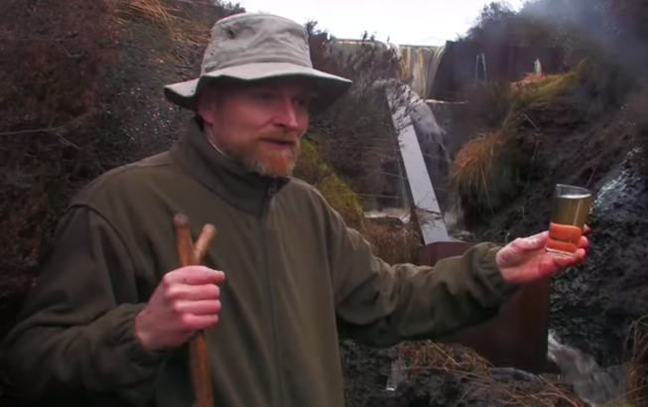
Restoring degraded peatland
Degraded peatland is peatland that has been drained or otherwise damaged but not completely converted into other land use.
The main way of restoring degraded peatlands is re-wetting, like the canal blocking of Kalimantan.
46 million hectares of peatland are degraded currently around the world, and acting as a carbon source. Restoring this area would stop 394 million tonnes of carbon emissions.
Activity
Watch this video about restoring peatland and make notes on:
methods of peatland restoration
challenges of peatland restoration.
Can you divide the methods into hard engineering and soft engineering?

Slide 10
Taking it further
Erosion, restoration and carbon cycling in UK peatlands
Reflection
Explain why peat soils store carbon.
Summarise the causes of peat erosion in the UK and Ireland.
Discuss the ways in which the peatlands of the Pennines have been subject to restoration projects.
The accompanying download has a worked example of fieldwork undertaken in a peatland area to measure total carbon storage.
In this paper Martin Evans describes the dramatic changes that have occurred in peatlands, explores the impact of these changes on the carbon cycle, and suggests ways in which work on peatlands might support skills and fieldwork elements of the A level curriculum.
Notes:
Full reference: Evans, M. (2017) ‘Erosion, restoration and carbon cycling in UK peatlands’, Teaching Geography, 42, 1, pp.26-29

Slide 11
Links
From the awarding bodies
Further reading
 | Topic
AQA | 3.1.1.3 The carbon cycle
Eduqas | 2.1.6 The global carbon cycle
Edexcel | 6.1 and 6.2 The carbon cycle
OCR | 1.2 Earth’s Life Support Systems
WJEC | 3.1.6 The global carbon cycle
Top Spec Geography: Water and Carbon Cycles by Russell Chapman and Sara Thornton, published by the GA, 2020.
Carbon cycle related NEA from the FSC
The UK Land Carbon Registry
The IUCN’s issues brief on ‘Peatlands and climate change’.
Activity
Read this GEO unit about systems. Identify examples of equilibrium and positive/negative feedback mechanisms in peatlands.

Slide 12
Glossary
Aerobic: in the presence of oxygen; requiring oxygen.
Anaerobic: without oxygen present; not requiring oxygen.
GtC: gigatonne of carbon (1 billion tonnes).
Pedosphere: the layer of the Earth’s surface that is made of soil.
Sequestration: the process of removing carbon from the air and holding it somewhere else, e.g. in organic material.
Stores: in the carbon cycle, stores or sinks are where carbon is held, while flows are the transfers of carbon between stores.

Slide 13
Acknowledgements
This presentation has been written by Rob Bircher, an experienced author, publisher and secretary of the Worcester Branch of the GA.
Figures
Slide 3: Diagram source: Top Spec Geography: Water and carbon cycles (2019), Russell Chapman and Sara Thornton, Figure 5.2, page 32
Slide 4: Map featured on https://theconversation.com/peatlands-keep-a-lot-of-carbon-out-of-earths-atmosphere-but-that-could-end-with-warming-and-development-151364
Slide 10: Full reference to article: Evans, M. (2017) ‘Erosion, restoration and carbon cycling in UK peatlands’, Teaching Geography, 42, 1, pp.26-29

