Slide 1
A toolkit for the A level independent investigation

Slide 2
Getting started
You’ll need a notepad on which to make notes as you go along, or you could make notes, paste images, etc. on your device.
You can view these slides:
as a slide-show for any animations and to follow links
in ‘normal’ view if you want to add call-outs or extra slides to make notes, paste images, answer questions.

Slide 3
The independent investigation
The independent investigation features in all A level geography specifications. It is sometimes called the non-exam assessment (NEA).
This resource uses a toolkit to take you through the basics of how to tackle different stages in the investigation.

Slide 4
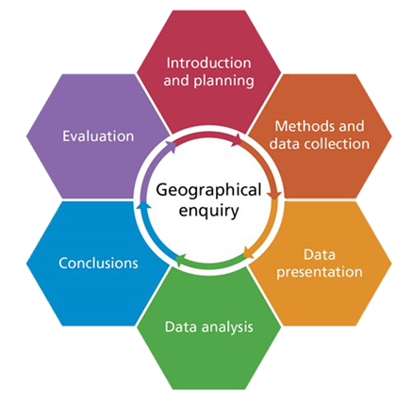
What you need to know
A clear structure is vital. The stages in geographical enquiry will be familiar from GCSE – from the introduction, planning and enquiry questions, through to conclusions and evaluation.
At A level there is a new requirement – a literature review.
You have a deadline to meet, so being well-organised will help you do this. You might find this action plan will help you to set your own targets and dates.
Notes:
Graphic © Field Studies Council

Slide 5
Getting started
Your investigation must relate to a topic in the geography specification you are studying.
Another key point – this is an independent investigation, not an individual one.
Independent means:
You must carry out your enquiry without relying on teachers and other students.
You do not need to work in isolation, or have a unique title for your investigation.
You can draw on advice (e.g. from teachers) to become an independent and critical thinker.

Slide 6
Introduction and planning 1
Your most important task is to devise a central question or hypothesis to guide your investigation.
Poor questions lead to poor investigations:
What is a groyne? This is not a good question at A level – think about why not.
A good question is one which is focused:
To what extent does the character of the Mumbles change with increasing distance away from Oyster Wharf? This is better – think about why.
This question generator is one way to help you think of better questions.
Resource
This Time for Geography video explores asking research questions.
Activity
Look out of your window.
Fill in each cell in the generator with a question.
Which question has the most scope for an independent investigation, and why?

Slide 7
Introduction and planning 2
Now you need to do some reading around. What have other geographers published that’s relevant to your investigation? What processes and key ideas do they help you understand?
This is your literature review: it sets your investigation in a wider theoretical context.
You might need to read more later, and it’s easy to lose sight of your readings, so keeping a literature log is one way to keep focused.
Resource
From Geo:
The A level independent investigation literature review

Slide 8
Methods and data collection
You need to decide which methods to use independently.
Work out which are the most useful and appropriate methods. Which are essential? How many are realistic? The methodology card sort may help.
Think through how your methods will work and the evidence they will bring in: creating a mind map might help.
Collect secondary as well as primary data: a secondary data log could help you record what you use.
Resource
This Time for Geography video explores research methods.
Activity
Write a list of secondary sources of data which might be useful for your enquiry.
Swap your list with a friend and discuss.

Slide 9
Data presentation
It is helpful to think of this at the same time as you plan your methods: you can match the method and the presentation style, while thinking of their advantages and disadvantages.
There are many different possibilities for data presentation: this card sort may help you choose.
Some methods may seem obvious – but you could discuss your choice with a critical friend to check.
Resource
has some great resources supporting you in creating your own maps.

Slide 10
Data analysis
Here you’re looking at your findings, thinking about them and how to show what they tell you about your enquiry question.
You’ll need to write about this: structuring your writing will help show your thinking clearly. Double bubble and Argument frames are two ways that may help.
Check the mark scheme in the specification to see what level you are working at and how you can improve – you could work with a partner on this.

Slide 11
Conclusion and evaluation
Your conclusion needs to be:
linked to your key question or hypothesis
clear and concise.
Evaluation is about:
the whole investigation, not just methods and data
the validity, reliability, limitations and ethics of your enquiry: check you’re sure about the differences between these.
Retrofitting this thinking is tricky. It is better to think of these from the start: keeping a research diary helps you to evaluate as you go along.
Activity
Try the 5-4-3-2-1 approach.
Start with five sentences, then boil them down in stages to one.
You now have a key finding to hang the whole conclusion on.

Slide 12
Research ethics
Like other aspects of your investigation, it’s important you consider and plan the ethics of your research from the start. Researching ethically is about respecting the people involved in your investigation, including:
thinking about people’s dignity, especially vulnerable people
your health and security.
Research ethics includes thinking about:
doing good, for example: are your questions worth asking?
not doing harm, for example: how are you representing people and communities?
confidentiality, especially regarding data
your integrity as a researcher, such as respect for evidence.
Resource
This Time for Geography video explores research ethics in more detail.

Slide 13
Before you finish...
Just to focus your thinking, you might share and present your findings to your class: e.g. on one ppt slide, in a one-page document, in a one-minute talk.
Do a final check: try this checklist and perhaps check your work with a critical friend.
You can download an adapted version of the article on which this presentation is based.
© Geographical Association, 2020

Slide 14
Links
From the awarding bodies
Find out more
 | Topic
AQA | Specification, support and example NEA
Eduqas | Specification, investigating and research and data analysis skills
Edexcel | Specification, exemplars and maths support
OCR | Specification and NEA support
WJEC | Specification, investigating and research skills and data analysis skills
GA Student guide to the NEA
FSC guide to geographical investigations
GA shop: Fieldwork at A level: your guide to the independent investigation
GA article feedback from the examiners
GA conference 2018: look for sessions 10 and 22
Support from GEO: Planning the independent investigation on Changing Places
Next slide: support from ESRI

Slide 15
Support from ESRI
Esri offers some great support for using GIS in your independent investigation, and mapping data from some public sources:
Data sources
Support for the independent investigation
GIS and the NEA
Demographic Data I: Enriching Maps with ArcGIS Online Data
Demographic Data II: Adding data to ArcGIS Online
Taming Open Data – source of online data
Ordnance Survey Open Rivers data
Open geography portal from the Office of National Statistics
Natural England Open Data GeoPortal
Using crime data from www.police.uk

Slide 16
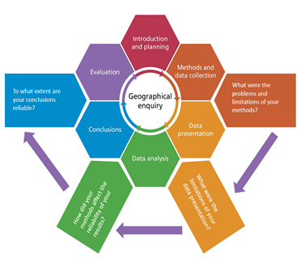
More on geographical enquiry
Here’s a summary of the enquiry process: thinking about evaluation concerns many of its stages.
© Geographical Association, 2020
Notes:
Adapted by Rebecca Kitchen from a graphic © Field Studies Council

Slide 17
Acknowledgements
This presentation has been written by John Hopkin, formerly Head of Accreditation for the GA and is an adaptation of Rebecca Kitchen’s article ‘Developing an A level independent investigation toolkit’, Teaching Geography, Autumn 2017, pp. 90-92.
Figures
Slides 4 and 16: Diagrams © Field Studies Council

