Slide 1
Session 1
What is the independent investigation
all about?
Bob Digby and David Holmes

Slide 2
Today’s aims
This tutorial will give an overview of what the independent investigation at A level is all about.
It’s intended for those who have done no (or very little) thinking about their study.
It will:
outline the nature of the independent investigation
give you some starting points in choosing a focus for study
identify some of the qualities you need for success
provide some pointers for putting together a good proposal.

Slide 3
Today’s tutorial will cover …
What is the independent investigation?
Where to start with ideas for your independent investigation.
Fieldwork, the independent investigation and enquiry process.
How to put together a proposal.
By the end of today’s tutorial, we hope that you’ll:
know what the independent investigation is
understand how the independent investigation features within A level geography
recognise the importance of fieldwork and primary data collection
understand some features of a good proposal.

Slide 4
Part 1
What is the independent investigation? (10 mins)

Slide 5
What is the independent investigation?
The independent investigation (also known as the Non-Examined Assessment, or NEA) is known informally as coursework.
It is worth 20% of the A level.
It consists of a written report of 3–4000 words (recommended – though there are no penalties).
Its focus should be linked to your A level course – but can be part of the specification that you have not personally studied.
The title must be unique to YOU – though you can use group fieldwork and you can do similar topics.
It must include fieldwork.

Slide 6
What’s the point of the independent investigation?
The independent investigation is an opportunity for you to devise your own investigation.
Because it’s independent, it represents a chance for you to demonstrate how well you can work alone (or as part of a team if you’re collecting group data).
Universities and employers always seek evidence of you having worked alone outside the classroom – you’ll have to work like this in your new destination.
It includes fieldwork and the collection of raw data, trying to make sense of how far the data fit with what’s already published – a good chance for you to develop academically and personally.

Slide 7
Outlining the process
You think of an idea worth investigating.
You consider ways in which you might collect data.
You discuss your ideas with your teacher.
You complete a proposal form with an outline of your enquiry.
You collect data – then collate and present the data.
You write a report which analyses the data, draws conclusions and evaluates the study.
You hand it in! No later than mid-March.
Your teacher marks it and sends marks to the exam board.

Slide 8
What makes a good study? Some basics
It has a clear title (often a question) – one that you understand (and feel you can answer).
It has section headings – Aims and Introduction; Methodology; Results Presentation; Analysis; Conclusion and Evaluation.
It reads from start to finish – it has a beginning, a middle and an ending.
Sub-headings can be used wherever they help.
It needs to be easy to find things – so pages are numbered, as are all figures such as graphs, maps, etc.
It has been checked for sense, for syntax, for grammar, for spelling, paragraphing, etc.

Slide 9
How GEO can help you – 1
A series of ten tutorials (including this one) to help you think of ideas and give you some starter thinking about data collection methods you might use.
These tutorials include:
two about the independent investigation generally
one on ideas for how to think about your study
five on particular themes – carbon cycle, place identity, water cycle, glaciation and regeneration
one to help you think about GIS in your enquiry
finally, one to help you keep on track.

Slide 10
How GEO can help you – 2
The ten tutorials are given by people with real expertise in the independent investigation, such as:
teaching students – so they’re familiar with students and how to approach independent study
examining the work samples for different exam boards – so they know the standards you need to aim for to help you achieve highly
Field Studies Council tutors who are experts in teaching students on fieldwork and data collection – so you have access to specialists in their field.

Slide 11
Part 2
Where to start with ideas for your independent investigation (10 mins)

Slide 12
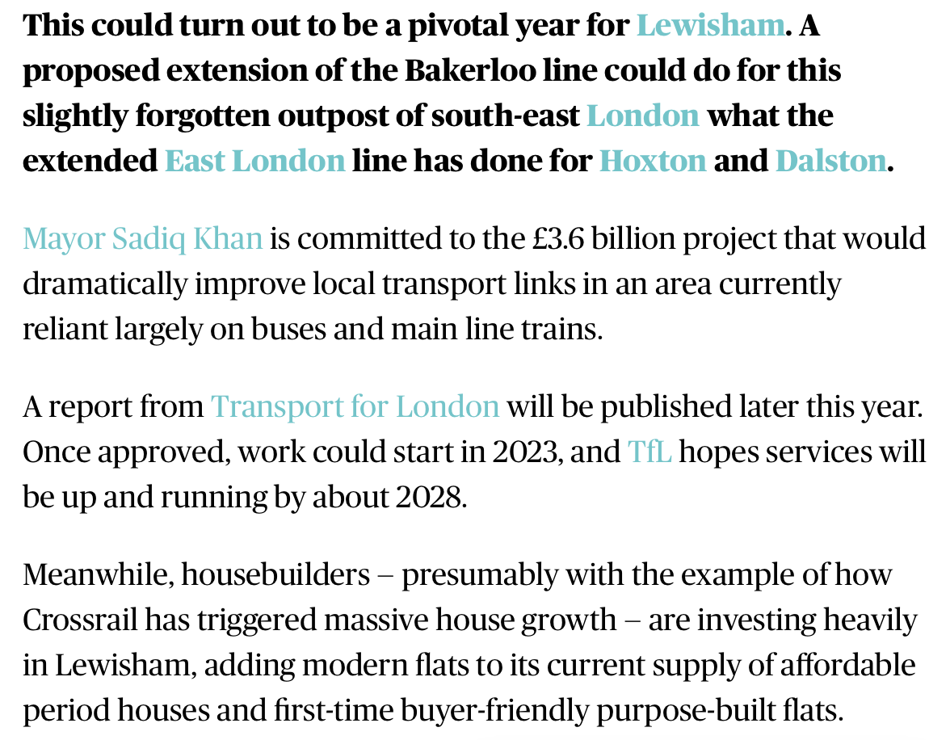
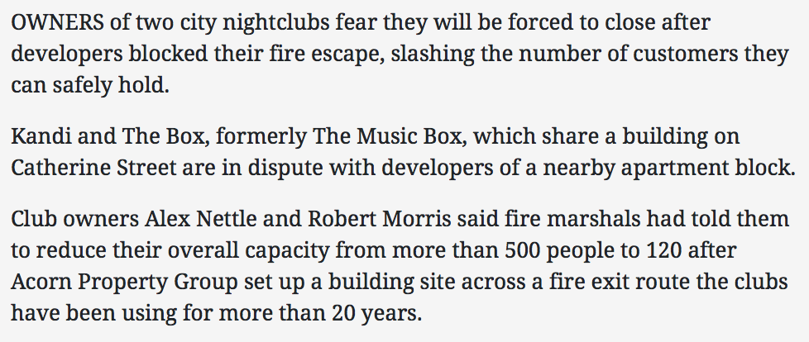
Start with a few local ideas – 1
What’s going on locally in your area – for example, in London?
What do these articles have to do with geography?
Notes:
Sources:
https://www.salisburyjournal.co.uk/news/16038584.two-city-nightclubs-forced-close-row-flats-developer/
https://www.homesandproperty.co.uk/property-news/lewisham-could-be-part-of-the-bakerloo-line-by-2028-but-36bn-project-doesnt-guarantee-regeneration-a118176.html
https://www.homesandproperty.co.uk/property-news/lewisham-could-be-part-of-the-bakerloo-line-by-2028-but-36bn-project-doesnt-guarantee-regeneration-a118176.html

Slide 13
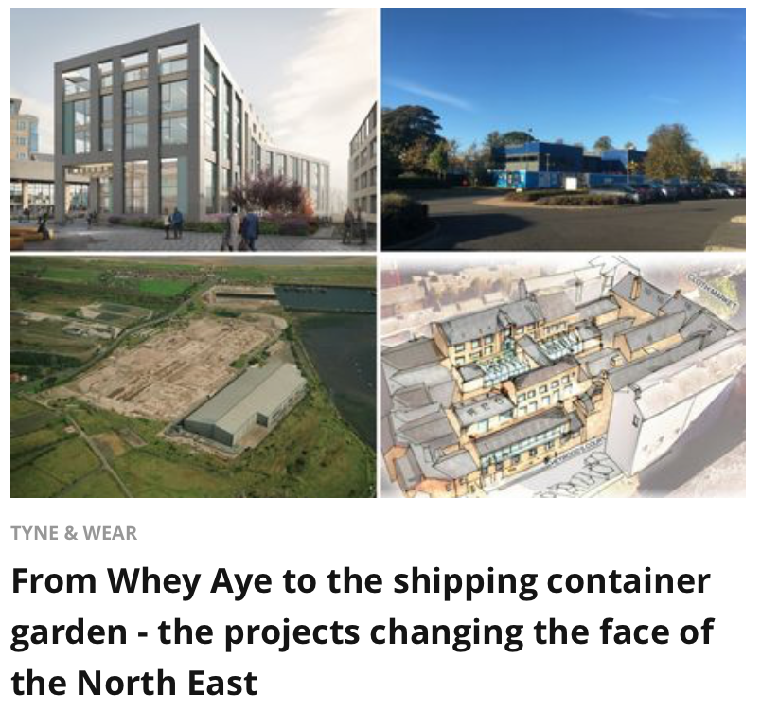
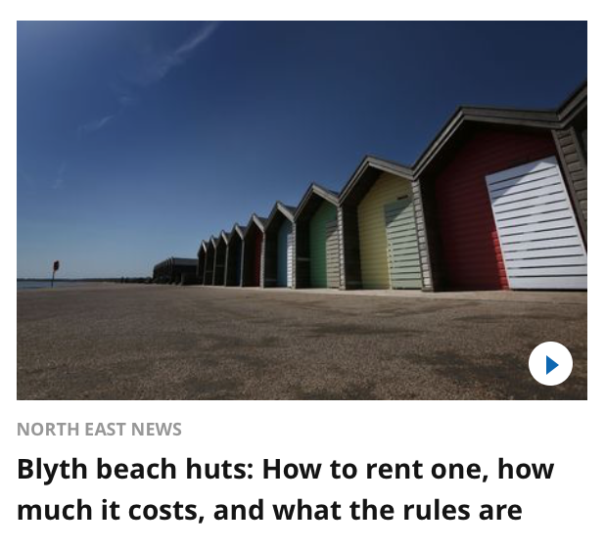
Start with a few local ideas – 2
What’s going on locally in your area – for example, Blyth, Northumberland?
What do these articles have to do with geography?
Notes:
Sources: https://www.chroniclelive.co.uk/news/north-east-news/whey-aye-shipping-container-garden-14718431
https://www.chroniclelive.co.uk/news/north-east-news/northumberlands-draft-local-plan-unveiled-14732953
https://www.chroniclelive.co.uk/news/north-east-news/blyth-beach-huts-how-rent-14708426

Slide 14
Think about changes in your area
What changes have happened in your area? What do people feel about them?
Think about ideas linked to economic change (de-industrialisation), examples of social change (e.g. identity and place image – ‘Billy Elliot’), or of environmental change (e.g. the Queen Elizabeth Olympic Park, London)
Big ideas given a local focus – e.g. how sustainable is the regeneration at X? How are social changes and population shifts affecting a locality?
Proposals for the future – an evaluation of attitudes in one small community towards issues such as a new nuclear power station / HS2?

Slide 15
Let’s add some more ideas …
From your course
Topics you’ve been taught so far: e.g. Changing Places, Coastal Landscapes
Topics you’ll cover in future e.g. water or carbon cycles
From your fieldwork that you’ve done
E.g. a coastal day
E.g. a day looking at urban regeneration
From the news
People’s experiences of migration
How your local place changed during the Covid-19 ‘lockdown’ and people’s experiences of it
From your own interests
Music? Literature? Art?

Slide 16
Choosing an appropriate scale
Decision – will you use the area around school or college, or your own locality?
Choose somewhere to which you have easy access.
Whichever locality you choose, DON’T choose somewhere that you cannot easily re-visit if you need more data.
The recommendation is an area no larger than up to 3-4 neighbouring LSOA (population 4-6k) - and preferably no larger than a single LSOA (population about 1500).
Use the IMD GIS database to help you select your area.
Supplement IMD data (2019) with Datashine and THE Consumer Data Research Centre.
Useful links for background data:
IMD (http://dclgapps.communities.gov.uk/imd/iod_index.html)
Datashine: https://datashine.org.uk
Consumer Data Research Centre: https://maps.cdrc.ac.uk/#/geodemographics/imde2019/default/BTTTFFT/10/-1.9948/51.3489/
© Geographical Association, 2020

Slide 17
Part 3
Fieldwork, the independent investigation and enquiry process
(10 mins)

Slide 18
Start with the process of enquiry
Remember:
The aims can only be set when you know something about the topic – so you know which questions are worth asking.
This needs to be done on the basis of initial research and reading.
Asking suitable questions won’t come instantly – it needs time.
Set the aims of the enquiry
Evaluate the enquiry
Collect the data
Reach conclusions
Process and present the data
Analyse the data
© Geographical Association, 2020

Slide 19
Where to begin? Early decisions
Primary data – that you collect
Physical – e.g. for hydrology, sediment survey, management of coastlines (e.g. EIA), ecosystems
Human – e.g. EQS, Quality of Life survey, Migration survey, Perception survey, People count
A need to decide between quantitative (‘hard’ data) and qualitative (’soft’) – because these will determine strategies you use
Secondary data – that others collect
Data and reports from specialist, professional organisations (e.g. ONS or local authority census data, Mayor’s Office London)
Contemporary articles from journals (‘Ecologist’, ‘New Scientist’, ‘Geography Review’)
Textbooks (beyond usual course textbooks)
Appropriate theory
Social media
© Geographical Association, 2020

Slide 20
Your fieldwork time
Minimum requirements are four days fieldwork over two years.
Some of this can be spent by teachers in teaching you fieldwork skills to help with your study.
Fieldwork for your study can be done outside this time.
If teachers take you on a fieldtrip and teach you physical and human fieldwork over four days, you can develop your title from there – but you must have done some independent work within that time so that the title is yours.
The option for your teachers is whether or not to use the four days as part of the study – or not.

Slide 21
How the independent investigation might work in school / college
Fieldwork skills e.g. sampling, design and pilot studies, risk and ethical considerations
Day 1 – Physical, e.g. coasts
Day 2 –Human, e.g. changing places
Day 3+4 – Physical in-depth for your study
Students arrive with an idea or focus
Individual data collection (or in safe groups)
Day 3+4 – Human in-depth for your study
Getting more local research information, maps, etc. and exploring similar studies

Slide 22
Making your study ‘independent’
‘Independent’ in the context of fieldwork does not mean lone working. You can collect data in groups.
However, you must work independently to come up with your title, contextualise, analyse and report your findings to produce an independent investigation.
Teachers can check titles to ensure that your title and proposal will enable you to access the full range of marks.
Teachers can teach you specific skills appropriate to the type of study e.g. chi-square, significance testing – but not based on your results!
You can work at your own pace – but teachers are entitled to give you staggered deadlines to help you in time management.
© Geographical Association, 2020

Slide 23
So – a local topic, or a distant topic?
Benefits of staying local
You know the place and everything going on there.
Access to local people, local resources, newspapers.
Chances to update your data if you don’t collect enough.
Likelihood that your study will be unique because it’ll be more focused on a place you know.
You’ll have no problem collecting data.
Benefits of doing something on a location where you’ve carried our fieldwork
You’ll know that what you’re doing is geographical because it’s been planned that way.
You can use group data.
You can make sure your work is unique because your teacher can double-check everyone’s title.
BUT you might need to return for more data – so how might this happen?
© Geographical Association, 2020

Slide 24
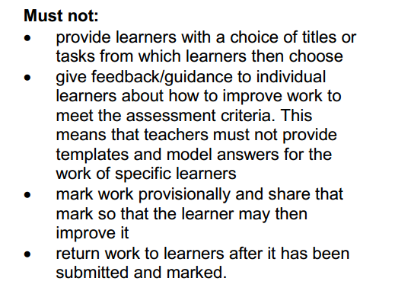
A reminder that teachers ...
© Geographical Association, 2020

Slide 25
Part 4
How do you put together a proposal? (10 mins)

Slide 26
Generating a good proposal
What makes a good proposal form?
Proposed title
Can be a title, question, or hypothesis
Links to the specification
Must link to a particular part of the specification – either a topic title, or a specific reference to part of the specification
Investigation context
Needs a statement about why the issue is worth studying, and the context of the place – what makes this a good place in which to investigate this issue?
Planned investigation hypothesis or question / sub-questions
Can be a title, question, or hypothesis.
Proposed data collection
Must include primary data (specified – and how it will enable the student to investigate their title. So, not just ‘questionnaire’.
Ideally, would cover quantitative and qualitative data – but this will very much depend upon the focus.
Secondary sources should be specified as well as primary – and not just ‘textbooks, journals’ generically.
You won’t fit it all on to an A4 sheet, so staple it together.
You probably won’t get it right first time!

Slide 27
Note – planned investigation. Written at the time of development of a title
A broad context and outline of the enquiry
Indicative – it’s not a contract
Note that teacher guidance CAN be given to you at this stage
If not approved, then student must re-submit until approval is given
The completed form is then submitted with the front mark sheet
when it is sent as a sample to your awarding body.
There may be changes between the proposal stage and when you finally submit the finished study – that’s fine, just be upfront about it and say why.

Slide 28
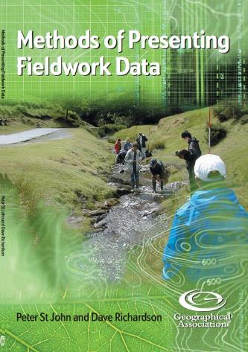
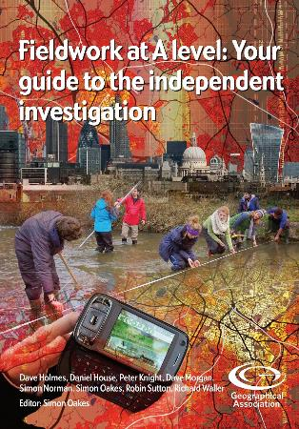
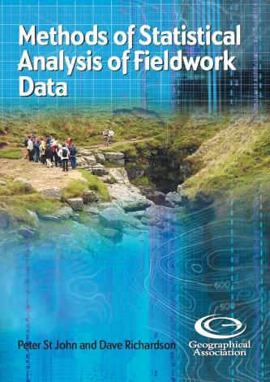
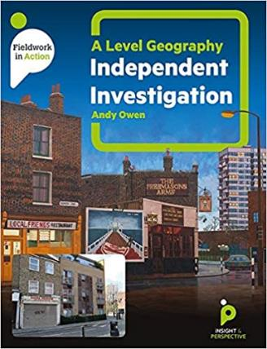
Books to help you from the GA
Also this from Insight
& Perspective – Silver
Award at the GA Awards
April 2020
Link: https://www.geography.org.uk/Shop

Slide 29
And this free guide from the RGS (with IBG)
Link: https://www.rgs.org/CMSPages/GetFile.aspx?nodeguid=882a6e79-5e28-4667-a753-17d26cec8c19&lang=en-GB

Slide 30
Finally – what to do next?
There are further sessions about ‘Preparing for your Independent Investigation’ (these are paid-for)
These spell out how to begin your study stage-by-stage
Look at the GEO web enquiries in A level skills section (https://geographyeducationonline.org/a-level) – these are free
Attend Sessions 3 to 10 inclusive of the GEO tutorials (these are free)
These will really help to skill you up and help you think of topics – and especially skills – that you can use in your own study
Don’t worry – you have a lot of time in which to get your investigation done.

Slide 31
Links to further support
GEO has a number of web enquiries to help you at https://geographyeducationonline.org/a-level
You can purchase pre-recorded sessions from last May-June from the Geographical Association’s webinar series ‘Getting ready for your independent investigation in Geography’ https://www.geography.org.uk/eBooks-detail/d463300b-b5fd-4555-a948-fffb62ffa769. Led by Bob Digby and David Holmes this series of five 40-minute webinars provide more detailed support for students beginning their Independent Investigation.
The Field Studies Council are offering a range of packages of support for A level geography students. With outreach and digital packages sitting alongside their more traditional day and residential course offer there is a solution to suit everyone. Find out more https://www.field-studies-council.org/secondary-and-further-education-courses/

