Slide 1
Session 1 Think like a geographer,
write like a geographer
Bob Digby and David Holmes

Slide 2
Today’s aims
This tutorial will provide you with skills in how to:
think like a geographer
write like a geographer.
It will:
explore how you can develop skills which will help you in your geographical writing
introduce you to some skills in looking at geographical sources, such as photos, maps, diagrams and data.

Slide 3
Today’s tutorial will cover …
What do we mean by the phrase ‘thinking like a geographer’? How can you spot when someone is ‘thinking like a geographer’?
Developing your skills in writing geographically
Developing your skills in handling a variety of geographical sources.
By the end of today’s tutorial, we hope that you’ll:
know how geographers think
understand how to develop your writing skills to help you express your inner geographer
recognise some of the geography contained within resource materials you’re likely to meet in GCSE Geography.

Slide 4
Part 1
What do we mean by the phrase ‘thinking like a geographer’? How can you spot when someone is ‘thinking like a geographer’? (10 mins)

Slide 5
How geographers look at the world
HDI | 0.69 | 0.94 | 0.55 | 0.63 | 0.73
GDP per capita US$ PPP | 9,200 | 49,900 | 3,900 | 4,900 | 11,900
Internet users (% pop) | 40 | 78 | 11 | 22 | 46
GDP from agriculture (%) | 10 | 1 | 17 | 38 | 6
Population growth rate (%) | 0.5 | 0.9 | 1.3 | 1.0 | 0.8
(2012 data) | China | USA | India | Indonesia | Brazil
Which set of data is –
Brazil?
China?
India
Indonesia?
USA?
Think what you had to do to get to an answer:
have some awareness of some of these countries
have some prior knowledge of how we measure development – including technical things like HDI
be able to manipulate data to tell a story
understand that countries vary.
Notes:
Source of Data: CIA Factbook (2014)

Slide 6
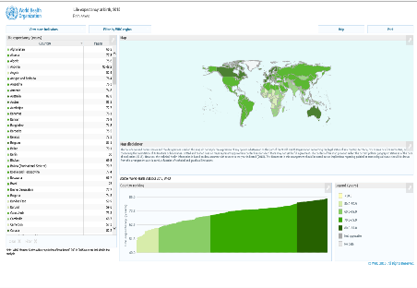
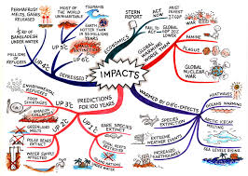
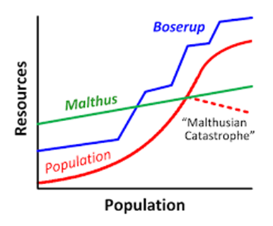
Making sense: developing understanding
(after Margaret Roberts 2017)
Causes, factors, reasons
Effects, impacts, consequences
Comparisons; patterns
Theories
Concepts
Systems
Notes:
Links to images used:
Causes factors reasons – https://www.metoffice.gov.uk/hadobs/hadcrut3/diagnostics/comparison.html
Effects impacts consequences – https://images.app.goo.gl/DxrqcDegD2EJdywd9
Theories – https://images.app.goo.gl/wakEHLMEqFKFzeCP8
Concepts – https://images.app.goo.gl/F9gZC9prxgExxjzv7
Systems – https://images.app.goo.gl/Xt5RWpD2d3ckShPGA

Slide 7
How geographers explain geographical phenomena (after Margaret Roberts 2017)
Geographical phenomena
Coastal features
Earthquakes
Climate change
Desertification
Increase in tourism
Variations in levels of health
Causes
Reasons for…
Factors leading to / affecting …
Conditions leading to
Why?
Geographers demonstrate links between different physical and human causes

Slide 8
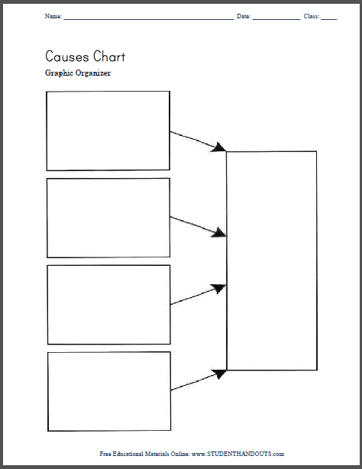
Desertification and geographical explanation
Weather and climate
Population growth
Human actions
Political factors
Geographers
look for a range of physical and human reasons why things occur
weigh up these reasons
come to a synthesised idea about which reasons may be most important
Image: https://images.app.goo.gl/G6KbueDPmnMAdnhT9

Slide 9
How geographers study impact
Geographical phenomena
Earthquakes
Cyclones
Climate change
Tourism
Trans-national Corporations (TNCs)
Regenerating places
Loss of traditional industry (de-industrialisation)
Impacts (social, economic, environmental)
Consequences for the future
Effects on others
Results in …
Leads to …
Links to …

Slide 10
How geographers analyse and predict: What might be the impacts of global warming?
Climate change
Impact on oceans and seas
Impact on people
Impact on ecosystems
Impact on weather
Based on Margaret Roberts (2017)
Image: https://images.app.goo.gl/DxrqcDegD2EJdywd9

Slide 11
Part 2
Eight skills to help you develop your geographical writing
(15 mins)

Slide 12
When geographical terminology is missing
Teacher: Somebody please give me a quick summary so that we can move on. How can outsourcing by TNCs encourage economic development?
Student: Miss, companies have stuff made overseas. Most of our things are made abroad. They sell them so their lives improve as they can buy things and so life gradually improves there.
What’s wrong with this in terms of language?
Extract adapted from https://researchschool.org.uk/news/literacy-through-the-geographical-looking-glass/

Slide 13
1 Be able to use geographical terminology
The language of the subject should change this ….
Miss, companies have stuff made overseas. Most of our things are made abroad. They sell them so their lives improve as they can buy things and so life gradually improves there.
into this ….
Miss, TNCs manufacture most products overseas in lower-income countries such as India where labour costs are cheaper, and export them to High Income Countries such as the UK. When countries increase exports, quality of life improves as there are more employment and higher incomes, which lead to improvements in health care and life expectancy.

Slide 14
2 Know the key words, e.g. Rivers
River Channel features
Stream, tributary, gradient, resistant rock, plunge pool, gorge.
River Channel processes
Friction, river energy, sediment, load, erosion, traction, saltation, suspension, solution, corrasion, abrasion, corrosion, hydraulic action, cavitation
Upper Course features and processes
V-shaped, interlocking spurs, weathering, mechanical weathering, freeze-thaw, scree, chemical weathering, biological weathering, mass movement, landslides, soil creep.
There are a lot! these are just a part of one GCSE Topic!

Slide 15
3 Be able to write briefly when required
In many situations, you aren’t required to write at length. This is especially true of exams.
Describe one way in which a region affected by hurricanes can prepare for this hazard (2 marks)
A region can have weather satellites put in place(correct point – 1 mark) so that when a real hurricane happens they get advance warning, and can evacuate people (a developed point – 1 mark)
In an exam, to turn a 1-mark answer into 2 marks, you need to develop a point, using a connective, e.g. ‘so that’
Though simple, knowing how to develop – or extend – points like this is the basis for structuring all longer pieces of writing

Slide 16
4 Be able to develop (or extend) your writing
In Geography, points can be developed or extended by –
Giving further detail e.g. ‘the tallest rainforest trees have canopies so that they can obtain more sunlight’
Giving an example – this can be either data or a named example of something e.g. ‘More traffic leads to greater amounts of greenhouse gases e.g. CO2’
Giving a consequence – e.g. ‘Heavy rain leads to surface run-off which can lead to greater flood risk’
These all use what we call ‘connective’ words or phrases.

Slide 17
5 Be able to explain causes
Explaining why something has happened i.e. its cause.
Explain how volcanoes can be formed along either constructive or destructive
plate boundaries. (4 marks)
Constructive margins are where plates pull apart. When this happens, a plume of magma rises to the surface to fill the gap. On constructive plate margins this tends to be basaltic lava so flows easily away from the boundary before solidifying. When more lava rises to the surface this creates another layer of rock on top of the first layer. This continues building up the volcano to be large with shallow sides.
✓
✓
✓
✓
Explain the causes of..
Give a sequential (stage-by-stage) explanation . Processes are explained in a logical way (step by step) – called ‘a chain of reasoning’, where one thing leads to another.

Slide 18
6 Be able to explain consequences
Explaining the outcomes, impacts, or effects of something means explaining its consequences.
Explain how economic growth in an emerging economy such as India can
lead to changes in the population. (4 marks)
If India gains more money through economic growth, they could invest in healthcare. By doing this, illnesses would be reduced which would make the population stronger. This would increase life expectancy and reduce death rates. India could also invest in education, teaching young people about contraceptives and hygiene. This would eventually reduce maternal mortality rates, as women would want to give birth in hospitals, and it would reduce the fertility rate because women will have a more equal place in society.
✓
✓
✓
✓
Explain the consequences of ...
Includes the key words impacts, effects, outcomes, results. Can be positive or negative, or economic, social or environmental Using examples and evidence helps to develop a case or an argument.

Slide 19
7 Be able to argue a case
The impacts of tectonic hazards on emerging or developing countries are greater than those in developed countries. How far do you agree?
One candidate’s answer | Examiner comment
The impacts of tectonic hazards are usually much greater on developing countries (e.g. Haiti) rather than developed countries (e.g. Japan). In Japan, economic impacts have been much greater than social. The 2011 Sendai earthquake and the tsunami that it caused caused over US$350 billion worth of economic damage, the most ever recorded for a disaster. Haiti was a major earthquake in 2010, but only caused US$7 billion of damage. So economic impacts are worse in developed countries. But socially it is very different. Both disasters were major events but Haiti was much more vulnerable and less able to cope so social impacts were greater. The 2010 earthquake killed 316,000 people compared to the Sendai earthquake, which killed 28,000. Haiti is a low income country and is much less able to cope. | Uses two good examples of tectonic hazards Makes comparisons – ‘rather than’, ‘much greater’, ‘is very different’, ‘was much more vulnerable’ Knows details about both earthquakes Makes it clear that the statement is only partly true

Slide 20
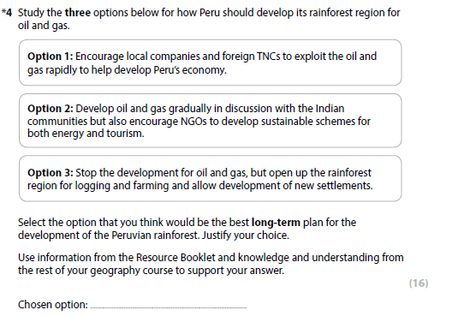
8 Be able to make decisions or judgments
Four GCSE specifications have exams where you’re asked to make decisions
You’re usually given a situation (in a Resource Booklet) where disagreement exists about the best future plan for a place or issue
You choose one, and justify your choice using evidence and reasoning
The answer will need to be lengthy – worth 9 or even 12 marks
The question will give you key words – these are important.
In this case ‘Long-term plan’
It might say ‘people and environment’ or ‘quality of life’ or ‘economic development for all people’ etc
It sets up criteria against which you make a judgement.
Notes:
Extract: from Pearson Edexcel Sample Assessment (2015)

Slide 21
Concluding: what good geographical writing looks like
Uses geographical terminology
Uses knowledge and understanding
Explains consequences of actions or events
Uses concepts to explain (e.g. multiplier effect)
Makes links (e.g. between economic, social and environmental factors)
Applies understanding to new situations or to arguments
Puts together a balanced, well-developed argument
Makes judgements – or decisions – based on evidence
Coherent, well-written and structured – not just ‘whatever comes next’.

Slide 22
Part 3
Developing your skills in handling a variety of geographical sources (15 mins)

Slide 23

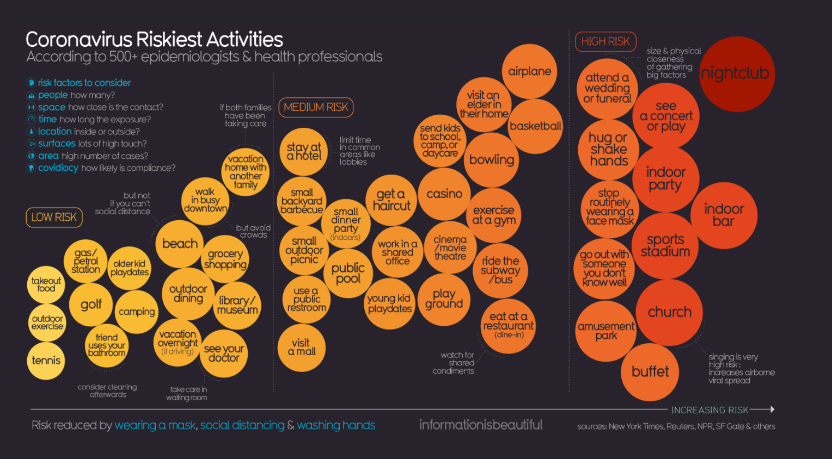
What do you make of this data?
https://informationisbeautiful.net/visualizations/covid-19-coronavirus-infographic-datapack/#activities
Notes:
Recent events like at Brussels airport have certainty had a dramatic effect on our perceptions of risk and safety. But the quantitative data shows us something different to our gut feeling. Perhaps we have short memories or miss patterns and trends when we reply on our perceptions. There is a lot of this type of talk from Hans Rosling (Gapminder). Worth a look.
According to the Global Terrorism Database, fewer and fewer terrorist attacks3 have targeted airplanes and airports. Erin Miller, program manager at the Global Terrorism Database, she confirmed that it was fair to compare transportation targets in North America and Europe this way. “The trend in attacks on transportation targets generally reflects the trend in all kinds of terrorist attacks,” she added, which she said suggested that “it’s more the result of decline of conflicts than increased security.”

Slide 24
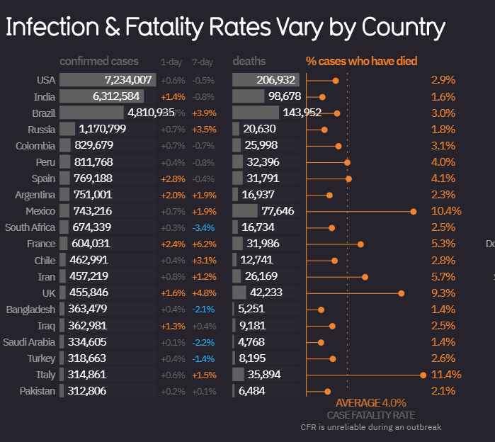
And some more numbers
https://informationisbeautiful.net/visualizations/covid-19-coronavirus-infographic-datapack/#activities
Notes:
Recent events like at Brussels airport have certainty had a dramatic effect on our perceptions of risk and safety. But the quantitative data shows us something different to our gut feeling. Perhaps we have short memories or miss patterns and trends when we reply on our perceptions. There is a lot of this type of talk from Hans Rosling (Gapminder). Worth a look.
According to the Global Terrorism Database, fewer and fewer terrorist attacks3 have targeted airplanes and airports. Erin Miller, program manager at the Global Terrorism Database, she confirmed that it was fair to compare transportation targets in North America and Europe this way. “The trend in attacks on transportation targets generally reflects the trend in all kinds of terrorist attacks,” she added, which she said suggested that “it’s more the result of decline of conflicts than increased security.”

Slide 25
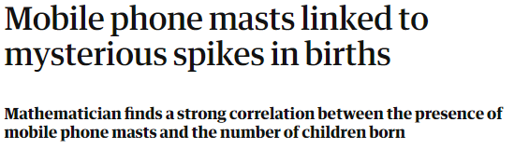
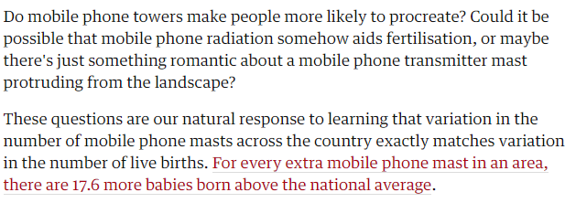
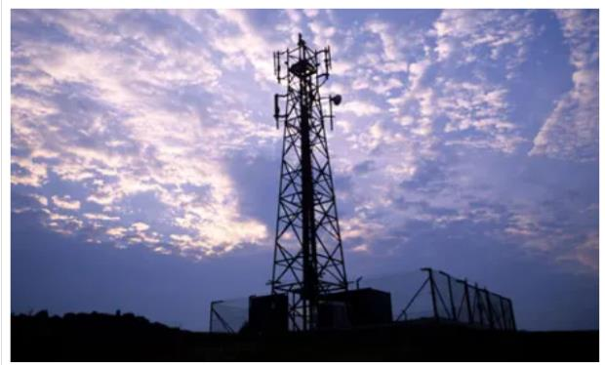
Correlation vs causation
This is an old favourite: correlation vs causation
Many students make assumptions based on flimsy evidence
In many cases there is a complex set of interrelationships at work, so difficult to say that one thing is directly linked (caused) by another factor/process in isolation.
How often do you see “big tropical storm = lots of people die”?
https://www.theguardian.com/science/blog/2010/dec/17/mobile-phone-masts-birth-rate

Slide 26
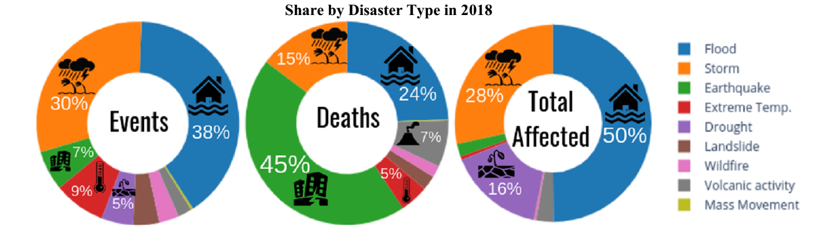
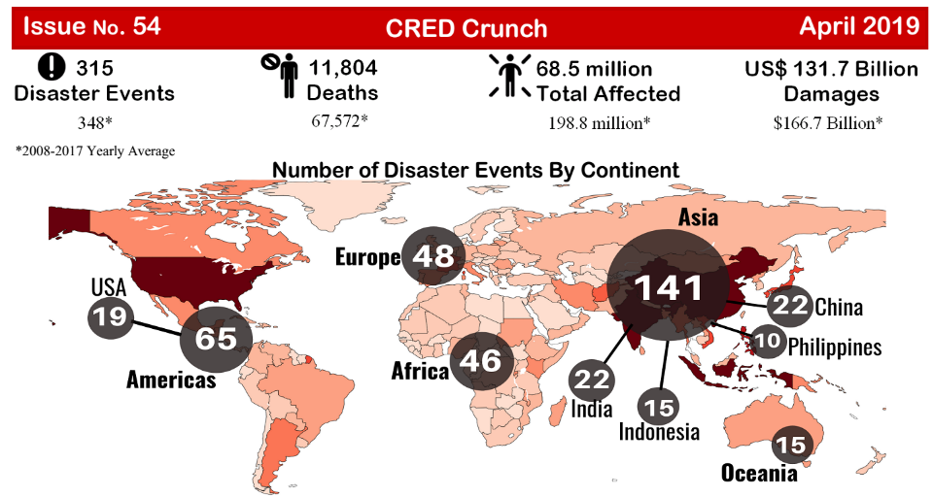
Misconceptions?
https://www.cred.be/

Slide 27
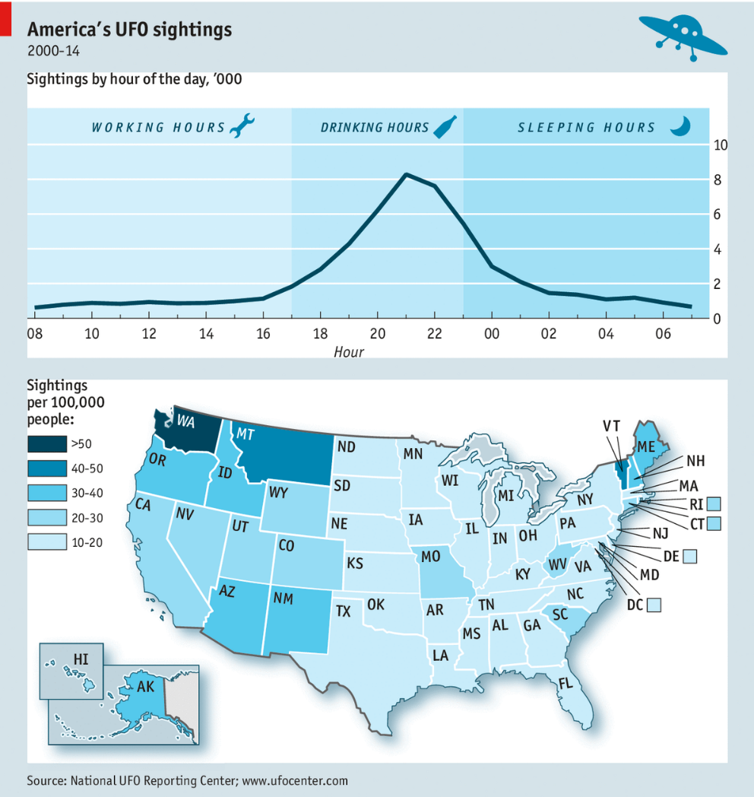
This is geographical!
https://www.economist.com/united-states/2014/06/28/everything-you-need-to-know-about-ufos
Notes:
An interesting graphic from the Economist. Here is the source link: http://www.economist.com/news/united-states/21605918-everything-you-need-know-about-ufos-0
But interestingly, what sort of questions might you ask? Not simple ones about patterns and distributions, but instead how might there be a bias, or unreliability? Does washing really get that many more sightings than say California (relative vs absolute?). Cannabis and Boeing are questions that also need to be asked, as well as is it “fair” to put drinking hours next to the map and imply, by way of presentation, that there is a connection?

Slide 28
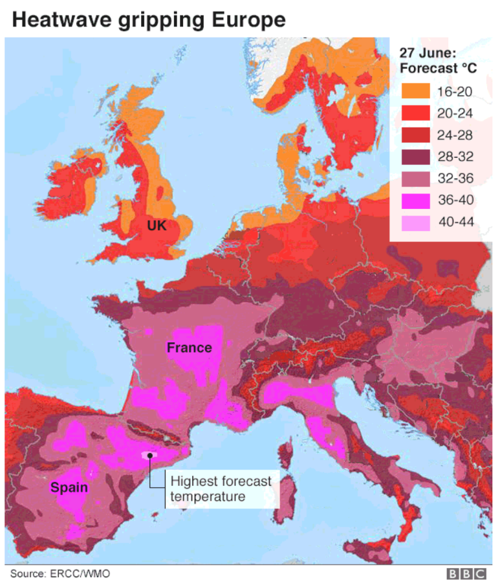
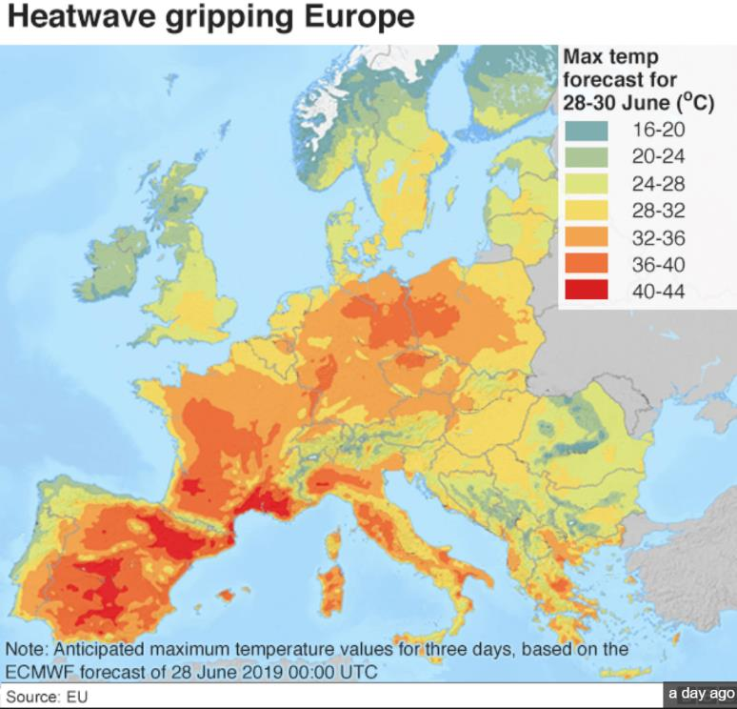
Similar but different?
https://www.bbc.co.uk/news/world-europe-48795264

Slide 29
BASIC SKILL 1 - Tables
Many questions are data stimulus
Look at a Figure
Use information from it, to answer the question
Some questions ask ‘describe’ (‘what’?) …
… while most ask explain (‘why’?)
You need to be able to quickly understand data
Looking for patterns, differences, trends, anomalies
 | Population aged 0-14 (%) | % of people connected to internet | Income per person ($) | HDI
Togo | 42 | 11 | 585 | 0.33
Chad | 46 | 5 | 780 | 0.24
Ghana | 40 | 34 | 1517 | 0.39
All quite similar
All very different
Usually the ‘worst’ (but not for income)
Much higher than the other two

Slide 30
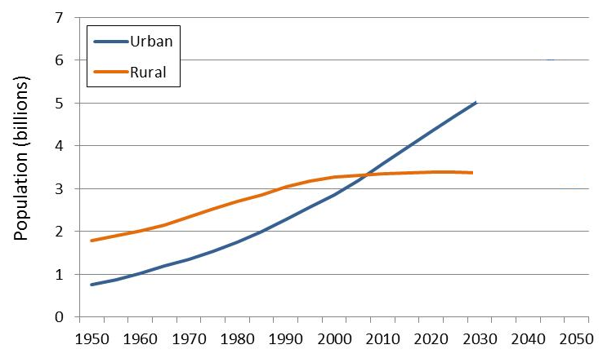
BASIC SKILL 2 - Graphs
* scattergraphs and line graphs often confused!
Relationship versus change over time
Rate of change is important on line graphs
Also Projections and extrapolations can be tested
Much better!
Not a sensible extrapolation of the trend
Slowing rate of change
Increasing rate of change

Slide 31
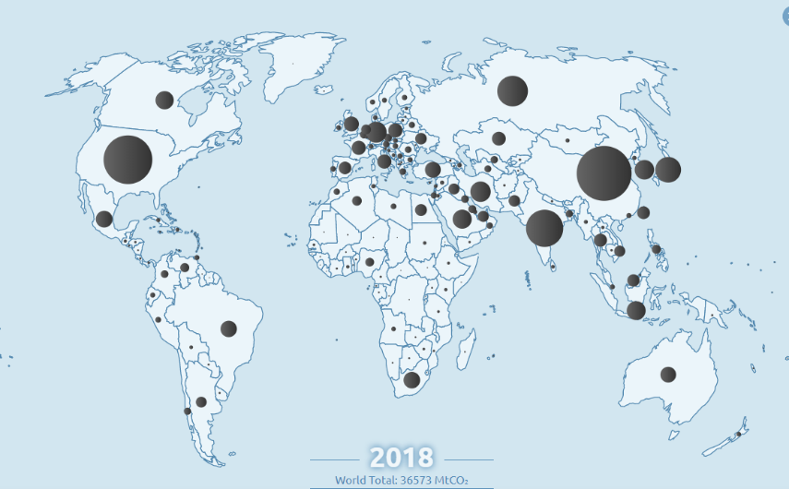
BASIC SKILL 3 – Patterns on maps
Maps of all types can appear in any GCSE paper
Maps can be presented at different scales: local, regional or global
‘Describe the distribution’ questions are possible (2 marks)
Try and use NSEW not ‘top’ and ‘bottom’ , ‘left’ and ‘right’
Need to name continents / countries
If the map contains numerical data, quote in the answer
http://www.globalcarbonatlas.org/en/CO2-emissions

Slide 32
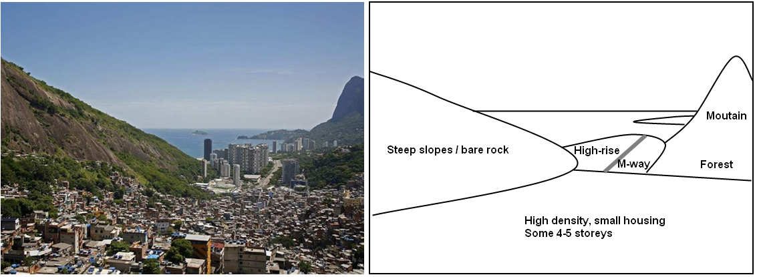
BASIC SKILL 4 – Photo interpretation
Think “Why have I been given this?”
Look at the foreground, middleground and background
Don’t be tricked by the Figure title into seeing something that is not there )e.g. “Slums in Rio de Janeiro” below does not just show slums).
Use a sketch (literally or in the mind) to break the photo up into areas / zones that show different things:

Slide 33
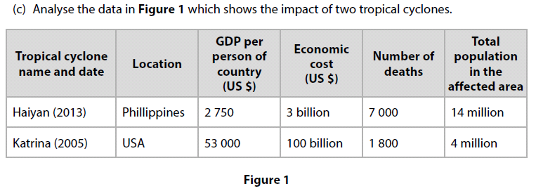
Practice makes perfect!
Use past papers.
Build your confidence and competence
Look at books and social media for examples of resources to “practice” on.
1. Which cyclone had the highest death toll?
2. Which cyclone had the highest economic cost?
3. Which country is the richest?
4. True or False: the difference between the deaths tolls is 6000?
5. Calculate Haiyan’s economic losses as a percentage of Katrina’s economic losses.

Slide 34
What to do next
Attend further GEO sessions, 2 to 4 inclusive, which focus upon GCSE skills
These focus on graphical skills (Session 2), numerical and statistical skills (Session 3), and maps and cartographic skills (Session 4) – these are free
Look at the GEO web enquiries in the GCSE section https://geographyeducationonline.org/gcse/geographical-skills-and-enquiry – these are also free
Join us in a series of sessions which will focus upon unfamiliar fieldwork to help you prepare for your GCSE exams, starting March 2nd 2021 (these are paid-for sessions).

Slide 35
Links to further support
The Field Studies Council are offering a range of packages of support for GCSE geography students. With outreach and digital packages sitting alongside their more traditional day and residential course offer there is a solution to suit everyone. Find out more https://www.field-studies-council.org/secondary-and-further-education-courses/

