Slide 1
Coasts: wave action

Slide 2
Getting started
You’ll need a notepad on which to make notes as you go along, or you could make notes or paste images, etc. on your device.
You can view these slides:
as a slideshow for any animations and to follow links
in ‘normal’ view if you want to add call-outs or extra slides to make notes, paste image or answer questions.

Slide 3
Dynamic coastal systems (1)
Coastal environments are an example of an open system.
The coastal system is made up of landforms, which are linked by flows of energy and flows of material (the transportation of sand and shingle) that is derived from processes such as erosion or mass movement.
The system is dynamic – constantly changing. For example:
during a storm, waves erode shingle from a beach. The shingle is dragged offshore in the swash and deposited in a bar below low tide.
the bar causes waves to break further from the land – reducing their erosive energy. Constructive waves push the shingle back up the beach.

Slide 4
Dynamic coastal systems (2)
This means there is feedback between coastal processes and coastal landforms.
Feedback can be positive or negative. This feedback keeps the coastal system in a state of dynamic equilibrium.

Slide 5
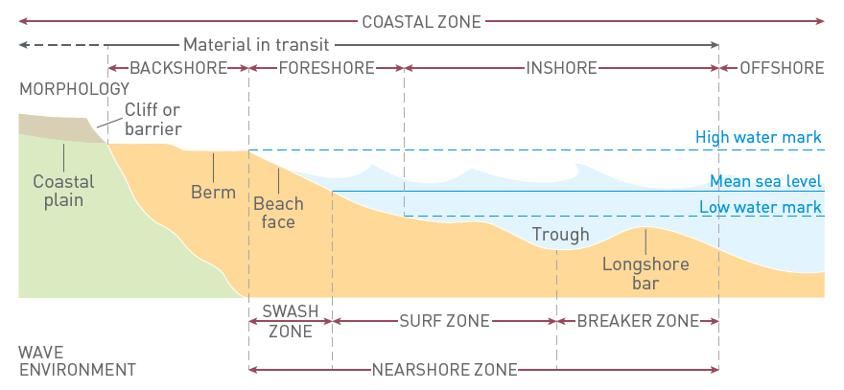
Coastal zone terms
Notes:
Source of diagram: TSG Coasts, page 6

Slide 6
Describing waves
Wave height – the difference in elevation between crest and trough.
Wave length – the distance between successive crests (or troughs).
Wave period – the time it takes for a complete wave to pass a fixed point from one crest to the next crest.
Wave steepness – the ratio of wave height to wave length.
Frequency – the number of wave crests that break per minute.
Notes:
Source of diagram: TSG Coasts, page 10

Slide 7
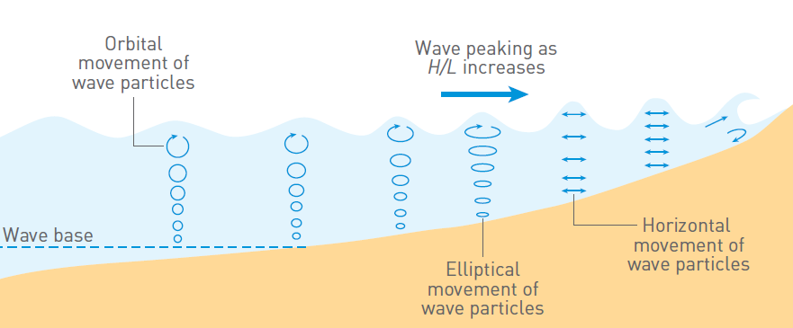
Water motion in waves
In deep water, water moves with an orbital motion within a wave.
As waves enter shallow water, the orbital motion experiences friction with the sea bed and the motion becomes elliptical.
The waves slow. Wavelength decreases and wave height increases.
Friction makes the waves asymmetrical and the crest is thrown forward – a process known as shoaling.
Notes:
Source of diagram: TSG Coasts, page 11

Slide 8
Wave refraction
Wave refraction occurs because waves travel more slowly in shallow water.
If waves approach the shore at an oblique angle, the part of the wave crest that is in shallow water moves more slowly than the part that is still in deeper water, causing the wave rays (shown in the diagram by the red arrows) to bend as the wave nears the coast.
Wave refraction concentrates wave energy onto headlands and leads to a reduction of wave energy in bays.
Notes:
Source of diagram: TSG Coasts, page 13

Slide 9
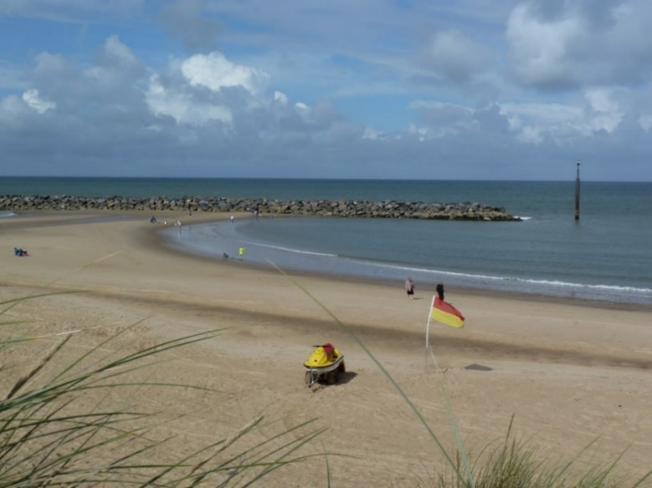
Wave refraction
A series of nine artificial reefs were built off the coastline of Sea Palling, Norfolk in the 1990s.
Their shape encourages wave refraction and deposition.
Activities
Use What3Words to view a satellite image of Sea Palling: liberty.regarding.nips
Switch to satellite view and zoom out so you can see the offshore reefs.
Sketch the coastline. Include the reefs, the shape of the beach and the wave crest patterns.
Use the satellite image and this photo to suggest how the reefs have encouraged deposition on the beach.
Notes:
URL https://what3words.com/liberty.regarding.nips
Photo © Jim Barton

Slide 10
Constructive waves
Constructive waves (also known as spilling or surging waves) are flat. Wave height is less than 1 metre and wave length is long.
Constructive waves roll up the beach with a strong swash. Sand/shingle is carried up the beach in the swash creating a ridge or ‘berm’ on the upper part of the foreshore.
Activity
Make notes to describe what is shown at each number (1–6) on the diagram of the constructive wave.
1
4
5
3
2
6

Slide 11
Destructive waves
Destructive waves (also known as plunging waves) are steep. Wave height is 1 metre or more and wave length is short.
Destructive waves have a swash that plunges down onto the beach. The backwash is strong – scouring sediment from the upper part of the foreshore and taking it down to the inshore where it is deposited in a bar below the line of low tide.
Activity
Study the diagram of the destructive wave. Make notes to describe what is shown at each number (1–7) on the diagram.
1
4
5
3
2
6
7

Slide 12
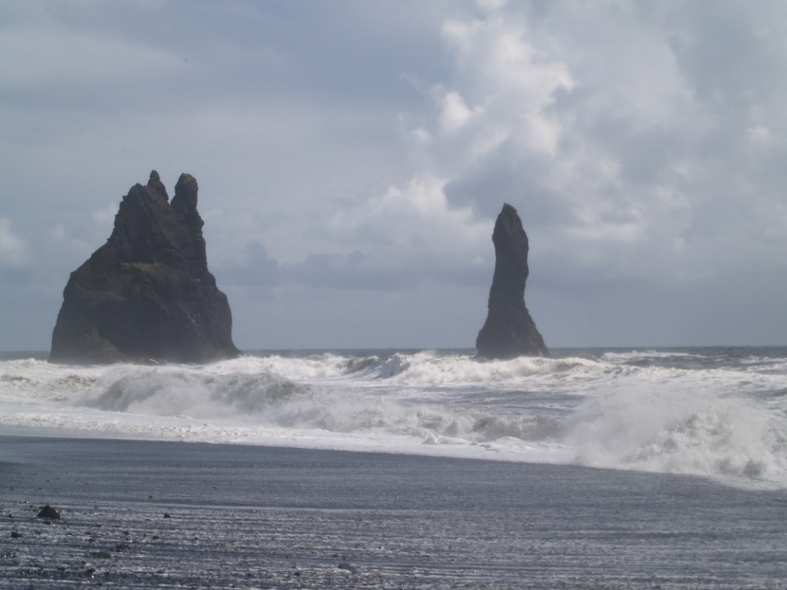
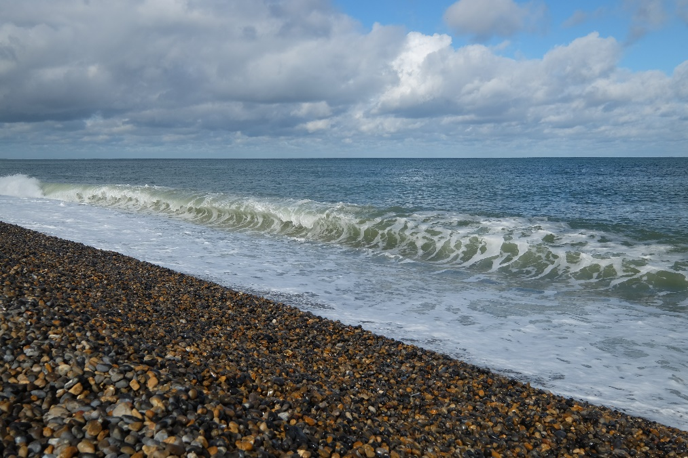
Wave types
A
B
Activities
Study photos A and B.
Describe the main differences between the waves in these photos.
Decide whether these are constructive or destructive waves. Justify your answer.
Notes:
Photos © Andy Owen

Slide 13
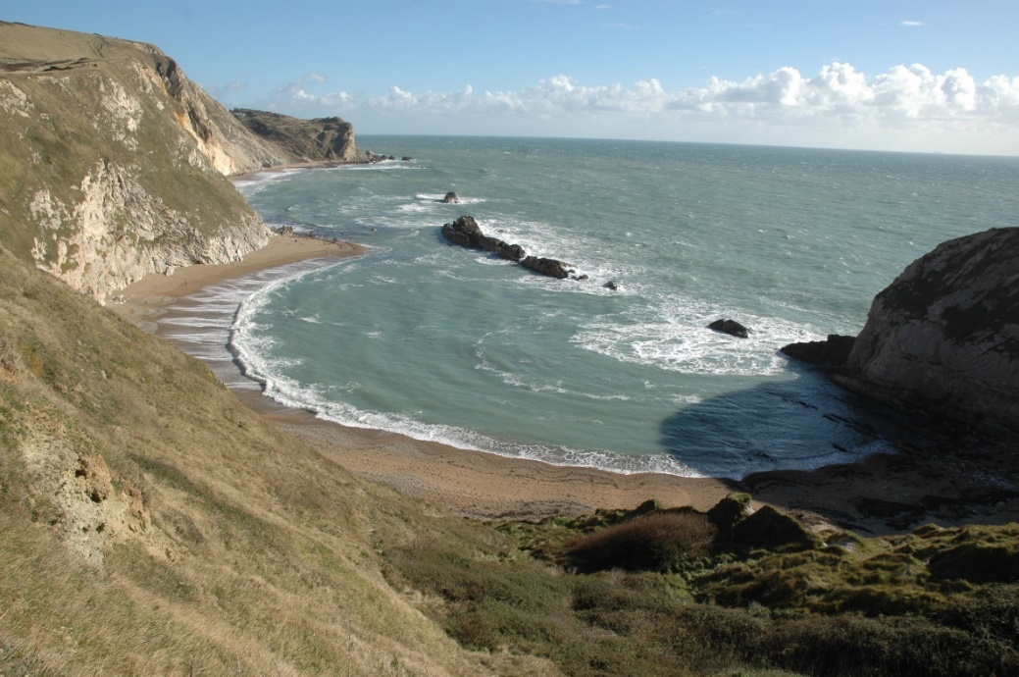
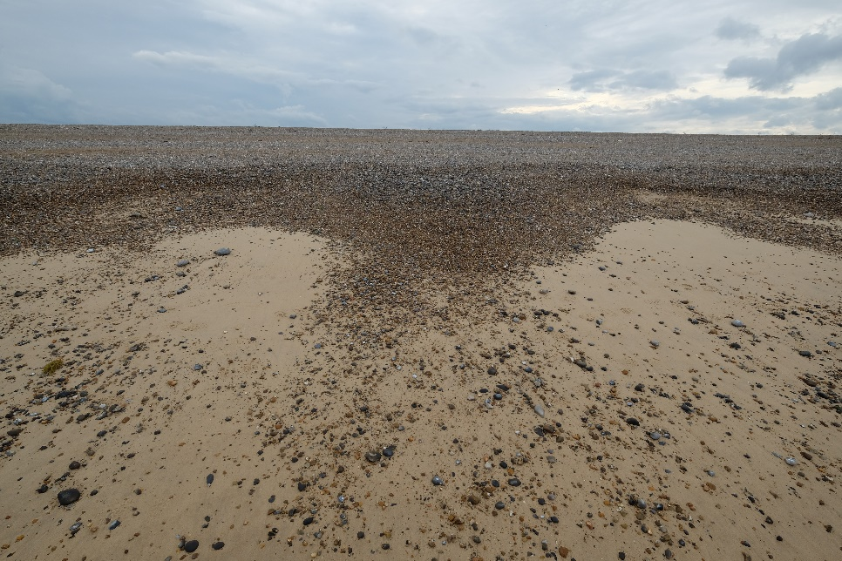
Beach features: cusps
Lulworth, Dorset
Blakeney, Norfolk
Activity
Study the photos carefully. They show regularly spaced bay shaped features on the beach called beach cusps. Research this feature. Explain how positive feedback reinforces their shape.
Notes:
Photos © Andy Owen

Slide 14
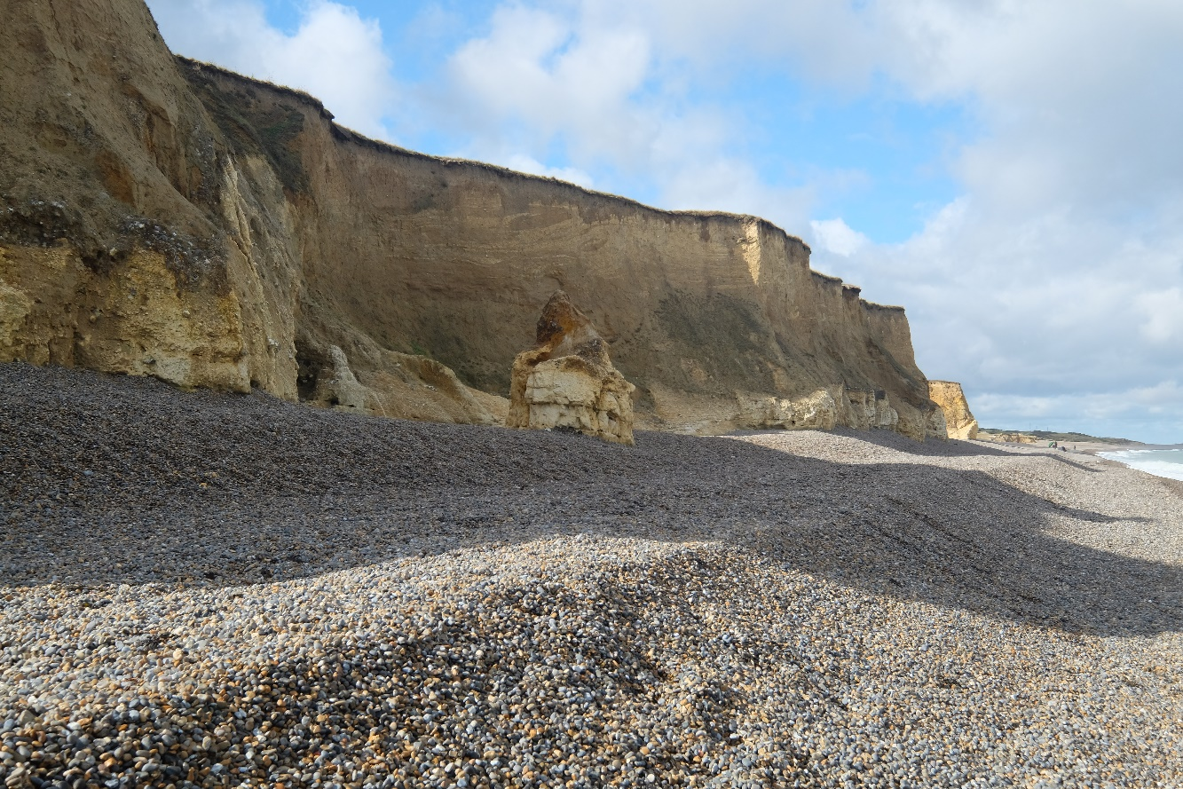
Beach features: berms
Activity
Study the photo. It shows parallel ridges (or berms) near the top of the beach. The photo was taken in early Autumn before any Autumn storms.
Draw a systems diagram to show how the profile of the beach is affected by sediment movement onshore and offshore during the year (refer back to slide 3 for some help).
Notes:
Photo © Colin Smith

Slide 15
High/low energy coastal environments
The amount of energy in the coastal system depends on factors such as:
wind – strength, direction, frequency
depth of water
tide – stage in cycle, range
fetch – distance and direction.
Coastlines fit on a continuum between high energy environments and low energy environments.
Headlands are usually high energy environments – partly because wave energy is concentrated by refraction.
Salt marshes are an example of a low energy environment.

Slide 16
High energy coastal environments
Beaches are high energy environments.
The amount of energy varies depending on factors such as tides, strength of wind and wave type all of which vary constantly. Fetch is another critical factor.
Holywell Bay, Cornwall
Activities
1. Use What3Words to view a satellite image of Holywell Bay in Cornwall: tapers.gravest.horseshoe
2. Explain why this is a high energy coastline.
3. Research the fetch in: a) North Cornwall, b) West Wales, c) North Norfolk.
Notes:
URL https://what3words.com/tapers.gravest.horseshoe
Photo © Andy Owen

Slide 17
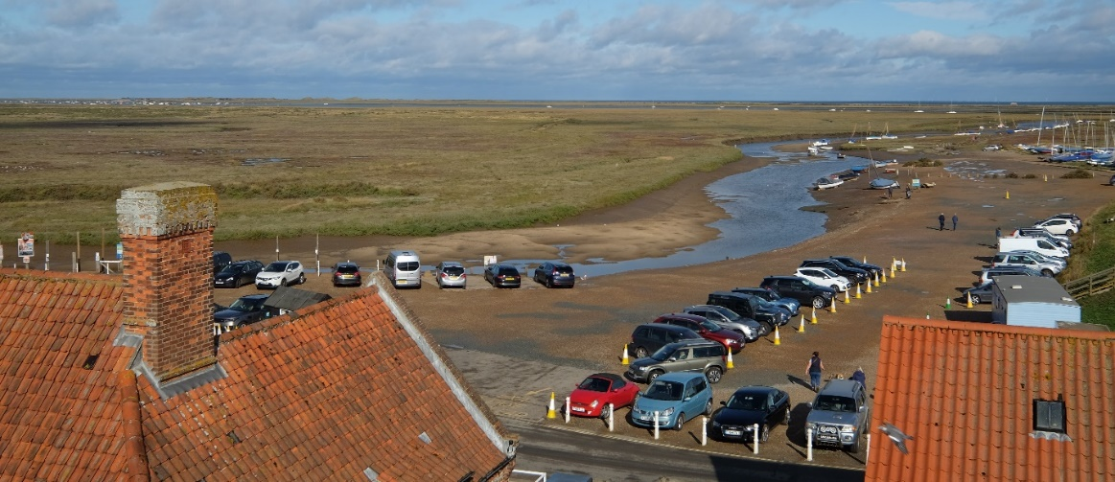
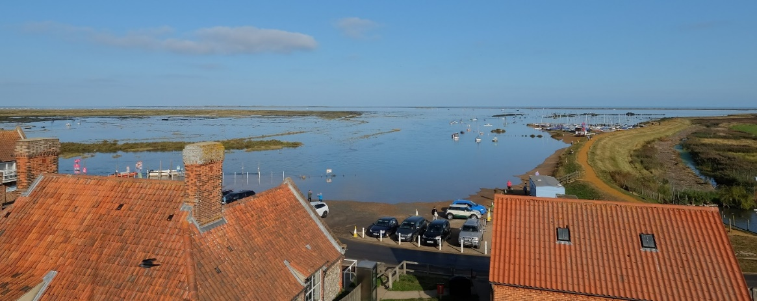
Low energy environments
Tidal estuaries and salt marshes are low energy environments.
This image shows the difference between low tide and high tide – the salt marsh is covered in still water at high tide.
The salt marsh is protected from wave action by the shingle bank along the coast (just visible on the horizon of the second photo) so this is a low energy depositional environment.
Low tide
High tide
Blakeney, Norfolk
Notes:
Photos © Andy Owen

Slide 18
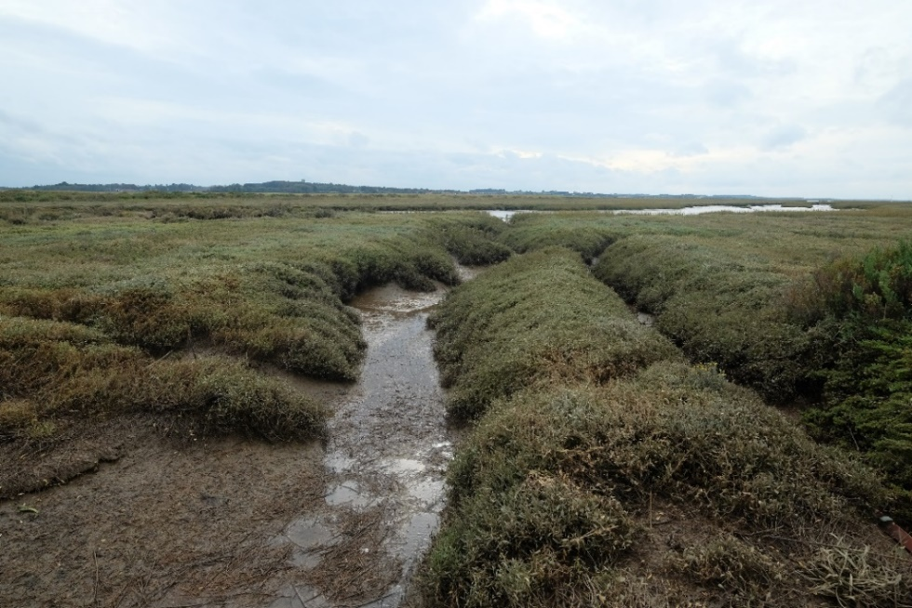
Salt marsh
During high tide, the water levels rise in the creeks of the salt marsh.
During the highest tides it fills the creeks and spills out across the marsh.
This shallow water is still, so the finer sediments that are held in suspension are deposited.
As the tide recedes, the water flows back into the creeks before entering the sea.
Blakeney, Norfolk
Activities
Use What3Words to view a satellite image of Blakeney Point: easy.lifeboats.paintings
1. Sketch the spit and salt marsh.
2. Label high energy and low energy environments.
3. Use your understanding of wave refraction to explain the shape of the spit.
Notes:
URL https://what3words.com/easy.lifeboats.paintings
Photo © Andy Owen

Slide 19
Summary
Coastal environments are an example of an open system made up of landforms linked by flows of energy and flows of material.
There is positive and negative feedback between coastal processes and coastal landforms.
Levels of energy within the coastal system vary depending on factors such as depth of water, wave form, wind strength and fetch.

Slide 20
Glossary 1
Constructive waves have a shallow gradient, which means that they have a long wavelength and a relatively low height.
Destructive waves have a steep gradient, which means that they have a short wavelength and a relatively great height.
Equilibrium is a state of balance between the inputs and outputs in a system. A system in dynamic equilibrium is one whose processes are constantly adjusting to change over time.
Feedback is a mechanism that enhances change (positive feedback) or decreases change (negative) in a system – sometimes called a feedback loop.
Open systems have transfers of both energy and material across their boundaries; they are linked with other systems.

Slide 21
Glossary 2
Shoaling is the process that waves undergo in shallow water when the motion of water becomes elliptical, making the wave asymmetric in form.
Wave refraction occurs as waves approach shallow water at an oblique angle. The process causes the wave rays to bend as they approach the shore.

Slide 22
Links
Further reading
From the awarding bodies
 | Topic
AQA | 3.1.3 Coastal systems and landscapes
Eduqas | A 1.1 Coastal landscapes
Edexcel | 2B: Coastal Landscapes and Change
OCR | 1.1.1 Coastal Landscapes
WJEC | A 1.1 Coastal landscapes
CCEA | C 1: Coastal processes and features
Top Spec Geography: Coasts, by Debbie Milton and Gerd Masselink, published by the GA, 2017
Time for Geography: Coasts
The British Geographer summaries: coastal processes and coasts of erosion and deposition
Explore the GEO unit Coasts to find out more about weathering and erosion of cliffs.
This GEO unit explores natural systems.

Slide 23
Acknowledgements
This presentation has been written by Andy Owen, author and Consultant to the GA.
Figures
Slides 5, 6, 7, 8: © Geographical Association
Slide 9: photo © Jim Barton
Slides 12, 13, 16, 17, 18: photos © Andy Owen
Slide 14: photo © Colin Smith

